Slide 1
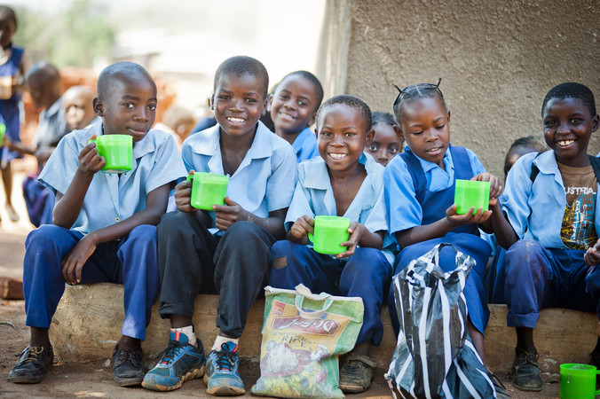
Recruitment pack for:
Head of Grassroots Engagement
Mary’s Meals UK
March 2022

Slide 2
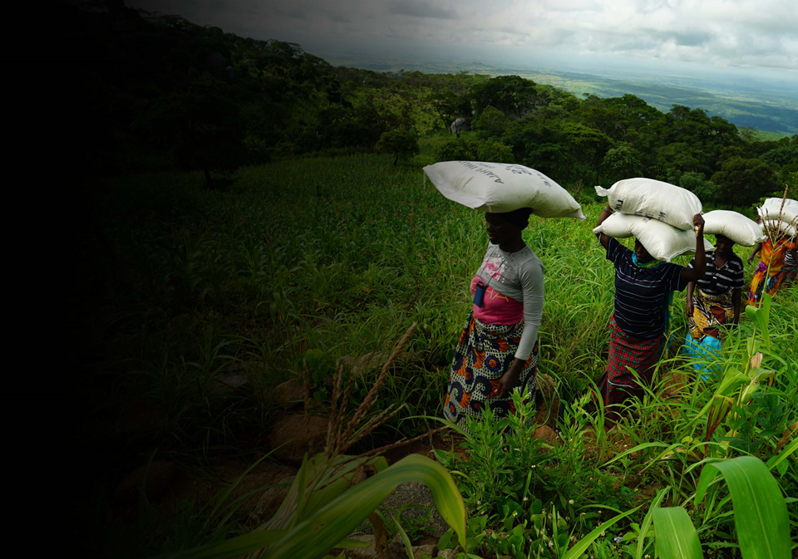
Recruitment pack contents
Welcome from our 3 Executive Director
Our vision, mission 5 and values
About the Mary’s Meals 7 movement
About Mary’s Meals UK 9
Role outline 11 and specification
Recruitment process 17 information
2

Slide 3
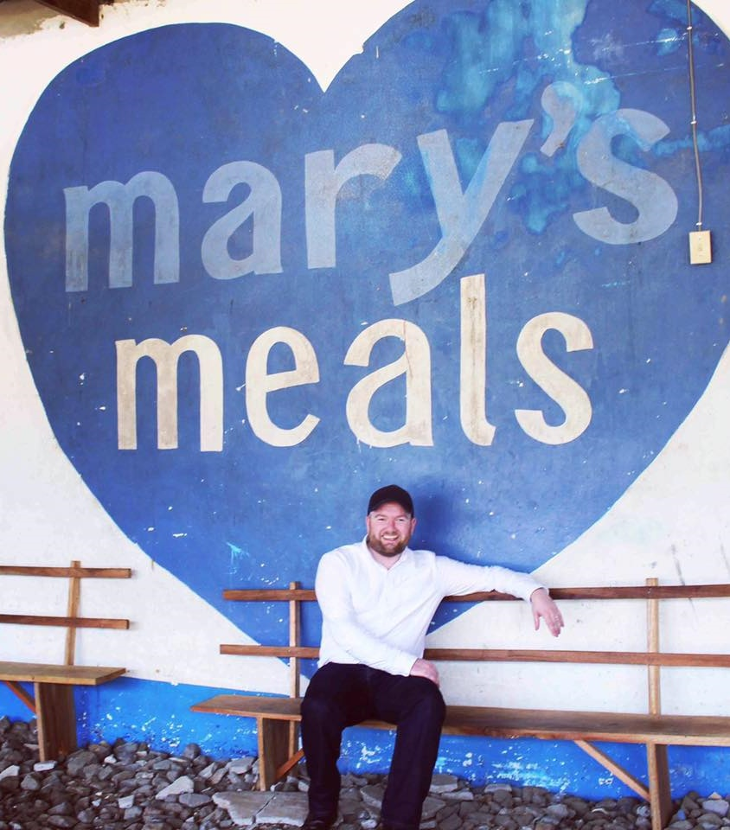
Welcome from our Executive Director
Thank you so much for your interest in joining the Mary’s Meals family. As you consider making an application for the role of Head of Grassroots Engagement with Mary’s Meals UK, I hope you find this pack helpful, encouraging, and exciting.
In joining Mary’s Meals UK, you would become part of a global movement of people who will simply not accept that any child should go hungry in this world of plenty. We are passionately driven by our simple belief that every child in the world deserves an education – and enough to eat.
From small beginnings feeding just 200 Malawian children in 2002, we are now reaching 2,058,099 children across 20 programme countries (including Malawi, Liberia, Zambia, Haiti, South Sudan, and Syria) with a nutritious daily meal in school.
This meal not only meets the immediate needs of the hungry child, but it attracts children to the classroom, where they can gain an all-important education. And we firmly believe that the children who are receiving Mary’s Meals today can grow up – better nourished and better educated – to become the men and women who will lift their communities out of poverty and end their reliance on aid.
3

Slide 4
Welcome from our Executive Director
None of this would be possible without the incredible generosity of our supporters all over the world, who give freely of their time, money, skills, and prayer. In Malawi alone, we have 80,000 volunteers who rise early each day to serve Mary’s Meals to children in their community.
And, across Mary’s Meals’ dozen or so ‘national affiliate’ countries, in which we raise awareness and funds for our work (including the UK, USA, Austria, Germany, Ireland, Croatia and Canada), thousands of people amaze and inspire us every day with their ‘little acts of love’, spreading the word about Mary’s Meals in their local communities and raising money to feed more children.
The UK, where we received the first-ever donations for our work, remains the country in which Mary’s Meals raises the majority of its funds. And Mary’s Meals UK, the organisation I am privileged to lead is responsible for continuing to tell our story across Scotland, England, Northern Ireland and Wales; engaging and inspiring more and more UK volunteers and donors; and driving forward the unrelenting growth of the Mary’s Meals movement on these shores.
We do this while working very closely and collaboratively with our colleagues at Mary’s Meals International, the organisation which co-ordinates the global movement and directly manages our school feeding programmes.
The Head of Grassroots Engagement is a vitally important position which will help us to develop and grow the Mary’s Meals movement across the UK. If successful, you will be responsible for developing the Supporter Engagement strategy, leading a team to engage communities. You will help inspire Volunteers, Supporters, Churches, Schools, other Faith, Youth and Community Groups and Corporates; and help to deliver fundraising and stewardship campaigns, to help us feed more children.
With more than 58 million children out of school around the world and a further 73 million attending school so hungry that they are unable to concentrate and learn, our work is only just beginning. Will you play a crucial part in shaping the future of Mary’s Meals UK and, with it, the lives of so many people who both contribute to and benefit from this incredible work of love, joy, and hope?
I look forward to hearing your story.
Daniel Adams
Executive Director, Mary’s Meals UK
4

Slide 5
Our vision and mission
• Our vision is that every child receives one daily meal in their place of education and that all those who have more than they need, share with those who lack even the most basic things.
• Our mission is to enable people to offer their money, goods, skills, time, or prayer, and through this involvement, provide the most effective help to those suffering the effects of extreme poverty in the world’s poorest communities.
5

Slide 6
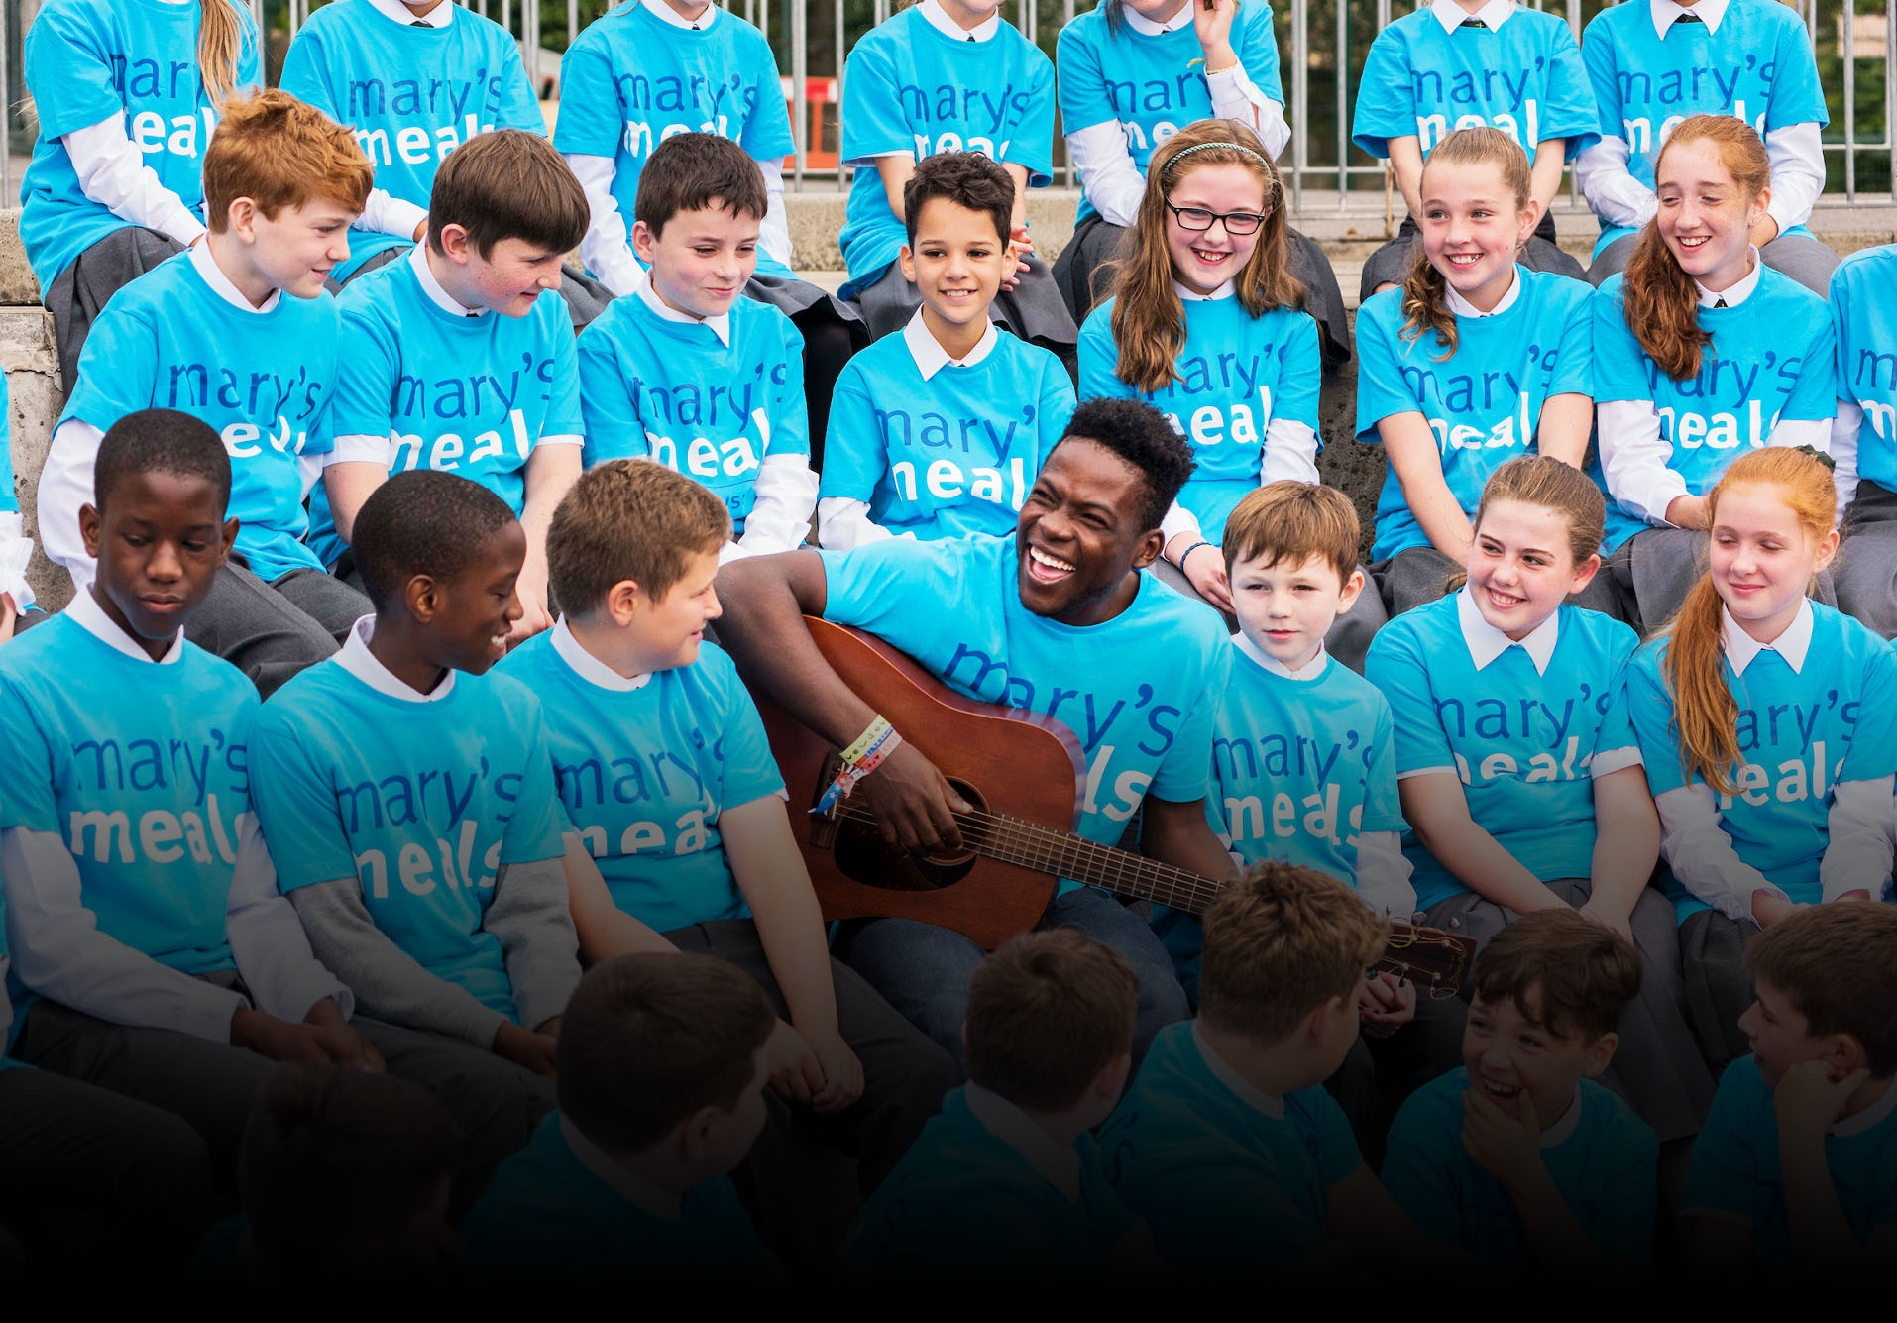
Our values
• We have confidence in the innate goodness of people.
• We respect the dignity of every human being and family life.
• We believe in good stewardship of the resources entrusted to us.
View Mary’s Meals’ full statement of values here: Statement of Values
6

Slide 7
About the Mary’s Meals movement
Mary’s Meals is a global movement that sets up school feeding projects in some of the world’s poorest communities, where poverty and hunger prevent children from gaining an education.
Our idea is a simple one that works. We provide one daily meal in a place of learning in order to attract chronically poor children into the classroom, where they receive an education that can, in the future, be their ladder out of poverty.
The Mary’s Meals campaign was born in 2002 when Magnus MacFarlane-Barrow, from Dalmally in Argyll, visited Malawi during a famine and met a mother dying from AIDS. When Magnus asked her eldest son Edward what his dreams were in life, he replied simply: “I want to have enough food to eat and to go to school one day.”
That moment was a key part of the inspiration which led to the founding of Mary’s Meals, which began by feeding just 200 children in Malawi in 2002. Today, 20 years later, we feed 2,058,099 hungry children every school day across four continents. The average worldwide cost for us to feed a child for a whole school year is just £15.90.
Where Mary’s Meals is provided, there is a rise in school enrolment, attainment and attendance. Wherever possible, Mary's Meals uses locally grown food to support the local economy and help smallholder farmers.
We work extremely hard to keep our running costs low and to ensure that at least 93% of donations goes directly on our charitable activities. This is only possible because most of our work is done by an army of dedicated volunteers all over the world, who carry out lots of little acts of love on behalf of Mary’s Meals.
Having been inspired, in part, by our founder’s Catholic faith, this work is named in honour of Mary, the mother of Jesus, who brought up her own child in poverty. We consist of, respect and reach out to people of all faiths and none.
Counting on support from around the globe, Mary’s Meals has registered national affiliate organisations, which raise awareness of our work, in 20 countries around the world. Funds raised by affiliates, including from Mary’s Meals UK, are passed to Mary’s Meals International, the organisation which co-ordinates our movement and directly manages the delivery of our school feeding programmes.
7

Slide 8
8

Slide 9
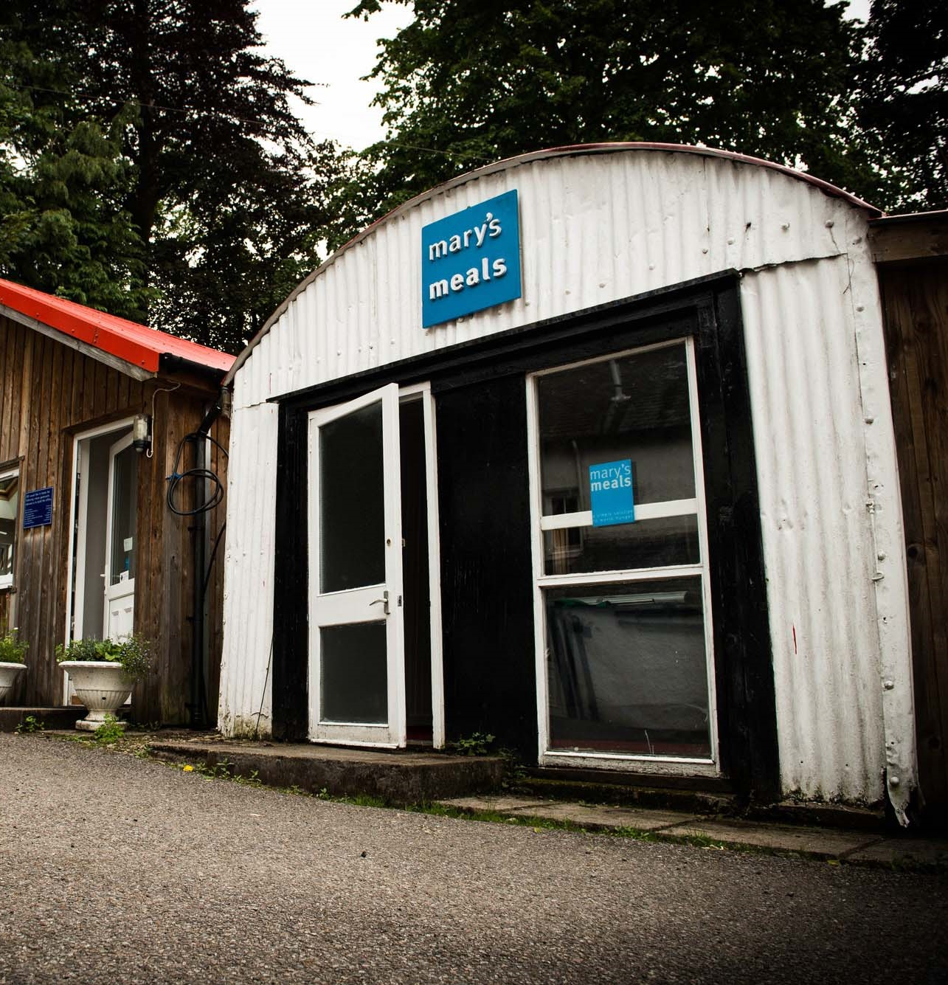
About Mary’s Meals UK
Mary’s Meals UK (or ‘MMUK’), a charity registered in Scotland, is the oldest entity in the Mary’s Meals family – the original organisation established as Scottish International Relief in the early 1990s, when our founder and global CEO, Magnus MacFarlane-Barrow, first became involved in international aid during the Bosnian Conflict.
Back then, Magnus was a simple salmon farmer who, along with his family, decided to do something to help those who were suffering because of the war.
They relied heavily on the generosity of local people in their village of Dalmally in Argyll, who relentlessly donated food, blankets and other items of aid, which were then stored in the family shed, before being driven out by Magnus to Bosnia-Herzegovina.
Though our largest office is now in Glasgow, that same shed – which continues to be filled, metaphorically at least, with the generosity of our supporters – still serves as the headquarters of Mary’s Meals UK to this day.
9

Slide 10
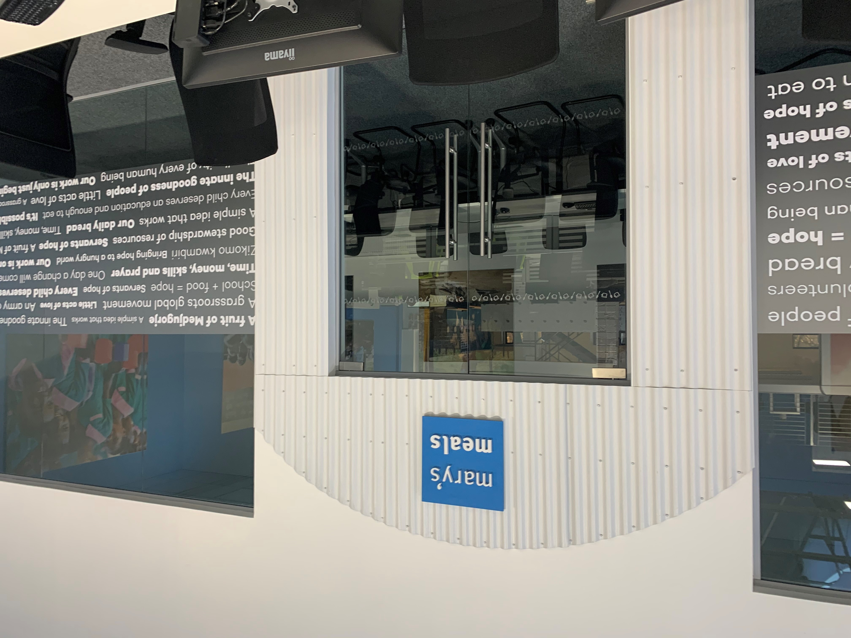
About Mary’s Meals UK
In January 2015, to recognise the incredible growth of the Mary’s Meals movement around the world and to facilitate future growth in new countries, another entity – Mary’s Meals International (or ‘MMI’) – was formed.
This new organisation assumed responsibility for directly delivering our programmes and for coordinating the growing number of Mary’s Meals organisations around the world, aimed at either awareness-raising or programme delivery.
This structural change saw Mary’s Meals UK become the global movement’s largest fundraising organisation and enabled it to focus even more passionately on its mission to tell our story across Scotland, England, Northern Ireland and Wales, and empower more people to help us reach the next hungry child by offering their money, goods, skills, time or prayer.
Today, Mary’s Meals UK raises awareness and funds under the direction of the executive director, and through the passion, commitment and dedication of our volunteers and staff, led by the director of communications, director of supporter engagement and income, and the director of finance and operations. We currently have offices in Glasgow, Dalmally and London with a hybrid working practice of three days at home, two days in the office.
10

Slide 11
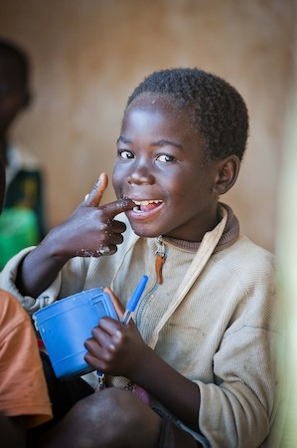
Role outline
Role title: Head of Grassroots Engagement
Location: Home-working from anywhere in the UK or hybrid/office working from
our Glasgow or London office
Contract: Full time, permanent (37.5 hours per week)
Salary: c. £46,093 - £50,676
Benefits: Flexible working, 34 days’ annual leave
(including public holidays), and a
non-contributory pension with employer contributions of 8%.
For more information on what we offer, please visit our website.
Reports to: Director of Supporter Engagement & Income
Direct reports: 4x Regionally based Supporter Engagement Managers
Key relationships:
Internal: Head of Communications,
Head of Supporter Care,
Head of Major Giving & Partnerships,
Board & Leadership,
Managers,
Staff
External: Supporters, Donors, Volunteers, Churches, Schools, other Faith, Young and Community groups, Corporates
11

Slide 12
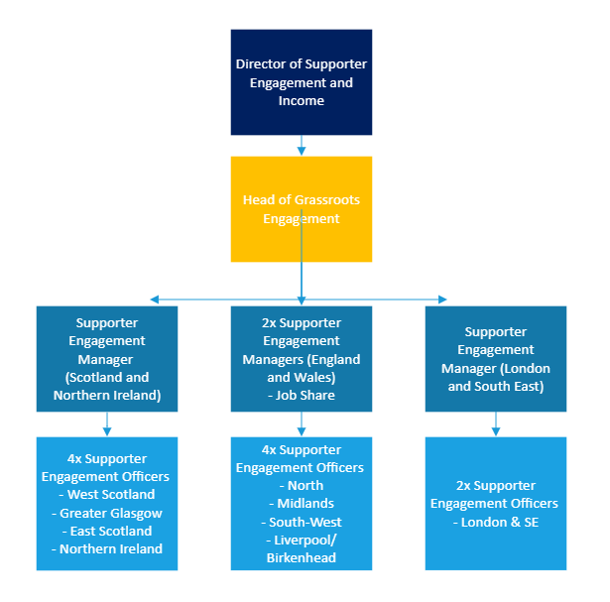
Grassroots team structure
Head of Grassroots Engagement
12

Slide 13
Duties and responsibilities
Role overview
A large part of the role will be in leading a team of Supporter Engagement Managers who have significant responsibilities in prioritising the growth and nurturing of the volunteer network and our support across demographics and groupings, through management of their teams.
Working at senior level, the Head of Grassroots Engagement will lead by example, encouraging consistently effective service across a UK-wide team and ensuring that our staff, supporters and volunteers are recruited, inducted, trained, supported, recognised and retained in line with Mary’s Meals values.
Principal duties
Development and implementation of Mary’s Meals supporter engagement strategy in the UK, aligned to the global strategy
Ensure that the Mary’s Meals approach is adopted in all supporter, fundraising and volunteer activities and that there is shared understanding in the team of how to build support
Ensure all delivery of activity has the necessary checks in place to protect the good name and values of Mary’s Meals
Lead, develop and manage the team, monitoring and evaluating their activities through set key performance indicators and providing support with staff development
Contribute to key decision making within the UK team as part of the Extended Leadership team
Oversee the continued expansion, enhancement and promotion of key fundraising campaigns such as Sponsor a School
Develop and grow Mary’s Meals grassroots support across the UK, ensuring our network is empowered and enabled, ensuring responsibility of the promotion of our campaigns and materials with our movement
Lead and develop support in churches, schools, clubs and other community organisations, allowing for more opportunities for our story to be shared and encourage growth in all parts of the UK
Proactively identify new opportunities for Mary’s Meals across all types of fundraising and support
Provide accurate and timely reports, data and analysis to the Director of Supporter Engagement and Income and the wider senior leadership team
Lead on volunteer strategy, management and support
Develop strong working relationships with colleagues to ensure supporter engagement plans are understood and supported
13

Slide 14
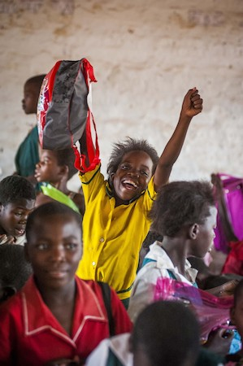
Duties and responsibilities
Contribute to the development and execution of key fundraising campaigns in close partnership with the global fundraising team
Work closely with the UK communications team in the production of fundraising resources, ensuring consistency of Mary’s Meals’ messages and materials
Act as an ambassador for Mary’s Meals, representing the organisation at public engagements and supporter events and where necessary, delivering speeches or presentations to a wide range of audiences.
14

Slide 15
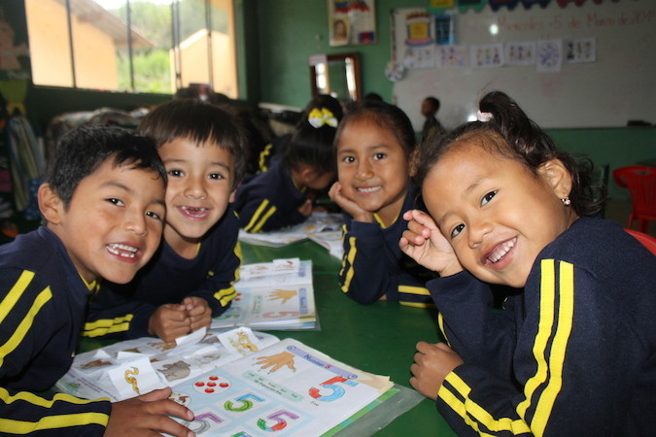
Qualifications, experience and skills
Essential
At least five years’ experience working within a senior fundraising role
Proven ability and experience of able managing and developing the capabilities of driven, bright and diverse teams
Mature and well-developed interpersonal skills, with demonstratable experience in persuading and influencing others
Ability to establish, develop and nurture collaborative relationships at all levels
Engaging and inspiring communication skills
Highly strategic with the ability to analyse, interpret and use data to plan for the future
Strong management and leadership skills
Sound knowledge of legislation, regulations and financial issues related to fundraising
Relationship management of senior stakeholders, donor relations, key accounts or similar high-level engagements
Ability to speak publicly in an inspiring and engaging manner
Experience of monitoring and reporting against agreed strategy
Experience of representing an organisation to key supporters, funders and stakeholders
Senior management experience
Desirable
Experience of working in a charity or not for profit organisation
15

Slide 16
Mary’s Meals UK manager competencies
Managers at Mary’s Meals UK approach their role in line with our 7S competency model:
1. Self
I build and demonstrate resilience
I lead by example
I’m authentic and true to Mary’s Meals values
I develop myself and set stretching goals
2. Service
I have a vocational attitude to my work
I inspire hope in others
I build belief that even difficult challenges can be solved
I am committed to serving and enabling all who want to be part of the global movement
I work to ensure our future will be even better than our past
3. Simplicity
I communicate effectively
I follow clear decision-making criteria
I create plans that are easy to follow and contribute to organisational goals
I embrace inclusivity and diversity
I focus on delivering results
4. Stewardship
I pay attention to the things that matter most; (a) our physical resources; (b) our people
I nurture, develop and respect our relationships with external stakeholders
I deliver on my promises
I am happy to be held accountable and to hold others to account
5. Strategy
I have a point of view about the future
I know our stakeholders and see our priorities clearly
I help others to work in ways that have the greatest impact
I develop strategy and translate it into action
6. Strengthen
I create a positive work environment
I increase the capabilities of my team
I help people manage their careers
I find and develop next-generation talent
7. Success
I ensure my team is technically competent and developing
I build high performing teams
I ensure accountability
I am a catalyst for change
16

Slide 17
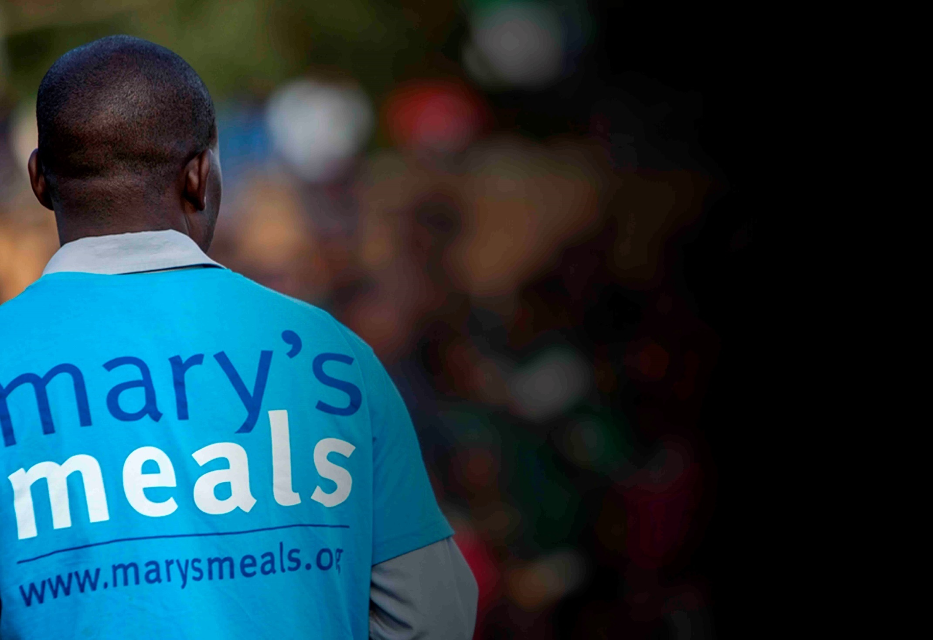
Recruitment process information
How to apply for this role
To apply for the role of Head of Grassroots Engagement, based at Mary’s Meals UK, please send a tailored CV and covering letter to: Jobs@marysmeals.org
Your covering letter should make a compelling case for why you feel motivated to apply for this role within Mary’s Meals UK, as well as giving a concise overview of your most relevant skills and experience, and should fill no more than two pages of A4.
Recruitment timescales
Closing date for applications:
Wednesday 30th March
Please note: If you have any special requirements or adjustments before an interview, please let us know.
A second interview stage may be required.
17

Slide 18
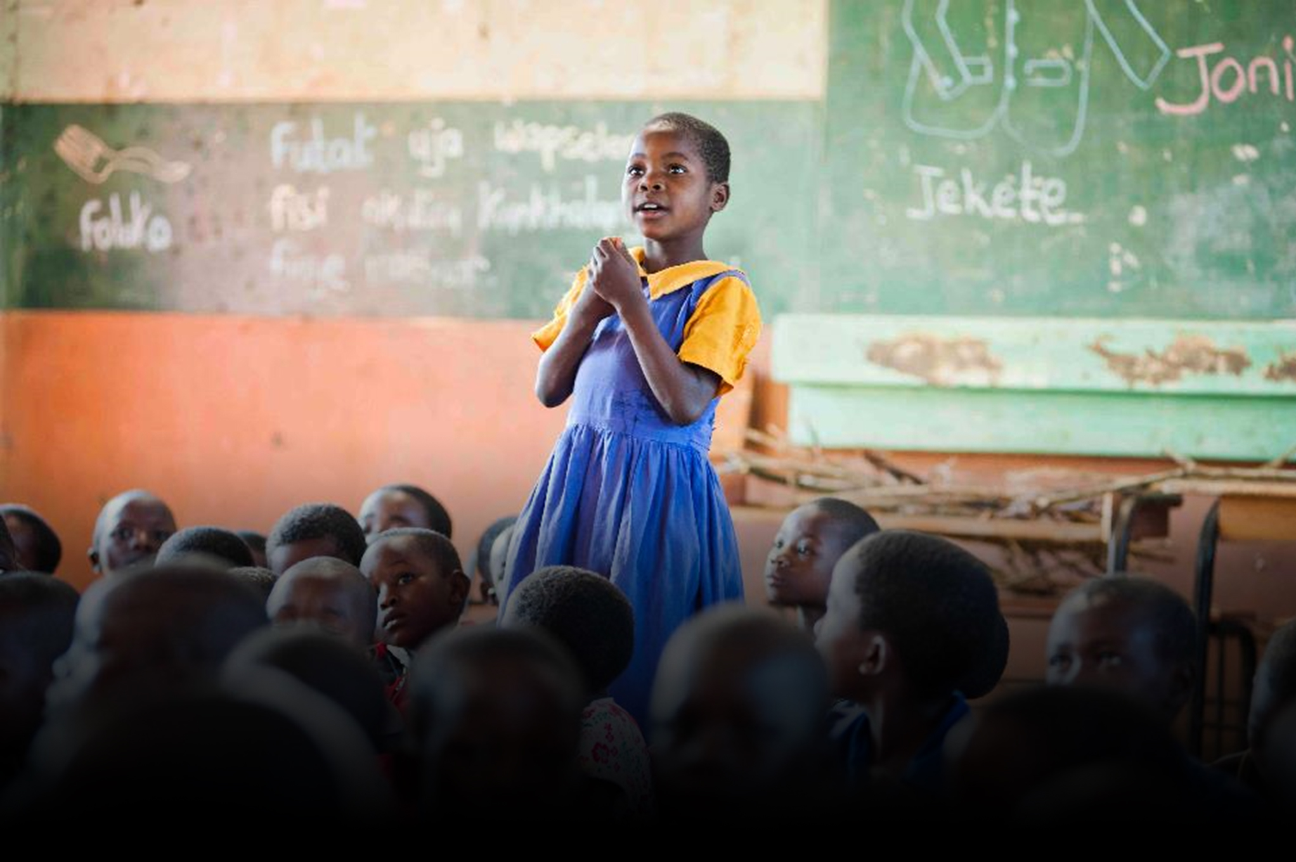
Mary’s Meals UK
Charity No. SC022140
Company No. SC265941
Tel: 0141 336 7094
Dalmally office
Craig Lodge
Dalmally, Argyll
PA33 1AR
Glasgow office
Unit 6 Claremont Centre
39 Durham Street, Glasgow
G41 1BS
London office
13 Hippodrome Place
Notting Hill, London
W11 4SF
“Together, let’s set out on this journey; one step at a time, one meal at a time, one child at a time.”
– Magnus MacFarlane-Barrow, Mary’s Meals founder

