Slide 1
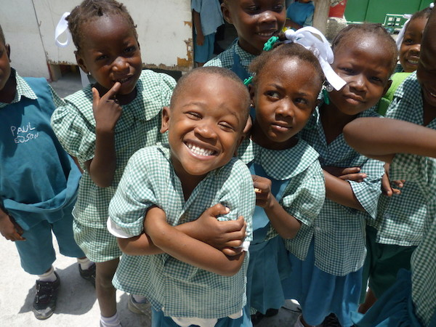
Recruitment pack for:
Head of Marketing and Digital
Mary’s Meals UK
April 2022

Slide 2
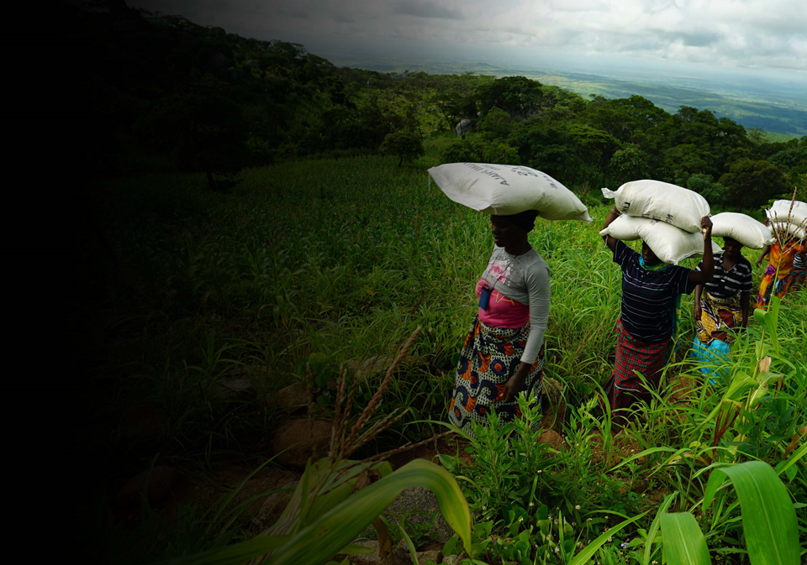
Recruitment pack contents
Welcome from our 3 Executive Director
Our vision, mission 5 and values
About the Mary’s Meals 7 movement
About Mary’s Meals UK 9
Role outline 11 and specification
Recruitment process 18 information
2

Slide 3
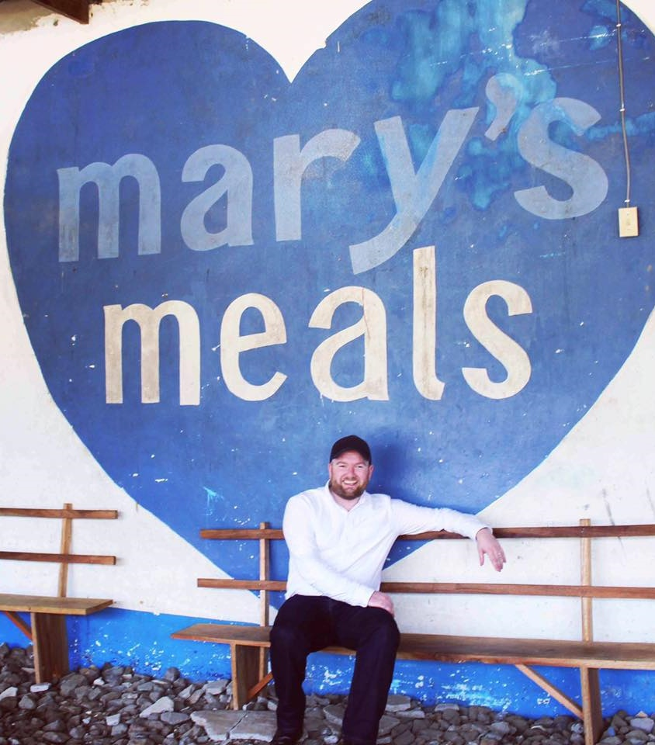
Welcome from our Executive Director
Thank you so much for your interest in joining the Mary’s Meals family. As you consider making an application for the role of head of marketing and digital with Mary’s Meals UK, I hope you find this pack helpful, encouraging, and exciting.
In joining Mary’s Meals UK, you would become part of a global movement of people who will simply not accept that any child should go hungry in this world of plenty. We are passionately driven by our simple belief that every child in the world deserves an education – and enough to eat.
From small beginnings feeding just 200 Malawian children in 2002, we are now reaching 2,279,941 children across 20 programme countries (including Malawi, Liberia, Zambia, Haiti, South Sudan, and Syria) with a nutritious daily meal in school.
This meal not only meets the immediate needs of the hungry child, but it attracts children to the classroom, where they can gain an all-important education. And we firmly believe that the children who are receiving Mary’s Meals today can grow up – better nourished and better educated – to become the men and women who will lift their communities out of poverty and end their reliance on aid.
3

Slide 4
Welcome from our Executive Director
None of this would be possible without the incredible generosity of our supporters all over the world, who give freely of their time, money, skills, and prayer. In Malawi alone, we have 80,000 volunteers who rise early each day to serve Mary’s Meals to children in their community.
And, across Mary’s Meals’ dozen or so ‘national affiliate’ countries, in which we raise awareness and funds for our work (including the UK, USA, Austria, Germany, Ireland, Croatia and Canada), thousands of people amaze and inspire us every day with their ‘little acts of love’, spreading the word about Mary’s Meals in their local communities and raising money to feed more children.
The UK, where we received the first-ever donations for our work, remains the country in which Mary’s Meals raises the majority of its funds. And Mary’s Meals UK, the organisation I am privileged to lead is responsible for continuing to tell our story across Scotland, England, Northern Ireland and Wales; engaging and inspiring more and more UK volunteers and donors; and driving forward the unrelenting growth of the Mary’s Meals movement on these shores.
We do this while working very closely and collaboratively with our colleagues at Mary’s Meals International, the organisation which co-ordinates the global movement and directly manages our school feeding programmes.
The head of marketing and digital is a new role responsible for growing support for Mary’s Meals in the UK through mass marketing, to attract new supporters, develop relationships with existing supporters and to ensure the values of the organisation are upheld and promoted in all communication activities.
With more than 58 million children out of school around the world and a further 73 million attending school so hungry, they’re unable to concentrate and learn, our work is only just beginning. Will you play a crucial part in shaping the future of Mary’s Meals UK and, with it, the lives of so many people who both contribute to and benefit from this incredible work of love, joy, and hope?
I look forward to hearing your story.
Daniel Adams
Executive Director, Mary’s Meals UK
4

Slide 5
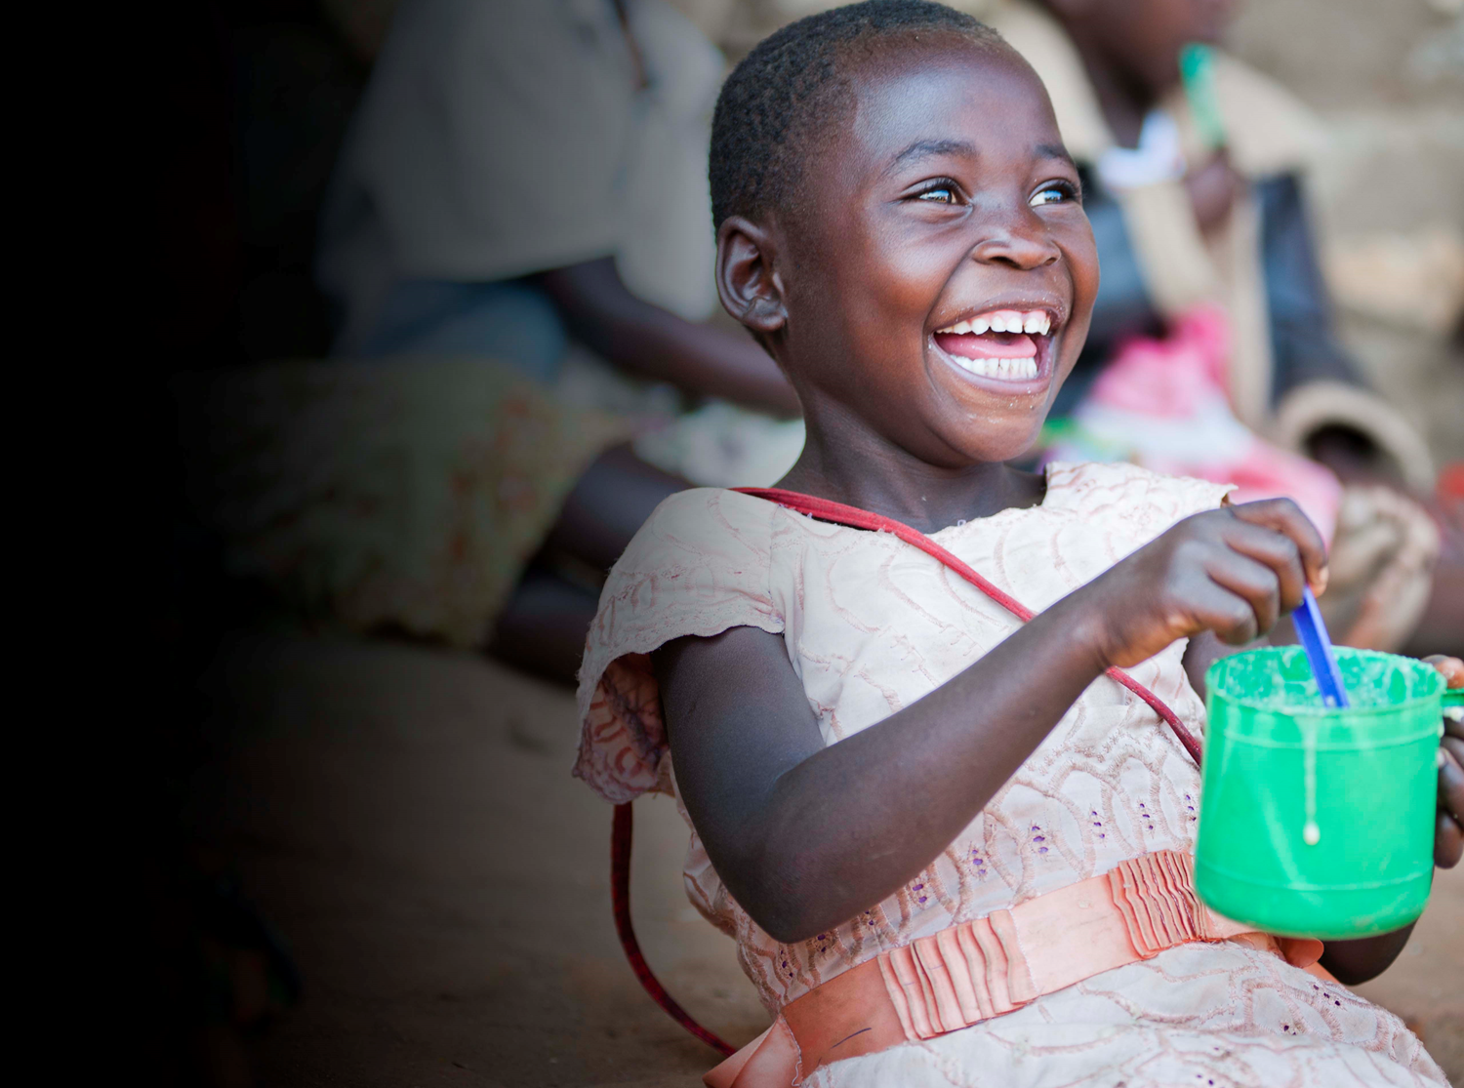
Our vision and mission
• Our vision is that every child receives one daily meal in their place of education and that all those who have more than they need, share with those who lack even the most basic things.
• Our mission is to enable people to offer their money, goods, skills, time, or prayer, and through this involvement, provide the most effective help to those suffering the effects of extreme poverty in the world’s poorest communities.
5

Slide 6
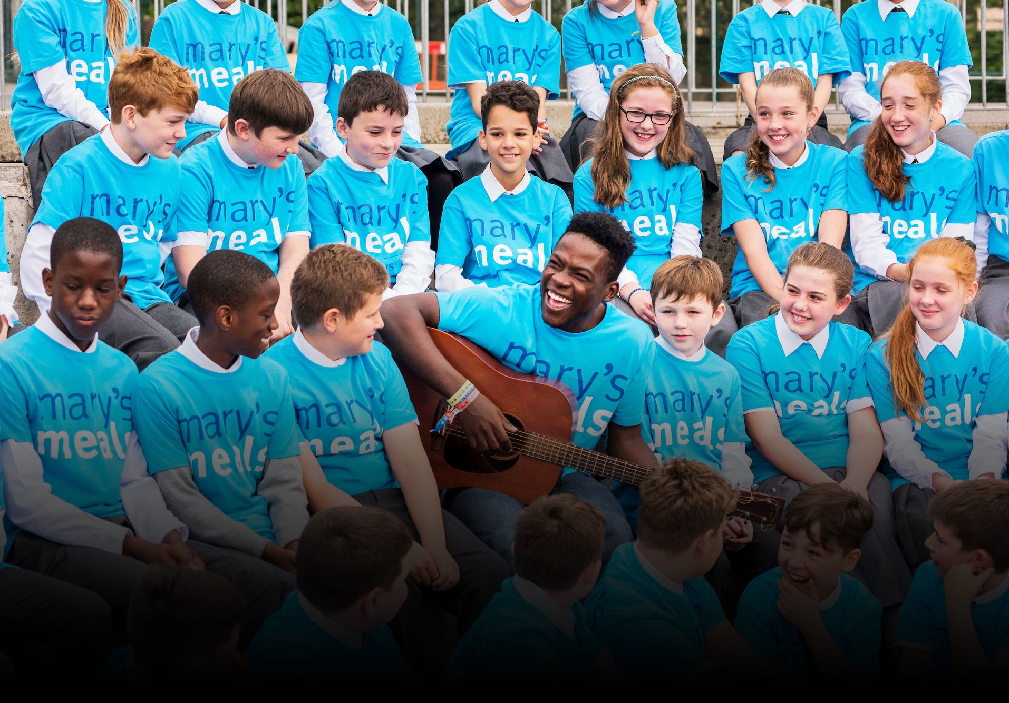
Our values
• We have confidence in the innate goodness of people.
• We respect the dignity of every human being and family life.
• We believe in good stewardship of the resources entrusted to us.
View Mary’s Meals’ full statement of values here: Statement of Values
6

Slide 7
About the Mary’s Meals movement
Mary’s Meals is a global movement that sets up school feeding projects in some of the world’s poorest communities, where poverty and hunger prevent children from gaining an education.
Our idea is a simple one that works. We provide one daily meal in a place of learning in order to attract chronically poor children into the classroom, where they receive an education that can, in the future, be their ladder out of poverty.
The Mary’s Meals campaign was born in 2002 when Magnus MacFarlane-Barrow, from Dalmally in Argyll, visited Malawi during a famine and met a mother dying from AIDS. When Magnus asked her eldest son Edward what his dreams were in life, he replied simply: “I want to have enough food to eat and to go to school one day.”
That moment was a key part of the inspiration which led to the founding of Mary’s Meals, which began by feeding just 200 children in Malawi in 2002. Today, 20 years later, we feed 2,279,941 hungry children every school day across four continents. The average worldwide cost for us to feed a child for a whole school year is just £15.90.
Where Mary’s Meals is provided, there is a rise in school enrolment, attainment and attendance. Wherever possible, Mary's Meals uses locally grown food to support the local economy and help smallholder farmers.
We work extremely hard to keep our running costs low and to ensure that at least 93% of donations goes directly on our charitable activities. This is only possible because most of our work is done by an army of dedicated volunteers all over the world, who carry out lots of little acts of love on behalf of Mary’s Meals.
Having been inspired, in part, by our founder’s Catholic faith, this work is named in honour of Mary, the mother of Jesus, who brought up her own child in poverty. We consist of, respect and reach out to people of all faiths and none.
Counting on support from around the globe, Mary’s Meals has registered national affiliate organisations, which raise awareness of our work, in 20 countries around the world. Funds raised by affiliates, including from Mary’s Meals UK, are passed to Mary’s Meals International, the organisation which co-ordinates our movement and directly manages the delivery of our school feeding programmes.
7

Slide 8
8

Slide 9
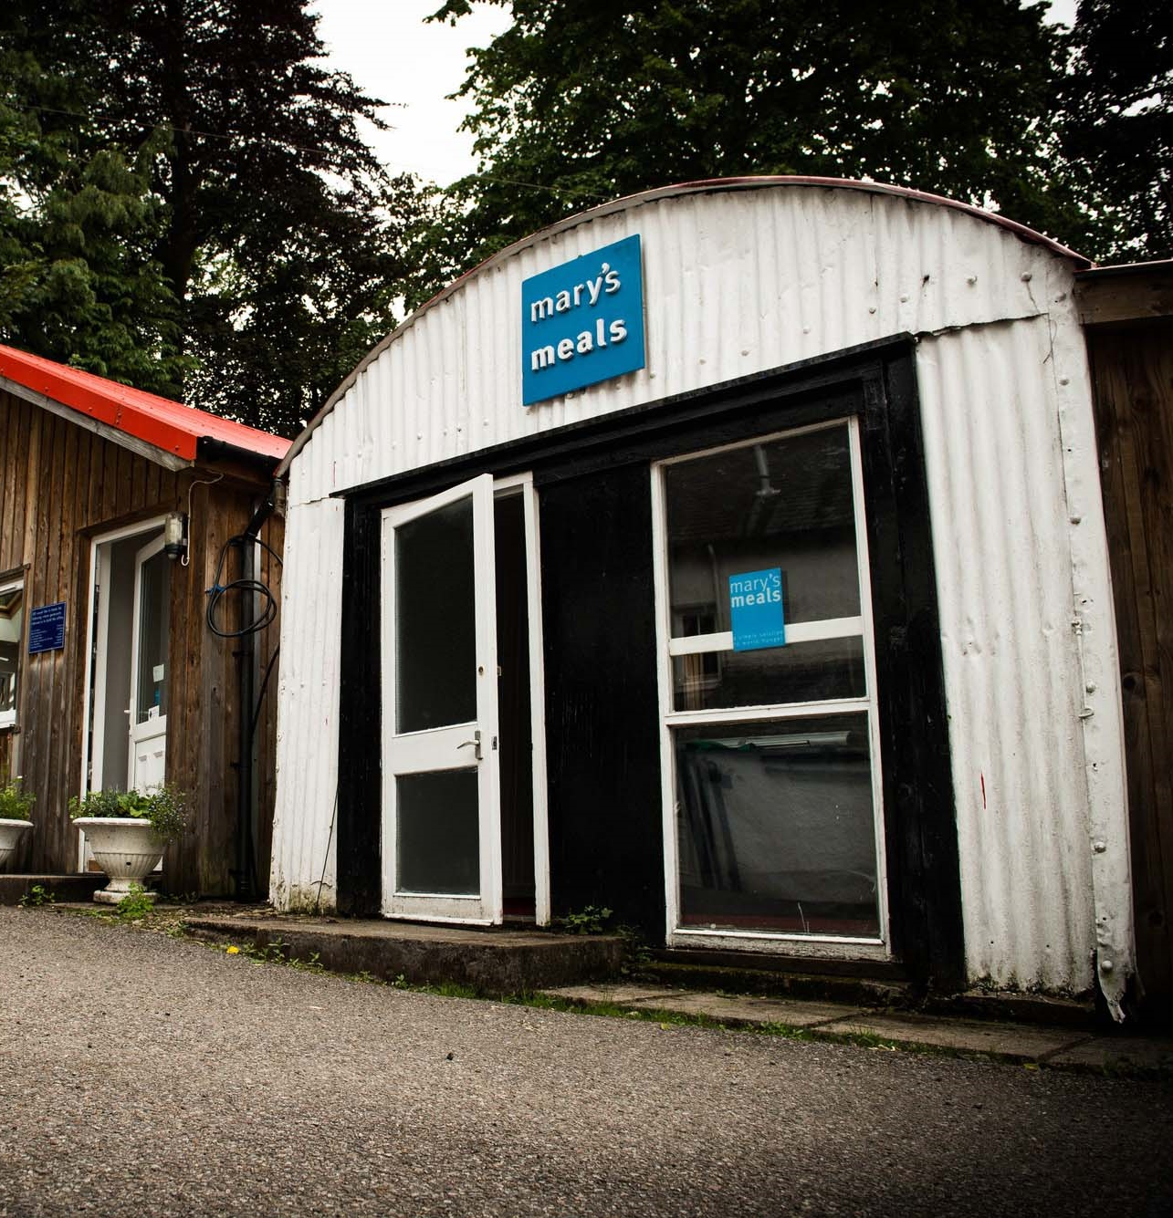
About Mary’s Meals UK
Mary’s Meals UK (or ‘MMUK’), a charity registered in Scotland, is the oldest entity in the Mary’s Meals family – the original organisation established as Scottish International Relief in the early 1990s, when our founder and global CEO, Magnus MacFarlane-Barrow, first became involved in international aid during the Bosnian Conflict.
Back then, Magnus was a simple salmon farmer who, along with his family, decided to do something to help those who were suffering because of the war.
They relied heavily on the generosity of local people in their village of Dalmally in Argyll, who relentlessly donated food, blankets and other items of aid, which were then stored in the family shed, before being driven out by Magnus to Bosnia-Herzegovina.
Though our largest office is now in Glasgow, that same shed – which continues to be filled, metaphorically at least, with the generosity of our supporters – still serves as the headquarters of Mary’s Meals UK to this day.
9

Slide 10
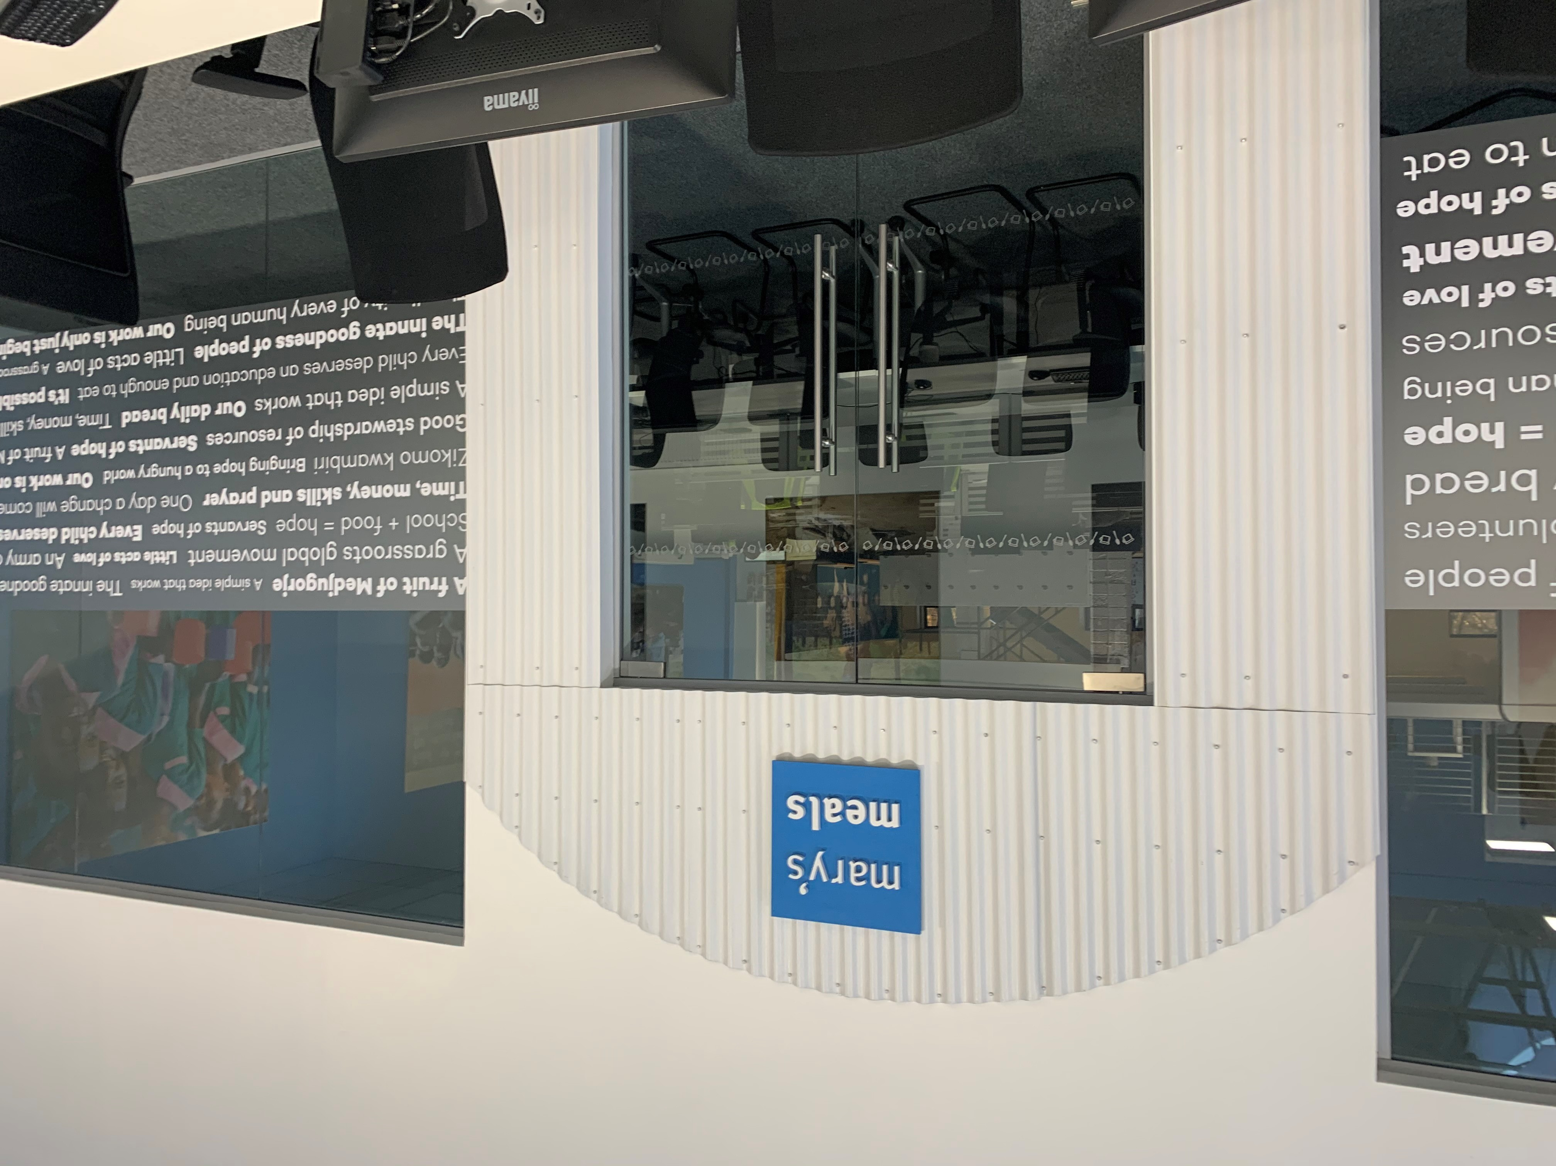
About Mary’s Meals UK
In January 2015, to recognise the incredible growth of the Mary’s Meals movement around the world and to facilitate future growth in new countries, another entity – Mary’s Meals International (or ‘MMI’) – was formed.
This new organisation assumed responsibility for directly delivering our programmes and for coordinating the growing number of Mary’s Meals organisations around the world, aimed at either awareness-raising or programme delivery.
This structural change saw Mary’s Meals UK become the global movement’s largest fundraising organisation and enabled it to focus even more passionately on its mission to tell our story across Scotland, England, Northern Ireland and Wales, and empower more people to help us reach the next hungry child by offering their money, goods, skills, time or prayer.
Today, Mary’s Meals UK raises awareness and funds under the direction of the Executive Director, and through the passion, commitment and dedication of our volunteers and staff, led by the Director of Communications, Director of Supporter Engagement and Income, and the Director of Finance and Operations. The organisation currently has offices in Glasgow, Dalmally and London and offers a flexible working model.
10

Slide 11
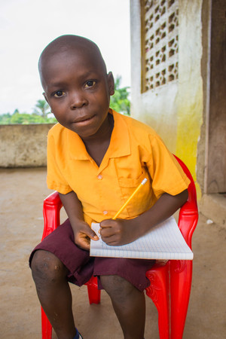
Role outline
Role title: Head of Marketing and Digital
Location: Home working from anywhere in the UK
Contract: Full time, 37.5 hours per week
Salary: c. £46,093 – £50,676 per annum (plus London Weighting Allowance, where applicable)
Benefits: Flexible working, 34 days’ annual leave
(including public holidays), and a
non-contributory pension with employer contributions of 8%. For more information on what we offer,
please visit our website.
Reports to: Director of Communications
Key relationships:
Internal: Head of Media and Content, Communications team, Extended Leadership team,
Head of Digital (MMI)
External: Supporters, agencies
11

Slide 12
Communications team structure
12

Slide 13
Duties and responsibilities
Role overview
The head of marketing and digital will work side-by-side with the head of media and content to ensure an integrated approach to all communications activities through the combining of strong storytelling and marketing expertise.
The role involves working closely with the international communications team and will be a part of the MMUK extended leadership team.
Principal duties
Direct line management of the marketing team, offering day-to-day support and ensuring their ongoing development
Develop and implement Mary’s Meals’ marketing strategy in the UK, linking ongoing progress to key organisational KPI’s, with a strong emphasis on digital communications
Manage the new UK website, working closely with digital colleagues in the international team to ensure the site is functioning well, generating traffic and attracting new supporters to our work
Lead on ongoing content development of the website, working closely with the media and content team to ensure copy and visuals are both engaging and optimised for SEO
Grow fundraising through the online Mary’s Meals shop, through the diversifying of our product range and improved experience for our supporters
Work closely with the operations team to develop use of our new email marketing tool, ensuring it is growing income and engagement
Develop and implement innovative marketing activities with existing supporters and identify creative ways to reach out to new audiences
Lead our approach to segmented communications for email marketing and direct mail, developing our supporter journeys and ensuring an ongoing testing and learning approach is in place
Manage the tracking and analysis of ongoing communications led data, working closely with the data insights teams where required, and using the data to inform ongoing communications strategies and development alongside the head of media and content
Oversee the development and day to day management of the Mary’s Meals UK social media channels, ensuring the channels are growing in followers and fundraising
Identify and set up new social media channels over time
Contribute to UK campaigns, ensuring that all marketing and digital elements are in place
13

Slide 14
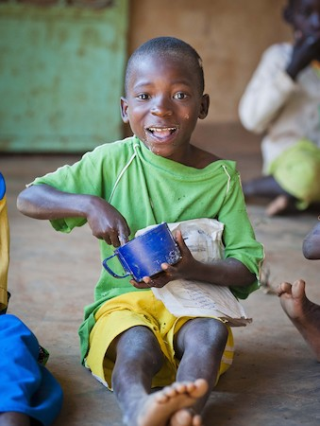
Duties and responsibilities
Amplify media, PR and celebrity opportunities, secured by the media and content team, through digital channels
Identify and manage advertising opportunities in the team on a (limited) paid for and pro bono basis
Ensure the consistent implementation of Mary’s Meals brand, key messages and style guide in UK marketing activities
Participate as part of the extended leadership team
14

Slide 15
Qualifications, experience and skills
Essential
At least five years’ experience working within a senior marketing/digital role
Proven ability and experience of managing and developing the capabilities of driven, bright and diverse teams
Track record of developing and implementing effective marketing strategies and activity plans, with a strong emphasis on digital
Experience of working in a fast-paced communications environment
A practical and pragmatic person able to exercise initiative and sound judgement
Excellent communication skills, including a strong ability to cut through jargon/detail to engage clearly with colleagues and stakeholders
Ability to manage a complex workload and juggle multiple priorities, ensuring deadlines are met
A credible and reliable person who can influence or persuade at all levels
A keen eye for accuracy and detail
Strong organisational, planning and project management skills
Sound experience and willingness to work ‘hands on’ as part of a small team, in a supportive, flexible and friendly manner
Organised self-starter with the ability to work to minimal supervision and able to refer or consult when necessary
Ability to demonstrate knowledge of a broad range of marketing activities – website, social media, email, communications, direct mail and advertising
Resilient, flexible and self-motivated with a good understanding of the charity sector
Ability to demonstrate experience of innovation, initiating ideas and bringing them to fruition
15

Slide 16
Qualifications, experience and skills
Experience of developing supporter journeys and segmenting audiences for communications
Excellent understanding of what data to track and how to distil learnings and recommendations
Detailed understanding of how to build audiences and engagement, particularly online
Computer literate with good MS Office skills
Excellent interpersonal skills including the ability to liaise at all levels within the organisation and externally
Knowledge of briefing agencies and other suppliers
Desirable
Understanding of media and PR
Understanding of Salesforce, Drupal and Mailchimp
Experience of the charity sector
16

Slide 17
Mary’s Meals UK manager competencies
Managers at Mary’s Meals UK approach their role in line with our 7S competency model:
1. Self
I build and demonstrate resilience
I lead by example
I’m authentic and true to Mary’s Meals values
I develop myself and set stretching goals
2. Service
I have a vocational attitude to my work
I inspire hope in others
I build belief that even difficult challenges can be solved
I am committed to serving and enabling all who want to be part of the global movement
I work to ensure our future will be even better than our past
3. Simplicity
I communicate effectively
I follow clear decision-making criteria
I create plans that are easy to follow and contribute to organisational goals
I embrace inclusivity and diversity
I focus on delivering results
4. Stewardship
I pay attention to the things that matter most; (a) our physical resources; (b) our people
I nurture, develop and respect our relationships with external stakeholders
I deliver on my promises
I am happy to be held accountable and to hold others to account
5. Strategy
I have a point of view about the future
I know our stakeholders and see our priorities clearly
I help others to work in ways that have the greatest impact
I develop strategy and translate it into action
6. Strengthen
I create a positive work environment
I increase the capabilities of my team
I help people manage their careers
I find and develop next-generation talent
7. Success
I ensure my team is technically competent and developing
I build high performing teams
I ensure accountability
I am a catalyst for change
17

Slide 18
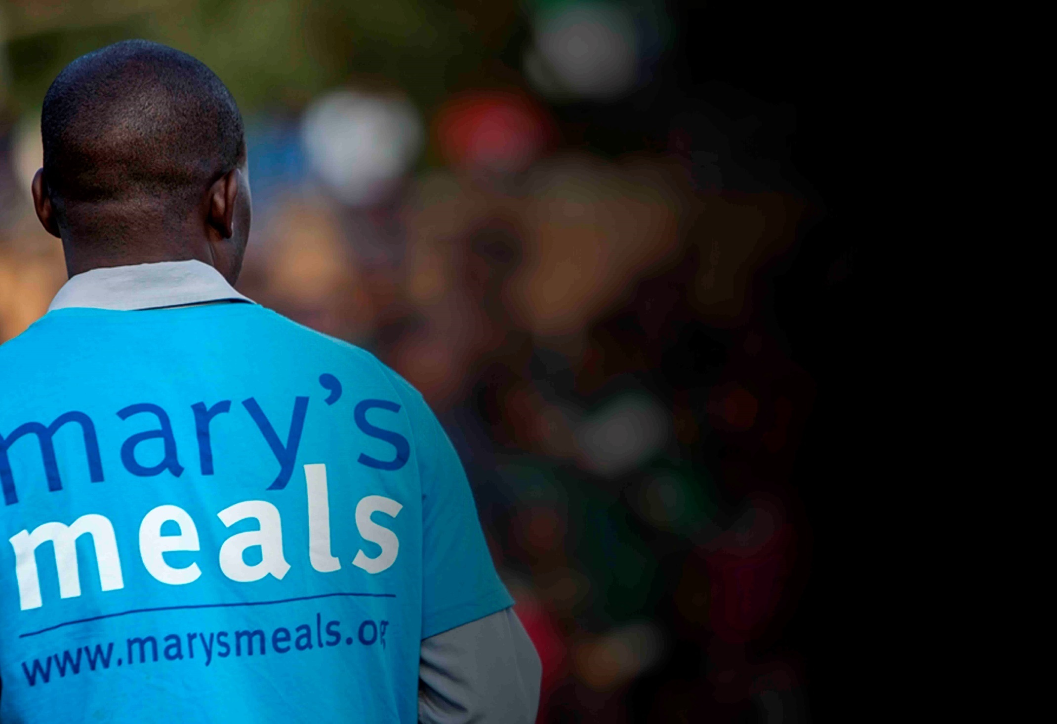
Recruitment process information
How to apply for this role
To apply for the role of head of marketing and digital based at Mary’s Meals UK, please send a tailored CV and covering letter to: Jobs@marysmeals.org
Your covering letter should make a compelling case for why you feel motivated to apply for this role within Mary’s Meals UK, as well as giving a concise overview of your most relevant skills and experience, and should fill no more than two pages of A4.
Recruitment timescales
Closing date for applications:
Tuesday 19th April
Please note: If you have any special requirements or adjustments before an interview, please let us know.
A second interview stage may be required.
18

Slide 19
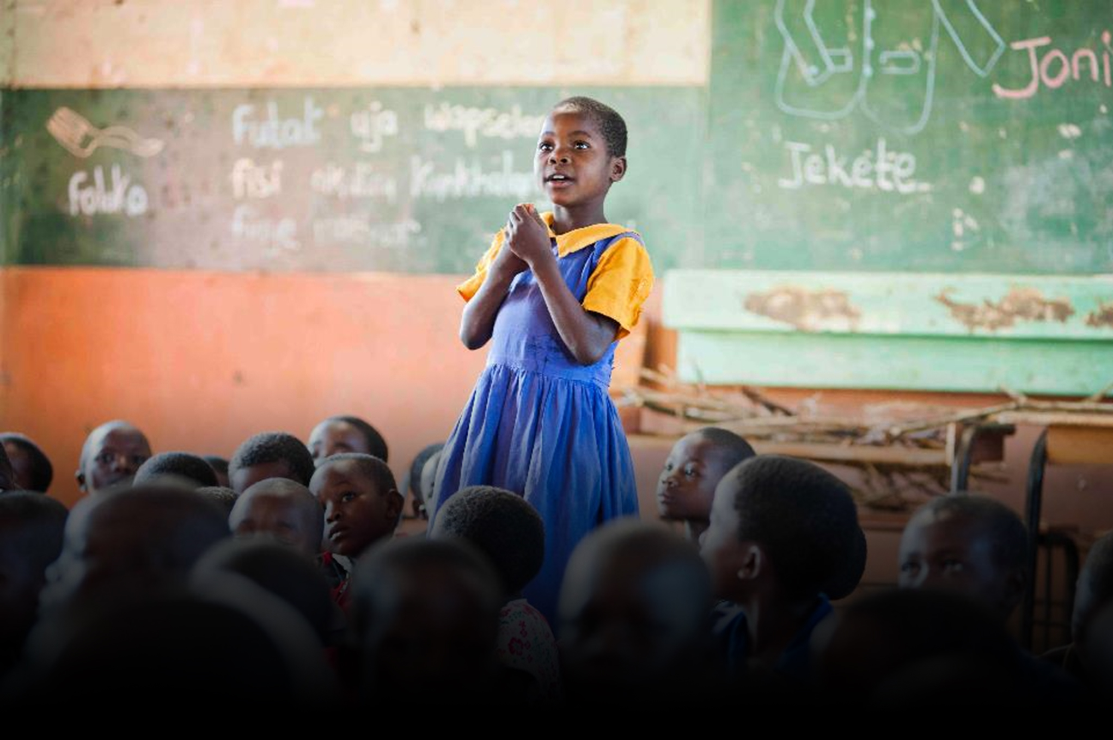
Mary’s Meals UK
Charity No. SC022140
Company No. SC265941
Tel: 0141 336 7094
Dalmally office
Craig Lodge
Dalmally, Argyll
PA33 1AR
Glasgow office
Unit 6 Claremont Centre
39 Durham Street, Glasgow
G41 1BS
London office
13 Hippodrome Place
Notting Hill, London
W11 4SF
“Together, let’s set out on this journey; one step at a time, one meal at a time, one child at a time.”
– Magnus MacFarlane-Barrow, Mary’s Meals founder

