Slide 1
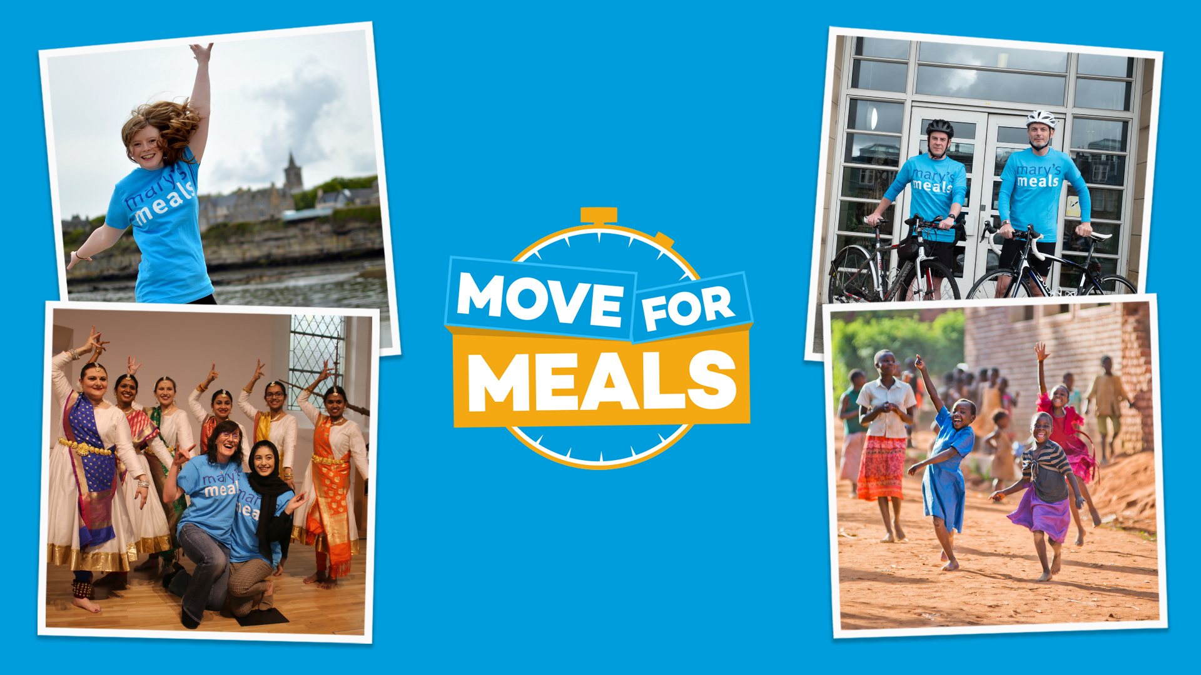
Notes:
This January we’re asking supporters to Move For Meals and help us to reach the next hungry child. Whether it’s skipping, dancing, swimming, walking or running – you can turn your moves into meals for impoverished children around the world.
All you need to do is:
1. Choose how to move – do whatever you enjoy most – whether it’s running, walking or cycling or skipping, dancing or hopping!
2. Decide whether to do it by yourself or with a group of friends or family.
3. Get sponsored or donate to Mary’s Meals to mark your achievement – you can set up a fundraising page at marysmeals.org.uk/get-involved/fundraising/
But whatever you do, make sure to tell everyone that you’re part of #moveformeals – because together we are transforming the lives of more than two million children thanks to the promise of a daily school meal. But with 67 million primary school-age children still out of school around the world because of poverty, your moves will mean we can bring smiles to even more little ones who are still waiting for our nutritious meals.
Find out more at: marysmeals.org.uk/move-for-meals
.

