Slide 1
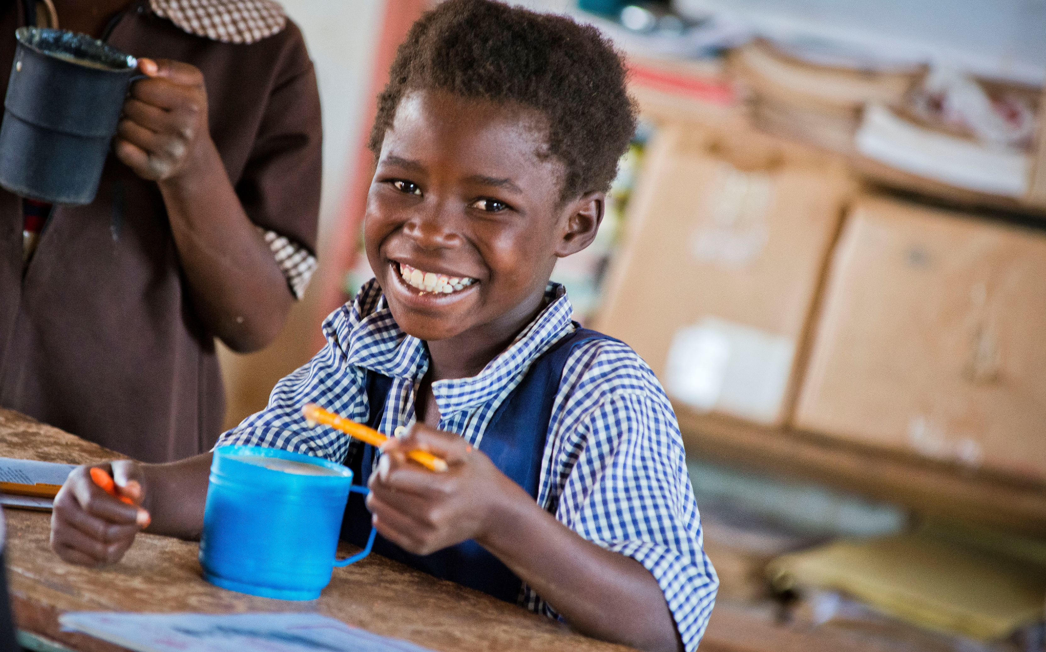
Ways to
support
our work

Slide 2
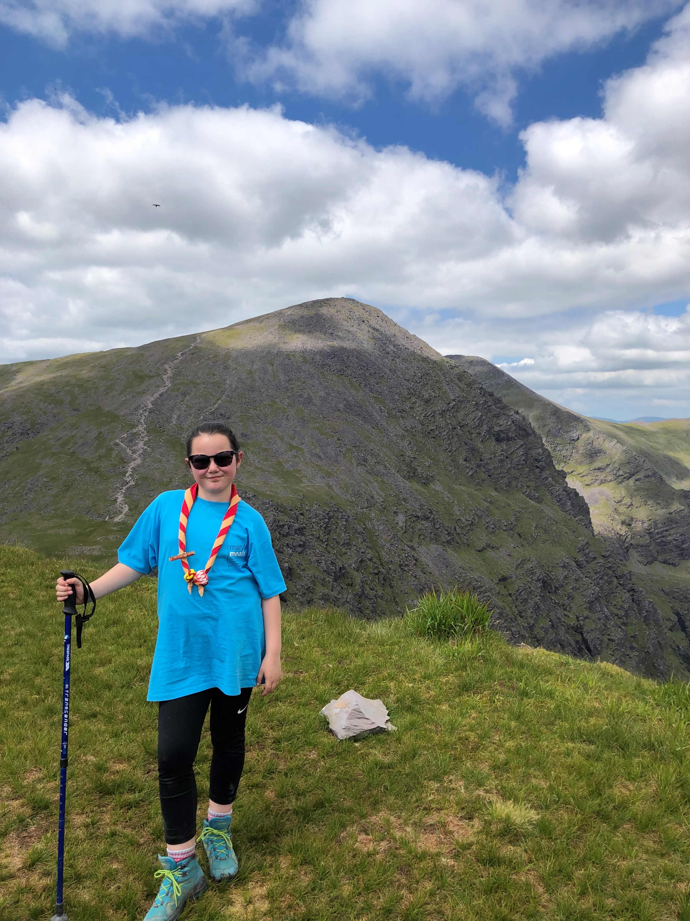
Fundraising
Notes:
You could choose to fundraise for Mary Meals.
Our supporters never fail to amaze us with their inspiring and original fundraising ideas. ​
​Inspiring nine-year-old Madison Burns hiked for five days, reaching the summit of five of the highest mountains in the UK and raising £700 for Mary’s Meals. ​

Slide 3
Volunteer your time and skills
Notes:
You could choose to volunteer – like I do.
We welcome everyone into the Mary’s Meals family and believe each of us has something to contribute towards our work.
​We have volunteer groups across the UK, open to all, including students and young people.

Slide 4
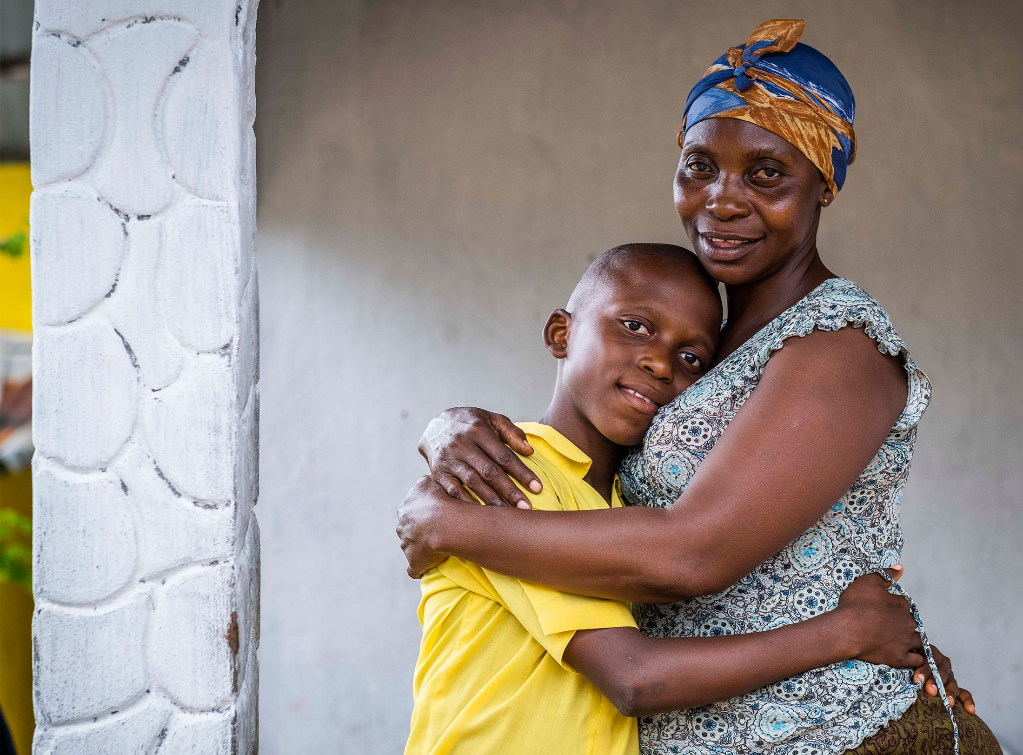
Leave a gift in your will
Notes:
Leaving a gift in your will to Mary’s Meals is simple, and your generosity will help build a brighter future for hungry children around the world.
We are offering our supporters a free will writing service in partnership with Farewill, the largest will writer in the UK.

Slide 5
Set up a Facebook fundraiser
Notes:
You could mark your birthday by inviting friends to make a small donation to a Facebook fundraiser.
Simply click on 'Fundraisers' in your Facebook menu and select Mary's Meals as your chosen charity.

Slide 6
Say it with school meals
Notes:
Our online shop has a lovely selection of gifts – from beautiful cards that will feed a child for a year, to Mary’s Meals t-shirts

Slide 7
Make the most of your shopping
Notes:
There are lots of ways to donate while you shop!
Visit our website to find out about using cashback sites and even donating your Nectar points!

Slide 8
Thank you!
marysmeals.org.uk
Notes:
To find out more, please visit marysmeals.org.uk – or ask me any questions!

