Slide 1
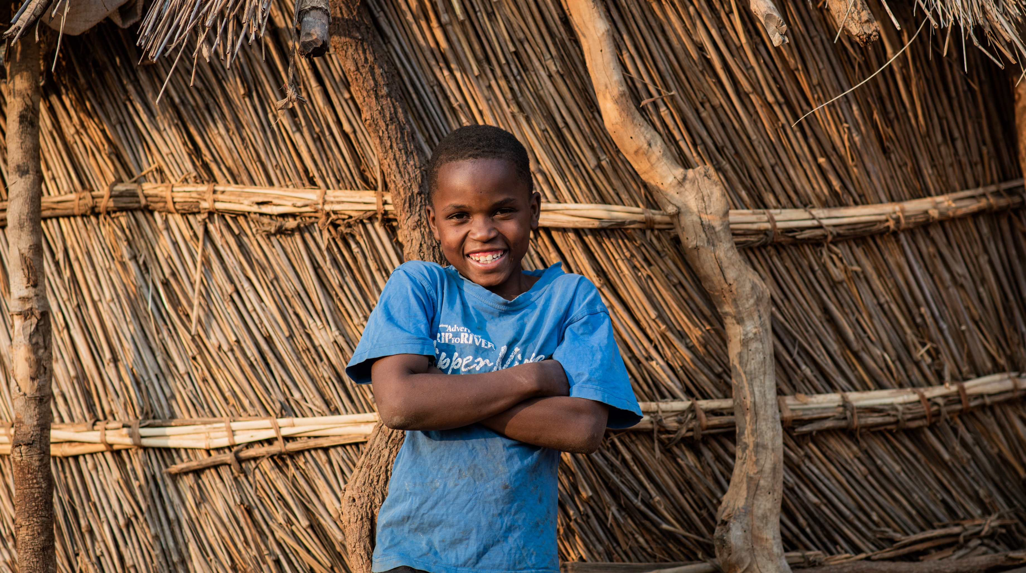
Failo, from Zambia
Notes:
Mary’s Meals feeds more than 2.4 million hungry children in school in 16 of the world’s poorest countries. Sometimes these children don’t have breakfast or dinner so their meal at school is the only food they get all day. This food gives them lots of energy and helps them to listen to their teachers, learn new things and play with their friends. We are going to have a look at some pictures following the daily routine of children in Zambia. I want you to think about what things are the same as your life and what things are different as we look at these pictures.
This is Failo. He is 11 years old and lives with his family in Zambia. Every day, he eats Mary’s Meals at his school. Let’s learn more about what he and children like him all over Zambia do every school day.

Slide 2
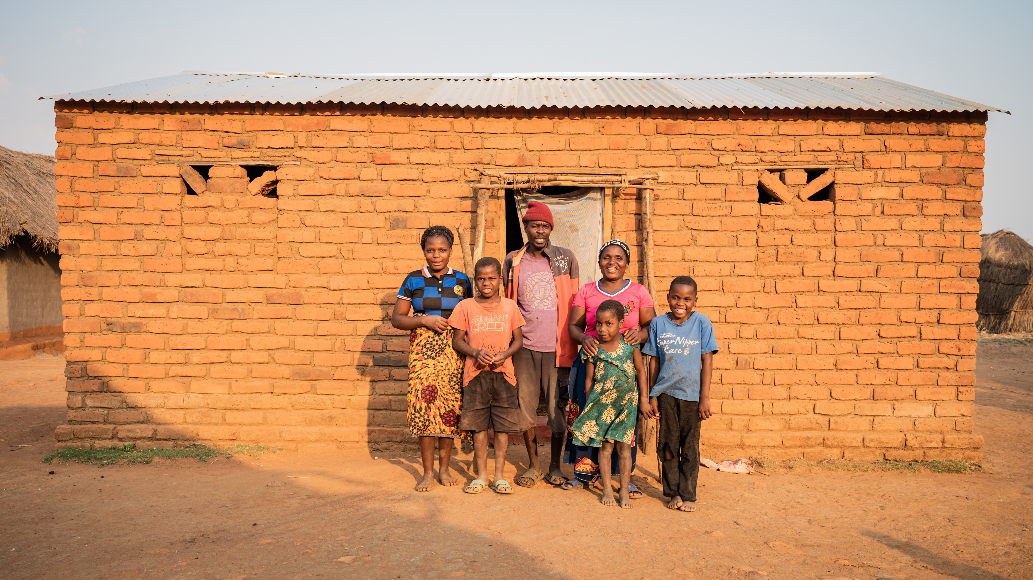
Failo and his family
Notes:
This is a picture of Failo’s family.
Every morning, the children are woken up very early by their parents. It’s time to get ready for school.

Slide 3
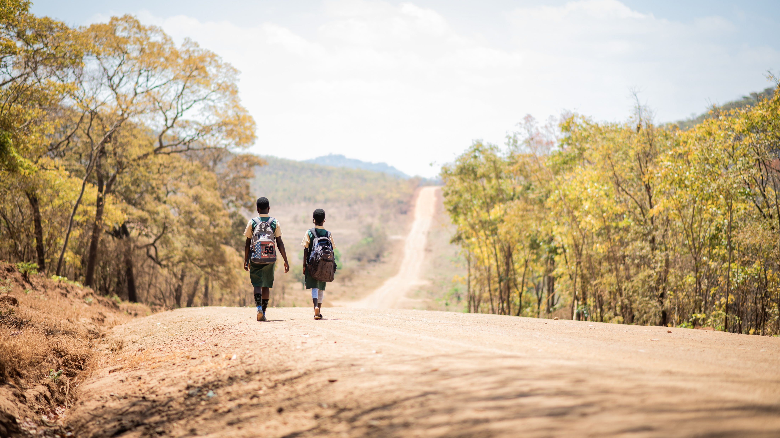
Journey to school
Notes:
Most children who eat Mary’s Meals in Zambia walk to school, like Failo. Some children might live close to a school, while others might walk a long distance, without eating any breakfast.

Slide 4
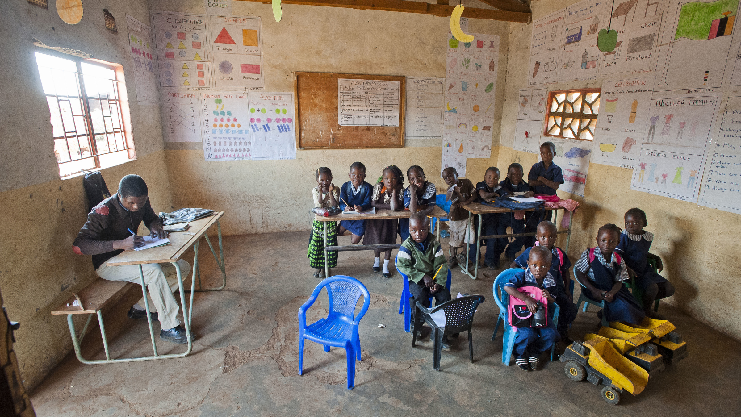
Classroom
Notes:
When children arrive at school, it’s time for lessons to begin. They work hard until lunchtime. This is a classroom in a primary school in Zambia.

Slide 5
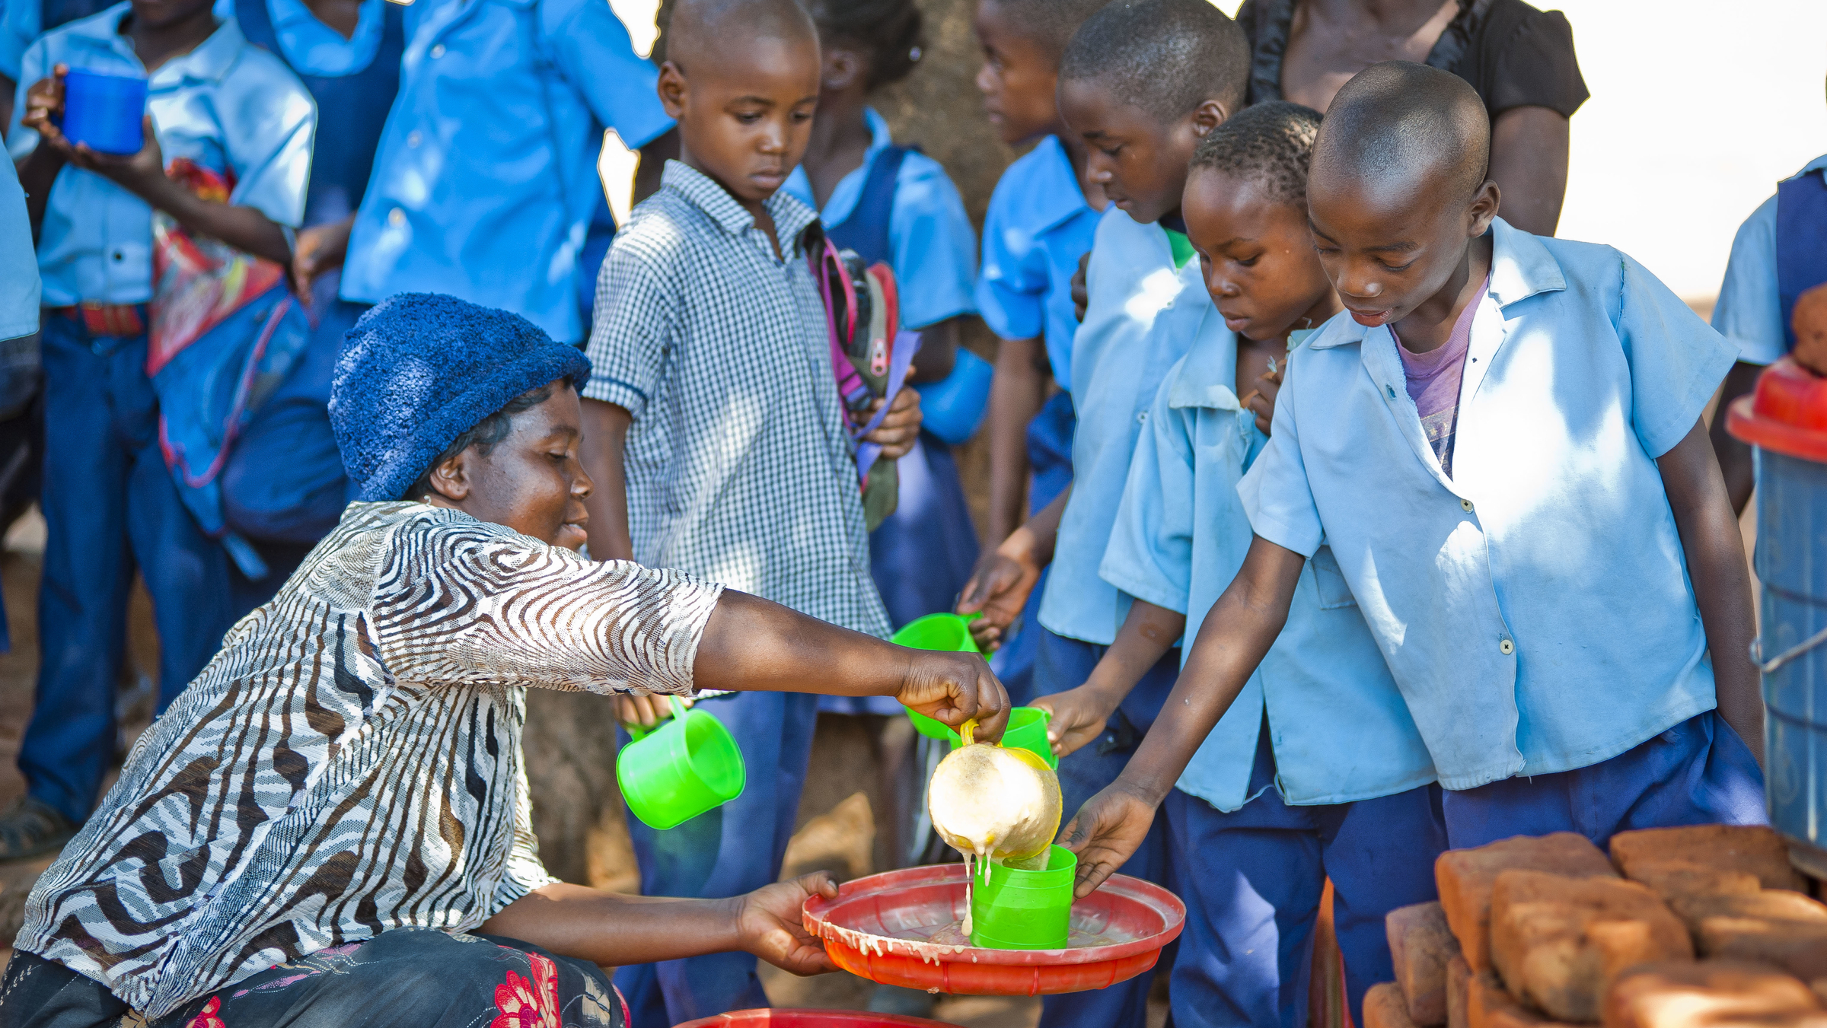
Lunchtime
Notes:
At lunchtime, the children line up to receive their mug of steaming hot porridge. Often, this is the only meal the children will eat today. In countries like Zambia, this porridge has a special name – Likuni Phala.
It has lots of vitamins in it to help the children to grow big and strong.

Slide 6
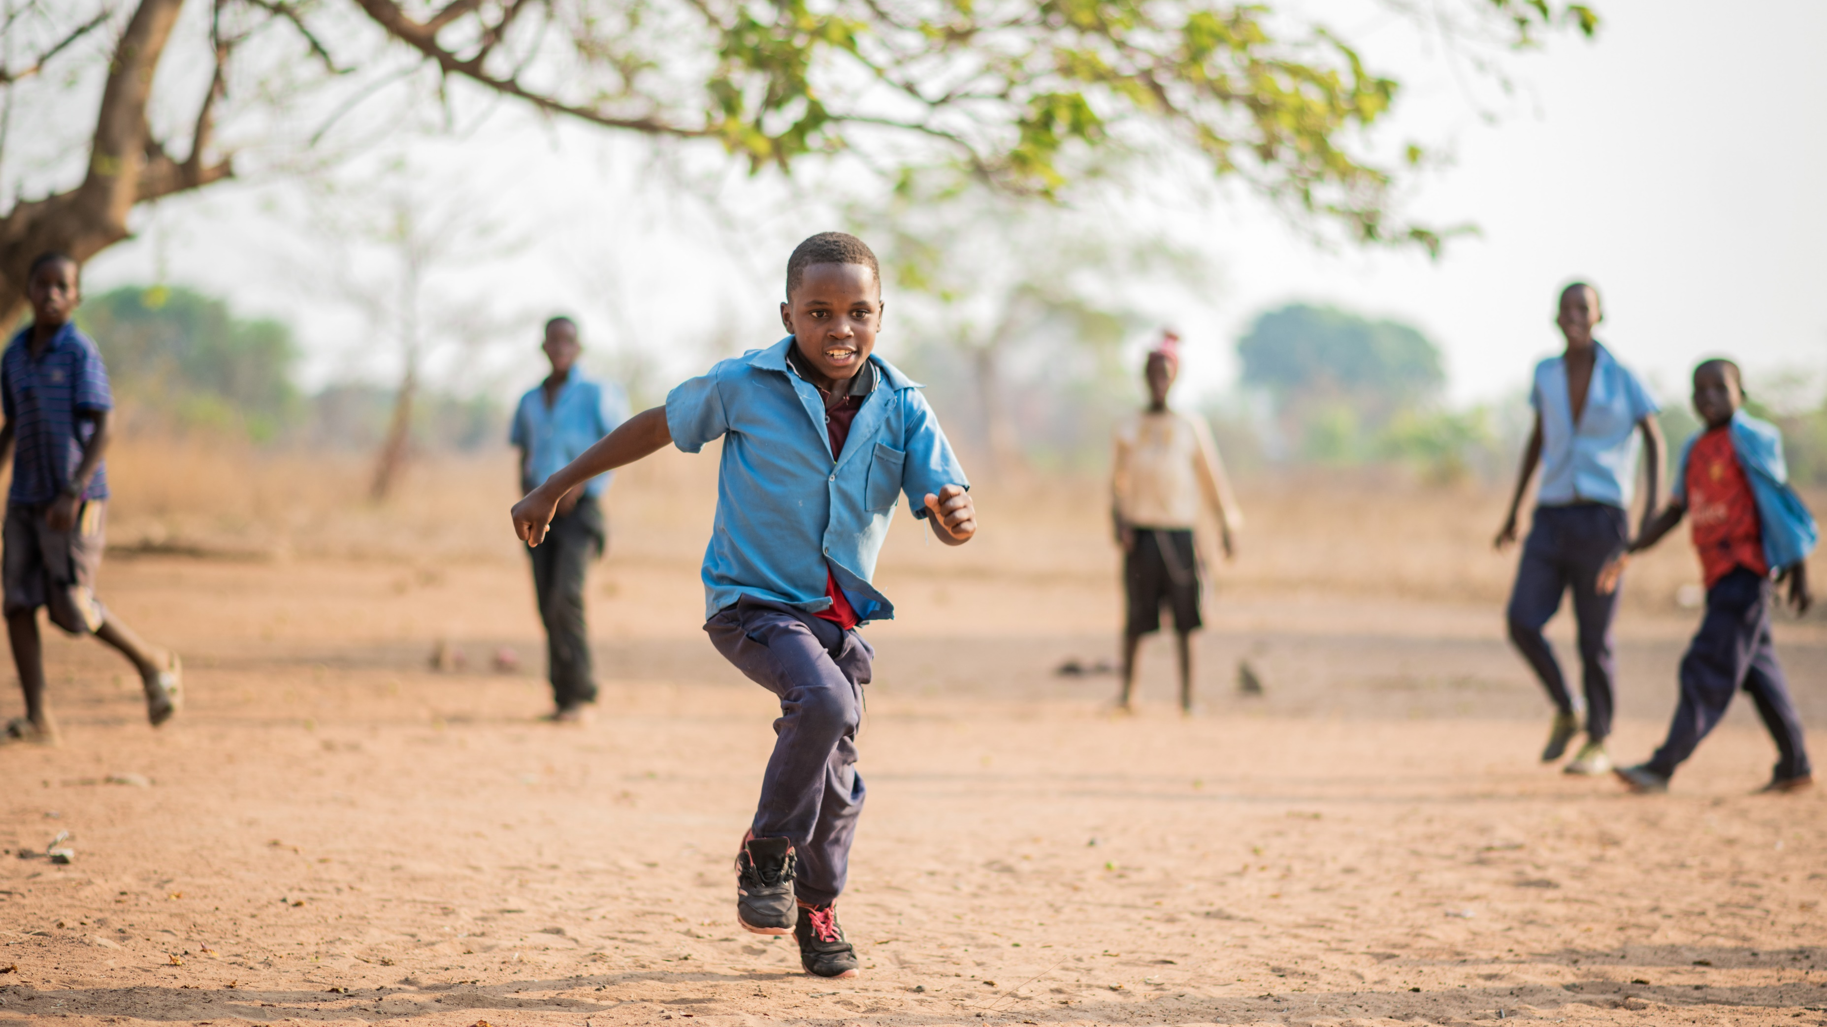
Playtime
Notes:
After lunch, the children have lots of energy to run and play. Failo and his friends love to play football after their porridge.

Slide 7
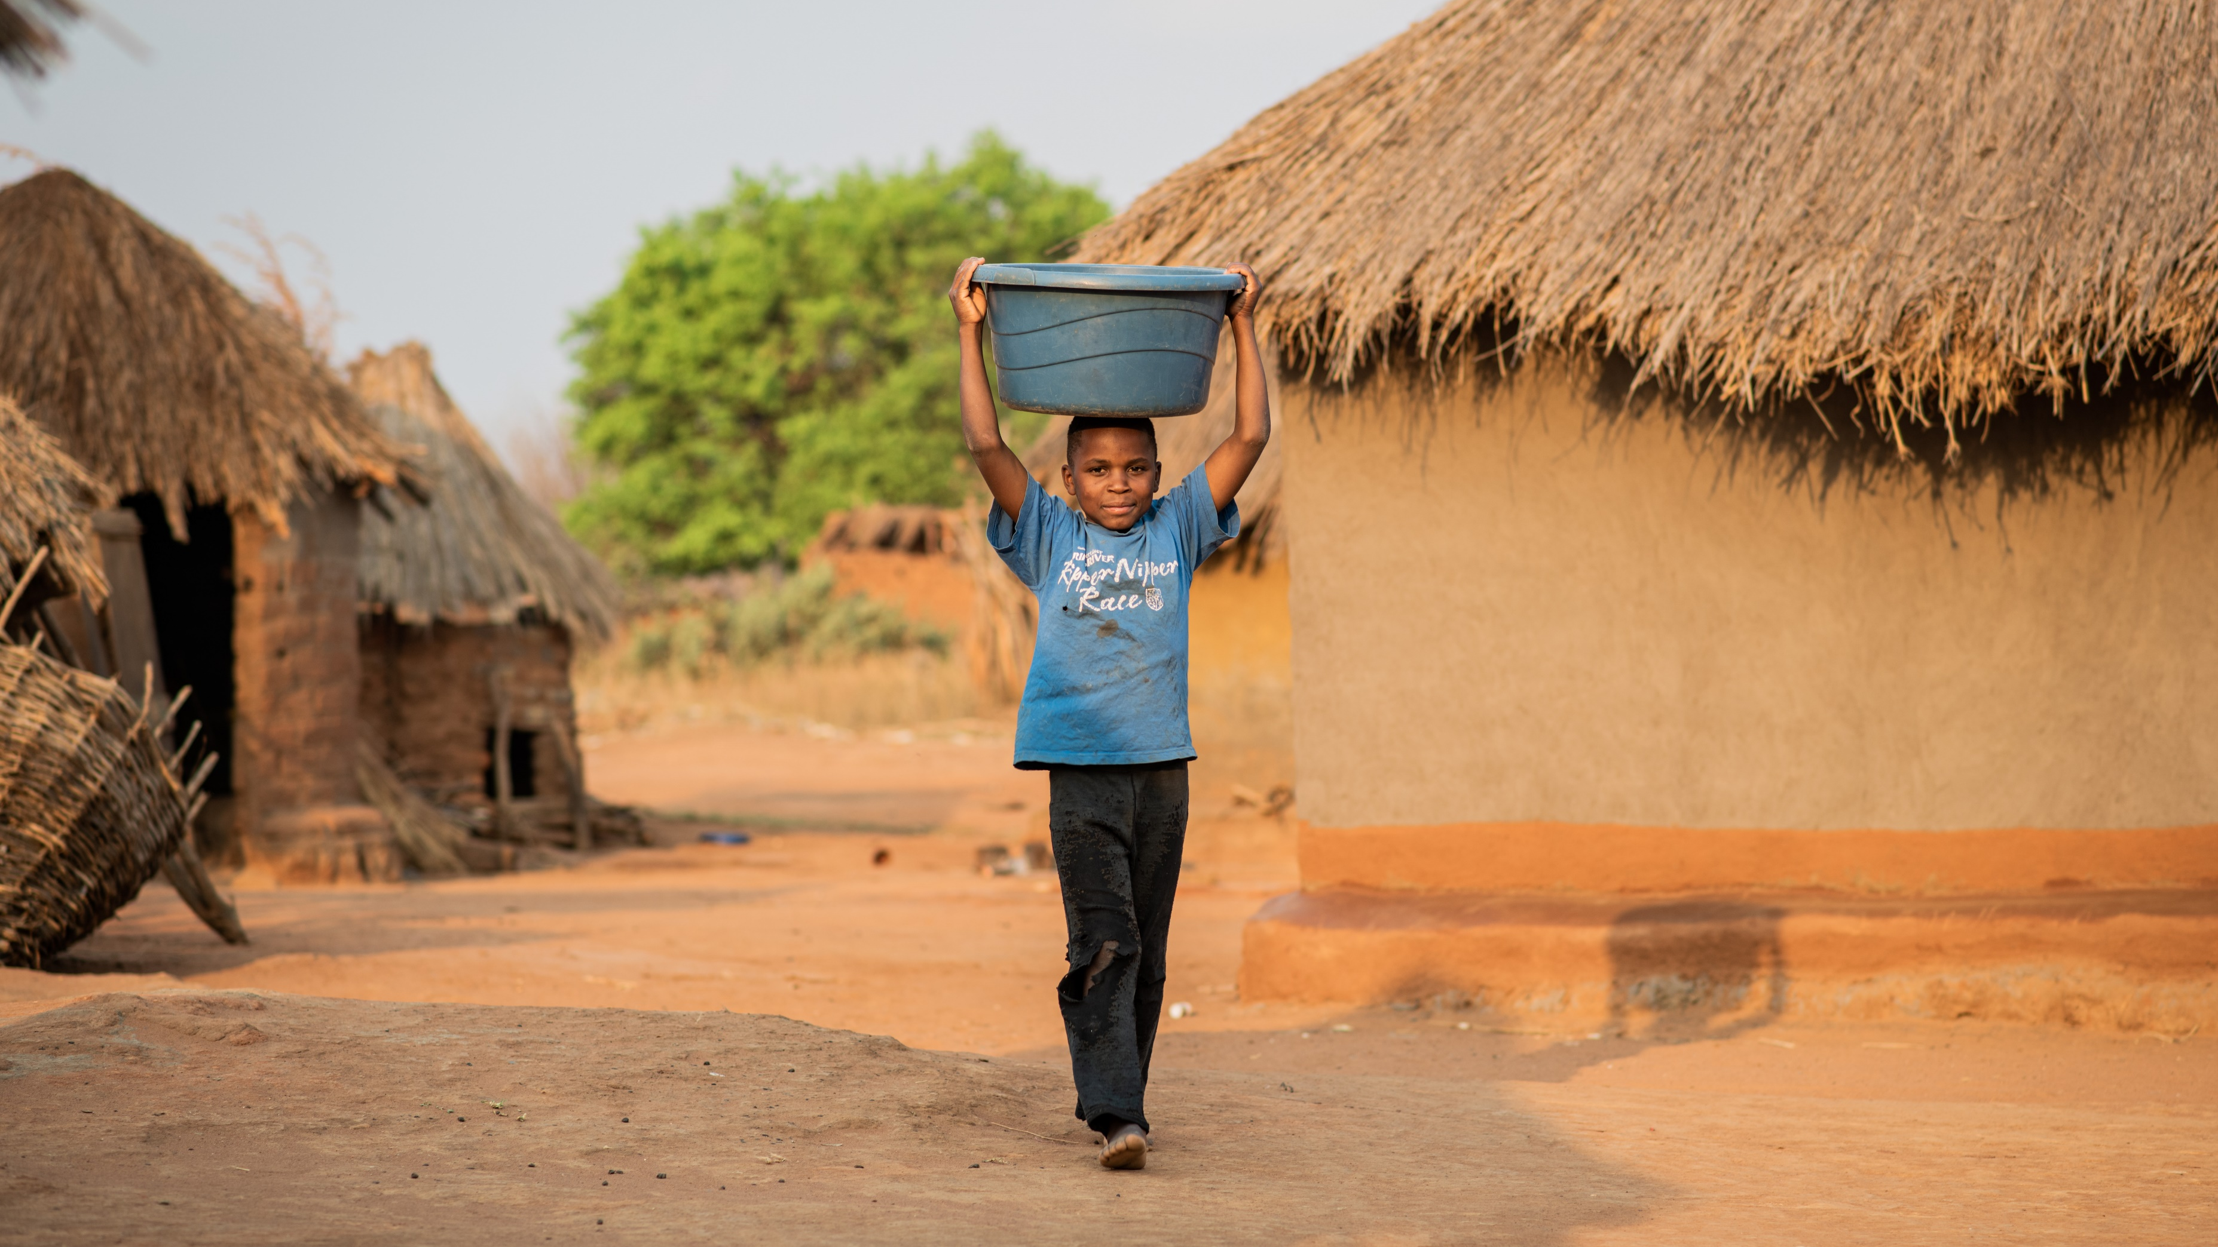
After school
Notes:
After school, many children have homework to do and then chores that help the family. Failo’s family has a garden, and they grow vegetables to sell. After Failo does his homework, he helps his family by watering the plants in their garden and going from house to house in his village selling vegetables.

Slide 8
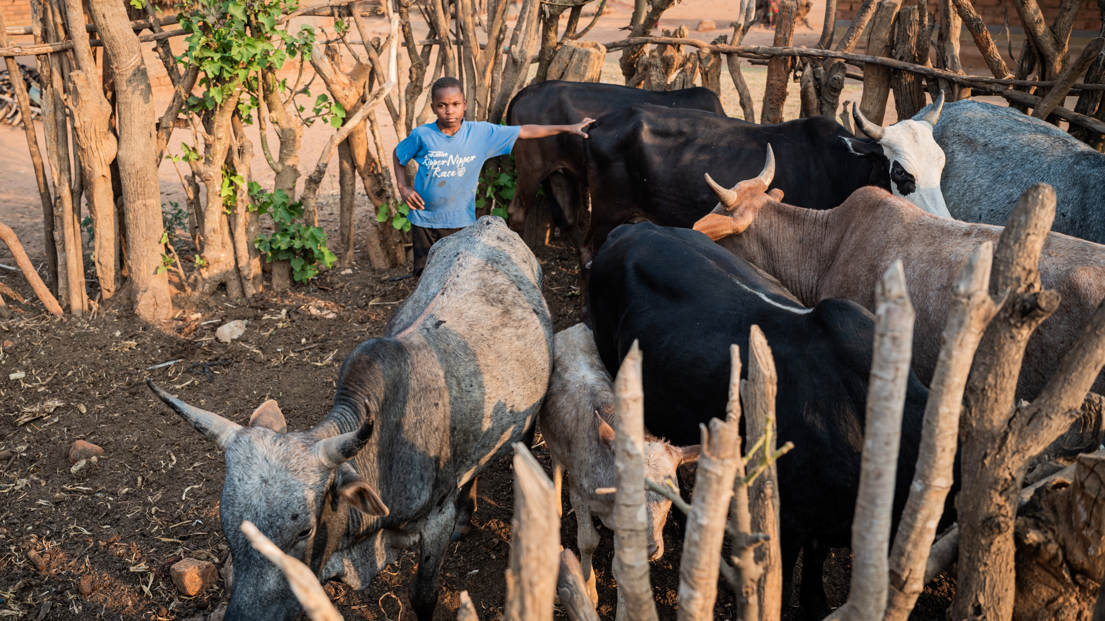
Before bed
Notes:
Before bed, Failo uses a big stick to close the entrance of the enclosure that keeps the family’s cattle safe.
We have learnt a lot today about the daily routine of children in Zambia.
Many children in Zambia are able to come to school because of Mary’s Meals, and they are starting to dream big dreams of what they will do when they finish school. Failo says: "I want to ride a motorbike for Mary’s Meals." He wants to be like one of the school feeding officers who travels from school to school making sure that all the meals are served each day.
Children feel happy when they eat Mary’s Meals, but the food also helps them to learn and do well at school so they can get good jobs one day.

