Slide 1
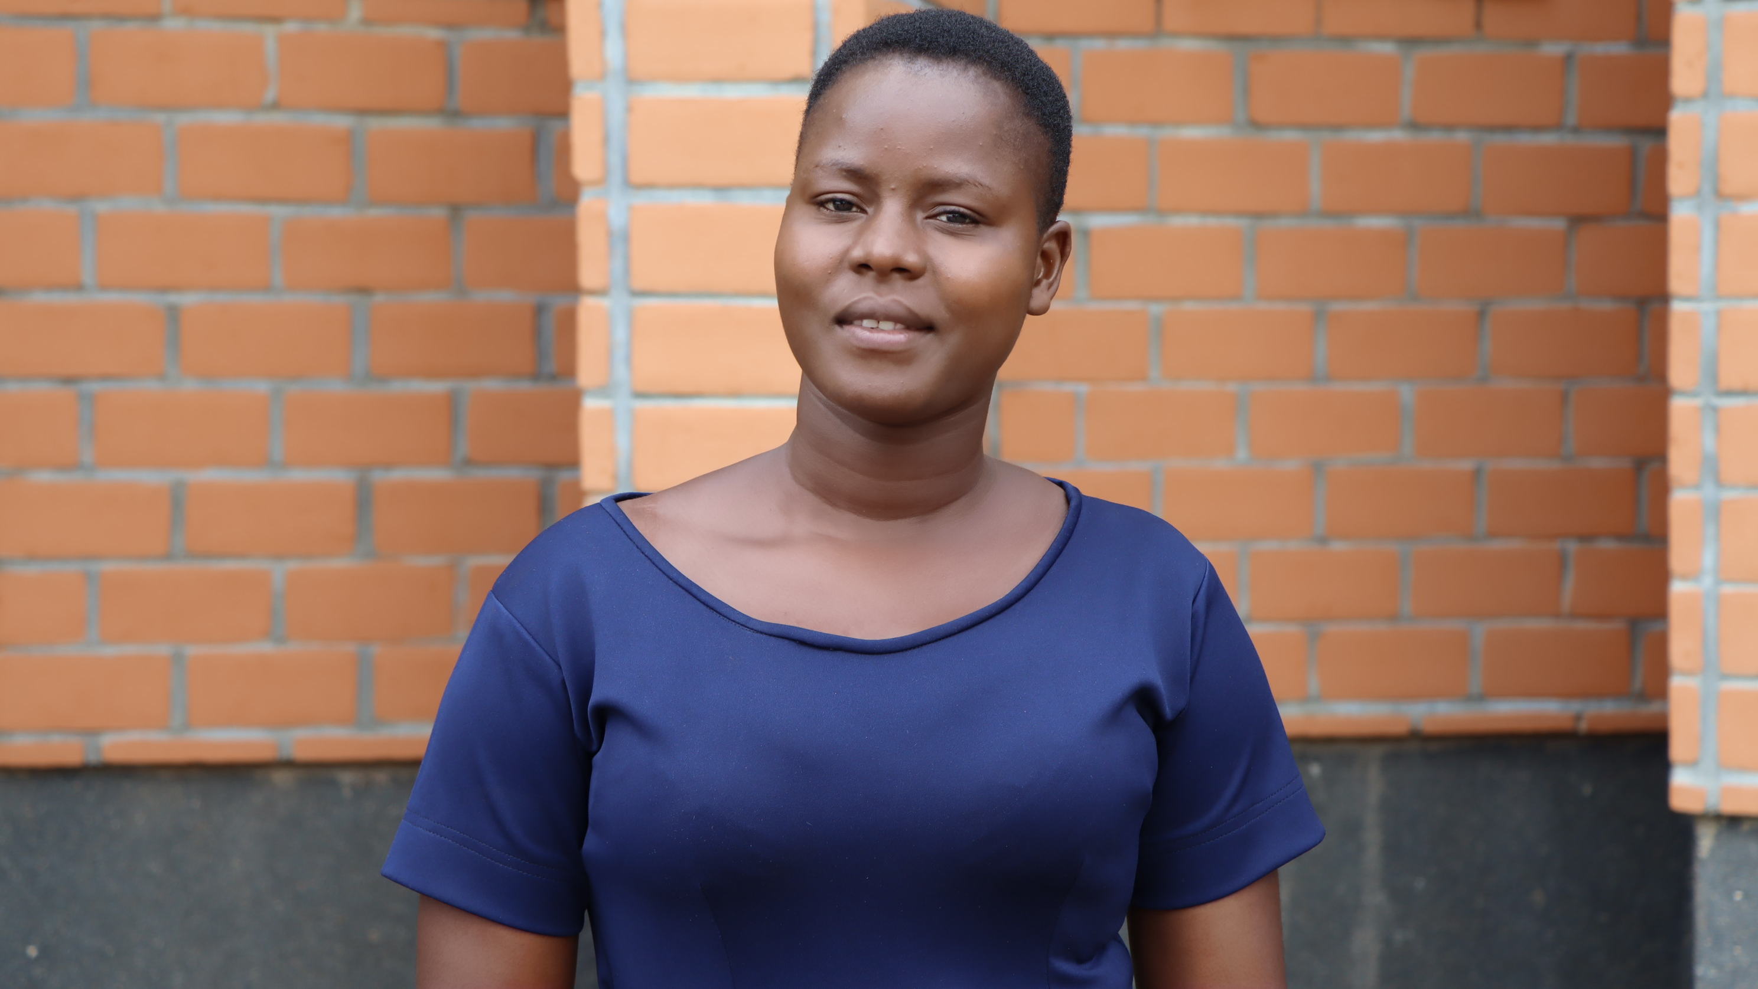
Notes:
By leaving a gift to Mary’s Meals, you will feed hungry children living in the world’s poorest countries. But your generosity won’t just deliver a meal, it will help pave the way to a brighter future for the next generation.
Your gift will have a lasting impact on the lives of children around the world. For Bernadette, the promise of a daily school meal changed her life.
Bernadette is a teacher at Chilomoni Primary School, Malawi, where she was once a pupil. When she first started attending school, she suffered from debilitating hunger. It deprived her of energy and reduced her confidence in class.
The introduction of Mary’s Meals’ school feeding programme changed all of that. With energy to learn and concentrate on her studies, Bernadette was able to gain an education and achieve her dream of becoming a teacher.
She says: "Every time I was in the top three positions in my class, it was because of Mary's Meals. I owe a great deal of my success to them.”
Bernadette now educates the next generation, helping to lift her community out of poverty.
Bernadette’s story shows that leaving a gift in your will won’t just feed a child for a day. It will fuel generations with hope.
Mary’s Meals offers a free will writing service in partnership with Farewill, the largest will writer in the UK. Supporters can use this free service whether or not they include Mary’s Meals in their will.
To find out more about how to include Mary’s Meals in your will, please visit www.marysmeals.org.uk/get-involved/ways-to-give/leave-a-gift-in-your-will

