Slide 1
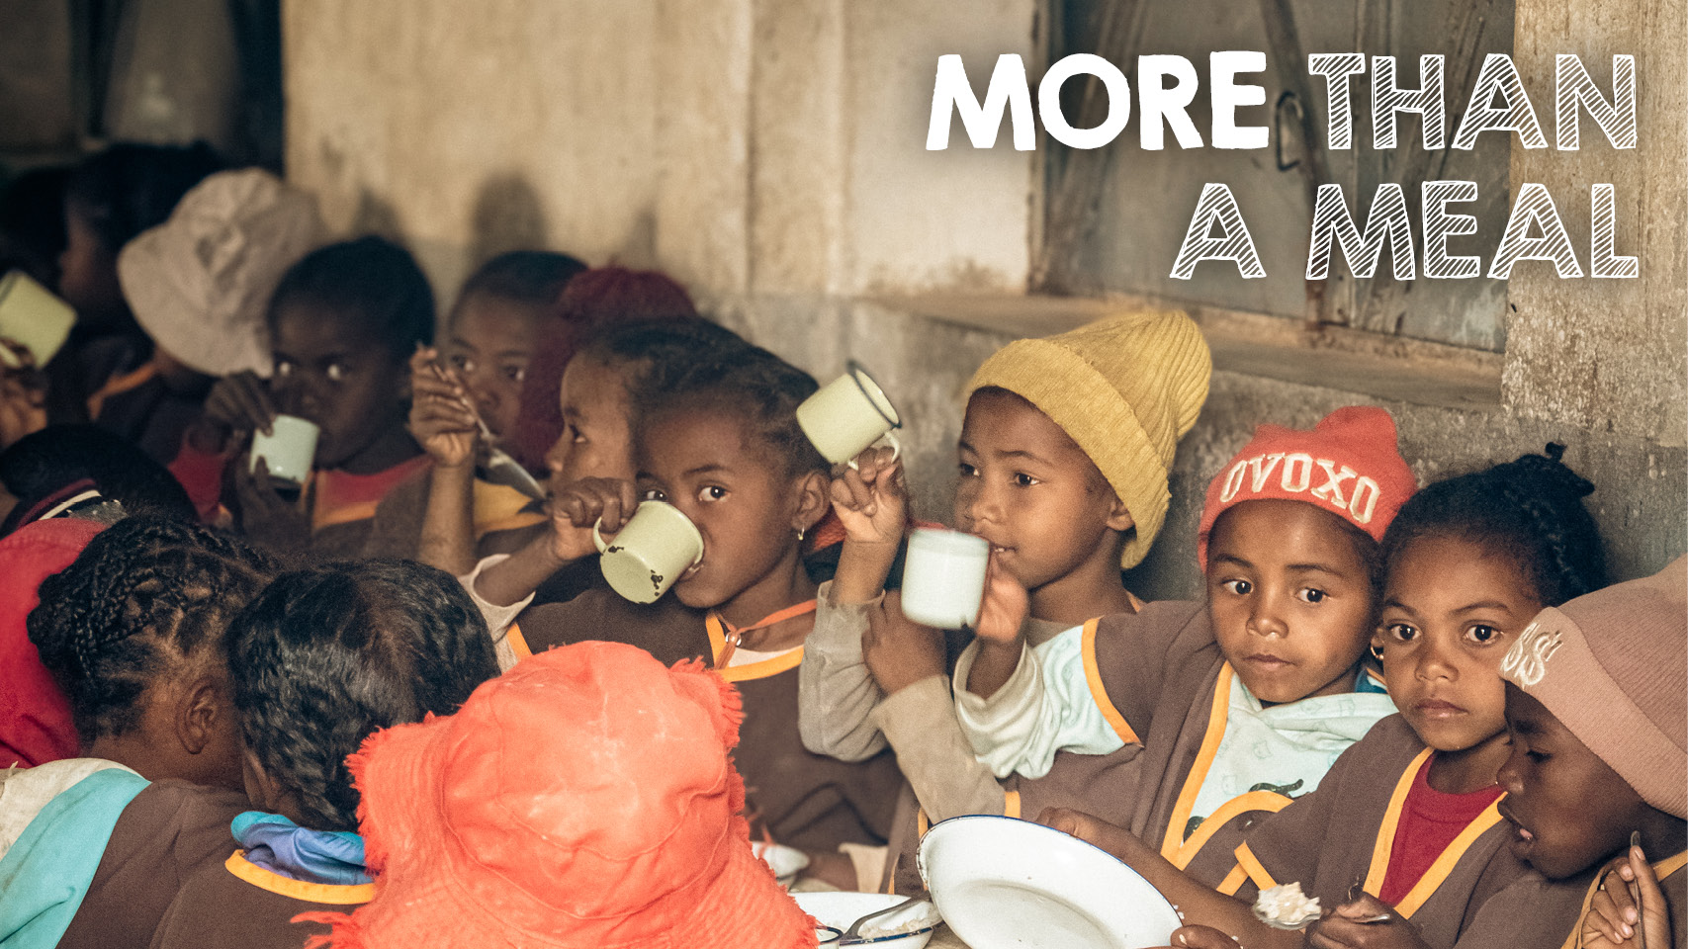
Notes:
The impact of Mary’s Meals stretches far beyond meeting a hungry child’s immediate need for food.
Our school meals give children the chance to gain an education, strengthen communities and bring hope for a better future.
Our school feeding programme in Madagascar is a shining example of how Mary’s Meals is more than a meal.
Mary’s Meals has been working in Madagascar since 2018. We feed more than 88,500 children there every school day, with a typical school meal being rice with pinto beans, lentils, or peanuts, and greens.
Madagascar, situated off the coast of southern Africa, is the fourth largest island in the world and one of the poorest countries in the world. Madagascar’s isolation contributes to its high levels of poverty, with around 76% of people earning below the International Poverty Line ($2.15) a day.
In Madagascar, education is vital to equip the next generation with the knowledge and skills they will need to overcome the challenges the country faces and, as adults, to lift their communities out of poverty.
In schools where Mary’s Meals are served, hunger is reduced, enrolment increases, attendance improves, and children are happier and more focused.
By encouraging children to come to school, Mary’s Meals is bringing hope for a brighter future to communities across Madagascar.
At Mary’s Meals, community is at the heart of everything we do. Teachers, parents and volunteers are the lifeblood that enable our work as the school feeding programme is run by schools, Parent Teacher Associations and volunteer cooks from the local community.
Our school feeding programme brings communities together and can act as a catalyst for other community-led innovations. In Madagascar, inspired and empowered by what they have achieved to deliver school meals for their children, communities have united to improve access to clean water and grow food for schools, while some schools reuse cooking oil bottles to plant vegetables.

Slide 2
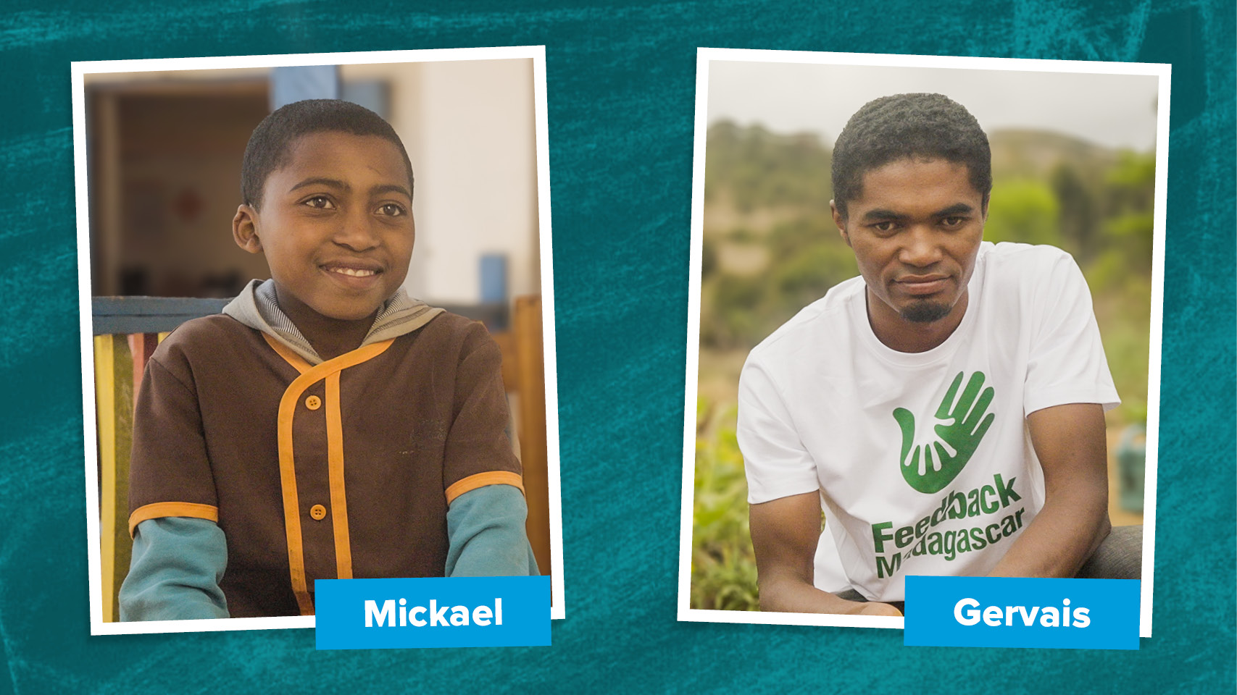
Notes:
Eleven-year-old Mickael walks for one hour every day through the eucalyptus trees to school, motivated by the promise of a hot meal at the canteen.
He says: “What motivates me to come to school is the canteen. I eat enough food and I study. I was in grade 4 when the school feeding first started and it was wonderful because all the pupils were excited and happy.”
Mary’s Meals has made a clear difference for Mikael, and he explains it in simple terms: “What has changed in me since the school feeding [started] is that I am not hungry at school and I can focus during class.”
Our life-changing school meals attract children into the classroom where they can gain an education and work towards a better future.
Gervais facilitates a small agroecology programme at Taratra Primary School, where Mary’s Meals is served, educating the children in their school garden about the importance of sustainability.
He says: “Since they started to work with Mary’s Meals the parents are more engaged, not only on education but with the other activities like planting trees.”
Mary’s Meals is bringing hope for a brighter future to communities across Madagascar, and the world. Help us reach the next child, and community, waiting for Mary’s Meals.

