Slide 1
Insert here a picture of
your school or school badge

Slide 2
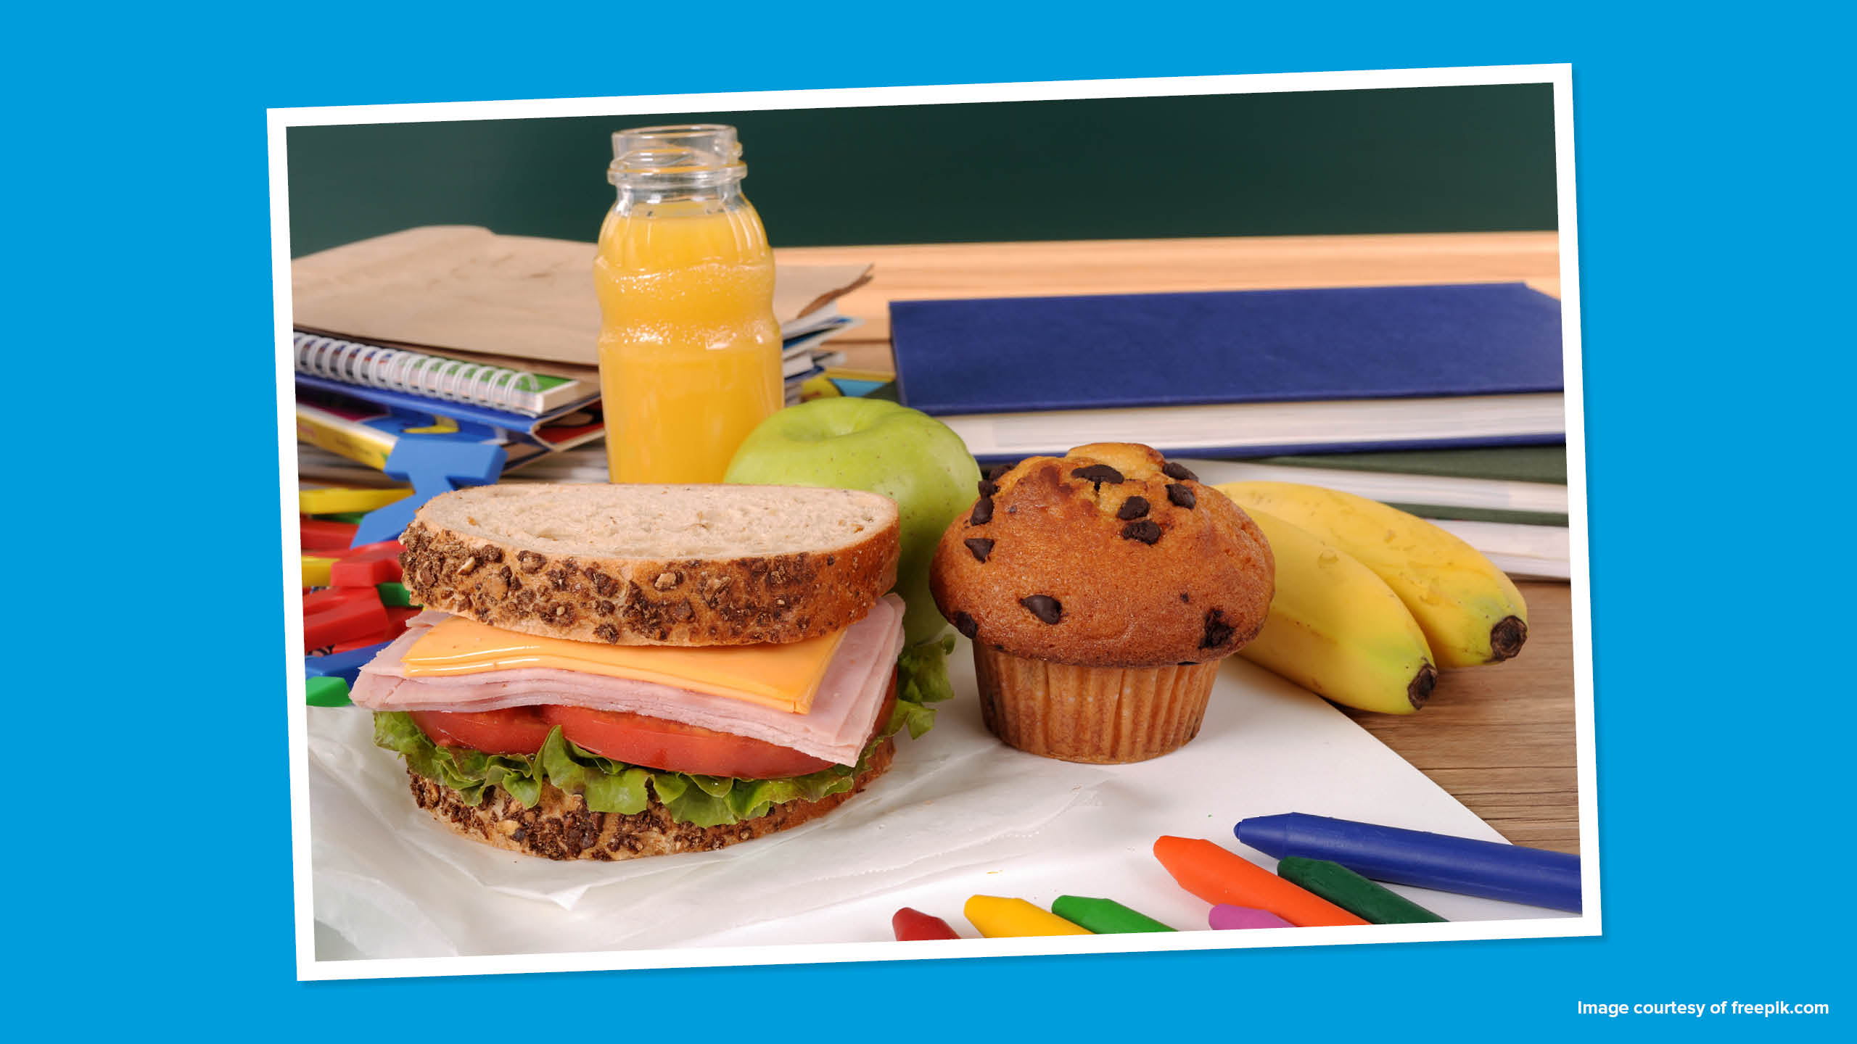

Slide 3
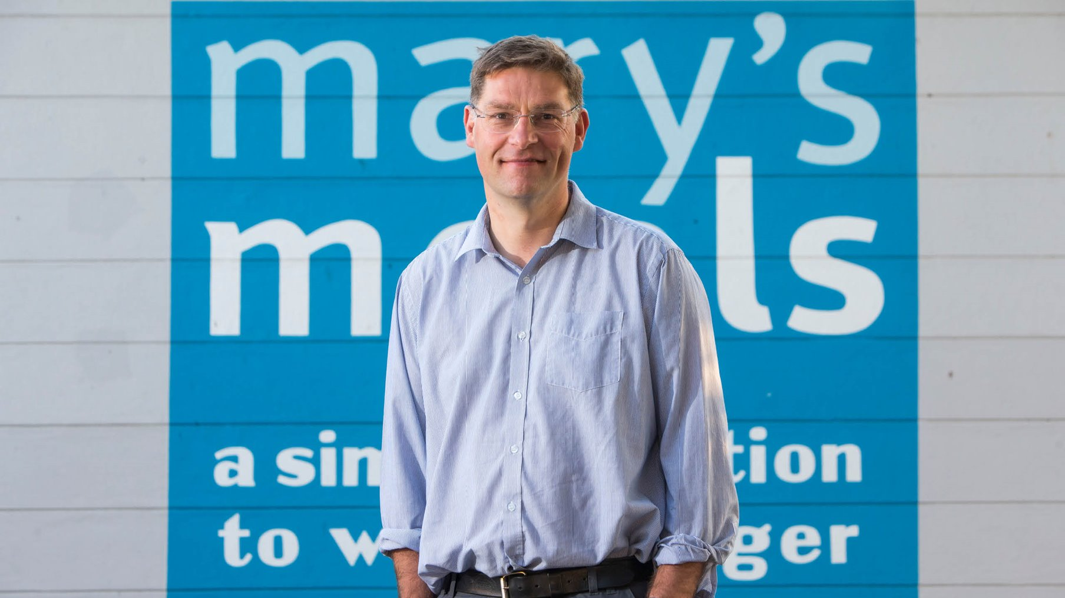

Slide 4
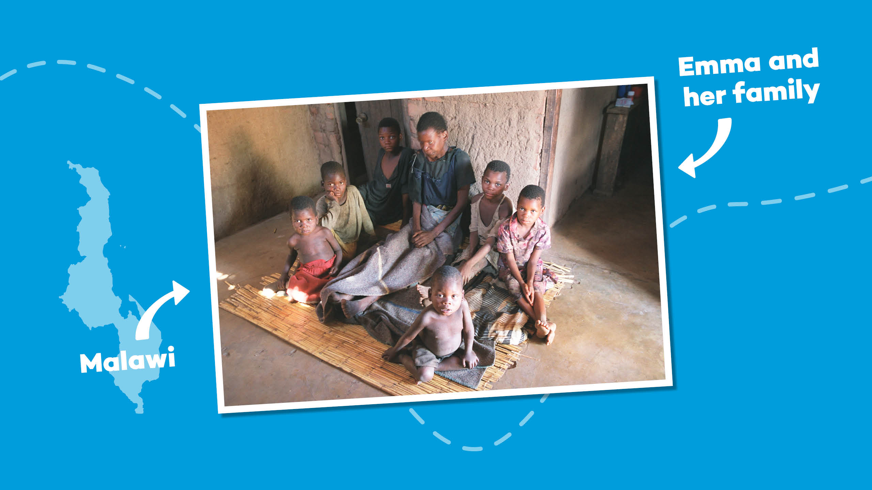
Notes:
In 2002, Magnus was visiting Malawi while the country was in the grip of famine. It was here he met Emma, a mother who was dying and who was surrounded by her six children.
Emma’s husband had died a year previously, killed by AIDS, the same disease that was now about to steal her from her children.
Magnus tried to lift the atmosphere by asking 14-year-old Edward, Emma’s eldest child, what his hopes and ambitions were.

Slide 5
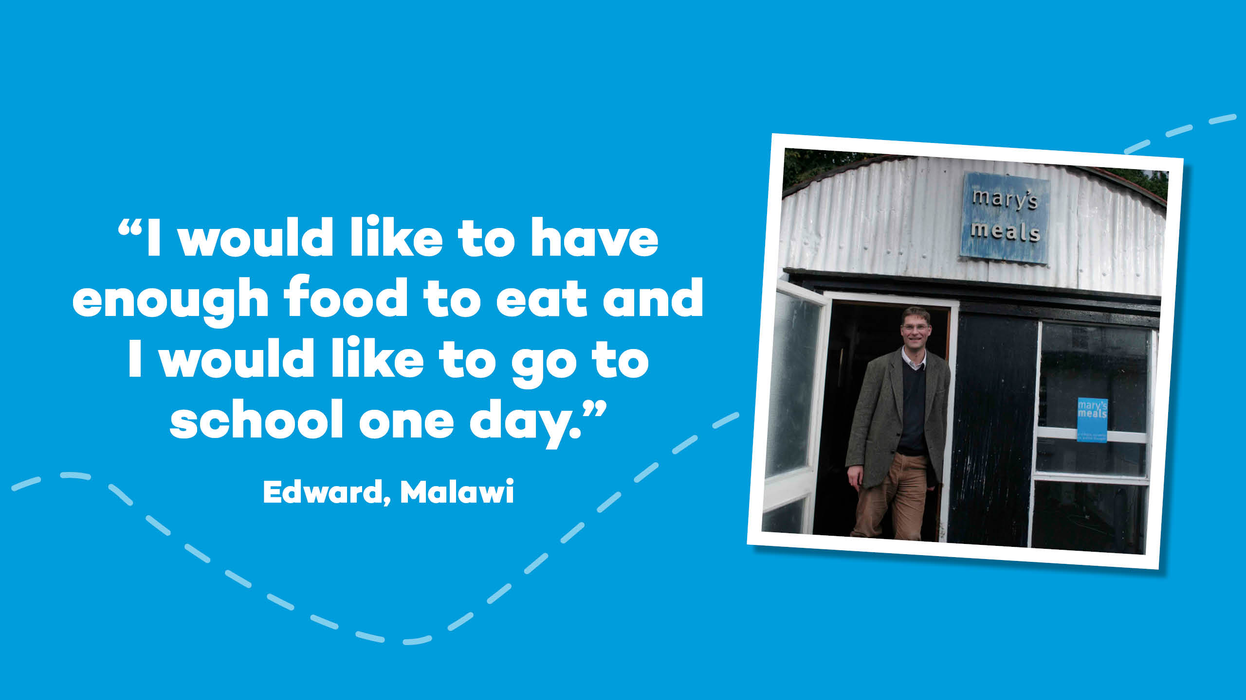
Notes:
Edward replied: “I would like to have enough to eat and I would like to be able to go to school one day.”
This was a call that could not be ignored. It led to the evolution of Scottish International Relief into Mary’s Meals as it is today.
The shed where Magnus and his family stored donations all those years ago still serves as the global headquarters for Mary’s Meals today!

Slide 6
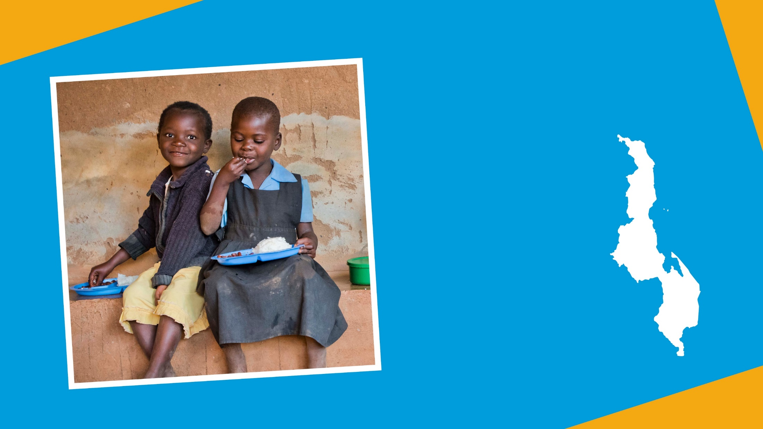

^{In 2002}
we started feeding 200 children in Malawi
Notes:
Mary's Meals started feeding just 200 children in Malawi in 2002.

Slide 7
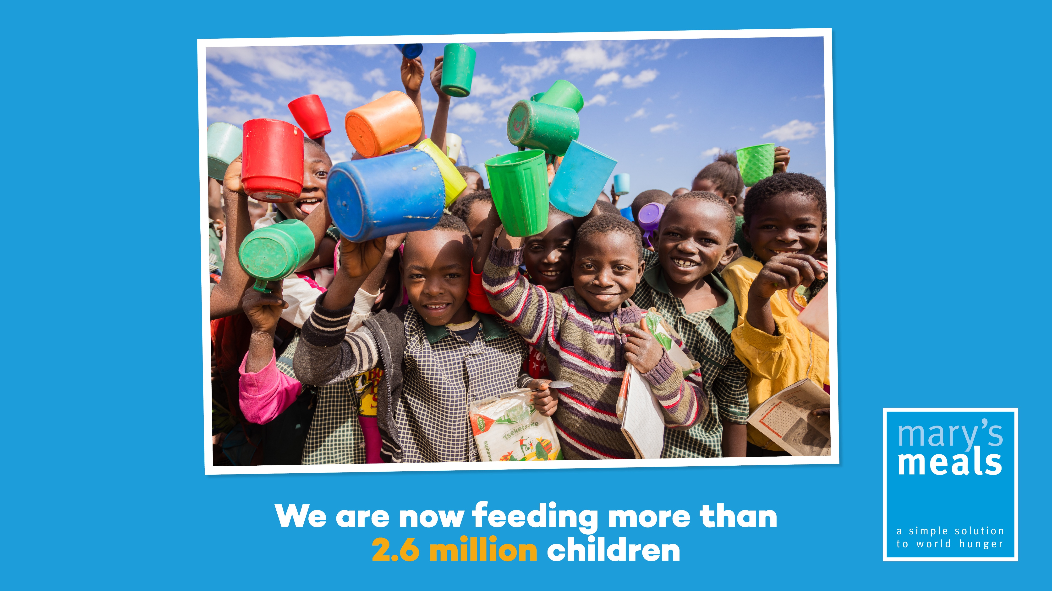

Slide 8
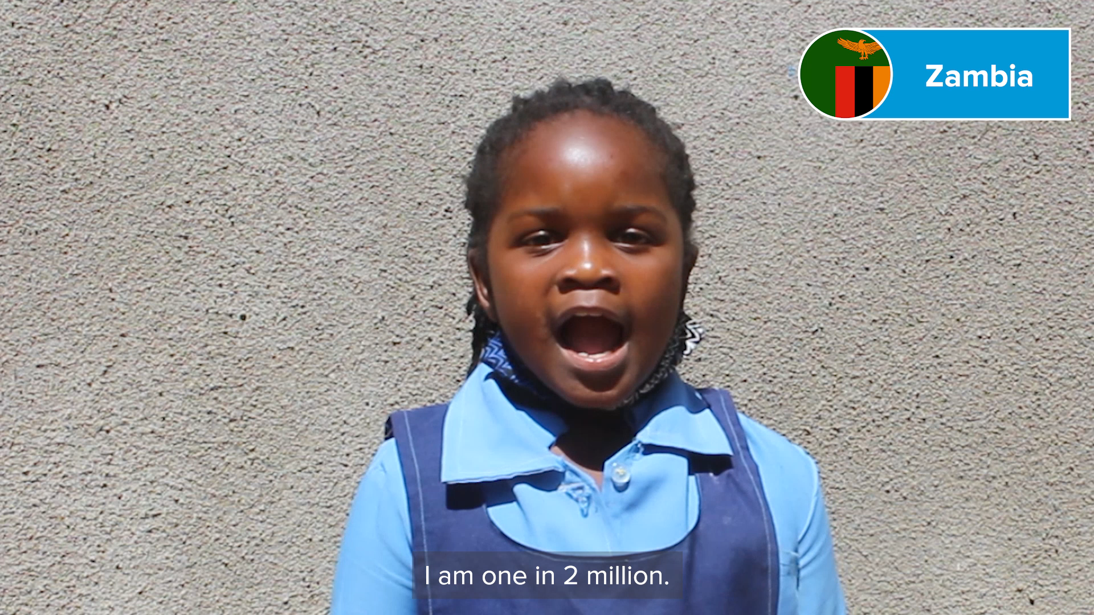

Slide 9
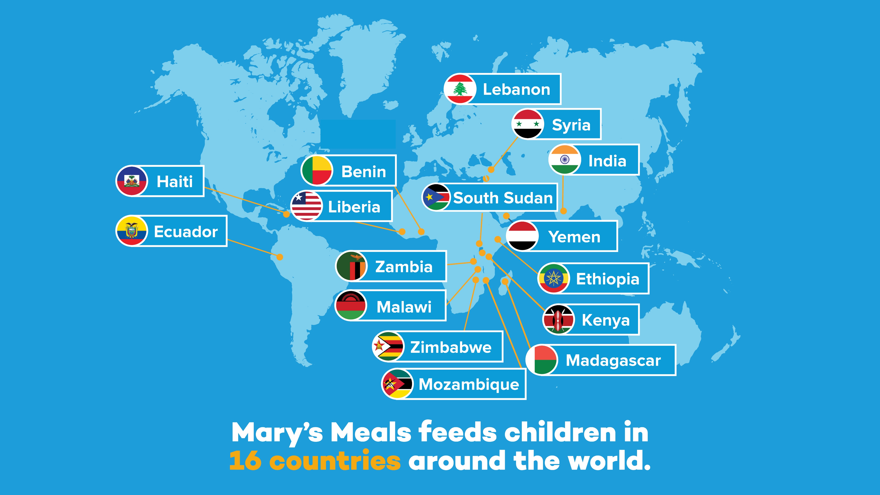

Slide 10
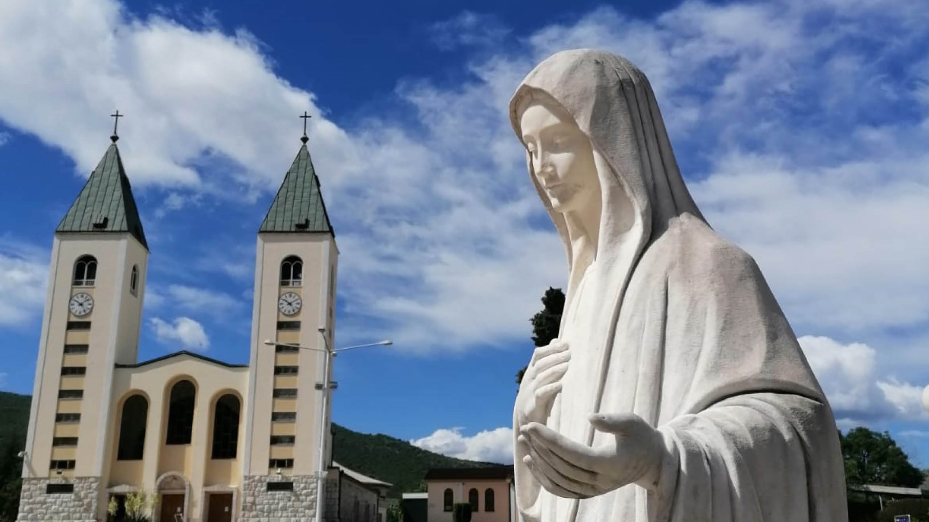

Slide 12


Slide 13
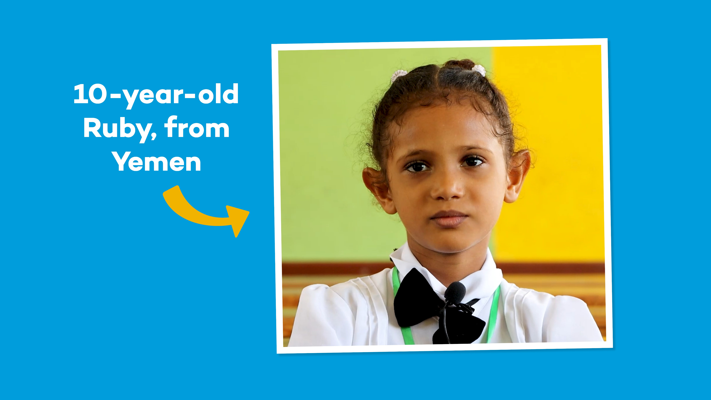

Slide 14
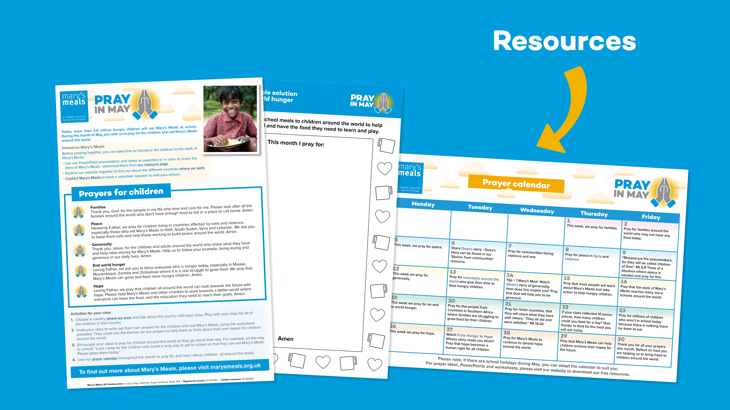

Slide 15


Slide 16


