Slide 1
Insert here a picture of
your school or school badge

Slide 2


Slide 3


Slide 4
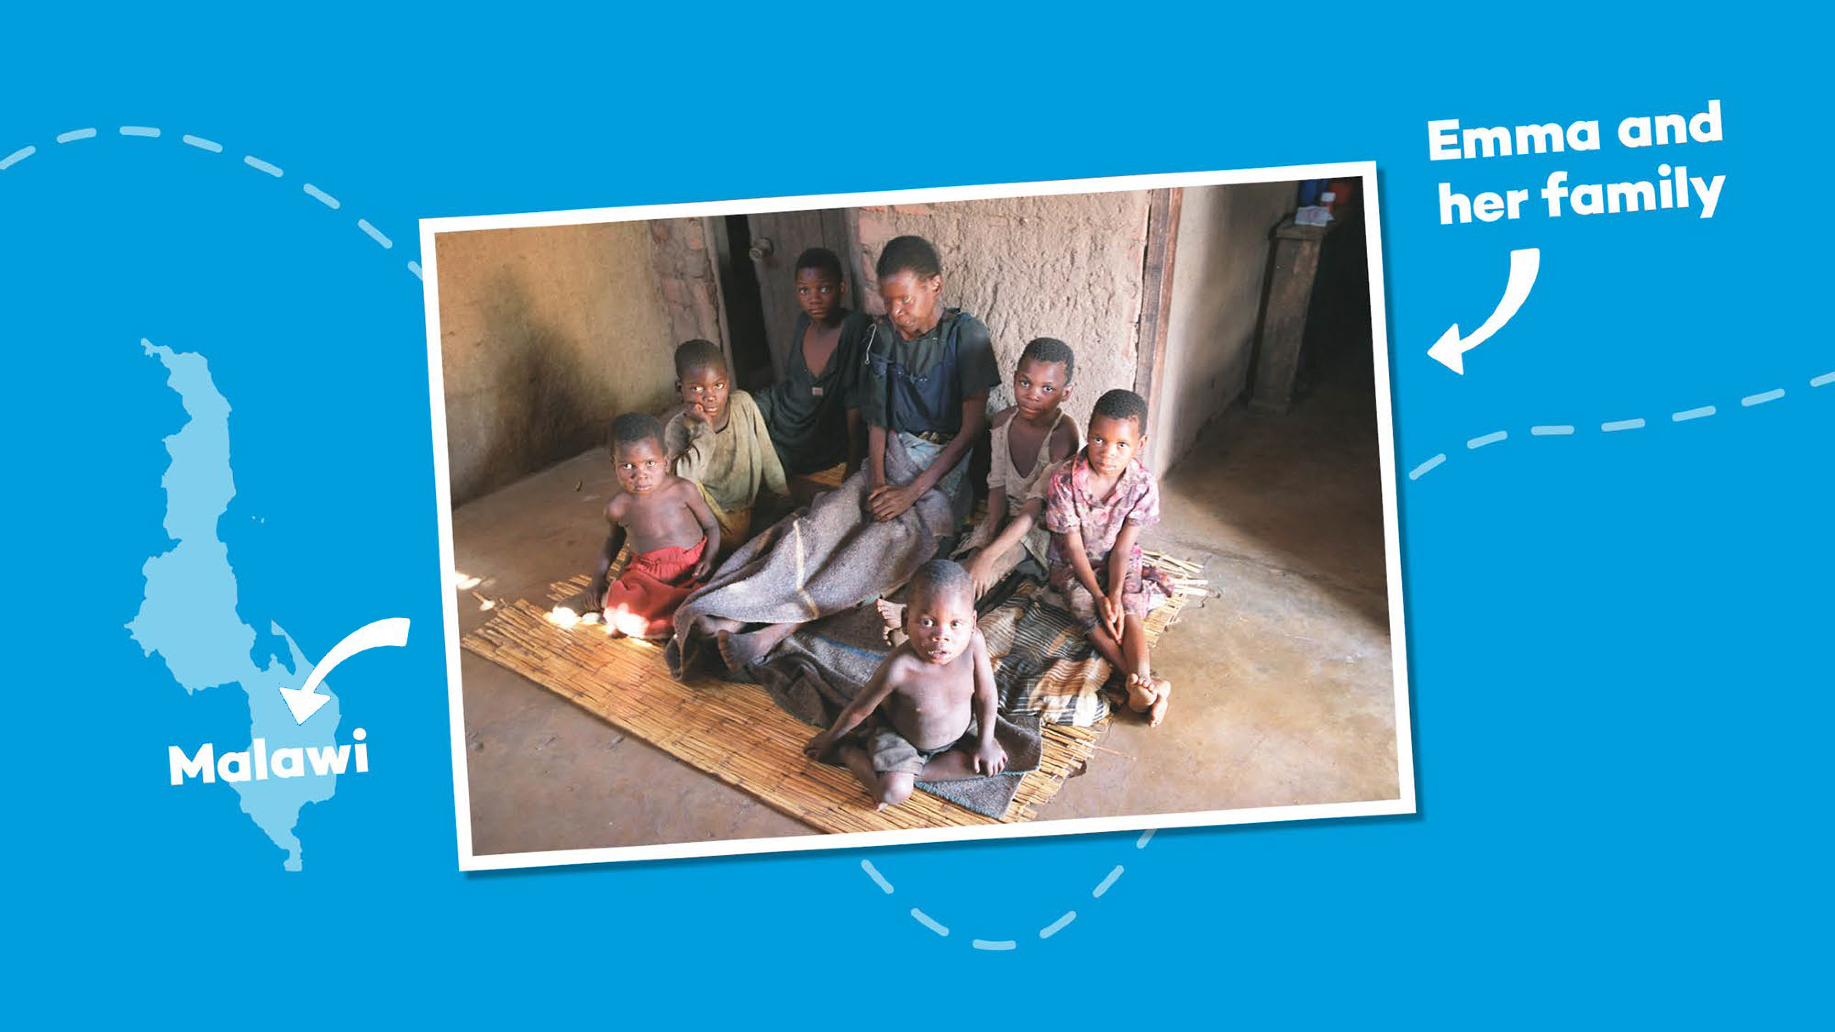
Notes:
In 2002, Magnus was visiting Malawi while the country was in the grip of famine. It was here he met Emma, a mother who was dying and who was surrounded by her six children.
Emma’s husband had died a year previously, killed by AIDS, the same disease that was now about to steal her from her children.
Magnus tried to lift the atmosphere by asking 14-year-old Edward, Emma’s eldest child, what his hopes and ambitions were.

Slide 5
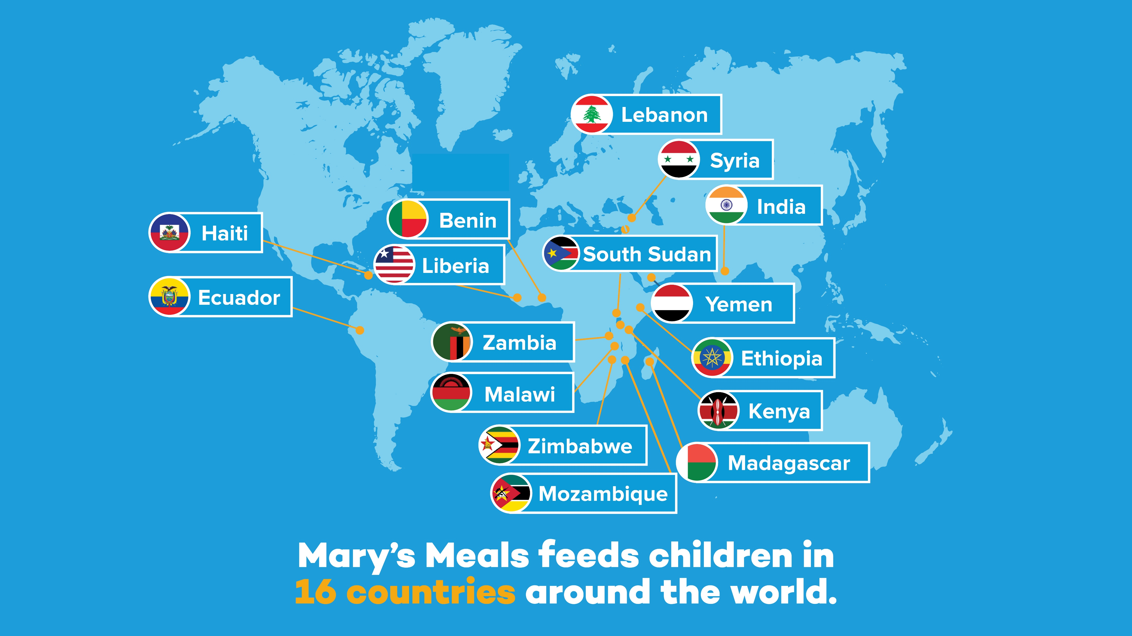

Slide 6
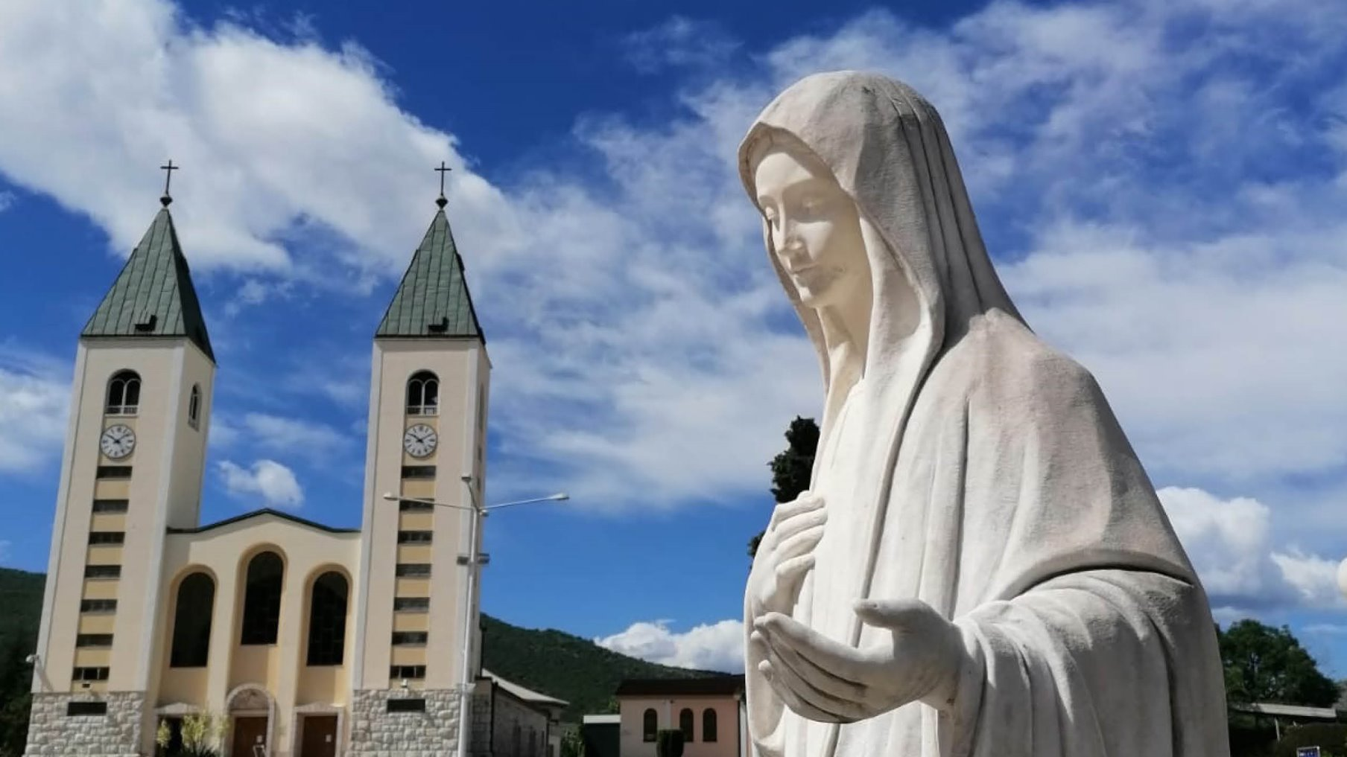

Slide 7


Slide 8
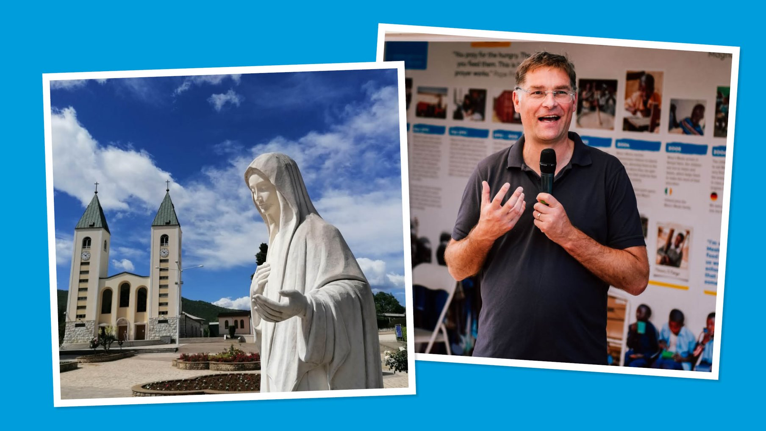

Slide 9
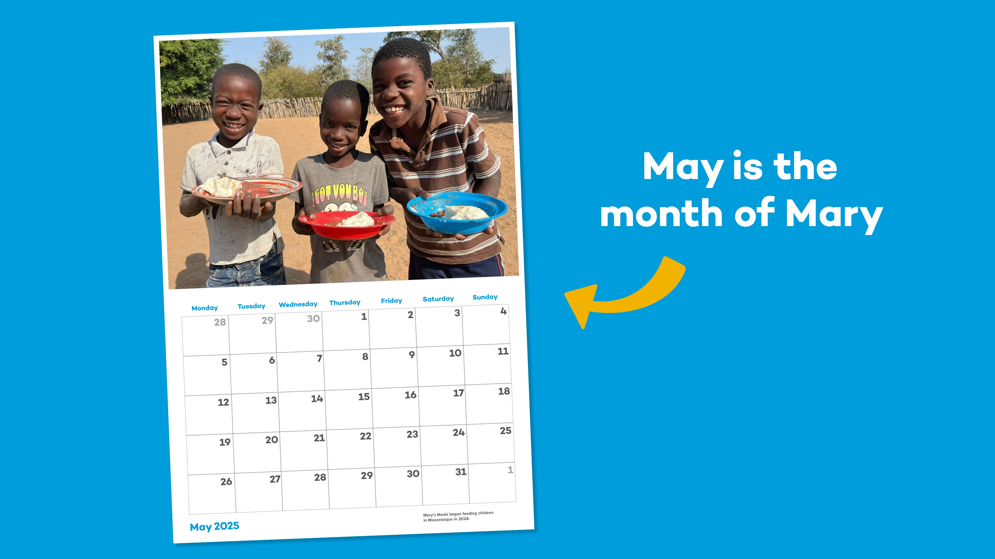

Slide 10


Slide 11


Slide 12


Slide 13

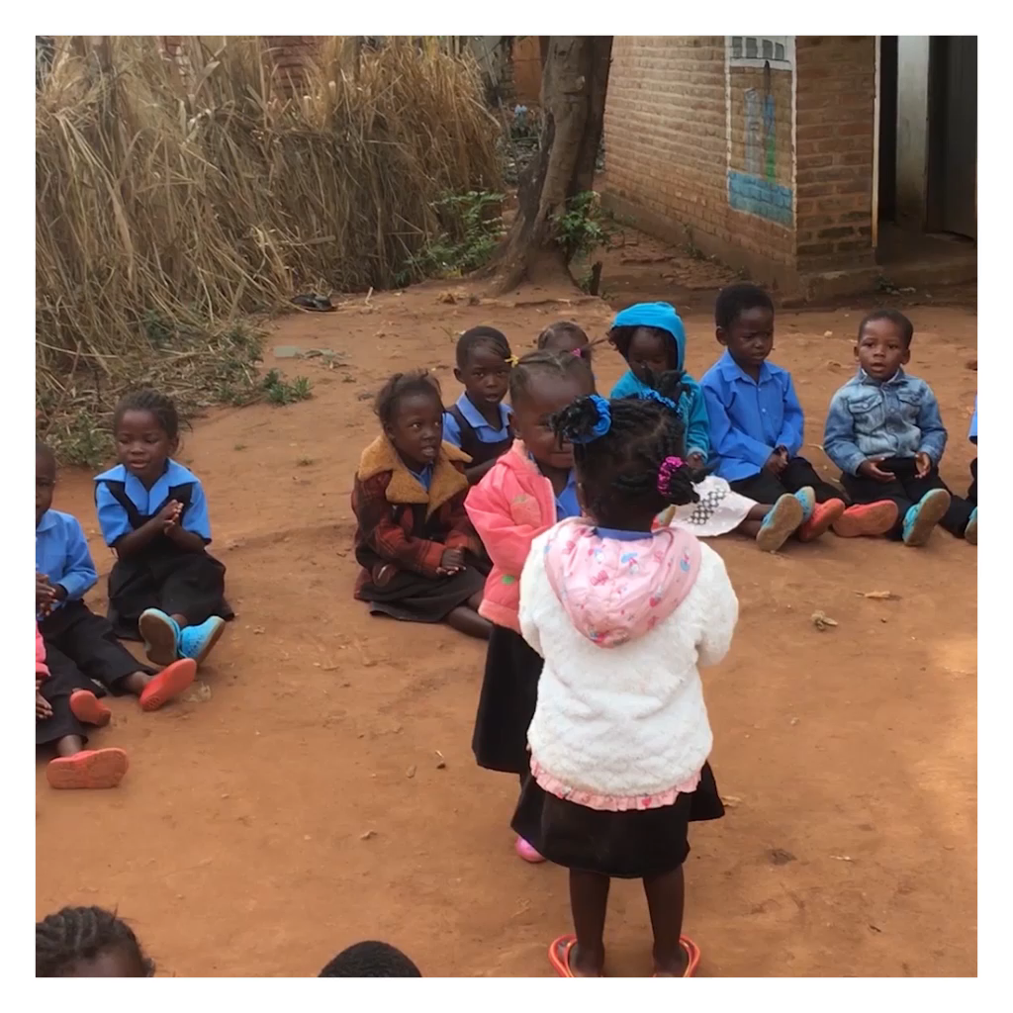
Notes:
Help us to keep bringing hope to hungry children so that they have the energy to concentrate in school…and to keep smiling and dancing like these tiny dancers from a nursery school in Malawi -full of energy after eating Mary’s Meals!

Slide 14


Slide 15


Slide 16


