Slide 1
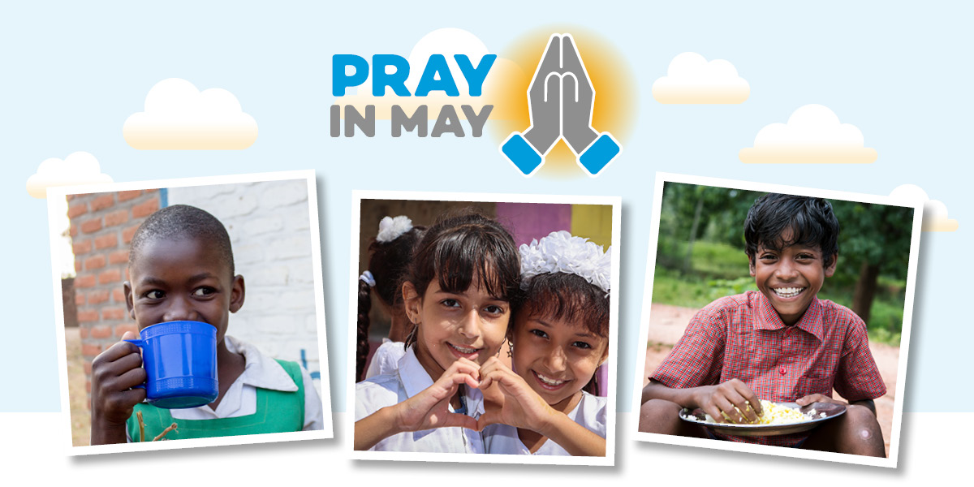
Notes:
Throughout the month of May, we ask churches and people of faith to pray with us to bless Mary’s Meals, as we recognise the special place of prayer in our work. ​
Since our humble beginnings, Mary’s Meals – named after Mary, the mother of Jesus – has been built on a foundation of prayer and the many little acts of love from those who support us.
We invite individuals, churches, schools and faith groups to pray with us that our work continues to flourish and grow, and that more children throughout the world will see their lives transformed by a daily meal in a place of education. ​
We have created a variety of resources to guide you in prayer during May, including prayer guides, prayer calendars, and more, which you can download at marysmeals.org.uk/prayinmay​.
You can also sign up to receive fortnightly prayer emails throughout May. Each email will contain updates on our work, a reflection from a team member and suggested prayer points and themes to help you walk in prayer with the children and communities we support.
To receive fortnightly prayer emails, please fill out the form at marysmeals.org.uk/prayinmay​.
Please note, for anyone who signs up after 1 May, a member of the Mary’s Meals team can send the content to you directly.
During the month of May, you can also support Mary’s Meals by:
Holding a time of prayer and reflection.
Encouraging children and your local schools to pray for our mission.
Joining us in prayer for those in Southern Africa, which is experiencing its worst drought in 100 years. We are currently reaching 1.5 million children in the region with our nutritious school meals, bringing hope and relief to them and their families. But there is more we can do.
While we recognise the important place of prayer in our work, Mary’s Meals consists of, respects and reaches out to people of all faiths and none.

