Slide 1


Recruitment Pack
Director of Strategic Initiatives – Mary's Meals International

Slide 2
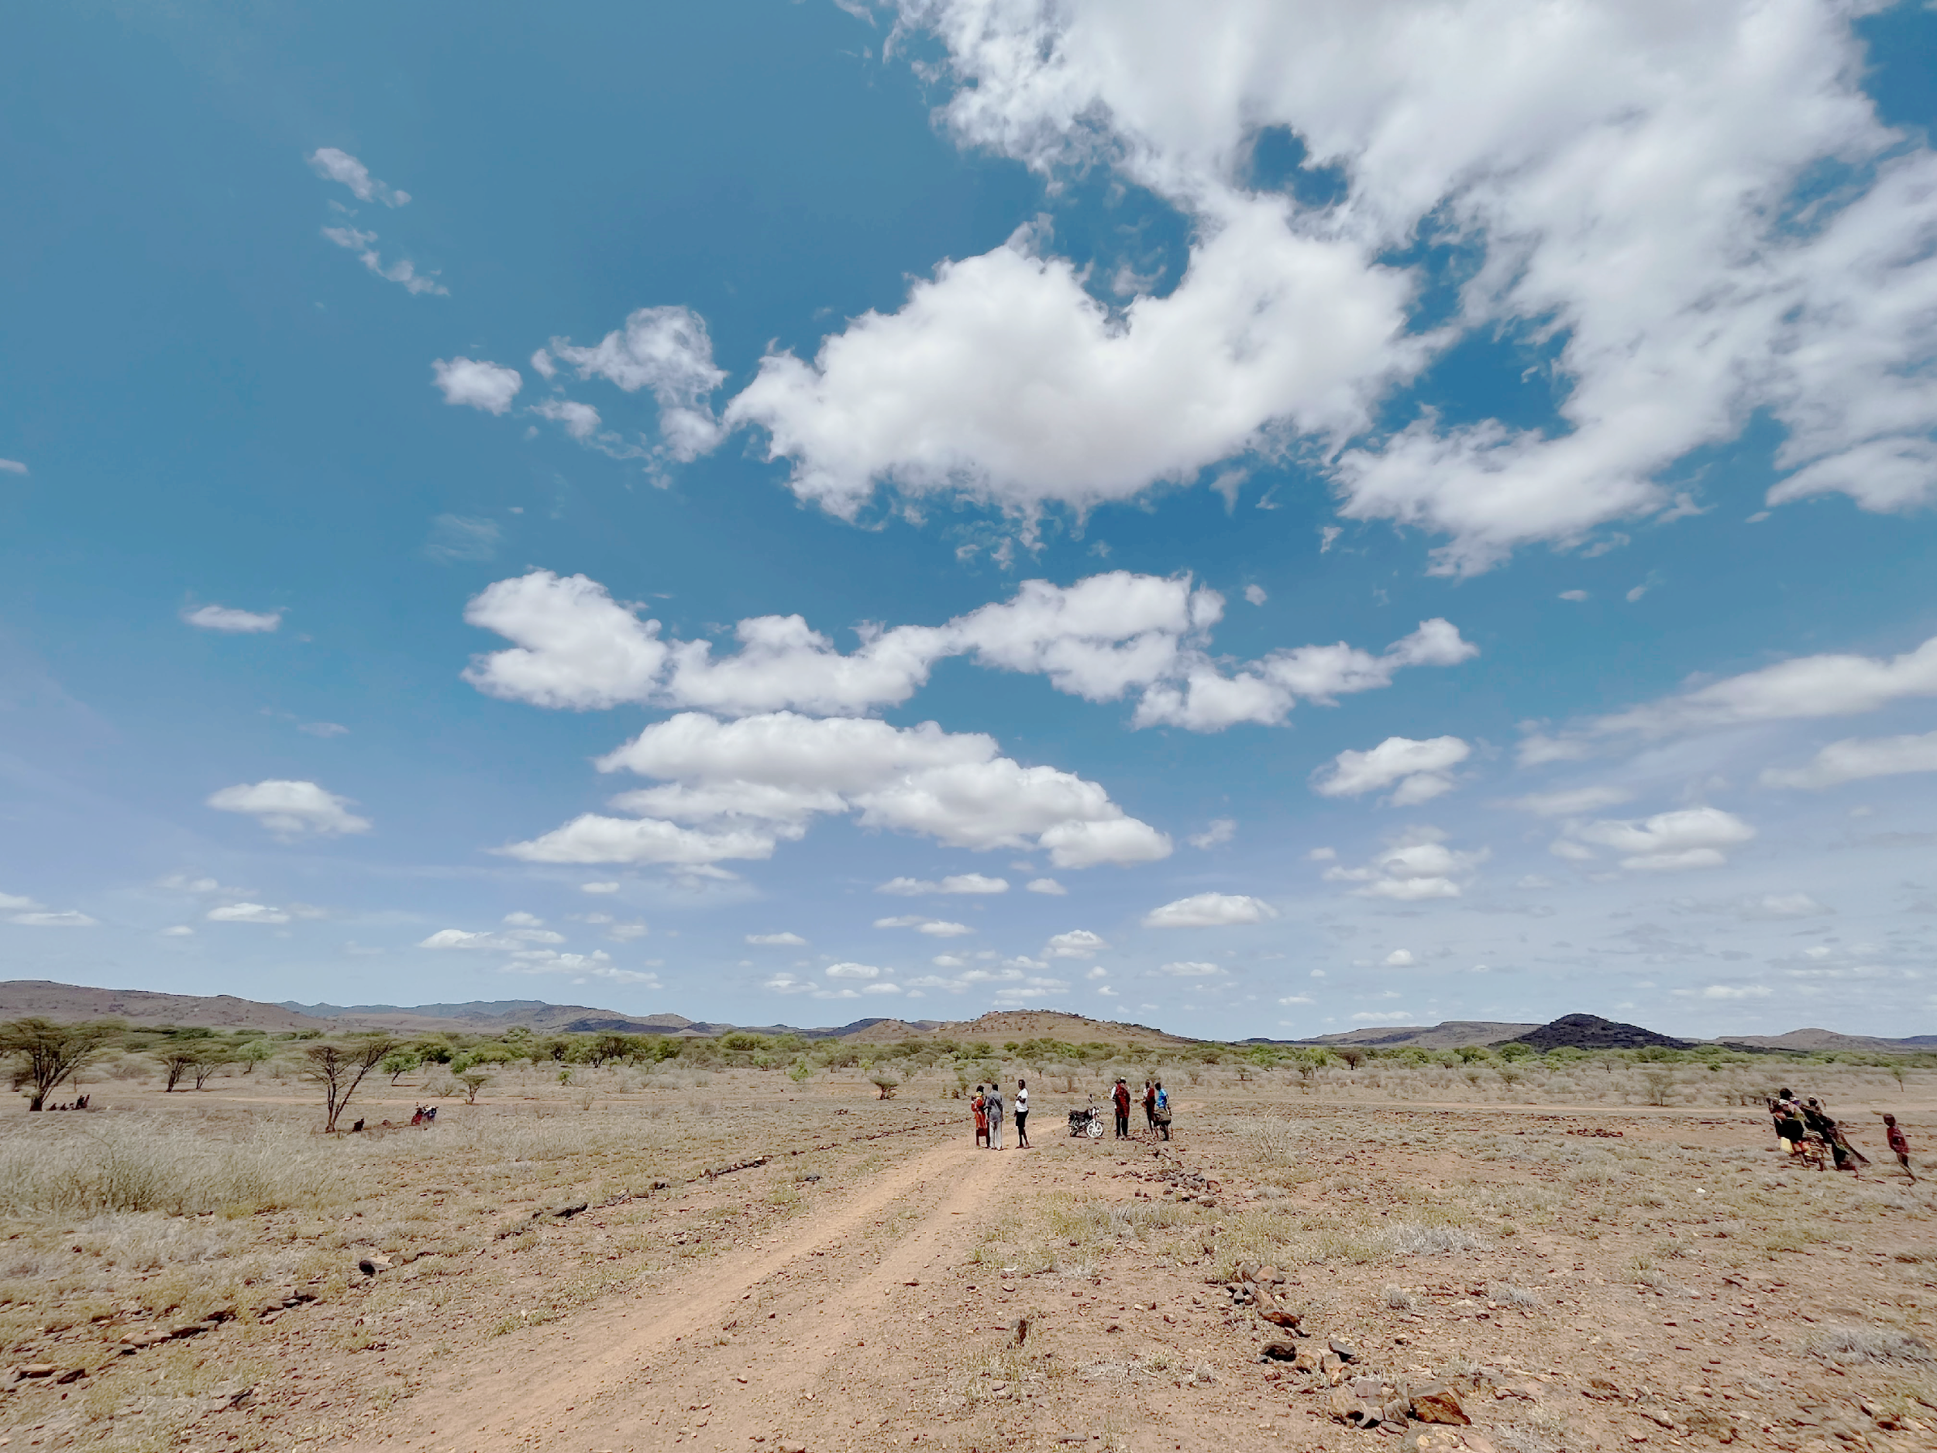
Our Vision
Mary’s Meals’ vision is that every child receives one daily meal in their place of education and that all those who have more than they need,
share with those who lack even the most basic things.
Working together with people who share our ideals, we believe that this vision can be achieved in this world where there is enough food for everyone.
Footer text

Slide 3


Welcome from
our CEO and Founder
Thank you for your interest in working with Mary’s Meals International. I hope you will find this pack informative and useful in supporting your decision to apply to join our team of employees, which exists to serve a global movement of people who are united around a simple mission; the provision of a daily meal in a place of education for the world’s poorest children.
This meal, cooked and served by local volunteers, meets the immediate need of the hungry child and, at the same time, plays a key role in encouraging them into the classroom where they gain an education that can set them free from poverty.
Today we serve over 2.6 million children each school day in 16 of the world’s poorest countries. This global movement of ours is achieving something wonderful, each meal served is the product of lots of ‘little acts of love’ carried out by people across many countries who freely give their time, money, skills or prayers and it is through that, that our movement grows.
Our work is named after Mary, the mother of Jesus, and our values and culture are rooted in and shaped by a Christian spirituality. We feel that the way we do things is as important as the end results. Ours is also a universal mission involving people of all faiths and none across the world. Everyone is invited to join and provide their own unique contribution to this work.
With 67 million children out of school around the world and a further 73 million attending school so hungry they’re not able to concentrate and learn, our work is only just beginning. Will you play a crucial part in shaping the future of Mary’s Meals and with it, the lives of thousands of children across the world?
Good luck with your application.
Magnus MacFarlane-Barrow
MMI CEO & Founder

Slide 4
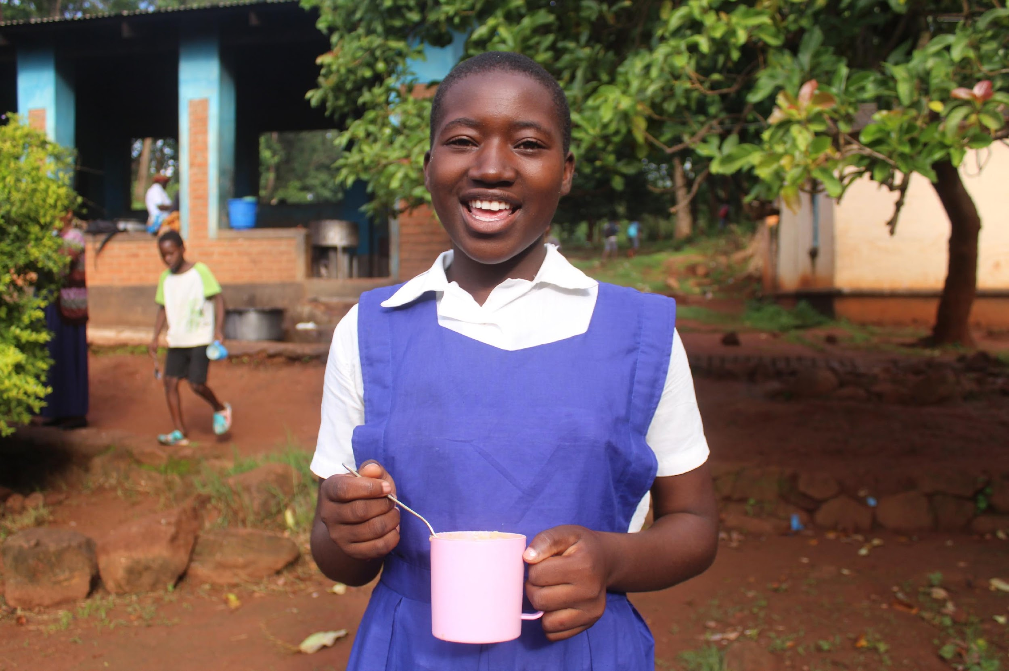
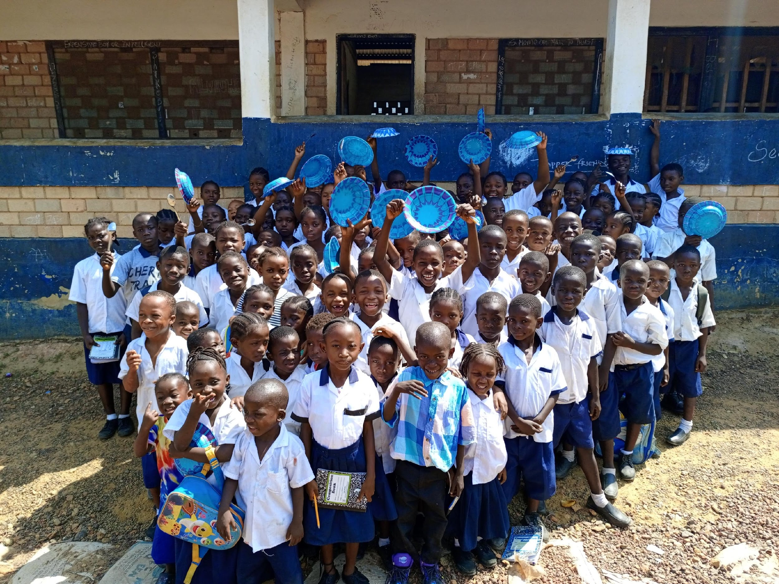
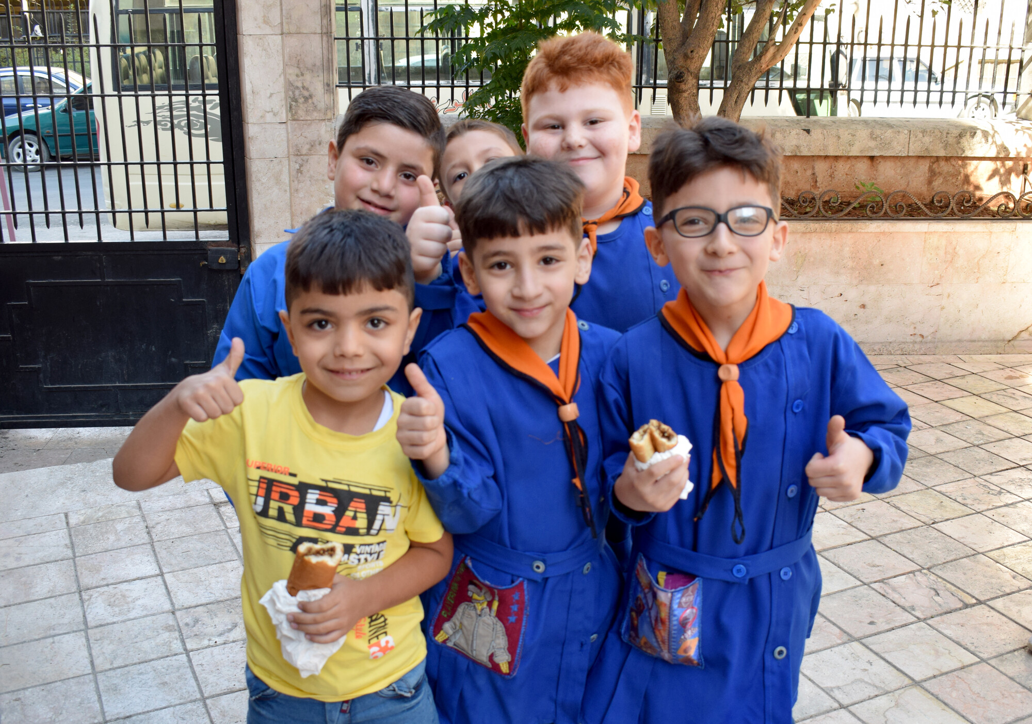
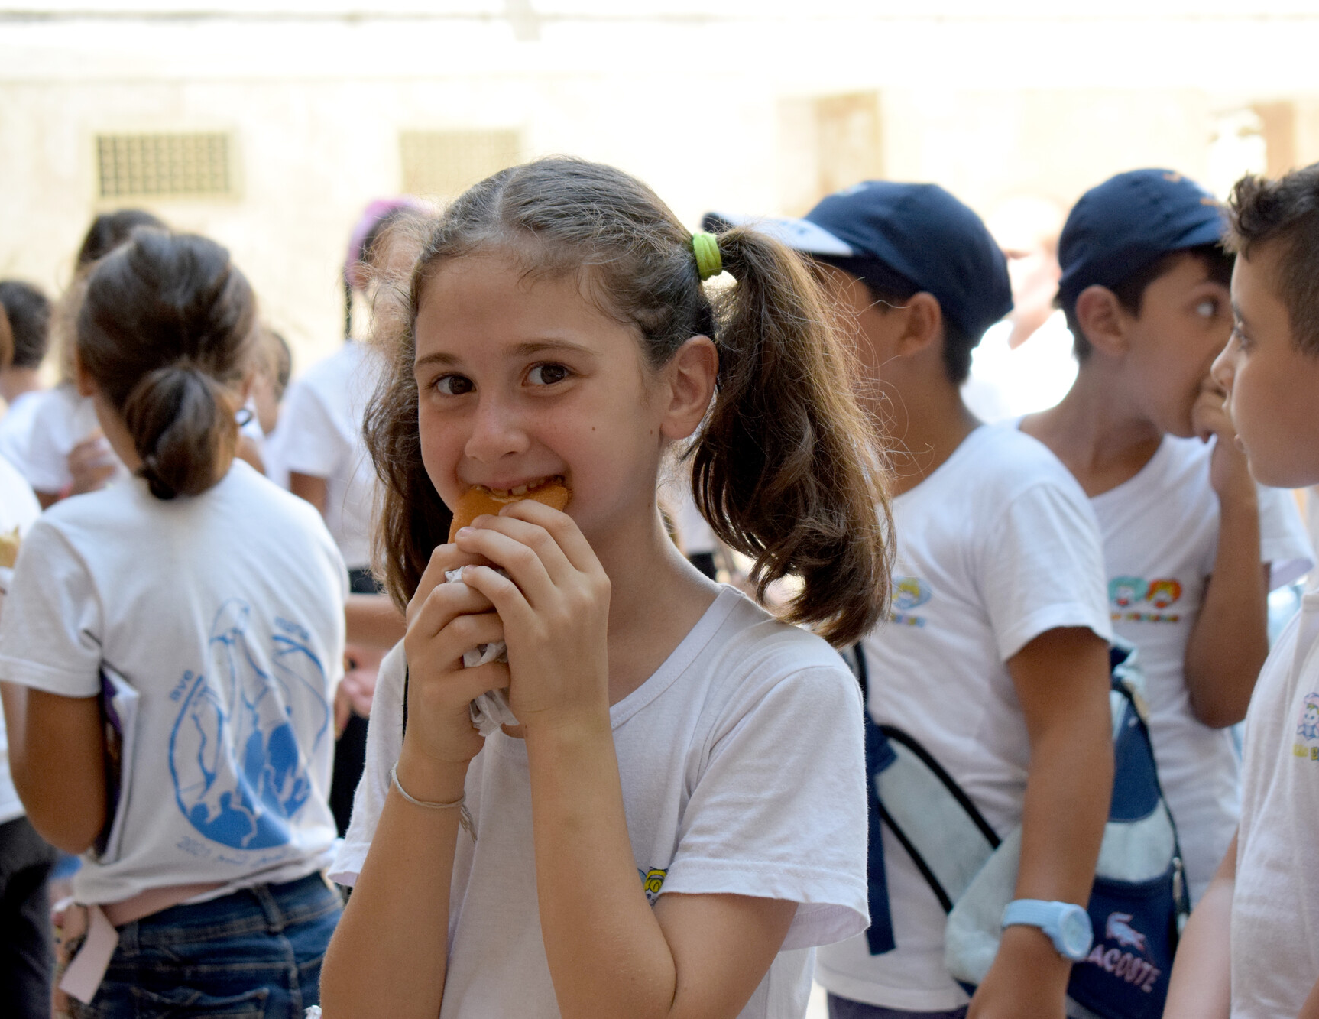
Working at Mary’s Meals
Our mission, vision, and values are at the very heart of everything we do, and this is more than a role, it’s an extraordinary opportunity to play a part in changing the story for children in some of the world’s poorest countries. You will be a true ambassador for our work and will demonstrate commitment to our movement, mission and vision.
We offer the opportunity to support our global movement in a dynamic, flexible and inclusive environment with a real focus on professional and personal development.
We believe in the innate goodness of people, respect the dignity of every human being and family life and believe in good stewardship of the resources entrusted to us. In line with our values, Mary’s Meals is fully committed to a culture of safeguarding.

Slide 5
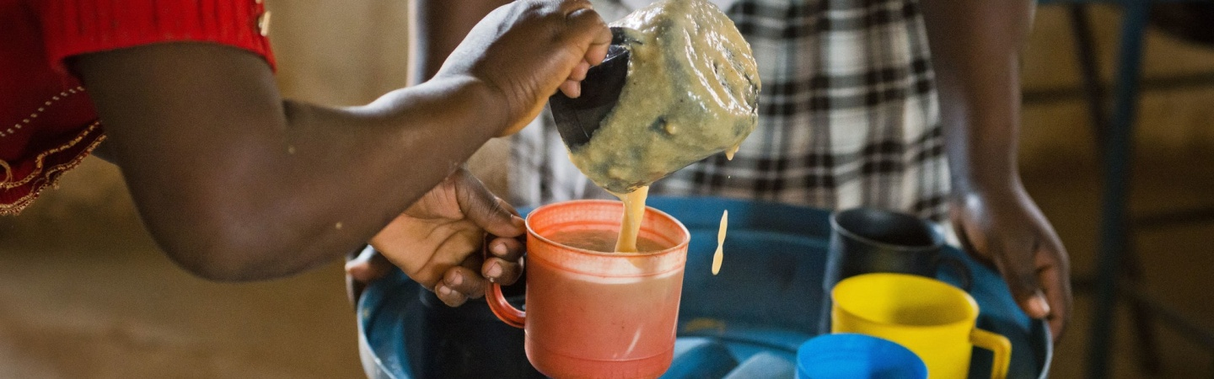
Director of Strategic Initiatives
Directorate: Growth
Reporting to: Chief Growth Officer
Contract type: Permanent
Location: Remote role
Salary: GBP 62,355 + benefits
Our pay philosophy ensures consistency across locations and salaries. The starting salary for this opportunity plus benefits depends on location of the candidate. The salary above is for UK based candidates.
An expectation of a vocational approach has shaped our approach to compensation for senior roles within Mary’s Meals International.
Benefits:
Flexible working hours
34 days’ annual leave (including public holidays) + 1 extra day per year up to 39 days.
Non-contributory pension with employer contributions of 8% if UK based (8% payment in lieu of pension depending on the location of the candidate. Any pension contribution paid as part of salary will be subject to normal statutory deductions/ taxation )
Life assurance
Lifeworks Employee Assistance Programme

Slide 6
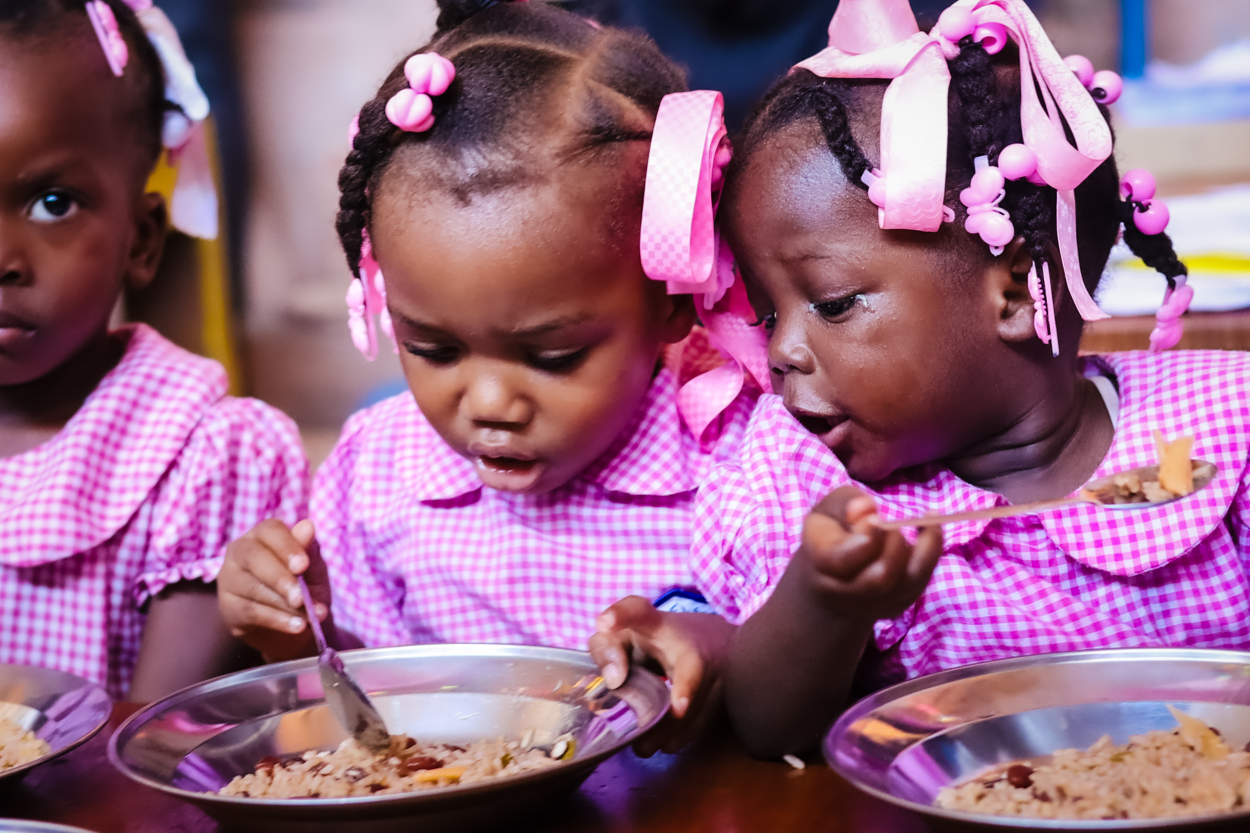
Role Purpose
As Director of Strategic Initiatives, you will develop and drive the delivery of new strategies to grow the strength of our global National Affiliate network. This has the overall aim of increasing revenue and developing sustainable paths for steady income growth over multiple years, enabling our movement to feed more children.
The Director of Strategic Initiatives will be accountable for an annual programme of change, aimed at new and existing audiences. It will include new fundraising products, technology enhancements and governance support to the benefit of the broad global organisation.
You will lead, coach and transform a global team which provides advice and support to the Executive Directors who lead our National Affiliates, as well as the MMI ELT on how we can achieve radical and sustainable growth.

Slide 7
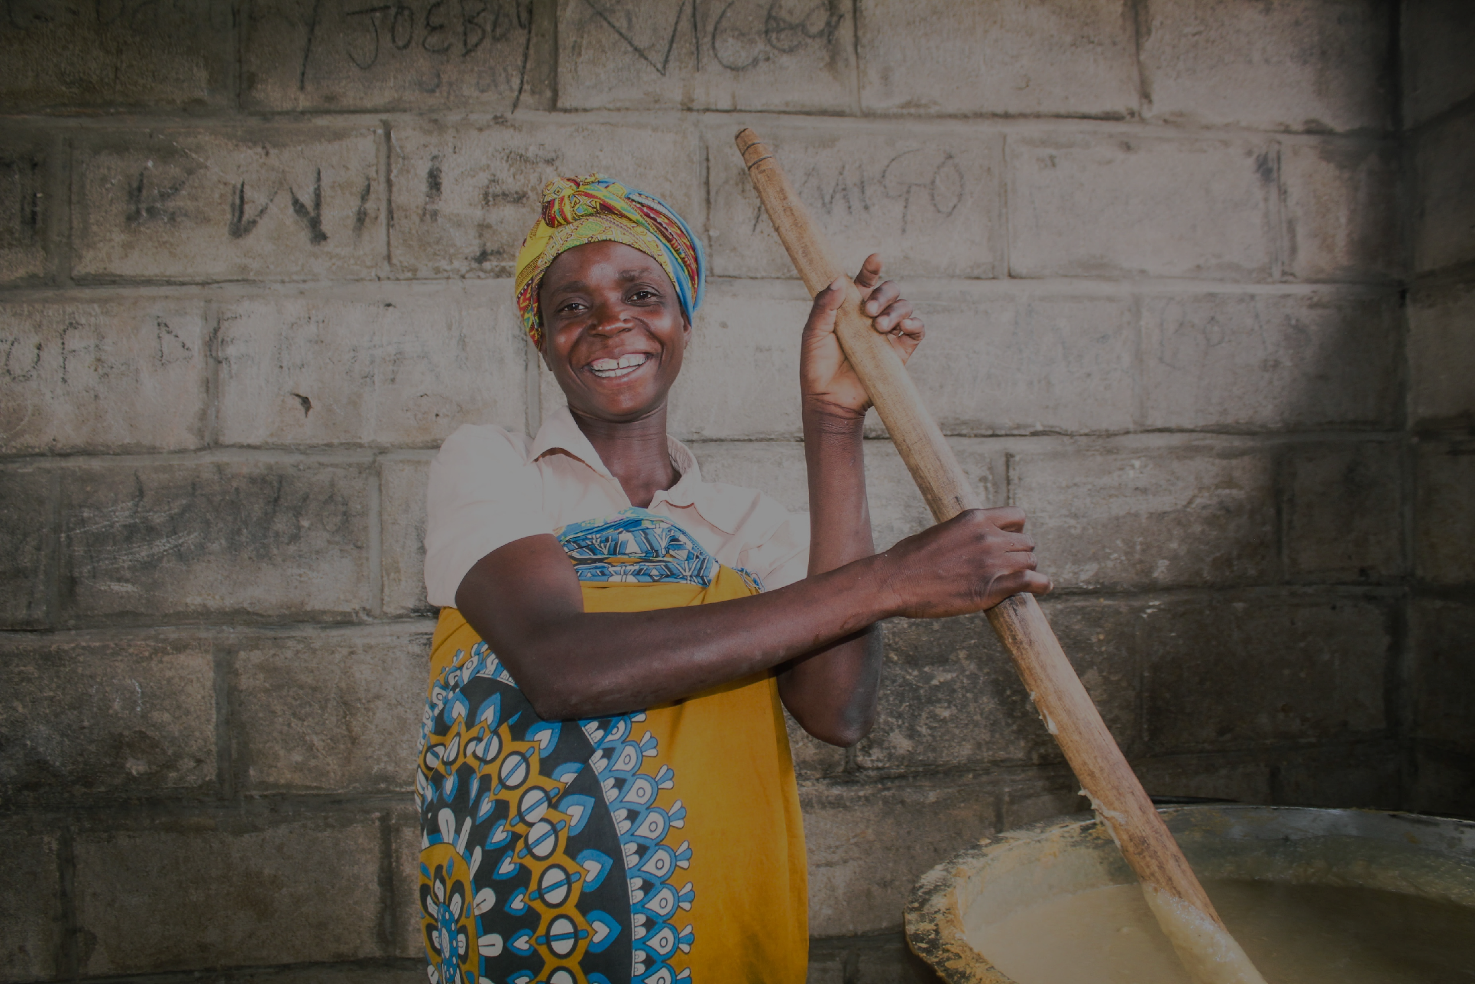
Key Responsibilities
& Activities
National Affiliate Support & Growth
Alongside the Chief Growth Officer, conceive of, consult on, and design and oversee delivery of a programme of Growth strategic initiates
Work with MMI colleagues to identify countries/regions for potential new expansion opportunities, building strategies to capitalise on these.
As part of the Growth Senior Leadership Team, support National Affiliates to prioritise and coordinate their strategic priorities, continually encouraging initiatives to support growth, ensuring they have the right skills, tools, training and insights to do so.
Identify and proactively manage threats to the growth of our National Affiliate network and adjust strategy where necessary to protect and maintain income levels.
Oversee and guide the development and execution of a global Faith based strategy and youth engagement programme.
Strategic Planning & Reporting
As part of the Growth Senior Leadership Team, ensure that growth plans are aligned, role clarity is defined and all sections of the function are collaborating as one entity.
Ensure that plans for strategic initiatives are well structured and include; measurable objectives, fully defined budgets and delivery schedules, and well planned activities that are clearly laid out across the calendar year, including anticipated needs from internal partners across the global network.
Build an annual operating budget that supports the plans for the department, keeping stewardship at the core of each financial decision.
7

Slide 8
Key Responsibilities
& Activities
Leading & Managing
Provide strategic direction and leadership to achieve the organisation's mission and goals.
Oversee the development, implementation and monitoring of efficient and agile operational plans to get results.
Lead, develop, coach and inspire a high-performing team, promoting a culture of engagement and empowerment including identifying and implementing opportunities for delegation and development.
Seek all opportunities for personal growth, reflection and development.
Role-model Mary’s Meals’ values and leadership behaviours, acting with integrity and optimism and in the charity’s best interest at all times.
Work cross-organisationally to improve efficiency, decisively solve problems, innovate and work towards continuous improvement.
Build and maintain effective relationships with internal and external stakeholders acting as an ambassador for Mary’s Meals.
Communicate concisely with clarity.
Regularly represent your function at ELT and Board meetings and at any internal and external fora with authority and credibility
8

Slide 9
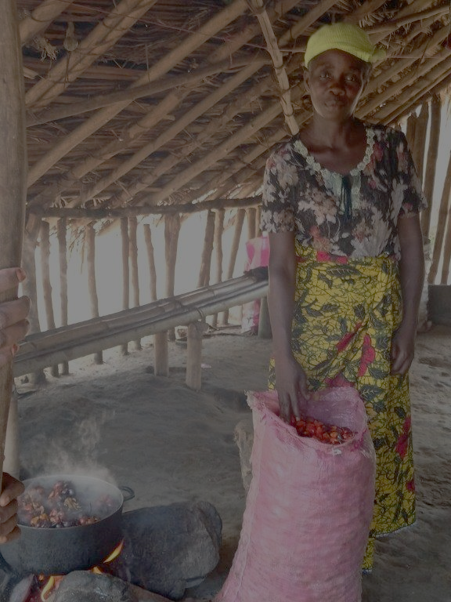
Essential Skills
& Experience
Relevant degree and/or significant experience in Strategy or Programme leadership
Experience working at a senior level, with a strong track record in developing and managing high level relationships.
Excellent change leadership capabilities to drive the cultural change that comes with ambitious strategy development.
A sharp focus on audiences and on what works in fundraising
Experience in leadership within a global organisation that has entities connected to it, such as franchises, charters, or matrixed organisations where there is a blend of autonomy and connection with the central organisation.
Experience in winning support from decision makers at the highest levels, with the ability to forge new relationships and enhance current partnerships.
Experience as a business partner working closely with a Technology team in the delivery of technology-enabled products or campaigns
A strong track record in growing income streams, with experience delivering tangible results and growth through new strategy development and implementation in a global environment.
A proven track record in building capacity and developing and leading high performing teams.
A high level of cultural sensitivity, with demonstrated ability to lead and collaborate effectively with colleagues in ‘remote’ and diverse teams across different cultures.
Exemplary communication, mentoring and coaching skills.
A strong vocational attitude that shows competence, commitment and contribution to the Mary’s Meals global movement and vision.
9

Slide 10
Organisational Chart
Chief Growth Officer
Director of Strategic Initiatives
Product Growth Lead
Audience Growth Lead
Market Growth Lead
Product Growth Manager
Audience Manager - Volunteers
Market Growth Manager
Product Growth Manager (CRM)
Medjugorje Lead
Market Growth Officer
Product Coordinator

Slide 11
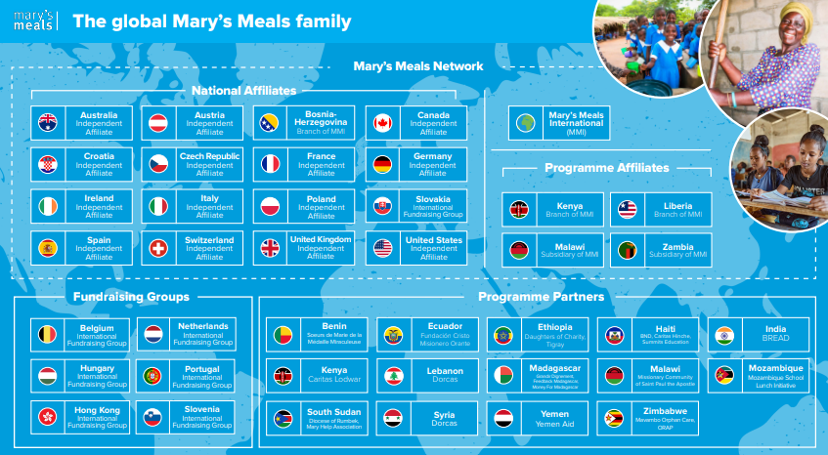
Our Fundraising Network
Mary's Meals fundraise directly through the National Affiliate Network and International Fundraising Groups in 22 countries, as well as internationally through Mary’s Meals International and our information centre in Medjugorje.
Where to find more information on our website
Where we work
Our Impact
Books & Films
Mary's Meals

Slide 12
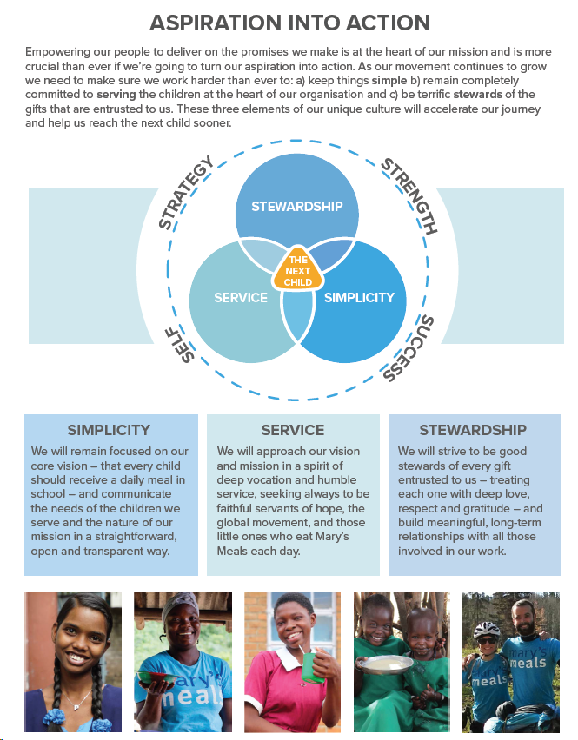
How we work

Slide 13
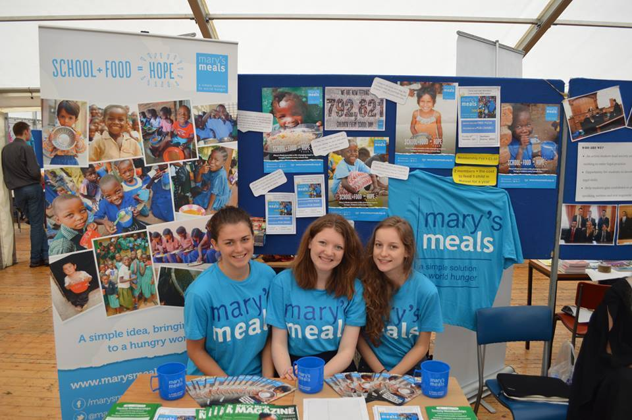
Recruitment process
Our processes are informal and informative. We are keen to get to know more about you, your experience, your motivations and hopefully give you a clear picture of the opportunity and life here at Mary’s Meals International.
Initial MS Teams call with Head of Recruitment
Interview with Chief Growth Officer, Executive Director – MMUSA and Head of Recruitment
Final interview with Chief Growth Officer and CEO & Founder.
How to Apply for this Role
If you are inspired to join our movement and vision, if our mission and values resonate with you, we would love to hear from you. To apply please visit our Work With Us page, Work with us | Mary's Meals
Please include your CV and a succinct covering letter of no more than 1 page, sharing why this role would be a great fit for you and why you want to work for Mary’s Meals International. For any enquiries or questions regarding the role or to discuss any adjustments to our recruitment process please email Leanne Gordon – Head of Recruitment at jobs.mmi@marysmeals.org

Slide 14
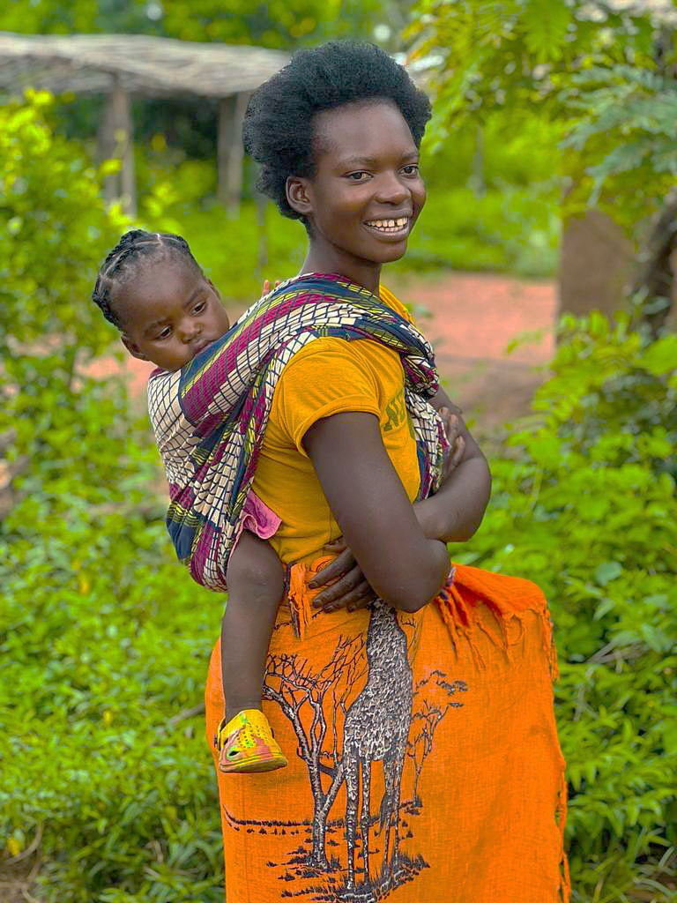

“Together, let’s set out on this journey; one step at a time, one meal at a time, one child at a time.”
– Magnus MacFarlane-Barrow, Mary’s Meals founder
14
Mary’s Meals International Organisation
Craig Lodge, Dalmally, Argyll,, PA33 1AR
Charity number: SC045223 Company number: SCScotland488380

