Slide 1
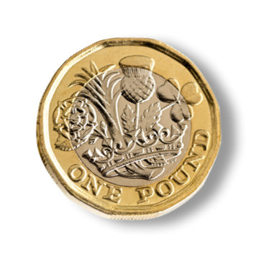

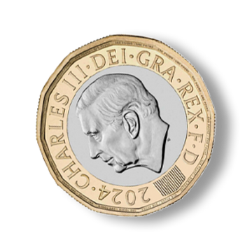
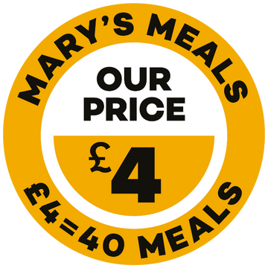

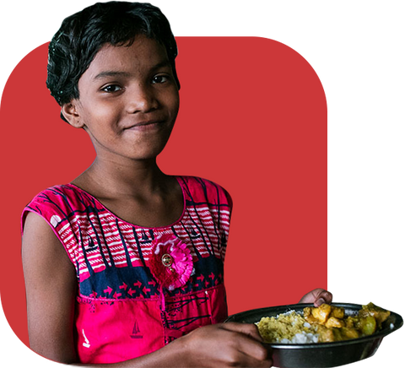


+
=
Food
School
Hope
Find out more at marysmeals.org.uk
Notes:
How often do you grab a supermarket meal deal for lunch? It’s a small habit but did you know, the cost of your lunch could transform lives? With Mary’s Meals Deals, you can turn your everyday spending into something extraordinary.
For the price of a £4 meal deal, you can provide a nutritious school meal to 40 hungry children – encouraging them into the classroom, where education can be their ladder out of poverty.
A regular supermarket meal deal gives you a sandwich, snack and drink. But Mary's Meals Deals offers so much more: school, food and hope for children in some of the world’s poorest communities.

Slide 2



Kelcy and her mum, Brendah
Notes:
By donating as little as £4, you can help fuel 11-year-old Kelcy’s future. Like many young girls her age, Kelcy loves to talk about clothes and fashion, and dreams of having more clothes she can call her own and be proud of.
But life in Mashonaland East Province, Zimbabwe is challenging for Kelcy and her family, and there are some days where they don’t have any food as the area has been terribly affected by drought.
Before Mary’s Meals, Kelcy would walk to and from school – an hour each way – without having eaten, and she would struggle to concentrate at school. Hunger took a toll on both her education and her health.
Now with Mary’s Meals being served at her school, Kelcy’s mum, Brendah, can see a visible improvement in her daughter. She says: “Whenever she comes in from school, you see a bright face.”
Whether you give £4, £10 or £25, you can help serve life-changing meals to even more children like Kelcy.
Or if you set up a regular donation of £4 to Mary’s Meals, you can feed 40 children every month! Regular gifts help us keep our promise to children around the world – and they help us plan for the future too. And this year, thanks to a generous donor, every new regular gift to Mary’s Meals will be matched for the first two payments, up to a value of £250,000 – meaning you can make your kindness go even further!
To find out more about Mary’s Meals Deals and how to donate, or set up a regular gift, please visit: www.marysmeals.org.uk/meal-deal

