Slide 1
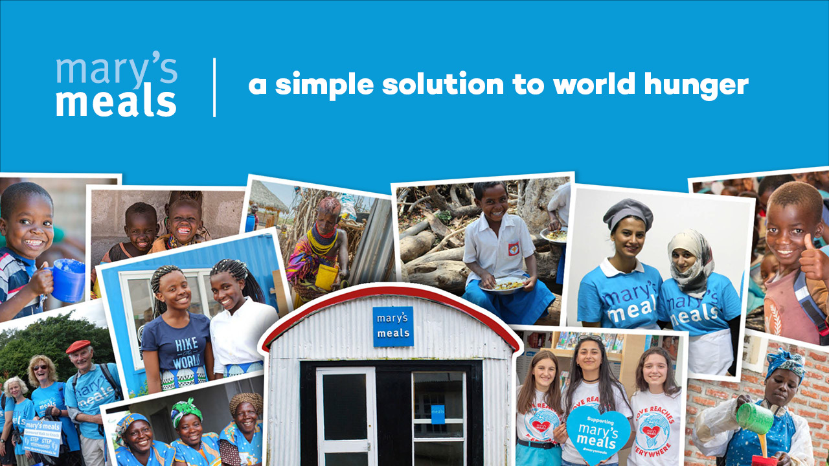
Notes:
Good [morning/afternoon/evening], my name is [NAME] and I am a community volunteer with the charity Mary’s Meals.
I’d like to start by thanking those of you who already support the work of Mary’s Meals. Your kindness and generosity are changing the lives of children around the world.
For those of you who have never heard of Mary’s Meals before, I’m so grateful for this opportunity to tell you about our work today.

Slide 2
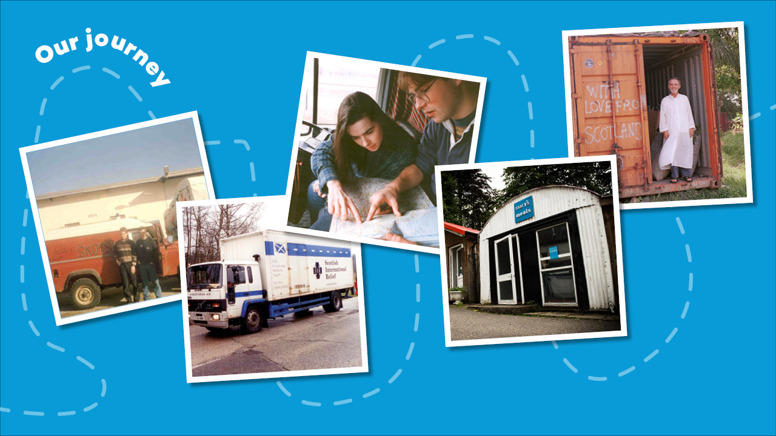
Notes:
I’m going to tell you a story and like many good stories, this one begins in a pub.
Let me take you back to a cold, dark evening in November 1992. Two brothers, Magnus and Fergus MacFarlane-Barrow, were sitting having a pint together in their local village pub in Dalmally. Their conversation turned to what they had seen on the television earlier in the evening.
A news report had shown the suffering of the people of Bosnia who had fled ethnic cleansing and were now housed in refugee camps. The brothers had previously visited Bosnia on a family holiday and felt compelled to help the people there, so they decided to appeal for aid, blankets and food from around their local community.
They hurriedly organised a week off work (they were both fish farmers at the time) and sourced a second-hand Land Rover. Barely three weeks after that conversation in the pub, the brothers found themselves driving to Bosnia as part of an aid convoy.
Magnus and Fergus safely delivered the aid and returned home to their day jobs. To their surprise, donations had continued to pour in, and their dad’s old shed was now full of provisions.
Magnus took a ‘gap year’ to deliver the aid, and it’s probably the longest gap year in history – as he never returned to his previous job!
The donations didn’t stop – they still haven’t. And so, in 1992 the work was registered as a charity named Scottish International Relief.

Slide 3
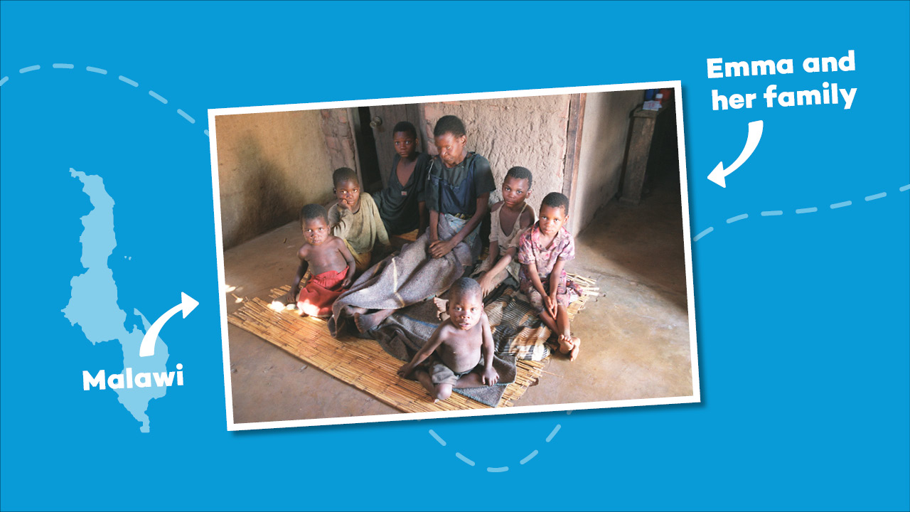
Notes:
The work of Scottish International Relief took a new turn in 2002. Magnus was visiting Malawi and the country was in the grip of famine. It was here he met Emma, a mother who was dying and who was surrounded by her six children.
Emma was lying on a straw mat. She was wrapped in an old blanket and was wringing her hands continuously as she spoke.
She whispered to Magnus: “There is nothing left now except to pray that someone looks after my children when I’m gone.”
Emma’s husband had died a year previously, killed by AIDS, the same disease that was now about to steal her from her children.
Magnus tried to lift the atmosphere by asking 14-year-old Edward, Emma’s eldest child, what his hopes and ambitions were. Magnus did not expect that the response would change his life and the lives of more than three million others.

Slide 4
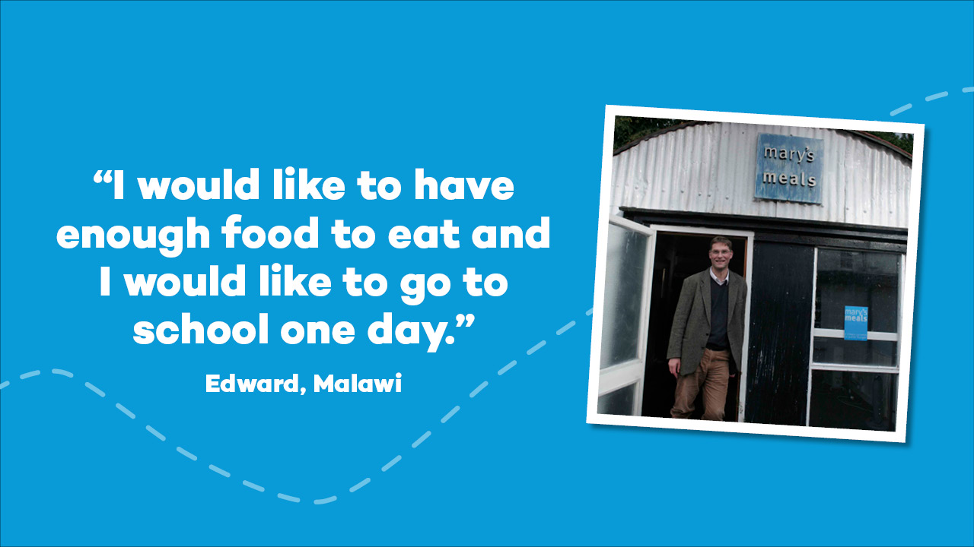
Notes:
Edward replied: “I would like to have enough to eat and I would like to be able to go to school one day.”
This was a call that could not be ignored. It led to the evolution of Scottish International Relief into Mary’s Meals as it is today.
The shed where Magnus and his family stored donations all those years ago still serves as the global headquarters for Mary’s Meals today!

Slide 5
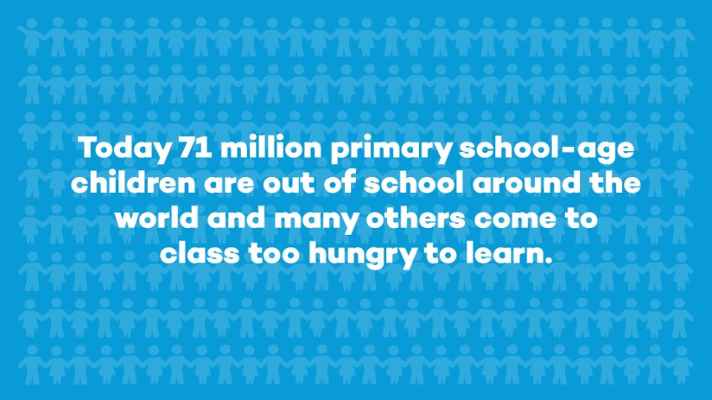
Notes:
Hunger remains the number one health risk in the world today. Tragically, hunger kills more people each year than AIDS, malaria and TB combined.
200 million children’s lives are at risk because they are malnourished, and more than 71 million primary school-age children are out of school around the world.
Instead of sitting in classrooms, children are working in fields, begging on street corners or scavenging among rubbish to find enough food just to survive. Today, too many children will wake up and go to bed hungry, and I don’t think that’s right. That’s why I’m here this [morning/afternoon/evening].

Slide 6
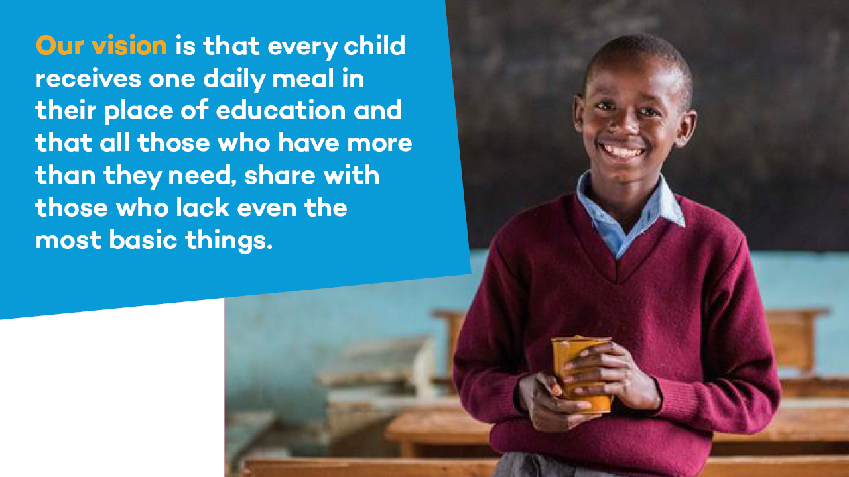
Notes:
Our vision at Mary’s Meals is that every child receives one daily meal in their place of education, and that all those who have more than they need, share with those that lack even the most basic of things.
Working together with those who share our vision, we believe there is no good reason why this cannot be realised.
At the heart of Mary’s Meals lies a simple idea which can transform the lives of millions of people around the world.
Providing a child with one daily meal in a place of education not only feeds the child’s body, it helps feed their mind too and provides families with a greater incentive to enrol their children in school.
We believe that education is essential to breaking the cycle of poverty. Children receiving Mary’s Meals today can grow up well-nourished and well-educated, to become the men and women who will lift their communities out of poverty and end their reliance on aid.

Slide 7
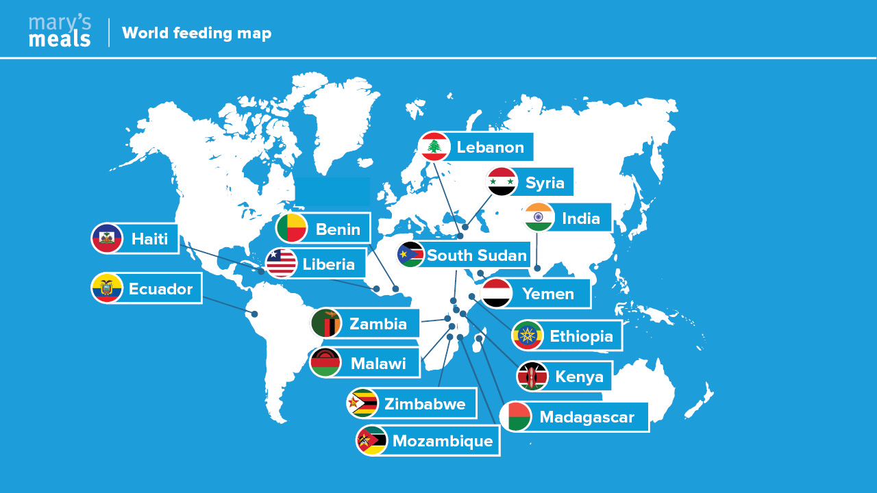
Notes:
Mary’s Meals is now feeding hungry children living in 16 countries across the globe. We are reaching the world’s poorest children who have no other safety net.
So what do we serve the children?
(Point to map graphic) In Malawi, Liberia and Zambia, we serve a vitamin-enriched porridge. In India we serve vegetable curry or lentil dhal with rice.
Wherever possible, we serve locally produced food. This supports the local community and its farmers, as well as the wider economy.

Slide 8
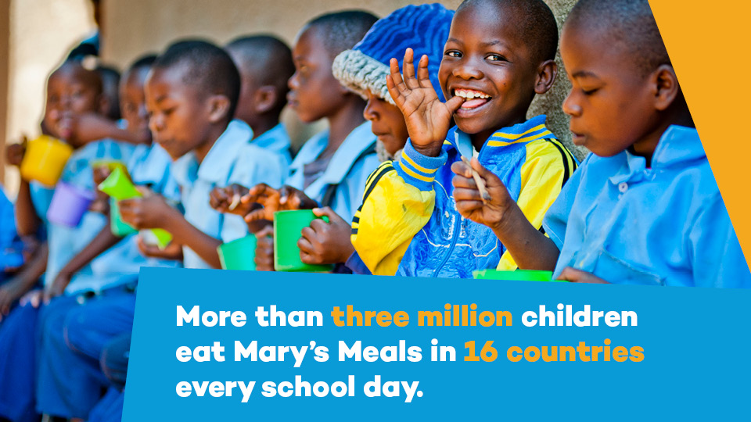
Notes:
Not only do we feed children in 16 countries every school day, we feed more than three million children in those countries.

Slide 9
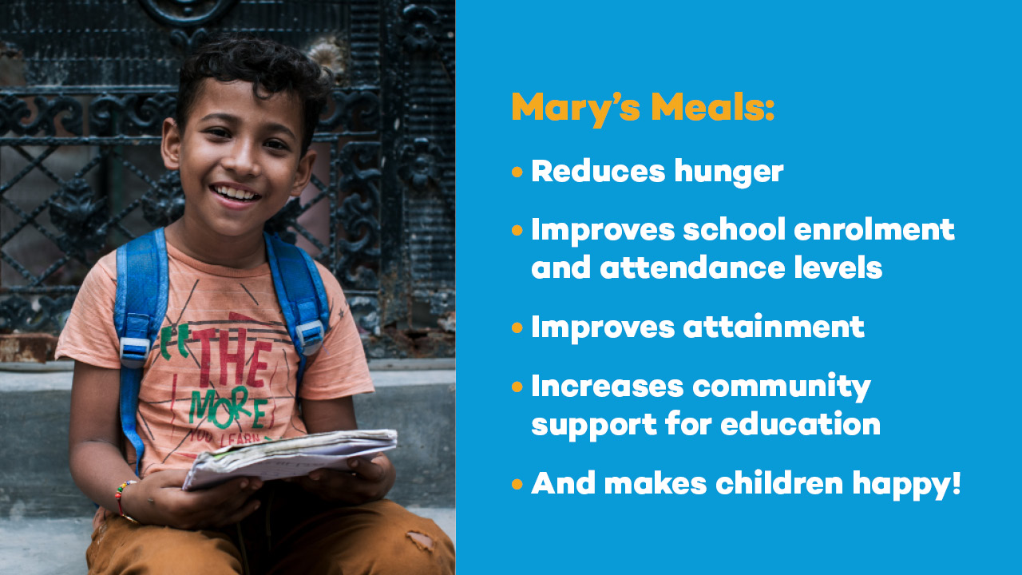
Notes:
Mary’s Meals is not only a powerful incentive to come to school, the daily meal also gives children the energy to learn and play.
When Mary’s Meals starts at a school our research shows that hunger is reduced, there is improved school enrolment and attendance levels, improved attainment, increased community support for education, and children are happier!

Slide 10
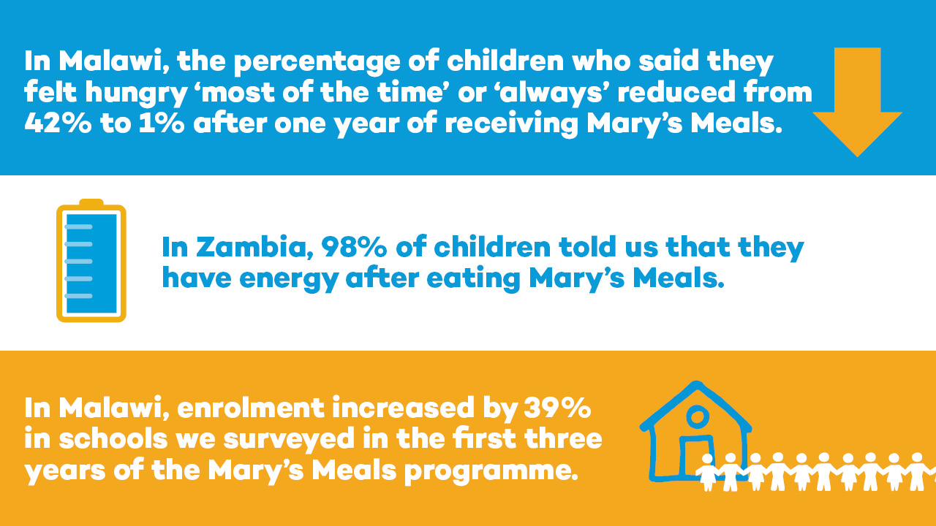
Notes:
Our research shows that Mary’s Meals reduces children’s hunger at school. In Malawi, the percentage of children who said they felt hungry ‘most of the time’ or ‘always’ reduced from 42% to 1% after one year of receiving Mary’s Meals.
Three years after the introduction of our programme in Zambia, 98% of children told us that they have energy after eating Mary’s Meals porridge. At Mary’s Meals, we believe in the power of porridge!
Our research also shows that enrolment increases in schools where Mary’s Meals provides school meals, and surrounding communities report fewer children being out of school. In Malawi, enrolment increased by 39% in schools we surveyed in the first three years of the Mary’s Meals programme.

Slide 11
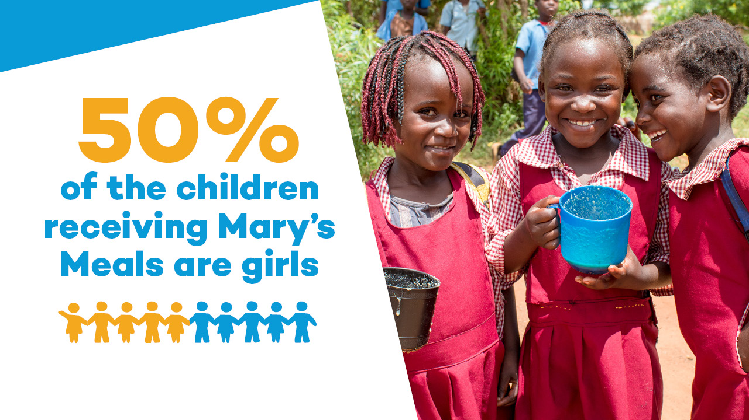
Notes:
In many of the contexts where we work, girls are often less likely to go to school. Girls are also disproportionately affected by safety risks in travelling to school and early pregnancy and marriage. Yet we can proudly say that around 50 per cent of all the children we feed are girls.
By providing a daily meal at school, we encourage girls to access education and enable them to concentrate and learn once they are there, so that there can be a brighter future for them and their communities.

Slide 12
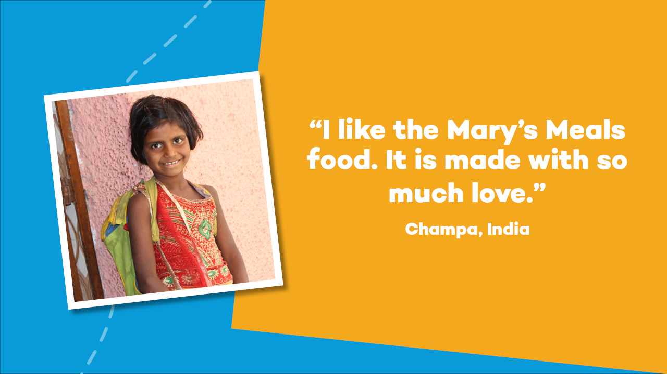
Notes:
Mary’s Meals offers a route out of poverty to girls like Champa (point at presentation), who lives next to a rubbish dump in a slum in Delhi, India. Her dad is a rag picker, sorting through piles of rubbish looking for scraps of material, metal or carboard to sell.
In this impoverished and deeply traditional community, educating girls is unusual. Champa and her little sister are among the lucky few who get the chance to go to school.
She says: “Some children pick rubbish, but my father has big dreams for us. We come to learn because we hope to become something. I like the Mary’s Meals food. It is made with so much love.”

Slide 13
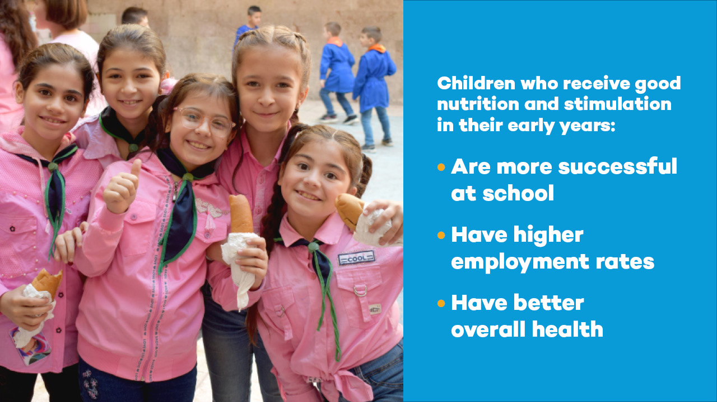
Notes:
While the majority of our programmes support children in primary school, we also feed in pre-school education facilities. In many of the places we work, these are referred to as Early Childhood Development (ECD) centres – here we would call them nurseries.
ECD centres help with children’s health, development and primary school readiness. ​
Pre-school aged children are particularly vulnerable to malnutrition and can suffer its effects in later life. Early interventions for disadvantaged children have been proven to lead to increased survival rates, and better health, growth and brain development.
Children who receive assistance in their early years are more successful at school and, as adults, have higher employment rates and better health.

Slide 14
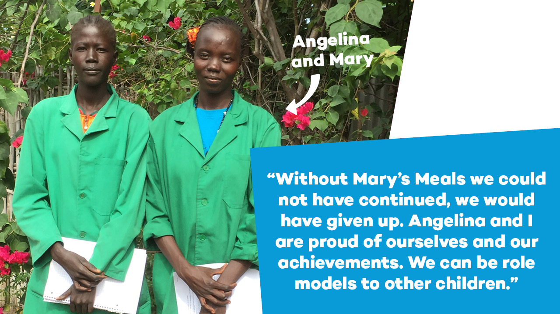
Notes:
We are beginning to see a new generation, once fed by Mary’s Meals, finding its voice. We call them ‘Generation Hope’ – these are the young people who have completed their education and are going on to become doctors, teachers and even professional athletes.
These inspirational young women (point at powerpoint image) Angelina and Mary received Mary’s Meals at school, and now work as auxiliary nurses in South Sudan.
Mary told us: “Without Mary’s Meals we could not have continued, we would have given up. Angelina and I are proud of ourselves and our achievements. We can be role models to other children.”
Young people such as Angelina and Mary are becoming the men and woman who will lift their communities out of poverty, reducing their reliance on aid and bringing them hope for the future.

Slide 15
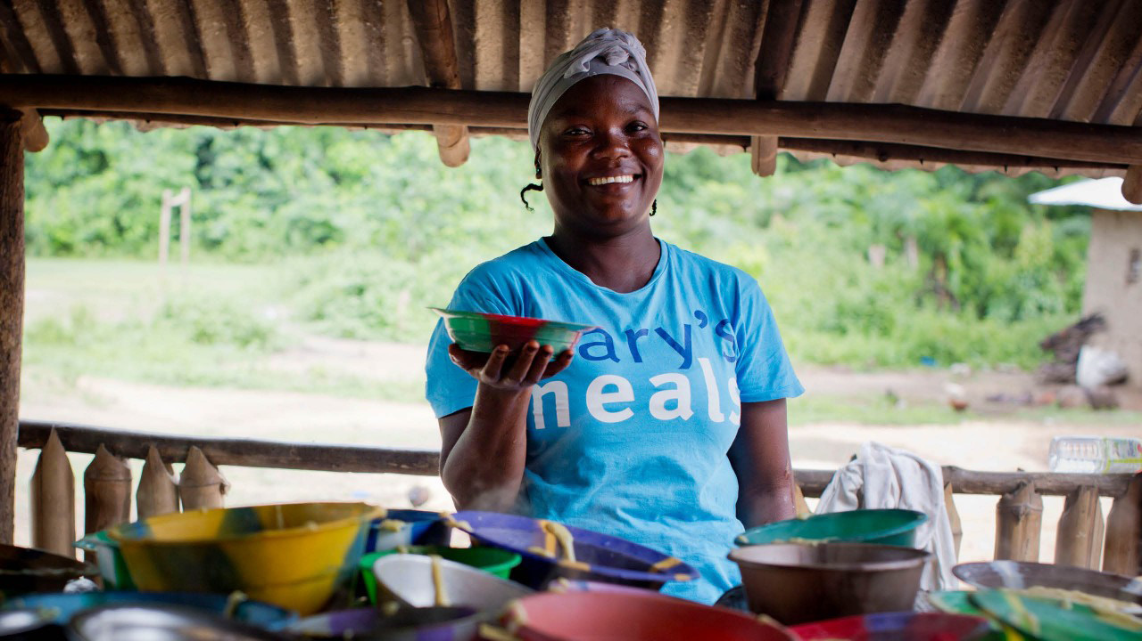
Notes:
The work of Mary’s Meals simply would not be possible without the support of volunteers – like me, here in the UK, but also overseas.
​Our school feeding programmes are owned by the community and run by local volunteers, with Mary’s Meals providing the food.
​Every day, thousands of volunteers – including more than 80,000 in Malawi alone – carry water, cook and serve plates of food to hungry children. They know that with a full stomach, their children will have the energy to learn at school.

Slide 16
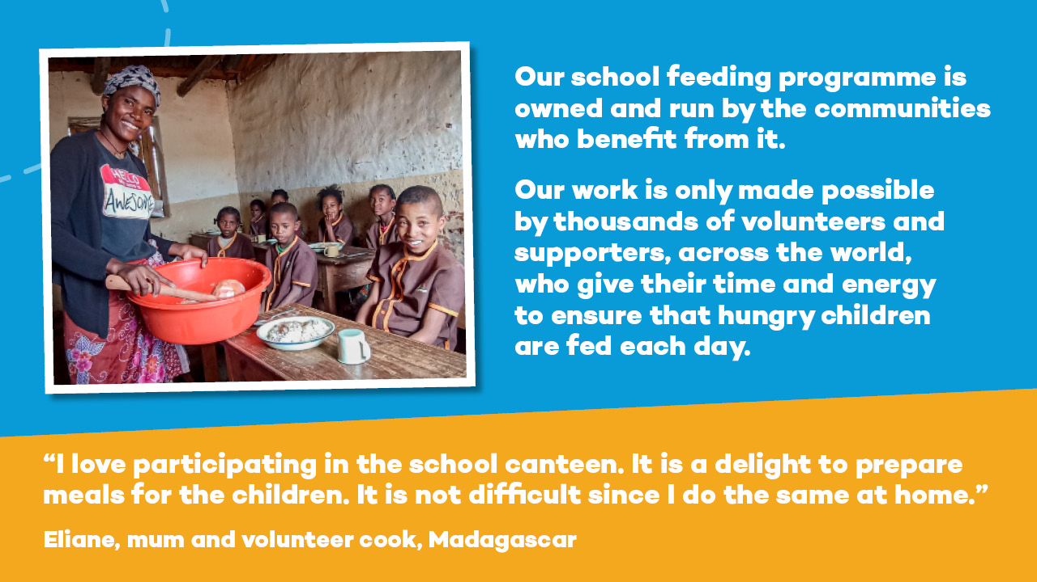
Notes:
At Mary’s Meals, community is at the heart of everything we do.
Our school feeding programme is owned and run by the communities who benefit from it.
Our work is only made possible by thousands of volunteers and supporters, across the world, who give their time and energy to ensure that hungry children are fed each day.
Many of the communities in which we work are facing hardship and adversity. But by working together and with our support, these communities are responding with innovation, creativity and determination to build a better future for their children.
Selfless volunteers like Eliane from Madagascar make our work possible, feeding children and growing their community for the better.

Slide 17
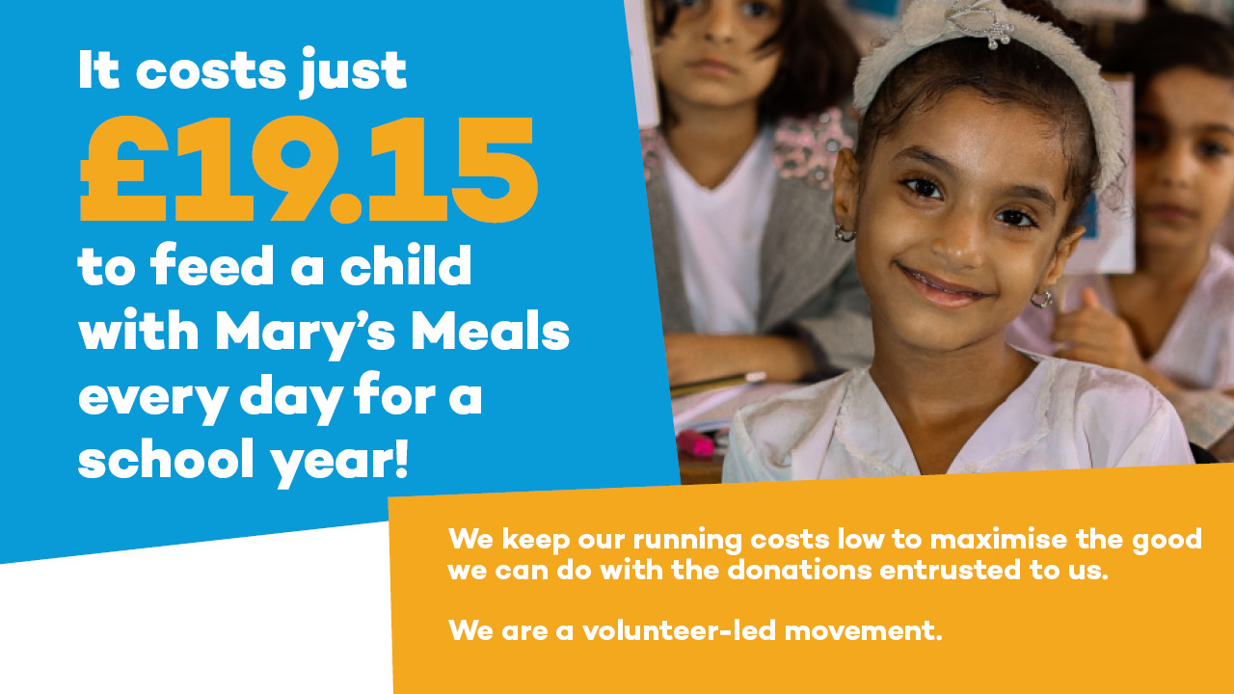
Notes:
It costs just £19.15 to provide a child with Mary’s Meals every school day for a whole year.
We keep our running costs low to maximise the good we can do with the donations entrusted to us.
This is only possible because most of our work is done by a global network of dedicated volunteers who carry out lots of little acts of love on behalf of Mary’s Meals.
Here in the UK, people like me give our time to spread the word about this important work.

Slide 18
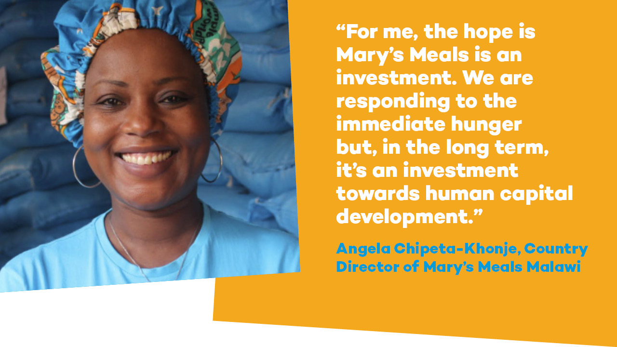
Notes:
Mary’s Meals is a simple idea that works. By providing a daily meal in a place of education, Mary’s Meals encourages children experiencing poverty and hunger into the classroom where they gain a basic education that can provide an escape route from poverty.
This wonderful quote from Angela, Country Director of Mary’s Meals Malawi, explains exactly what Mary’s Meals does for children and their communities.
“For me, the hope is Mary’s Meals is an investment. We are responding to the immediate hunger but, in the long term, it's an investment towards human capital development.”

Slide 19
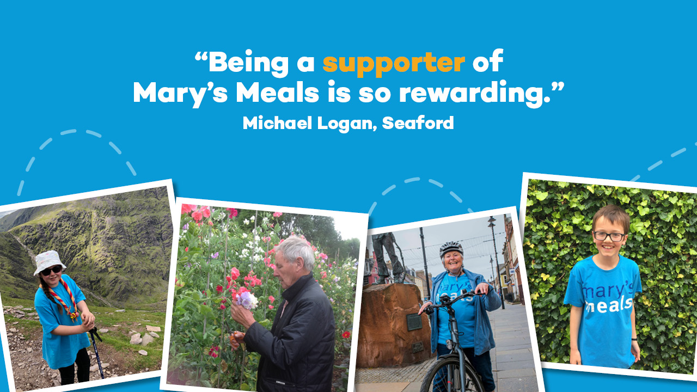
Notes:
You could choose to fundraise for Mary Meals.
Our supporters never fail to inspire us with their original fundraising ideas.
​
​Nine-year-old Madison Burns amazed her friends and family when she smashed her five-peak challenge, raising £700 for Mary’s Meals. ​
​Madison hiked for five days, reaching the summit of five of the highest mountains in the UK - Slieve Donard, Ben Nevis, Scafell Pike, Snowdon and Carrauntoohil. ​
​Pippa and Michael Logan from Seaford also raised funds for our work by supplying local residents with garden plants from a stall set up at the end of their driveway. So far this year the couple have sold more than 1,500 bedding plants!​
​Michael told us: “Being a supporter of Mary’s Meals is so rewarding.”
​Could you take on a sponsored cycle, or organise a fundraiser in your local community? By raising funds for us, you can help Mary’s Meals make a lasting difference to the lives of children in some of the world’s poorest communities.

Slide 20
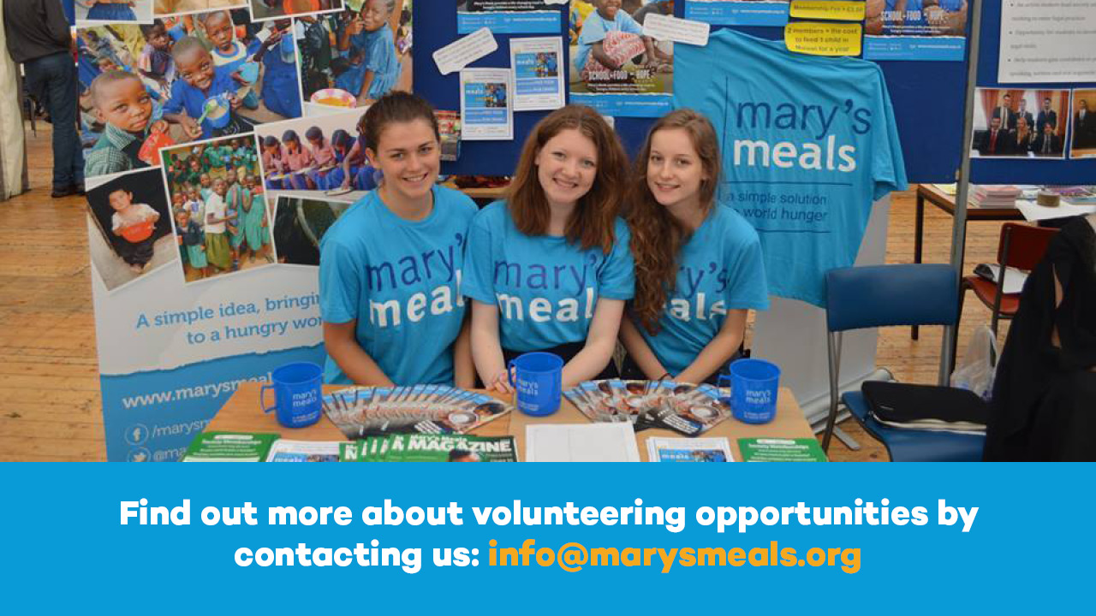
Notes:
Or you could choose to volunteer – like I do.
We welcome everyone into the Mary’s Meals family and believe each of us has something to contribute towards the realisation of our vision – that every child receives a daily meal in school.
​Our work is mainly carried out by our wonderful army of volunteers who contribute in all sorts of different ways.
​Explain when and why did you started volunteering for Mary’s Meals.
​Share your biggest achievement and/or your favourite thing about volunteering. ​
​We’re always in need of more volunteers. If you are interested in volunteering your time to our work, you can find out more by contacting info@marysmeals.org.​

Slide 21
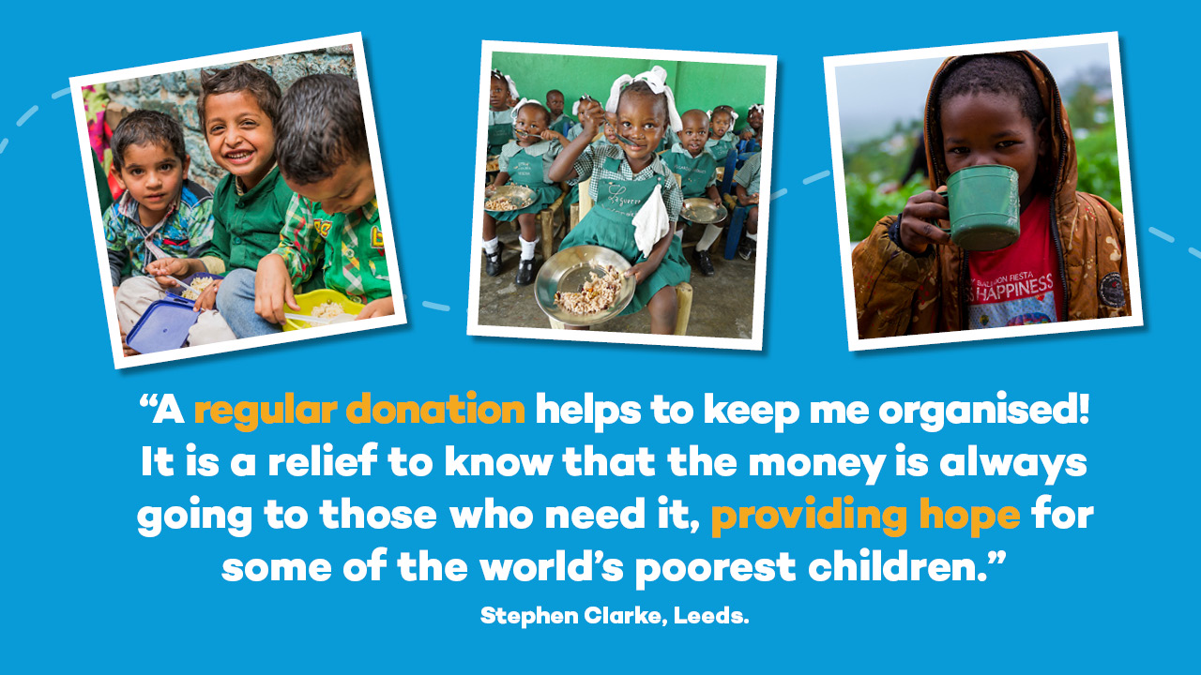
Notes:
Or you could make a donation.
​If you are a UK tax payer, please consider signing a Gift Aid form which allows us to claim, at no extra cost to yourself, an extra 25% from the government.
​Stephen Clark from Leeds donates monthly to Mary’s Meals by Direct Debit. ​
​He told us: “A regular donation helps keep me organised! It is a relief to know that the money is always going to those who need it, providing hope for some of the world’s poorest children.”​

Slide 22
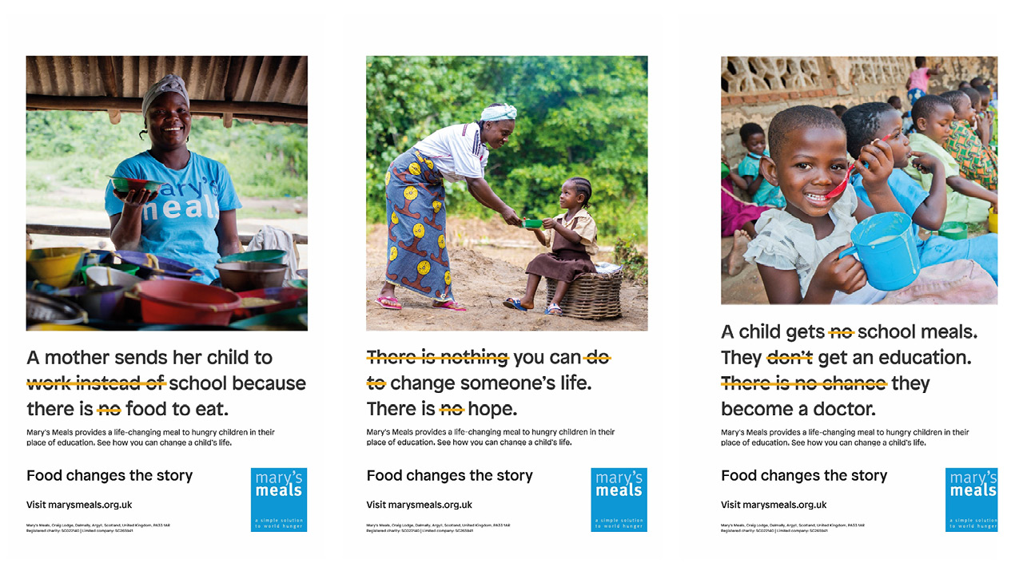
Notes:
Your regular donation can help to change a child’s story – the promise of a monthly donation, whatever size, means we can plan our work and reach more children with Mary’s Meals. Each meal costs 10p on average, so even small regular gifts can make a big difference.

Slide 23
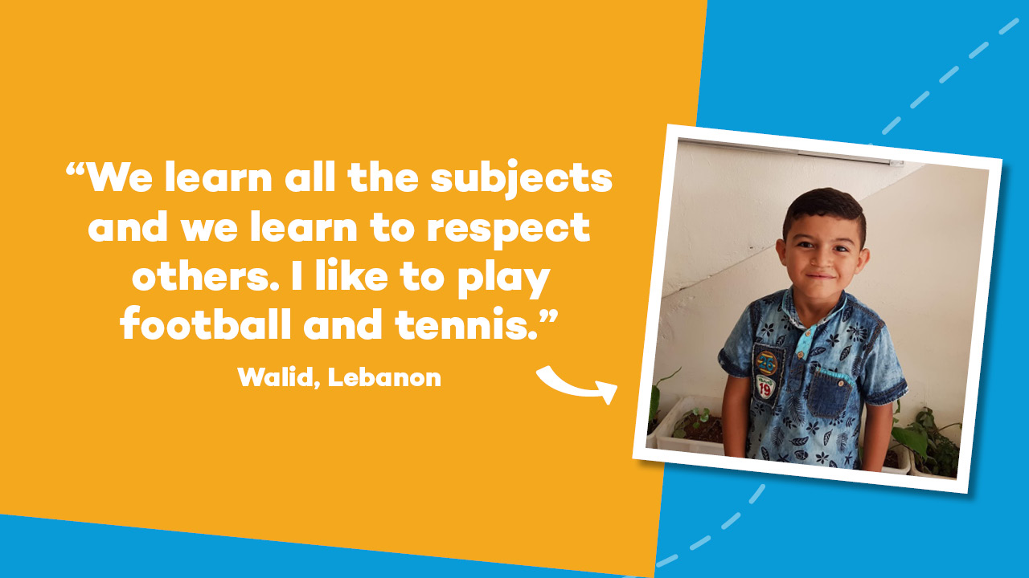
Notes:
A donation of £19.15, enough to feed a child every school day for a full year, will change the story of a little one like Walid.
​Walid and his family were forced to flee from their home during the Syrian conflict. ​
He now lives in a settlement on the outskirts of Beirut with his grandmother and father. ​
​School gives Walid the chance to enjoy a good meal, learn, and play with his friends – things every eight-year-old should have the opportunity to do. ​
​He says: “We learn all the subjects and we learn to respect other. I like to play football and tennis.”

Slide 24
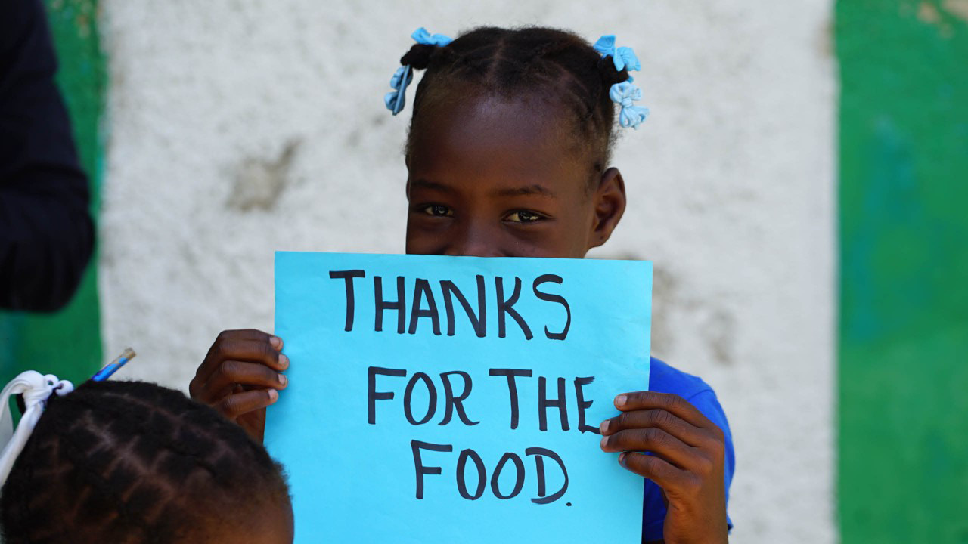
Notes:
You can find lots more information and resources about our work on our website.
Thank you so much for your listening today, and please let me know if you have any questions.
Then go onto next slide with logo and website URL while you take questions.

Slide 25


