Slide 1

<Insert school name here>
23 September 2025

Slide 2


Slide 3


Slide 4
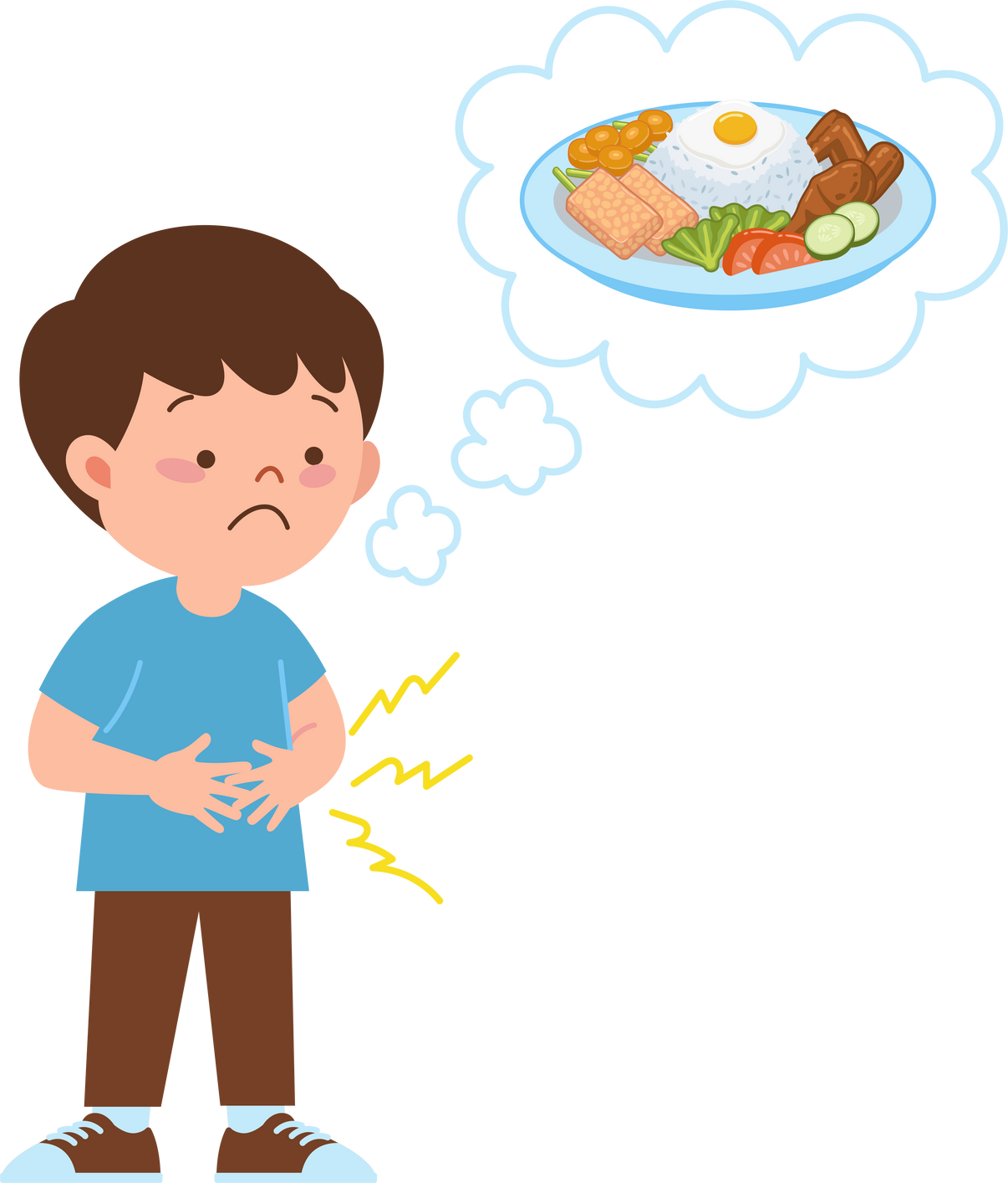

Slide 5
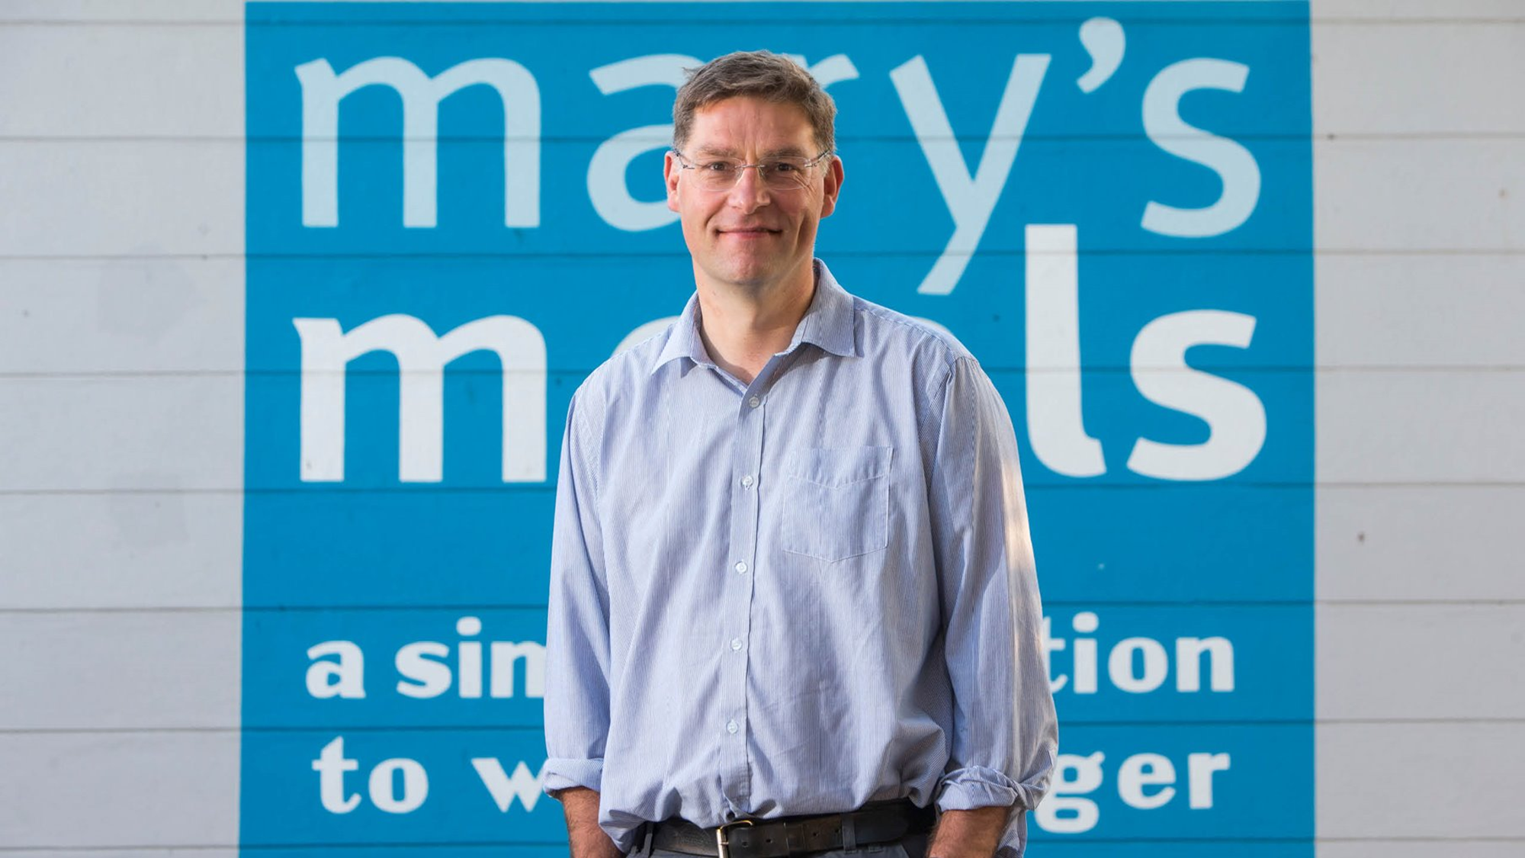

Slide 6
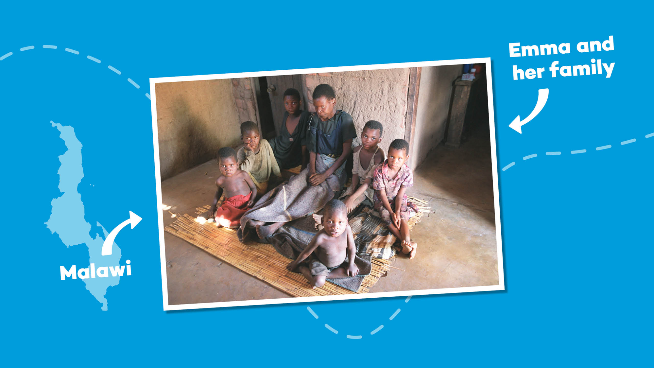

Slide 7
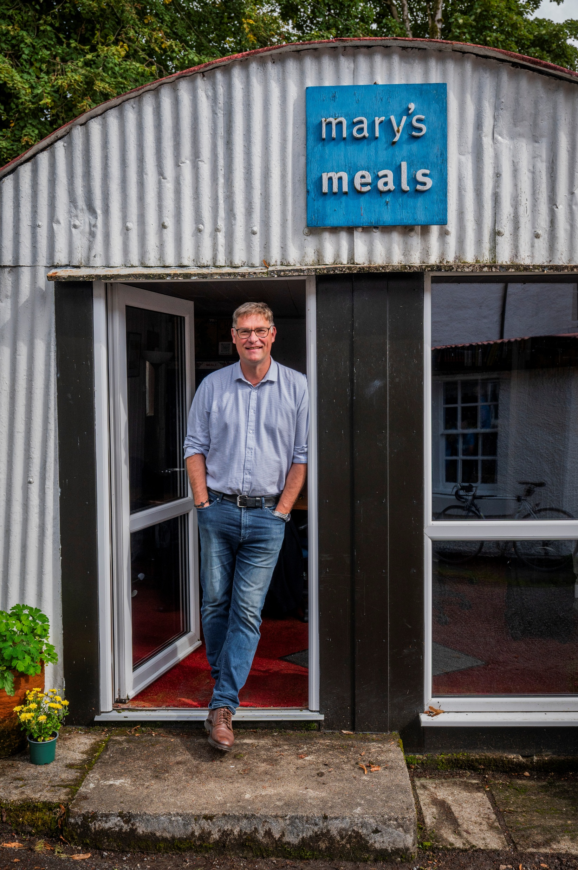
“I would like to have
enough food to eat and
I would like to go to
school one day.”
Edward, Malawi

Slide 8
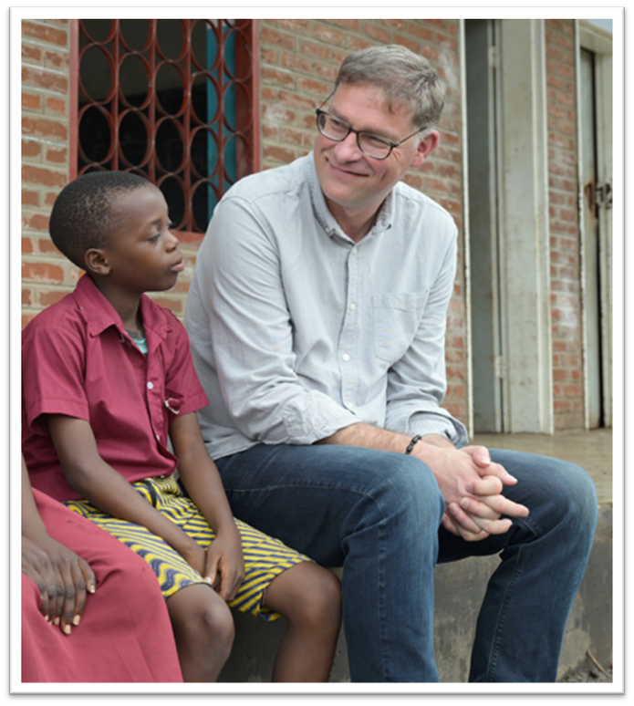

Slide 9
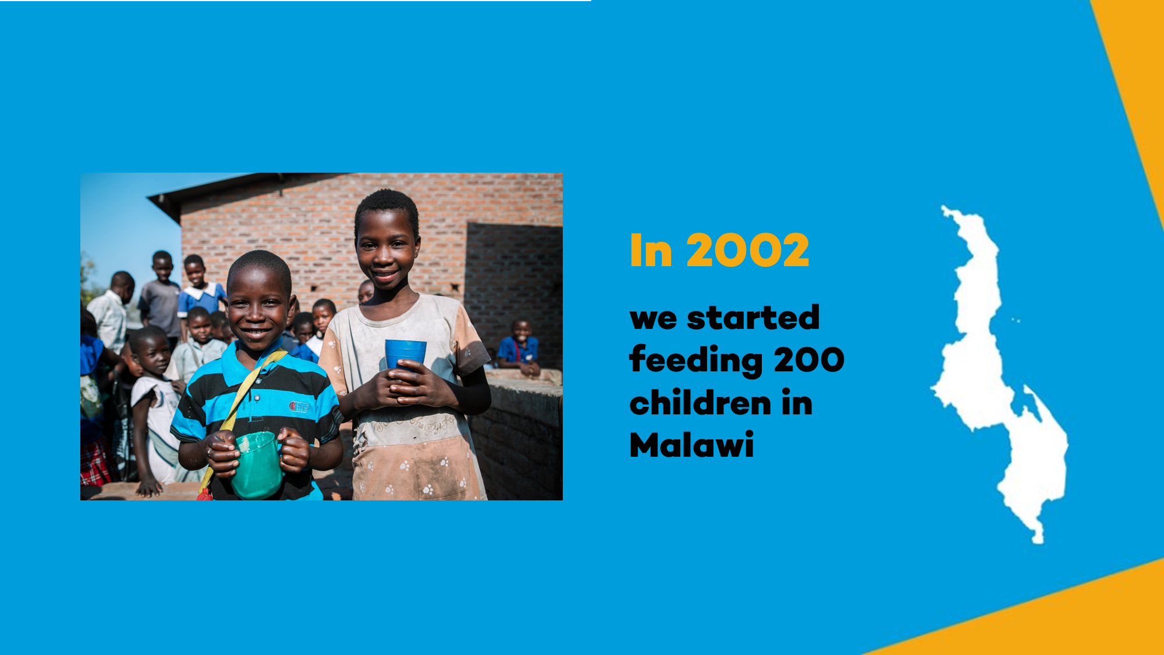
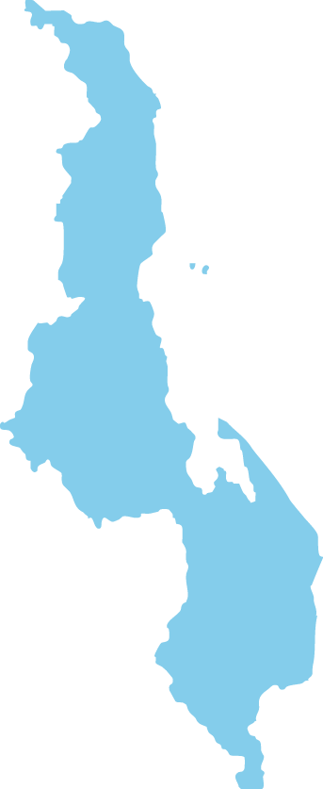

Malawi
In 2002 we started feeding 200 children in Malawi

Slide 10
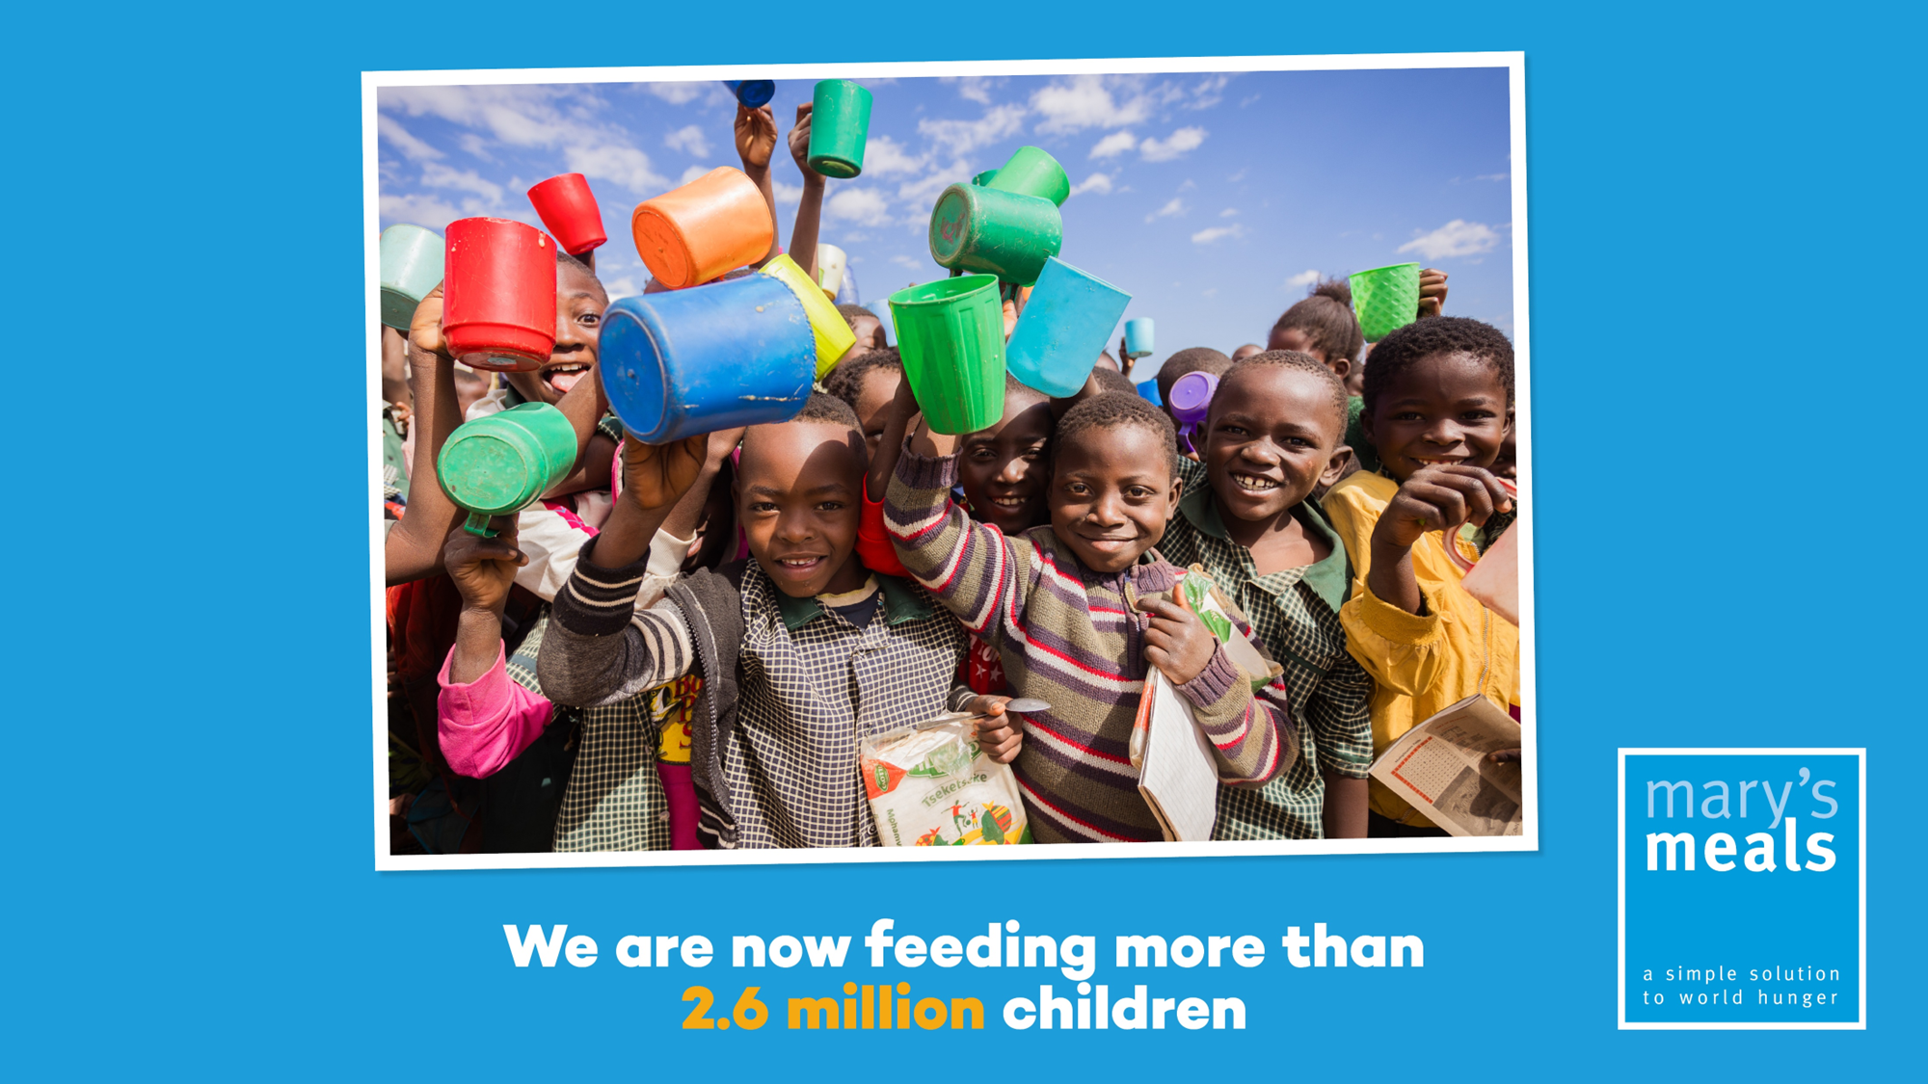

We are now feeding more than three million children every school day.

Slide 11
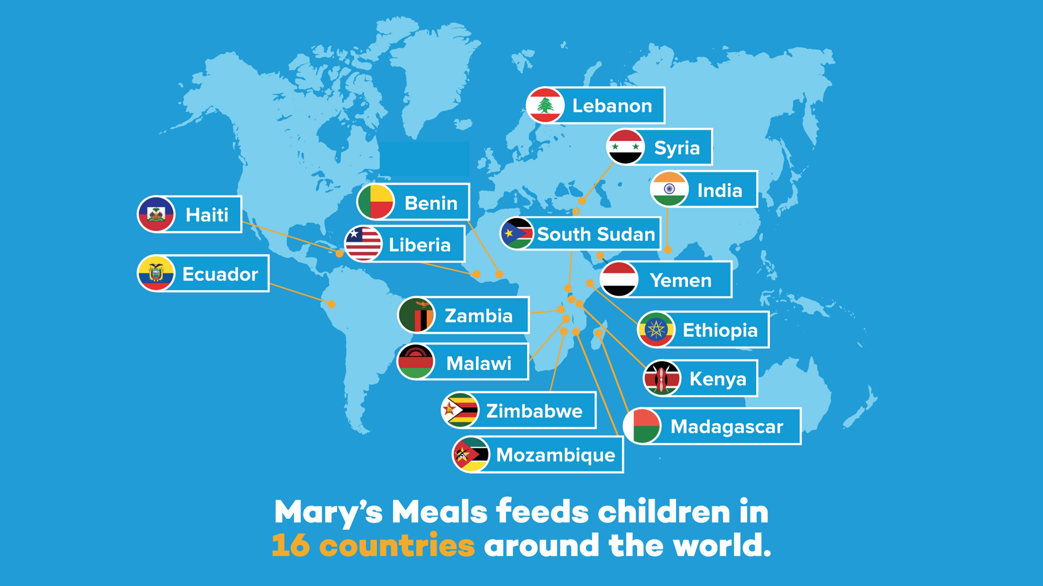
Mary’s Meals feeds children in 16 countries
around the world.

Slide 12
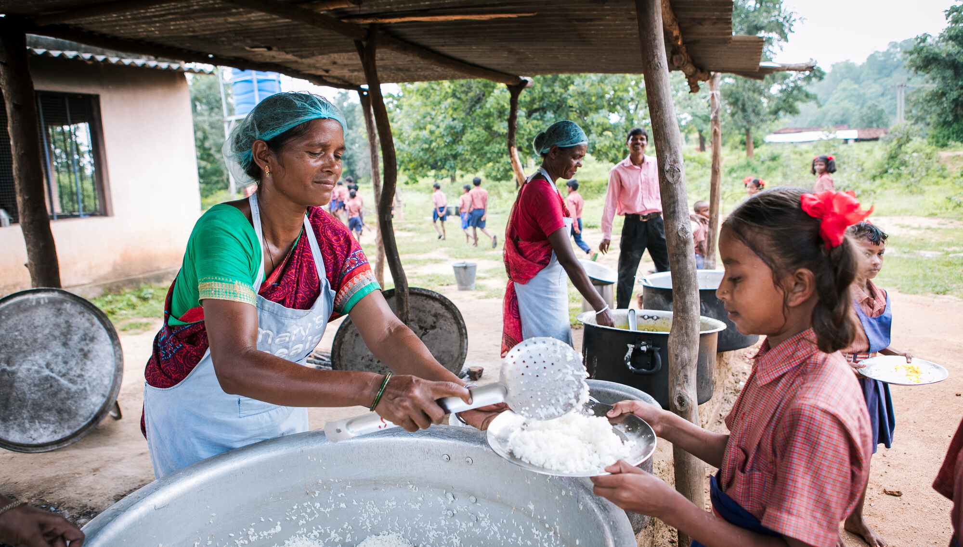

Slide 13


Slide 14





Slide 15





Slide 16

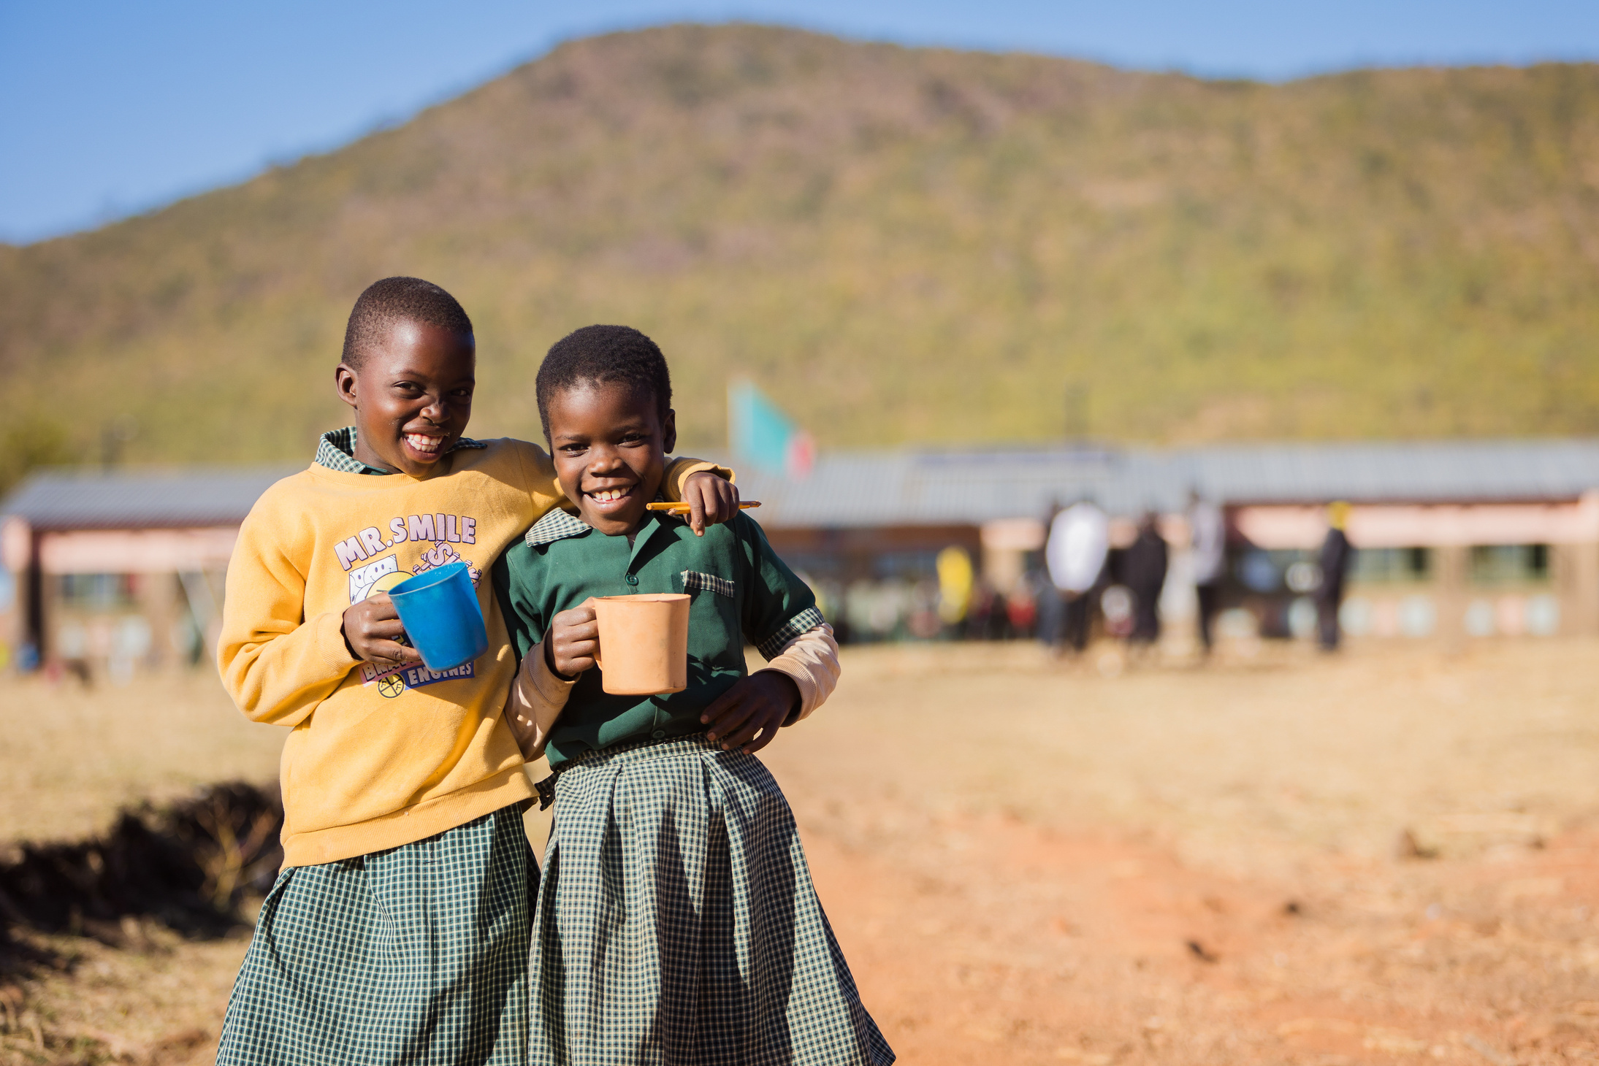



Slide 17



Slide 18
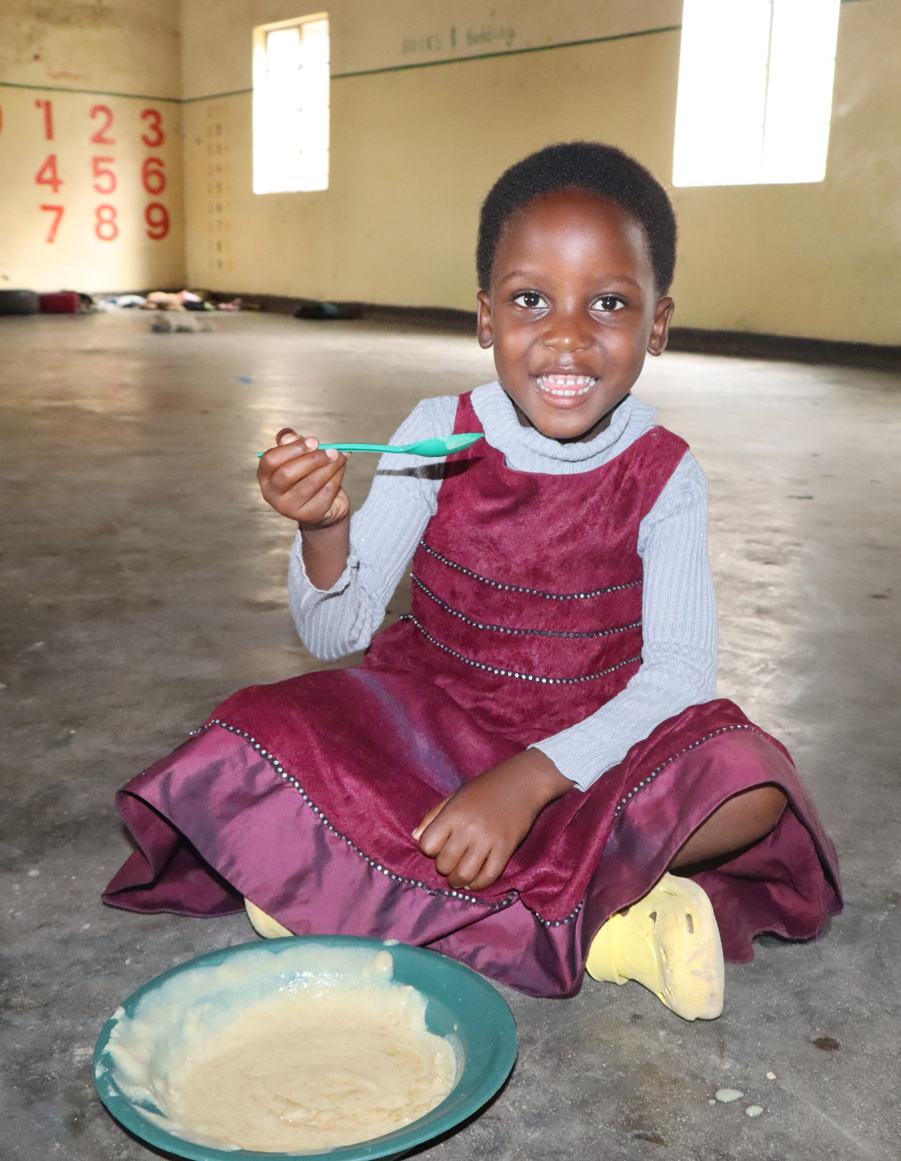
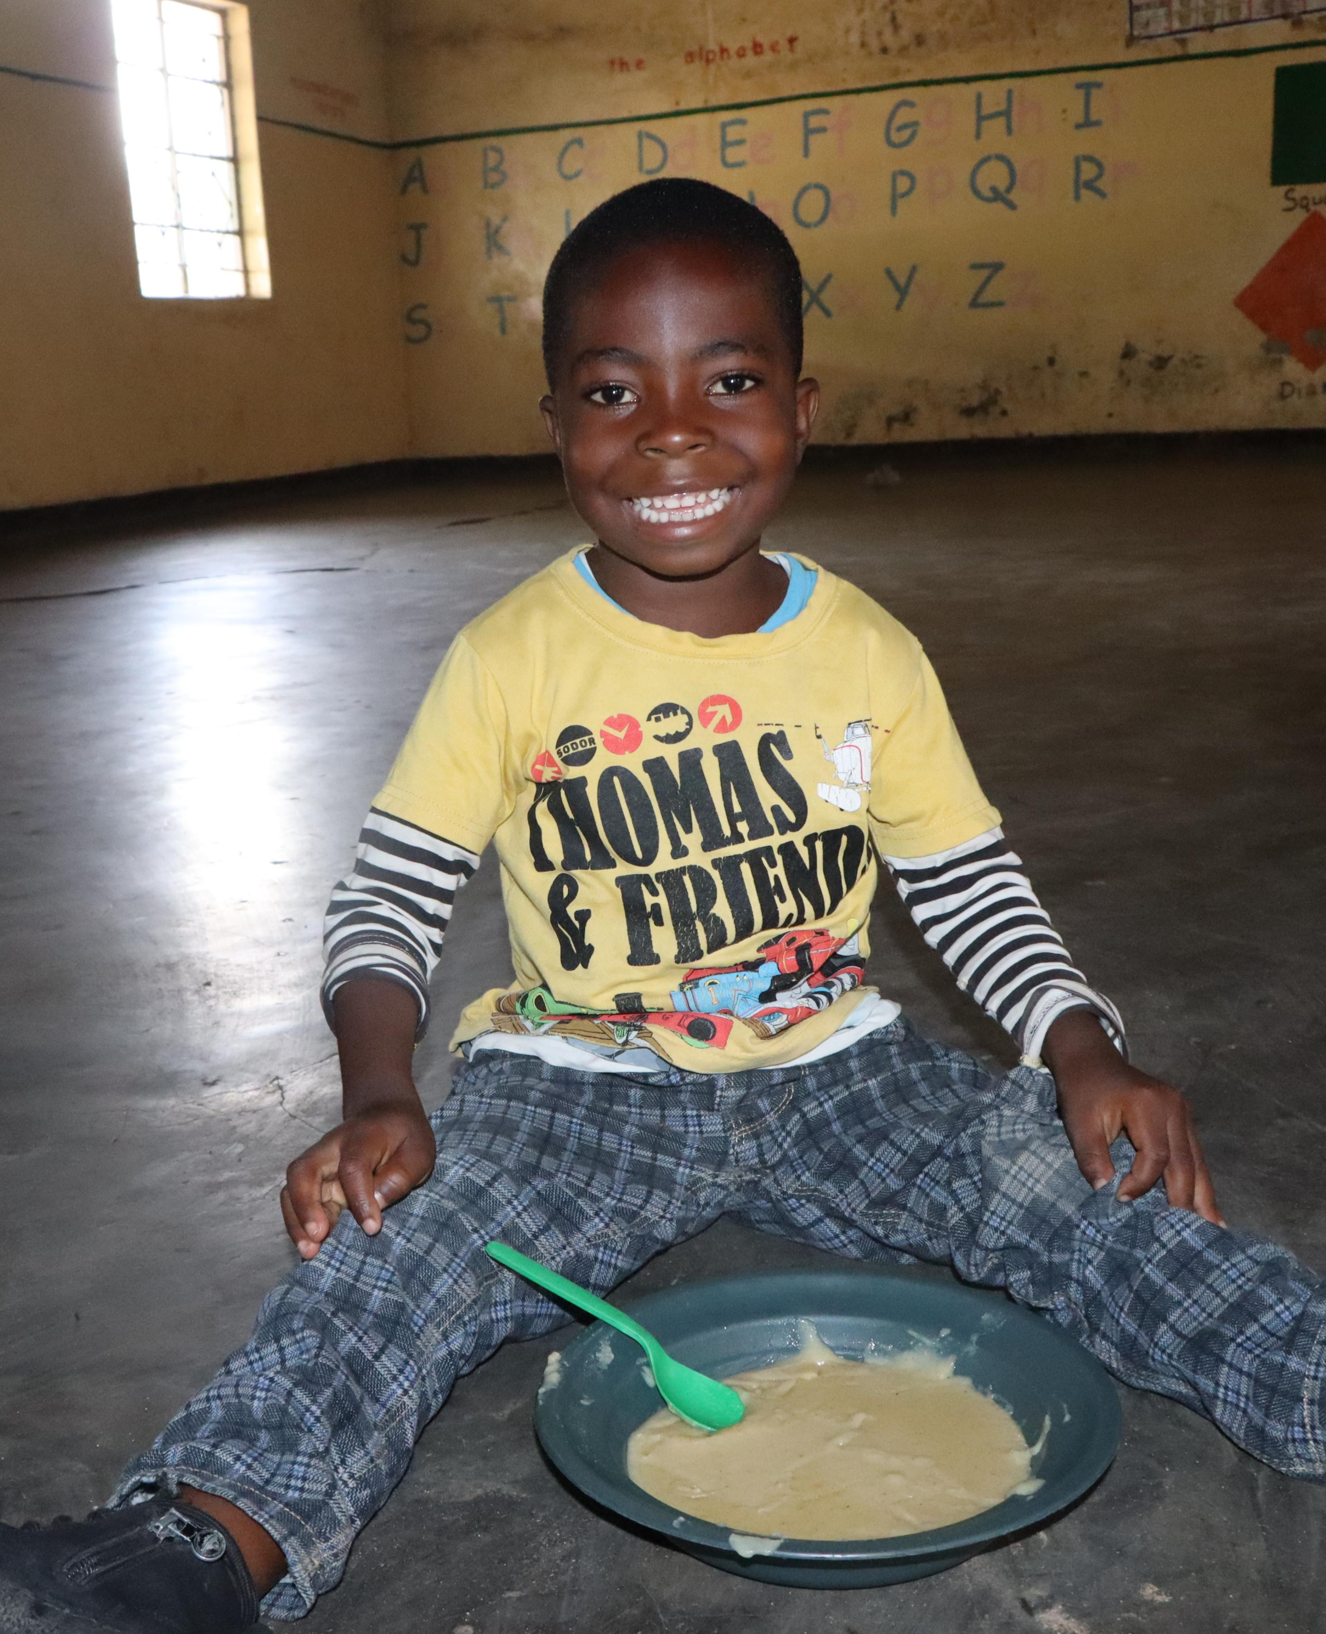

Slide 19
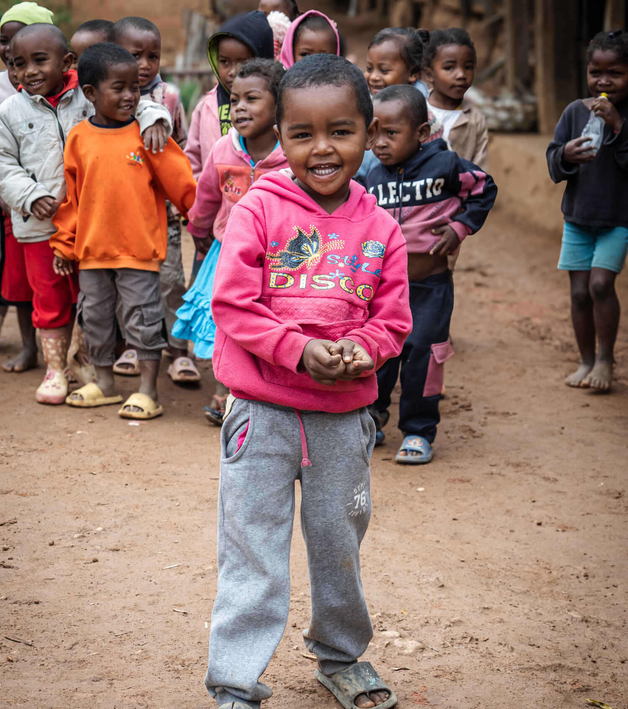

Sometimes our world seems hopeless.
There is so much that isn't fair.
Children without schools and food,
Are struggling everywhere.
I used to try and block it out,
what could a school kid do?
I felt that I was helpless.
Is that how you feel too?
But Mary’s Meals say I'm the one,
Who can pack a mighty punch.
Because it only costs 10p,
To buy a healthy lunch.
10p for lots of energy.
10p for lots of play.
10p for lots of learning,
Safe at school each day.
There's lots of us in Mary's Meals.
Join with us and you'll see.
How you can give such joy, and hope,
Each time you give 10p.
Denise Cottrell-Boyce

Slide 20


Slide 21
marysmeals.org.uk

