Slide 1

<Insert school name here>
17 September 2025

Slide 2
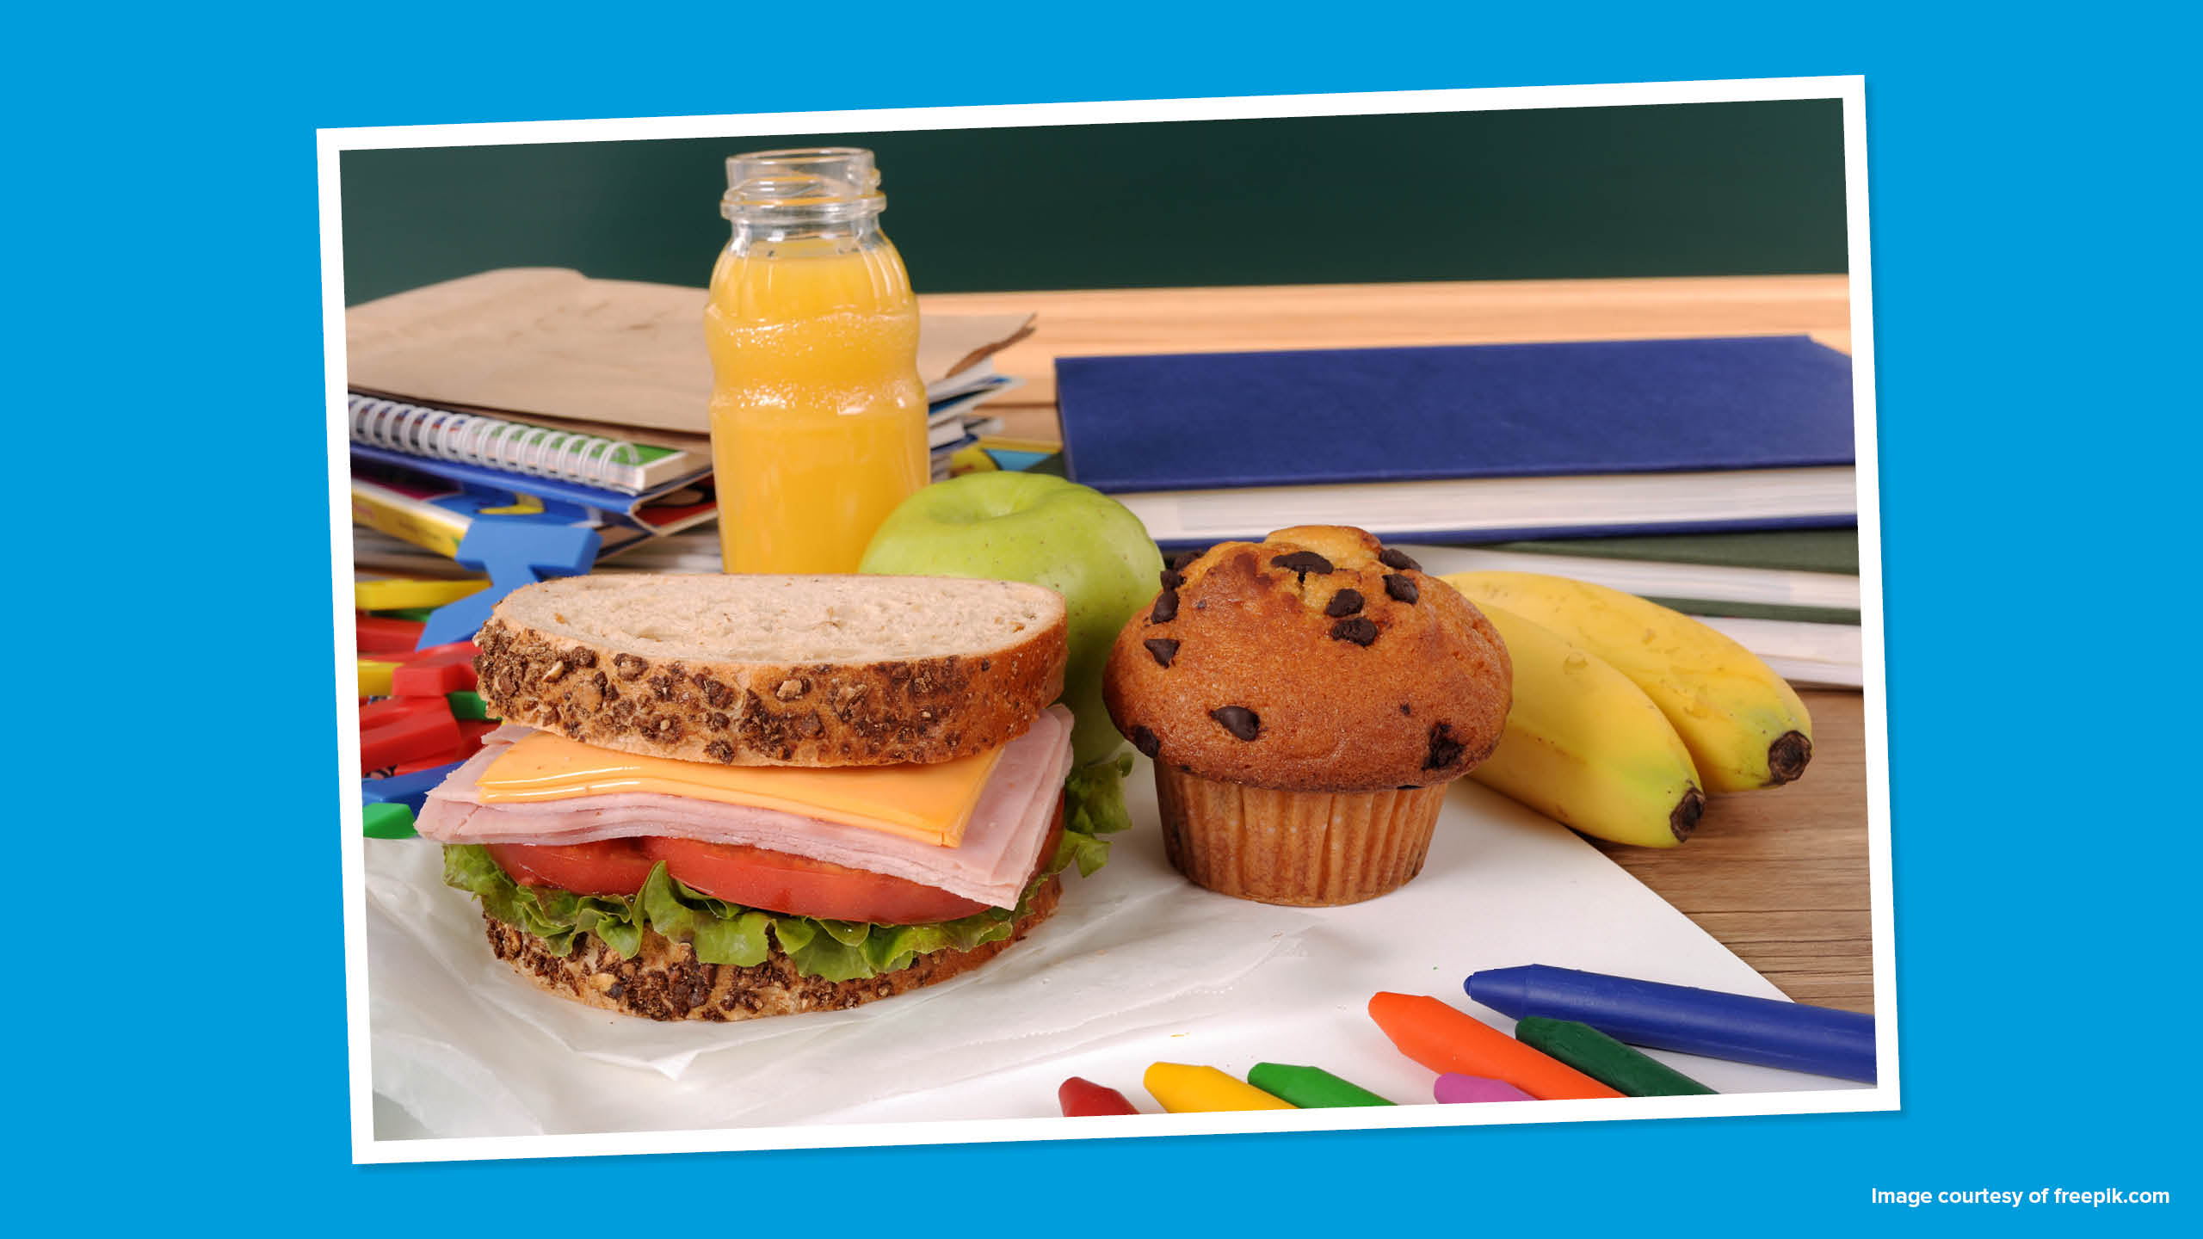

Slide 3



Is it important to eat at school?
How would you feel if you didn’t get to have a meal at school each day?

Slide 4
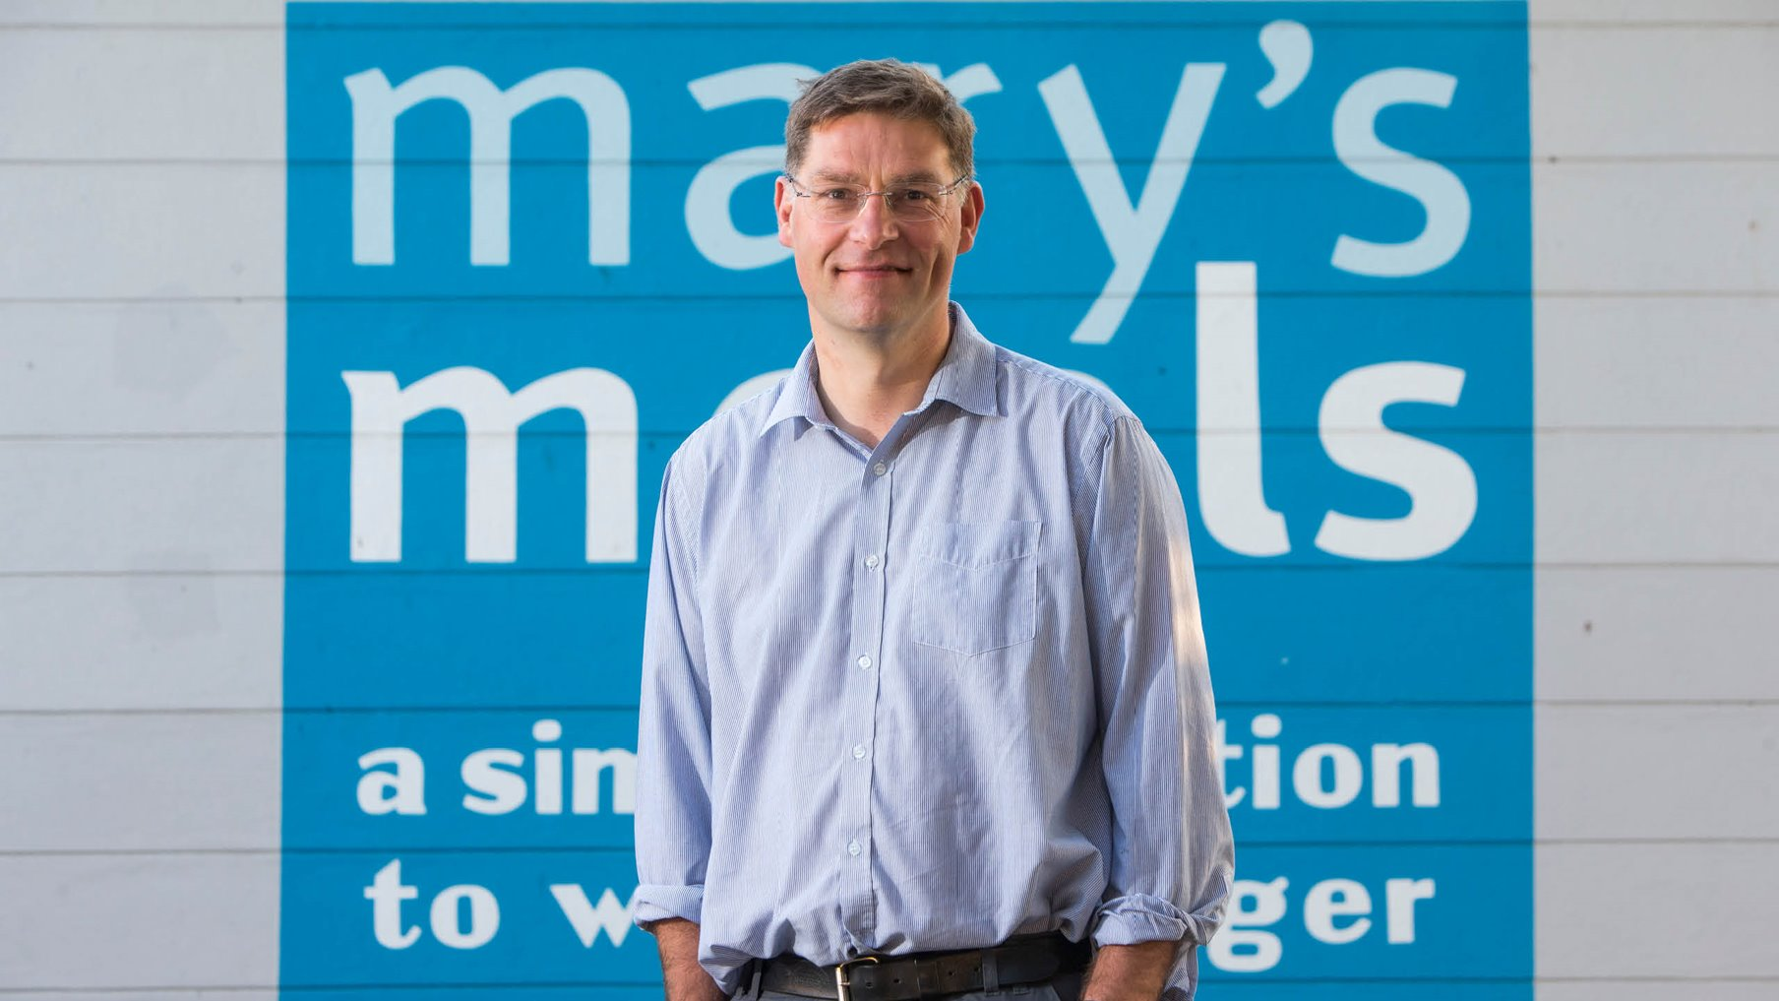

Slide 5
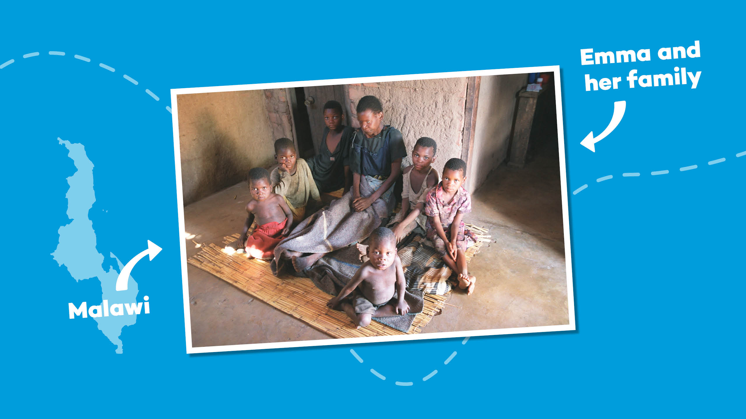
Notes:
In 2002, Magnus was visiting Malawi while the country was in the grip of famine. It was here he met Emma, a mother who was dying and who was surrounded by her six children.
Emma’s husband had died a year previously, killed by AIDS, the same disease that was now about to steal her from her children.
Magnus tried to lift the atmosphere by asking 14-year-old Edward, Emma’s eldest child, what his hopes and ambitions were.

Slide 6
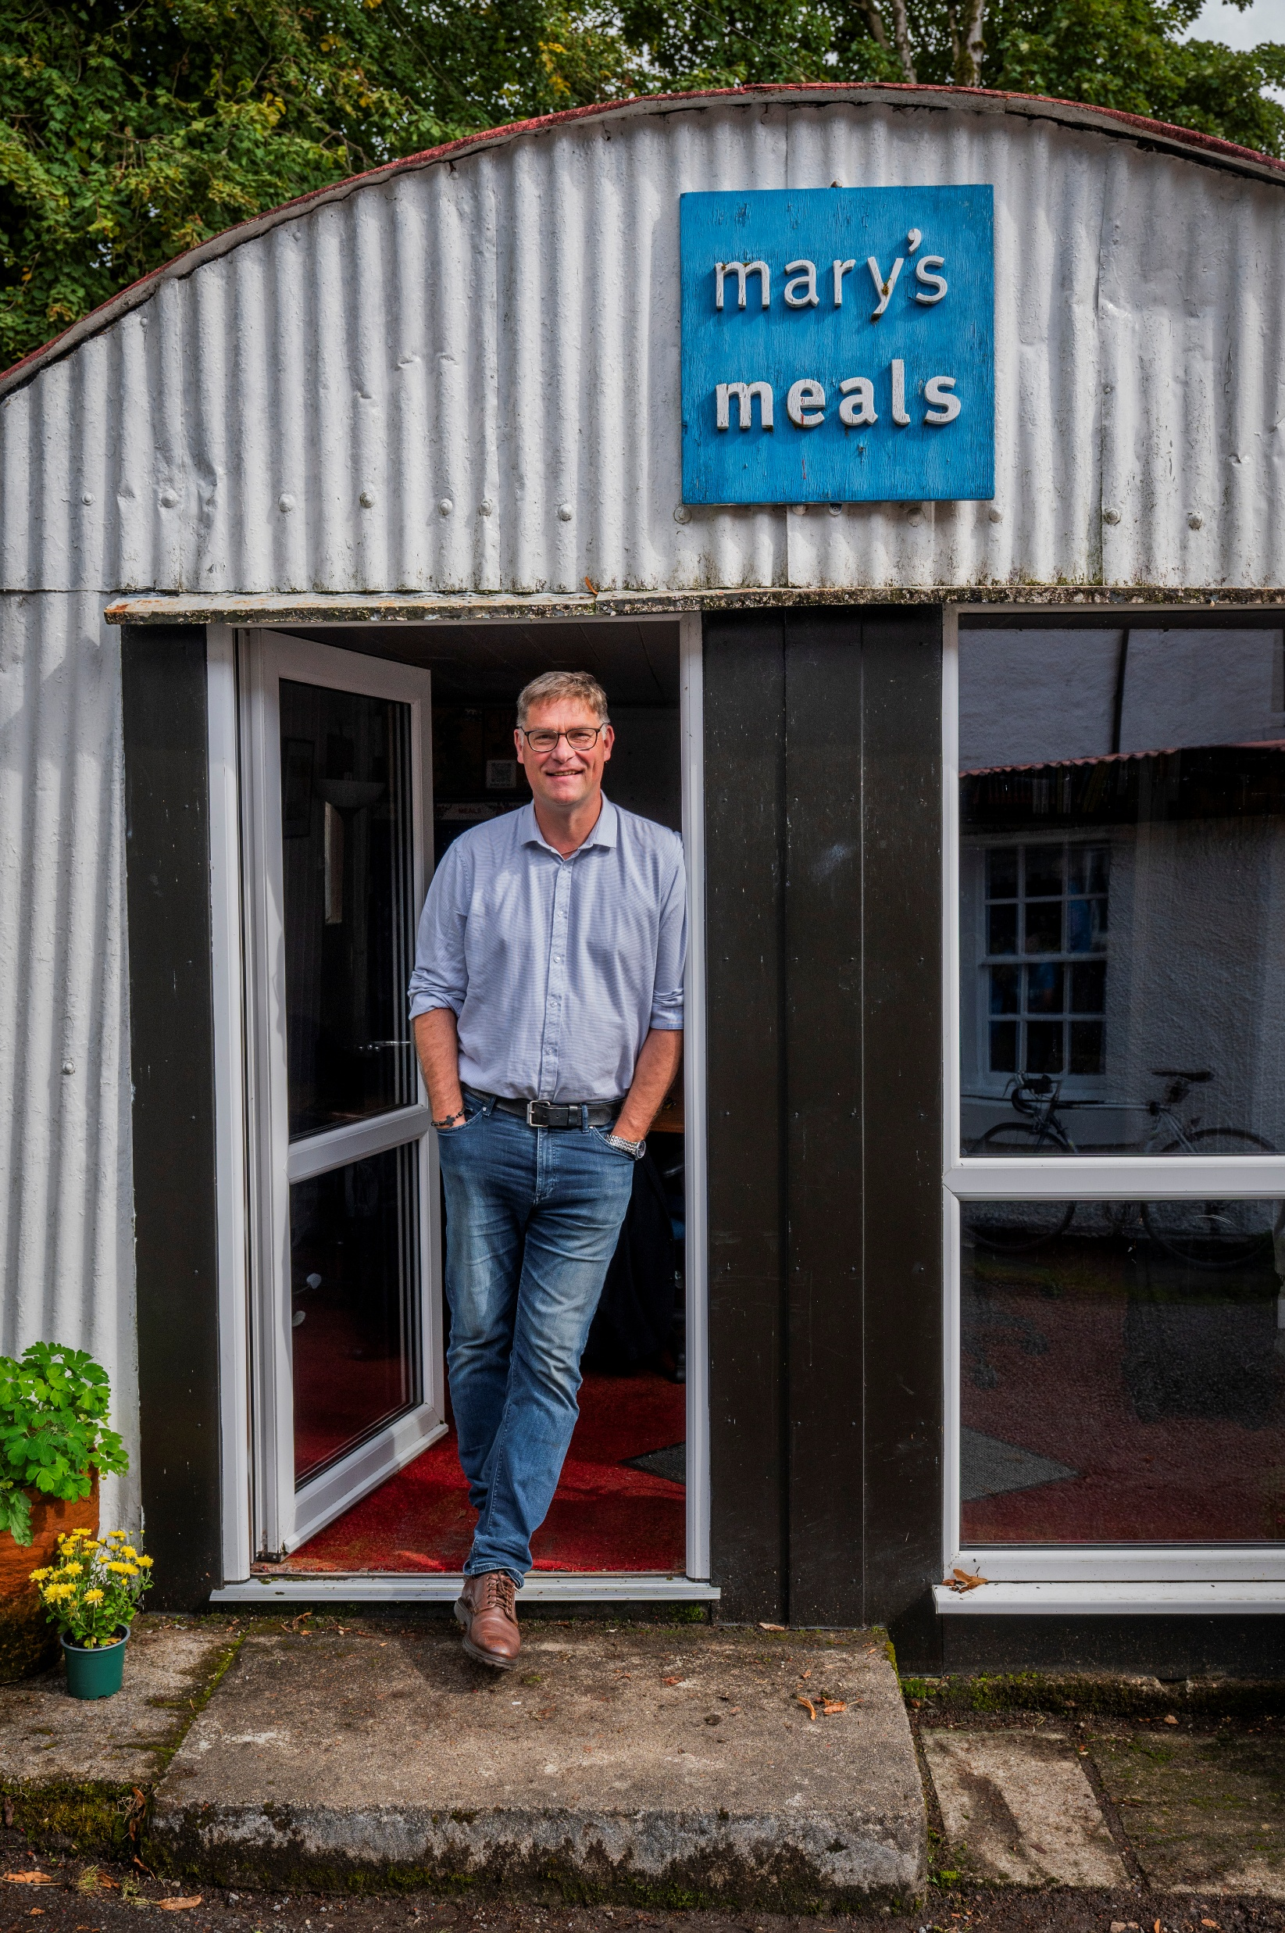
“I would like to have
enough food to eat and
I would like to go to
school one day.”
Edward, Malawi

Slide 7


Slide 8
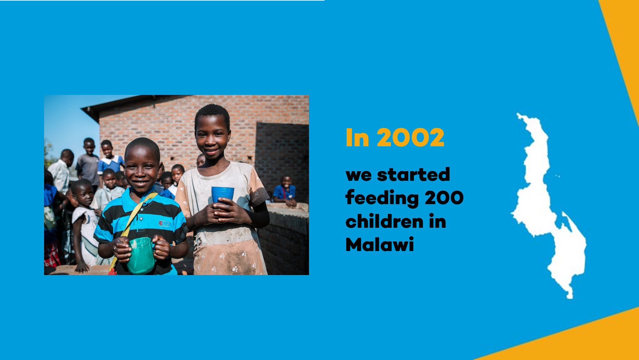


Malawi
In 2002 we started feeding 200 children in Malawi

Slide 9
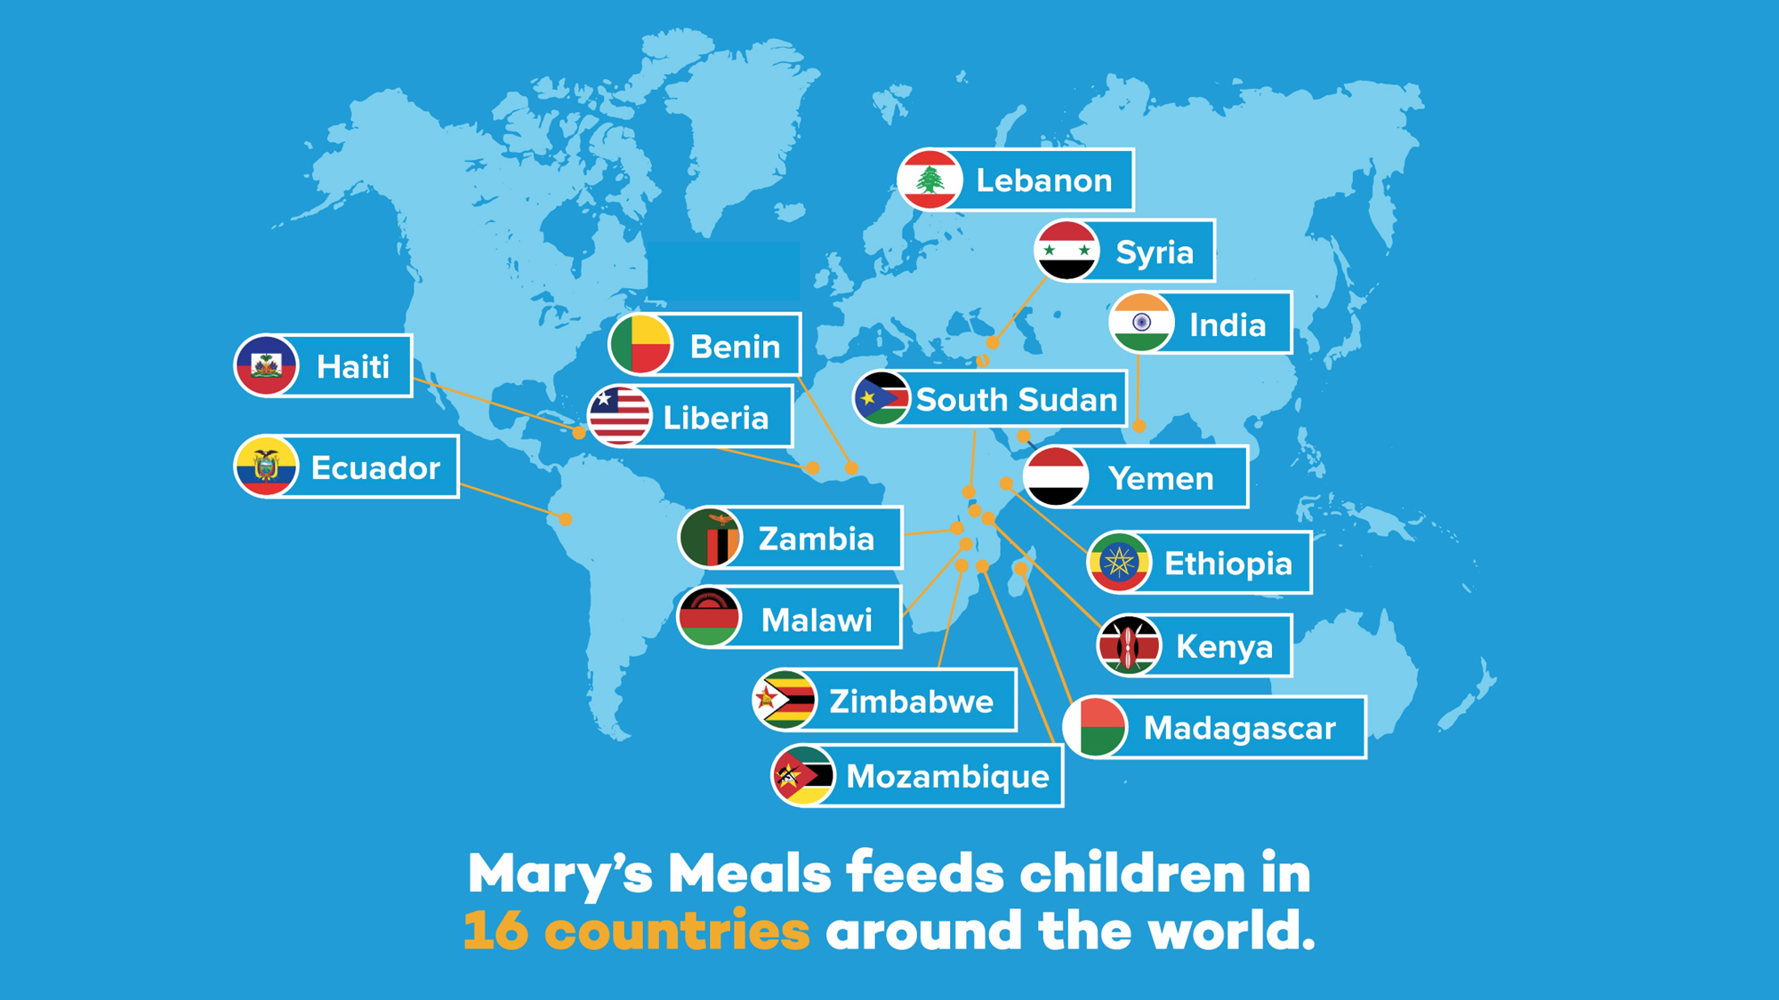
Mary’s Meals feeds children in 16 countries
around the world.

Slide 10


We are now feeding more than three million children every school day.

Slide 11

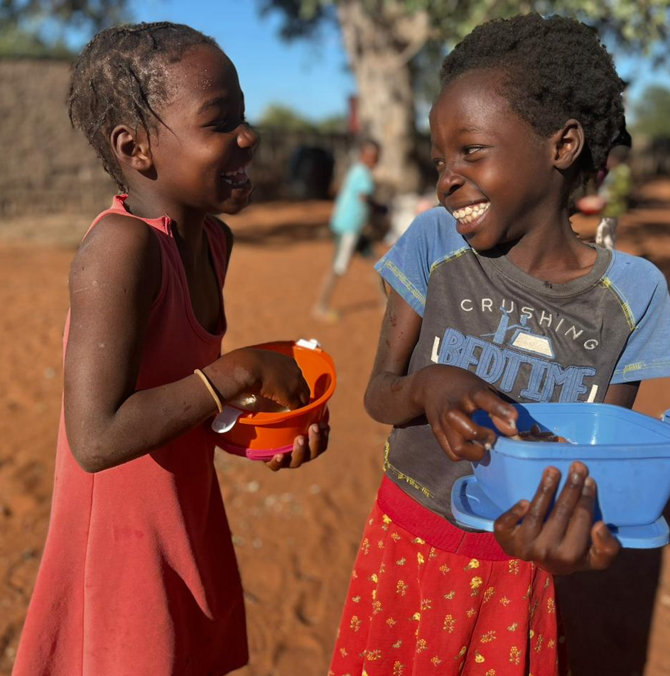

^{These nutritious meals…}
...encourage children to come to school.
...help them concentrate in class.
...and give them energy to learn and play!

Slide 12

Better futures

Slide 13

It costs just
£19.15
to feed a child for
a school year!

Slide 14






11p
£1.75
£1
£2.50
£3.50
16p

Slide 15
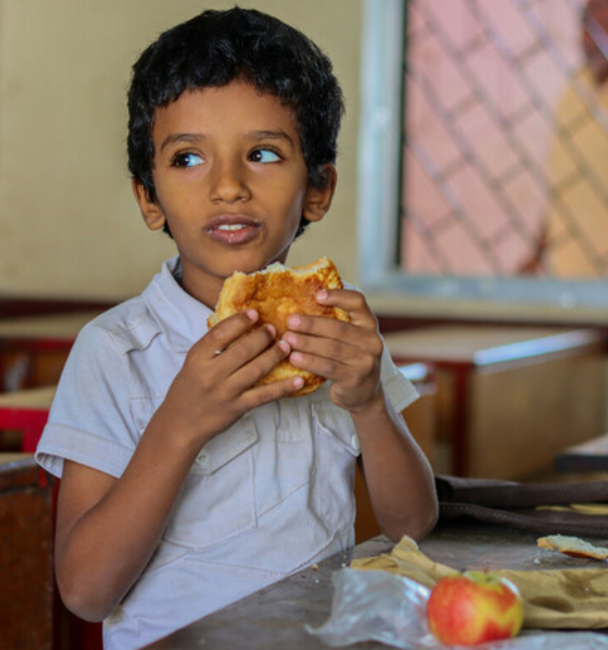
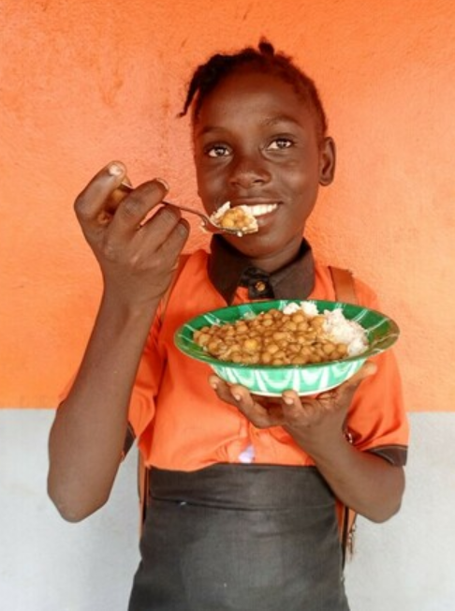
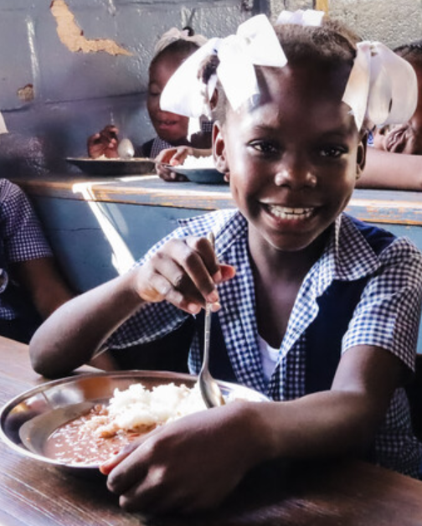


Slide 16







How many ways could you make 10p?

Slide 17

The porridge gives me energy. I was always hungry. Now, my stomach is full, and I can fully participate in class.”
Gabriel, age 14
Zambia

Slide 18

We knew that education could be a gamechanger for our family. It slowly dawned on me that education could change
my life.”
Fatima, with her sister
Soni, India

Slide 19
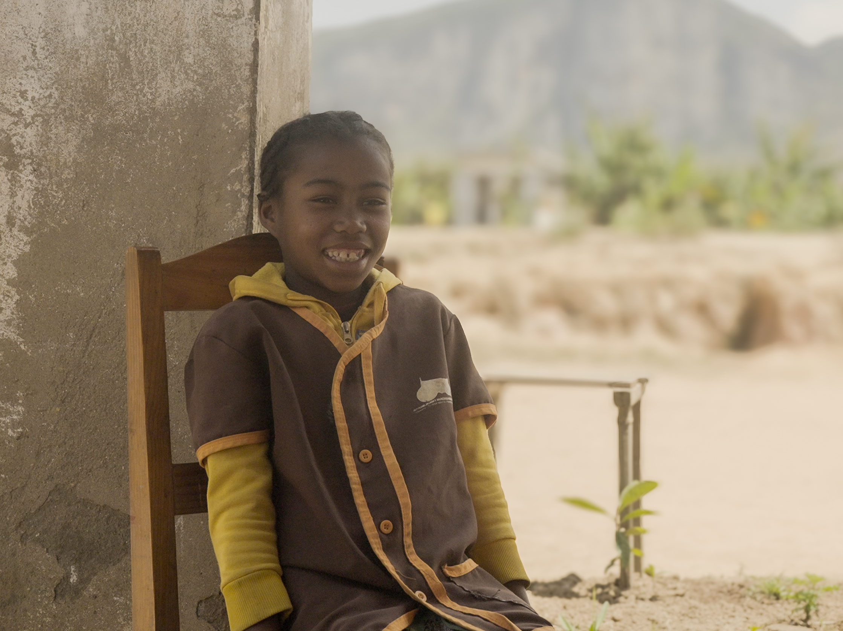
I think that the school canteen
is good. When I first ate at the canteen, it was nice. It’s satisfying and it also makes me smart.”
Collette, age 10
Madagascar

Slide 20


Sometimes our world seems hopeless.
There is so much that isn't fair.
Children without schools and food,
Are struggling everywhere.
I used to try and block it out,
what could a school kid do?
I felt that I was helpless.
Is that how you feel too?
But Mary’s Meals say I'm the one,
Who can pack a mighty punch.
Because it only costs 10p,
To buy a healthy lunch.
10p for lots of energy.
10p for lots of play.
10p for lots of learning,
Safe at school each day.
There's lots of us in Mary's Meals.
Join with us and you'll see.
How you can give such joy, and hope,
Each time you give 10p.
Denise Cottrell-Boyce

Slide 21
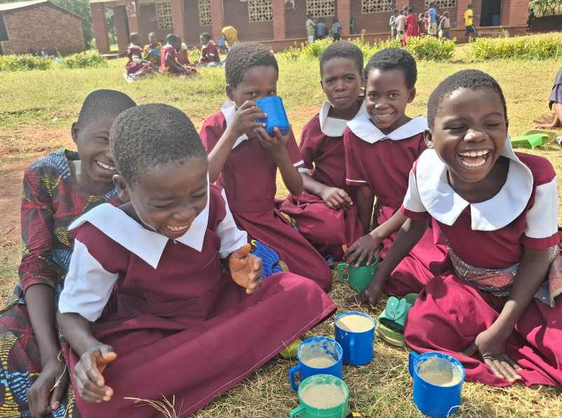

“I like to describe our work as just a series of lots and lots of little acts of love.”
Magnus MacFarlane-Barrow
Founder of Mary’s Meals

Slide 22


Slide 23
marysmeals.org.uk

