Slide 1

Notes:
Slide 1 – Give hope this Christmas with Double The Love
This Christmas, you can give the gift of hope to hungry children with life changing school meals.
Your gift will help Mary’s Meals keep our promise into 2026 and beyond to the world’s poorest communities in countries such as Ethiopia, Haiti and South Sudan – where conflict and the devastating impacts of climate change mean our nutritious meals are needed more than ever.
We stand ready to expand our programmes with communities in countries like Malawi and Zambia, and your kindness means we can bring food, school and hope to thousands more hungry children in the coming year.
With your support, more and more children will wake each morning knowing they will eat a good meal today – your donation means they have hope for a brighter tomorrow.
And with Double The Love, your donation can go twice as far! This festive season, all donations made to Mary’s Meals will be doubled by a group of generous supporters, up to £1.1 million.
This means every single donation will be matched, and every new regular gift will be doubled for the first two payments. If you already give regularly, any increase you make will also be matched for the first two payments – making your kindness go even further.
It costs just 10p a day to feed a child with Mary’s Meals, proof that even the smallest donation will have a big impact.
Because of our low-cost approach, it costs just £19.15 to feed a child with Mary’s Meals every school day for a year. And this Christmas, your donation of £19.15 will feed two children!
Gift matching will end once donations reach £1.1 million, so don’t miss your chance to ensure your kindness goes twice as far.
To learn more about Double The Love, please visit: www.marysmeals.org.uk/double-the-love

Slide 2
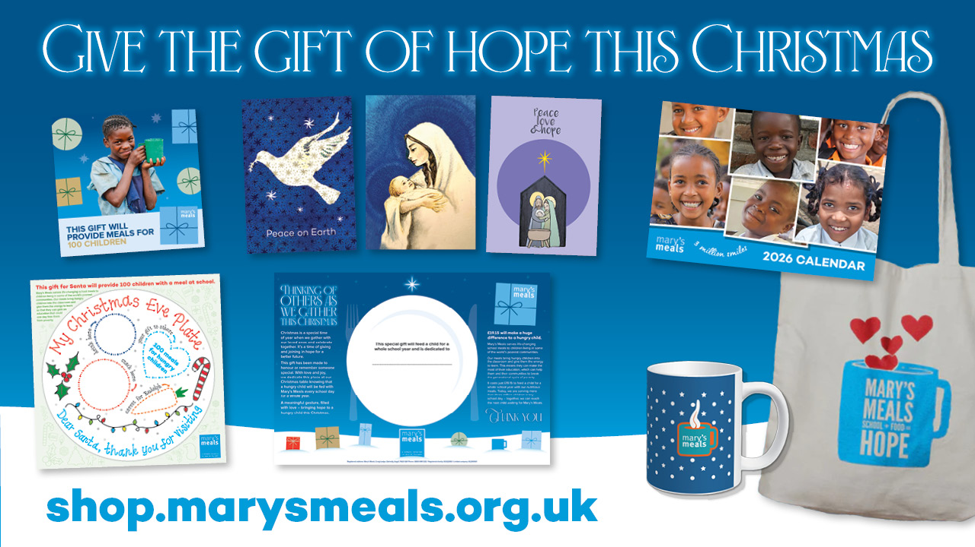
Notes:
Slide 2 – Give the gift of hope this Christmas
You can also bring hope to hungry this Christmas by shopping our range of beautiful festive cards and gifts on the Mary’s Meals online shop! These include:
Mary’s Meals gift cards:
Gift cards: From £10 plus postage, our beautiful gift cards are available as physical or digital cards delivered by email. Let a loved one know they are special by providing daily meals to a hungry child on their behalf.
Santa plate gift: Leave Santa the gift of 100 meals to deliver to hungry children as he travels round the world on Christmas Eve with our delightful Santa plate gift card. £10 plus postage.
Christmas table: A beautiful gift card to honour or remember someone special. Dedicate a place at your Christmas table and feed a child for a whole school year in their name. £19.15 plus postage.
All Mary’s Meals gift cards are also eligible for match funding through Double The Love, so your giving can go even further!
Christmas cards:
Featuring three beautiful new designs for 2025, each pack contains 10 cards and envelopes. Available in A6 size and square designs and made of high quality, uncoated paper, our charity cards are perfect for sending a Christmas message to your loved ones. £5 per pack.
Stocking fillers:
From tote bags, to mugs and aprons, these gifts are perfect for popping in a loved one’s present bag and spreading the word about Mary’s Meals! Prices start at £4.
Visit shop.marysmeals.org.uk to browse our range of unique charity gifts and cards.

