Slide 1

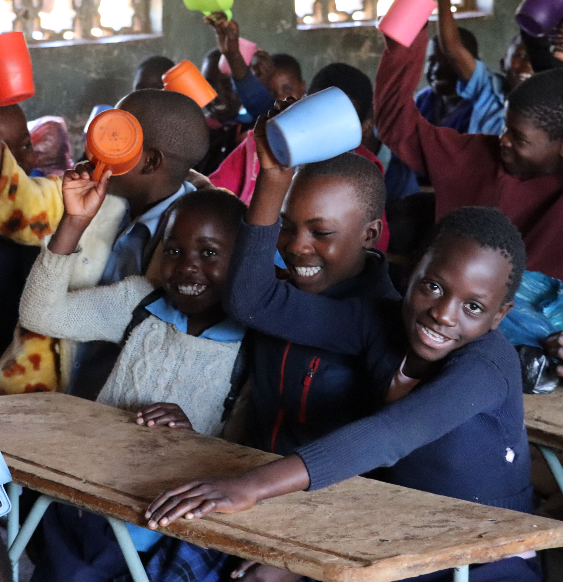

Notes:
Mary’s Meals has launched Feed A School! Formerly known as Sponsor A School, this initiative is a powerful way to help Mary’s Meals reach more of the world’s poorest children by fundraising or donating to provide a year’s worth of daily meals to an entire school.
Every day, millions of children across the world miss out on going to school due to hunger. With Feed A School, you can fund life changing meals for an entire school in Malawi or Zambia for a whole year – giving hungry children the energy to learn and the chance to gain an education that can be their ladder out of poverty.
Feed A School is a transformative way to give hundreds of vulnerable children hope for a better future. Providing life-changing meals for every child in a school has a huge impact, not only for the children, but for their families and wider communities.
Feeding an entire school for a year is more achievable than you think! With Mary’s Meals, it costs just 10p a day to provide a child with a nutritious school meal. Whether you choose to fundraise together with a group of people, or donate as an individual, Feed A School is a powerful way to create lasting change.
You will also have a real sense of connection to your chosen school and to the children you are helping, with regular email updates from the feeding programme and a final report from your chosen school at the end of the year.
Fundraising targets start at £3,000. You can choose to sponsor a school in Malawi, where our story began more than twenty years ago, or in Zambia, a region where high rates of malnutrition and poverty mean many children miss out on school.
There are lots of ways to support your chosen school, from fundraising to setting up a regular gift or making a one-off donation. However you choose to Feed A School, you’ll make a lasting difference to the lives of hungry children.
To find out more about Feed A School and how to get involved, please visit: www.marysmeals.org.uk/feed-a-school

