Slide 1


Slide 2


Slide 3
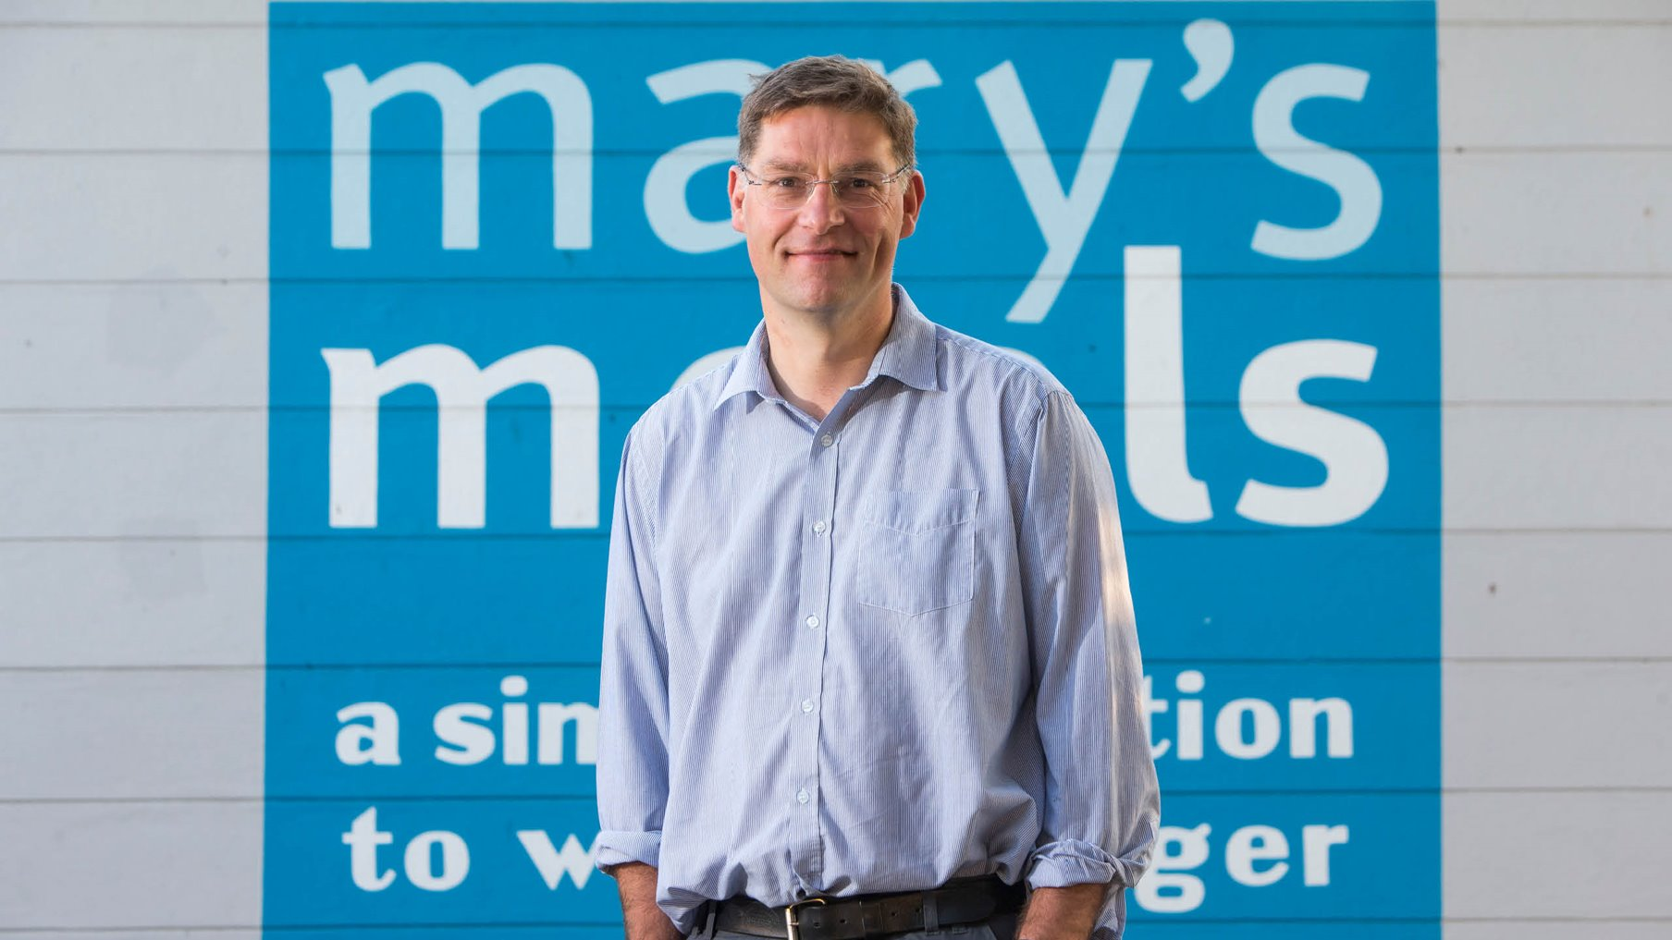

Slide 4
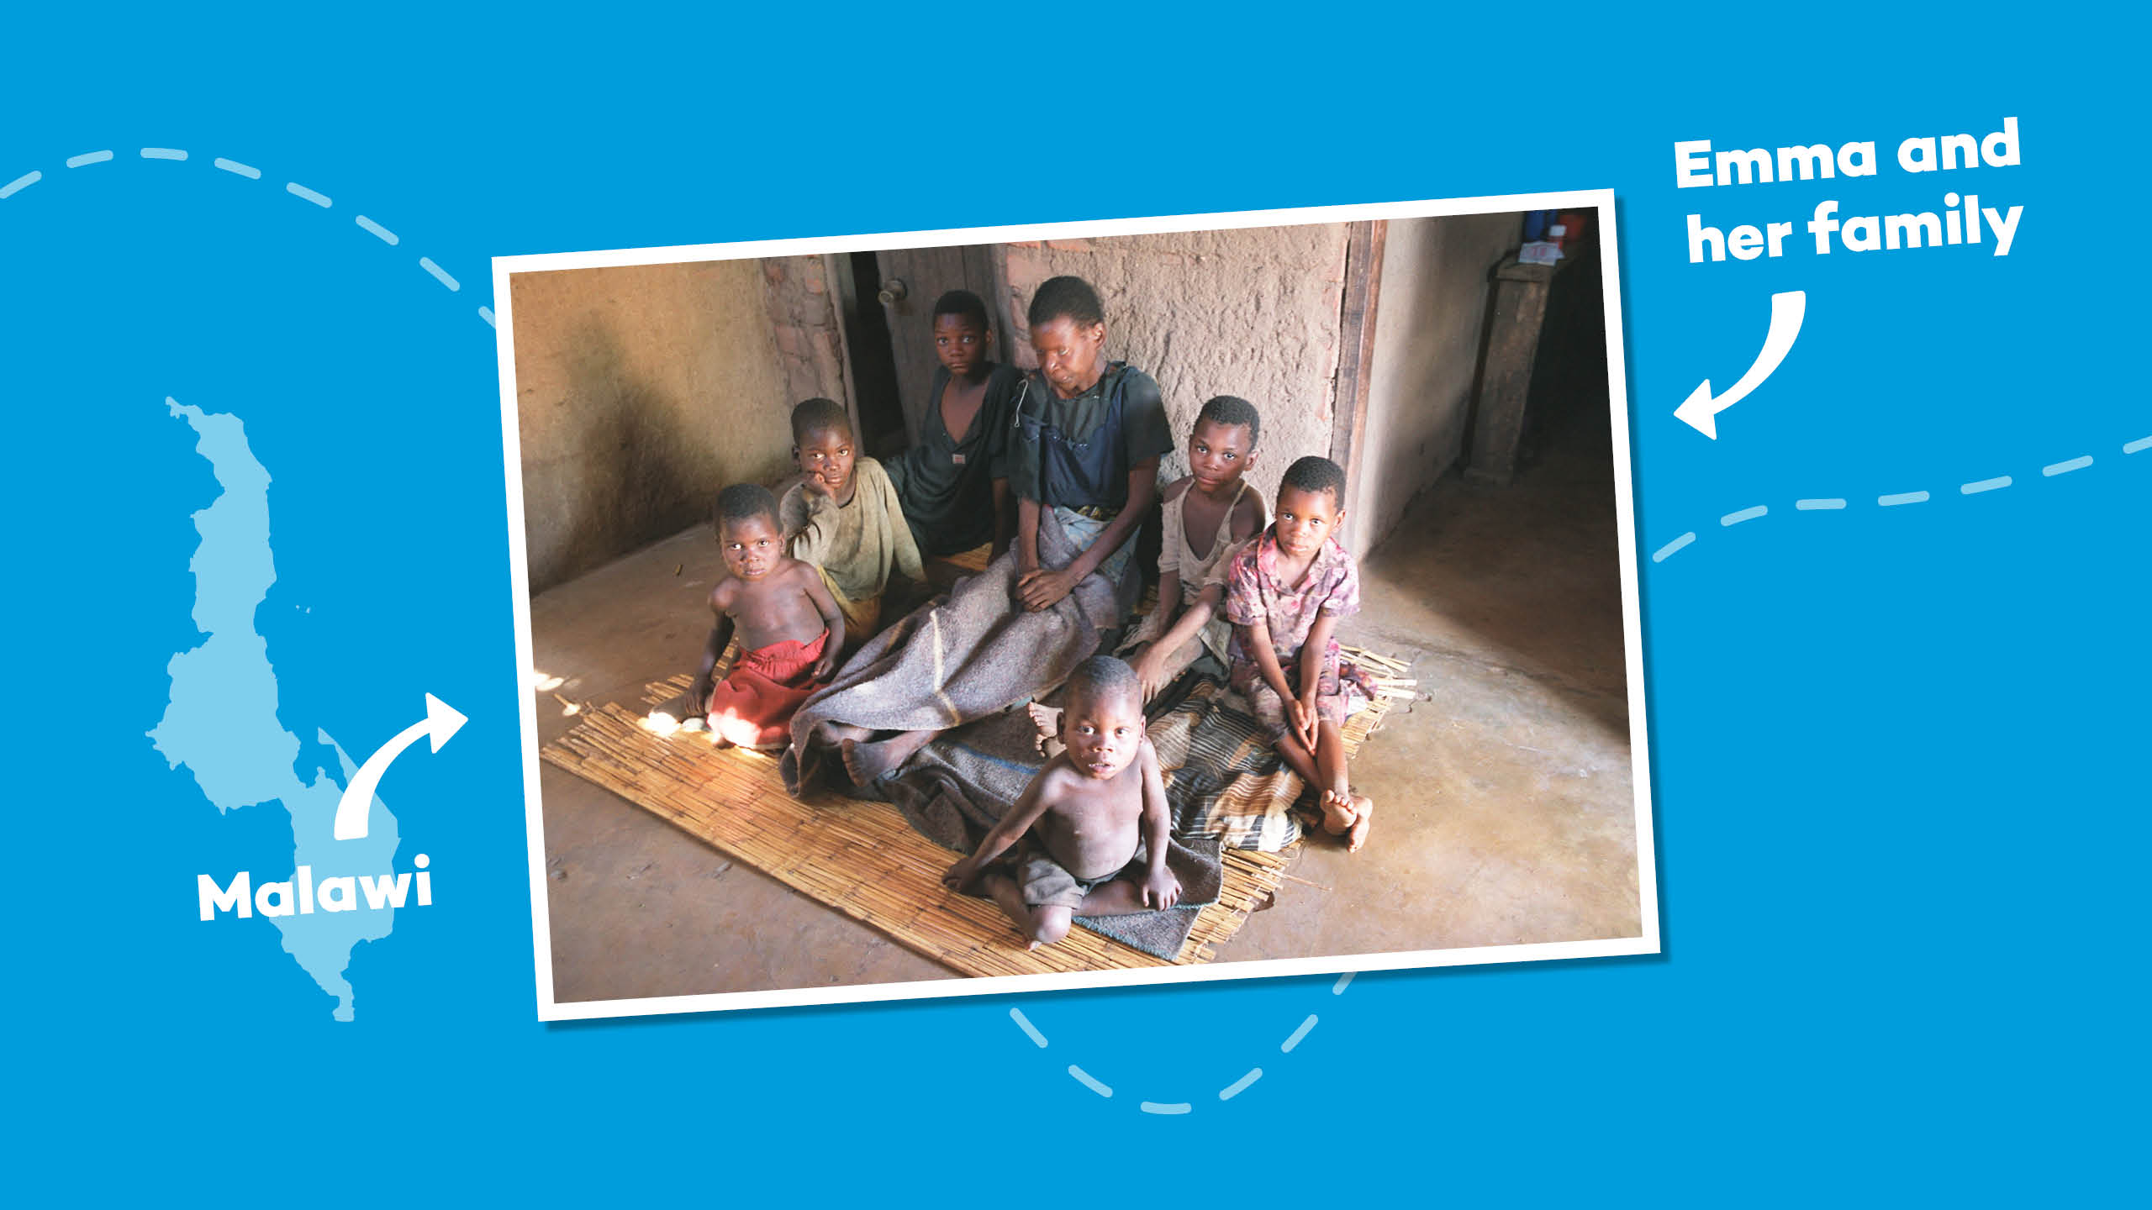
Notes:
In 2002, Magnus was visiting Malawi while the country was in the grip of famine. It was here he met Emma, a mother who was dying and who was surrounded by her six children.
Emma’s husband had died a year previously, killed by AIDS, the same disease that was now about to steal her from her children.
Magnus tried to lift the atmosphere by asking 14-year-old Edward, Emma’s eldest child, what his hopes and ambitions were.

Slide 5
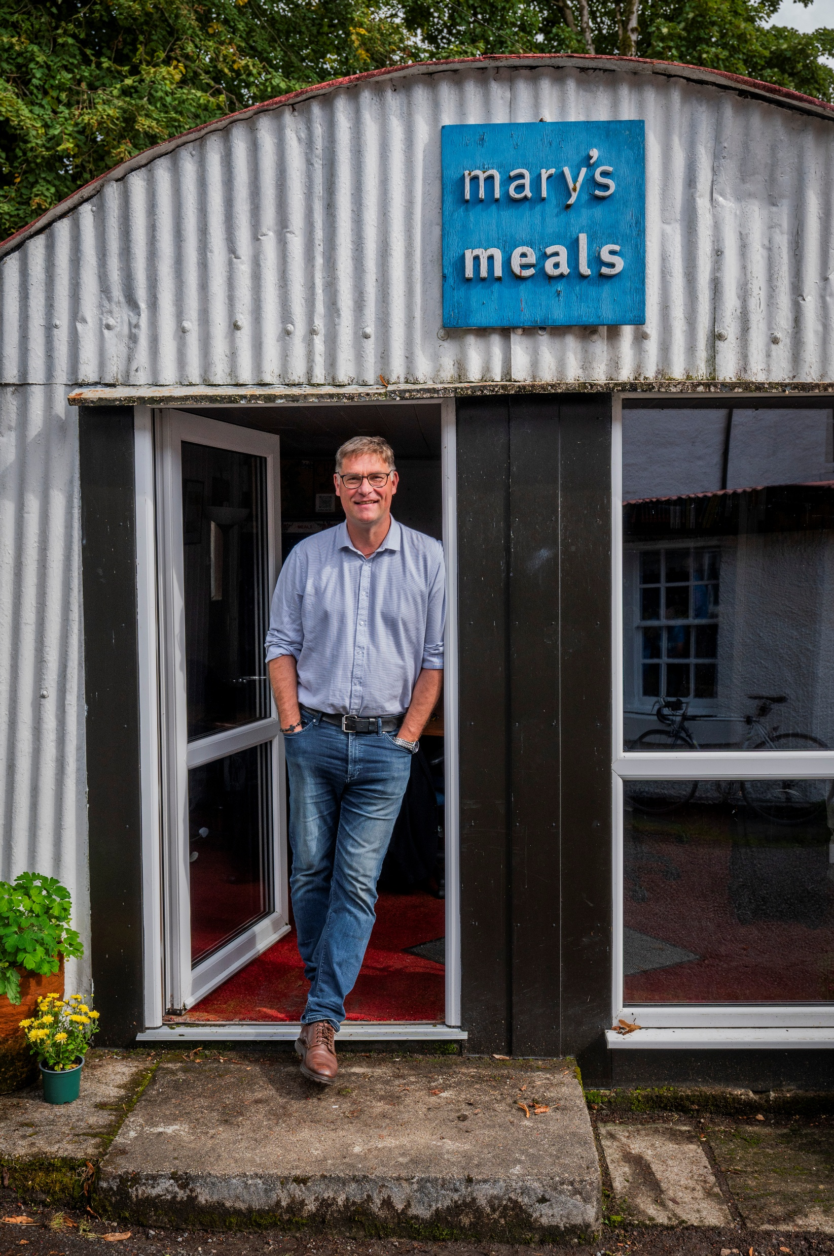
“I would like to have enough food to eat and
I would like to go to
school one day.”
Edward, Malawi

Slide 6
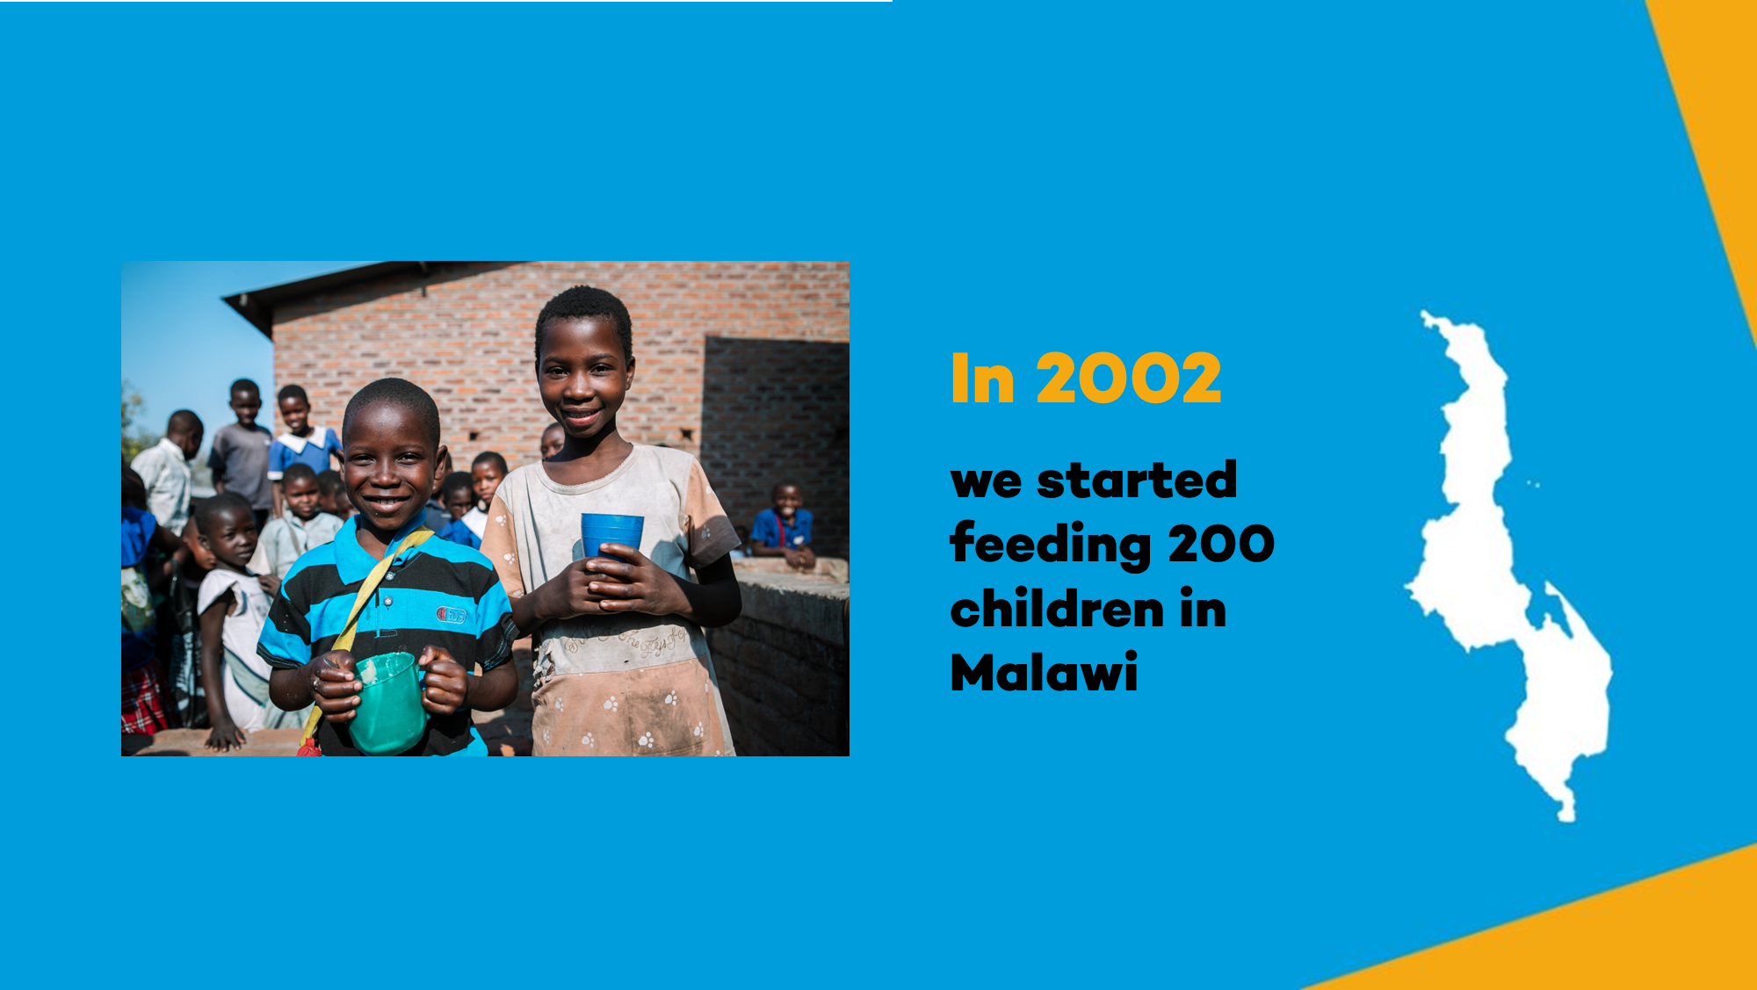
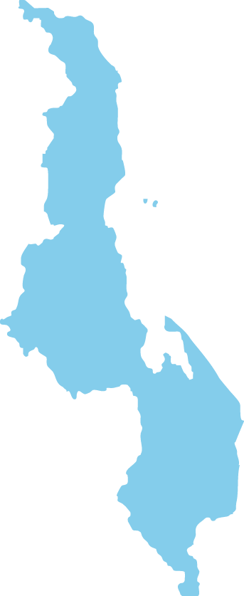

Malawi
In 2002 we started feeding 200 children in Malawi

Slide 7
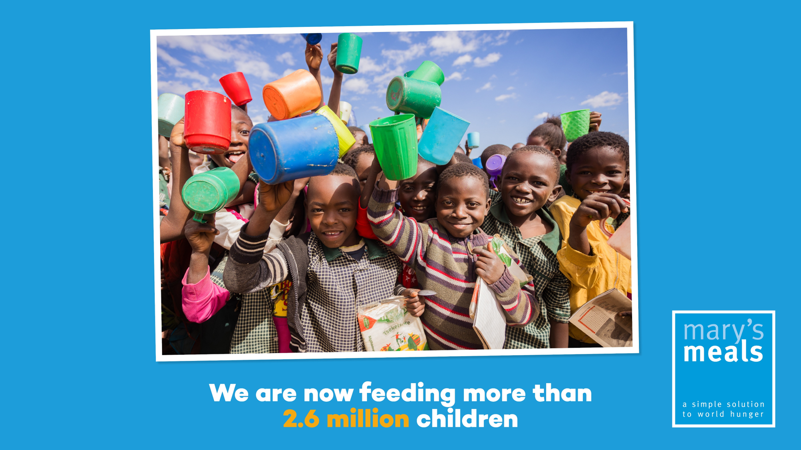

We are now feeding more than three million children every school day.

Slide 8
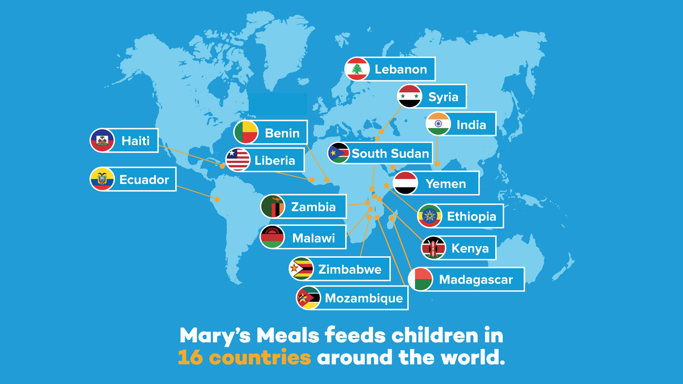
Mary’s Meals feeds children in 16 countries around the world.

Slide 9
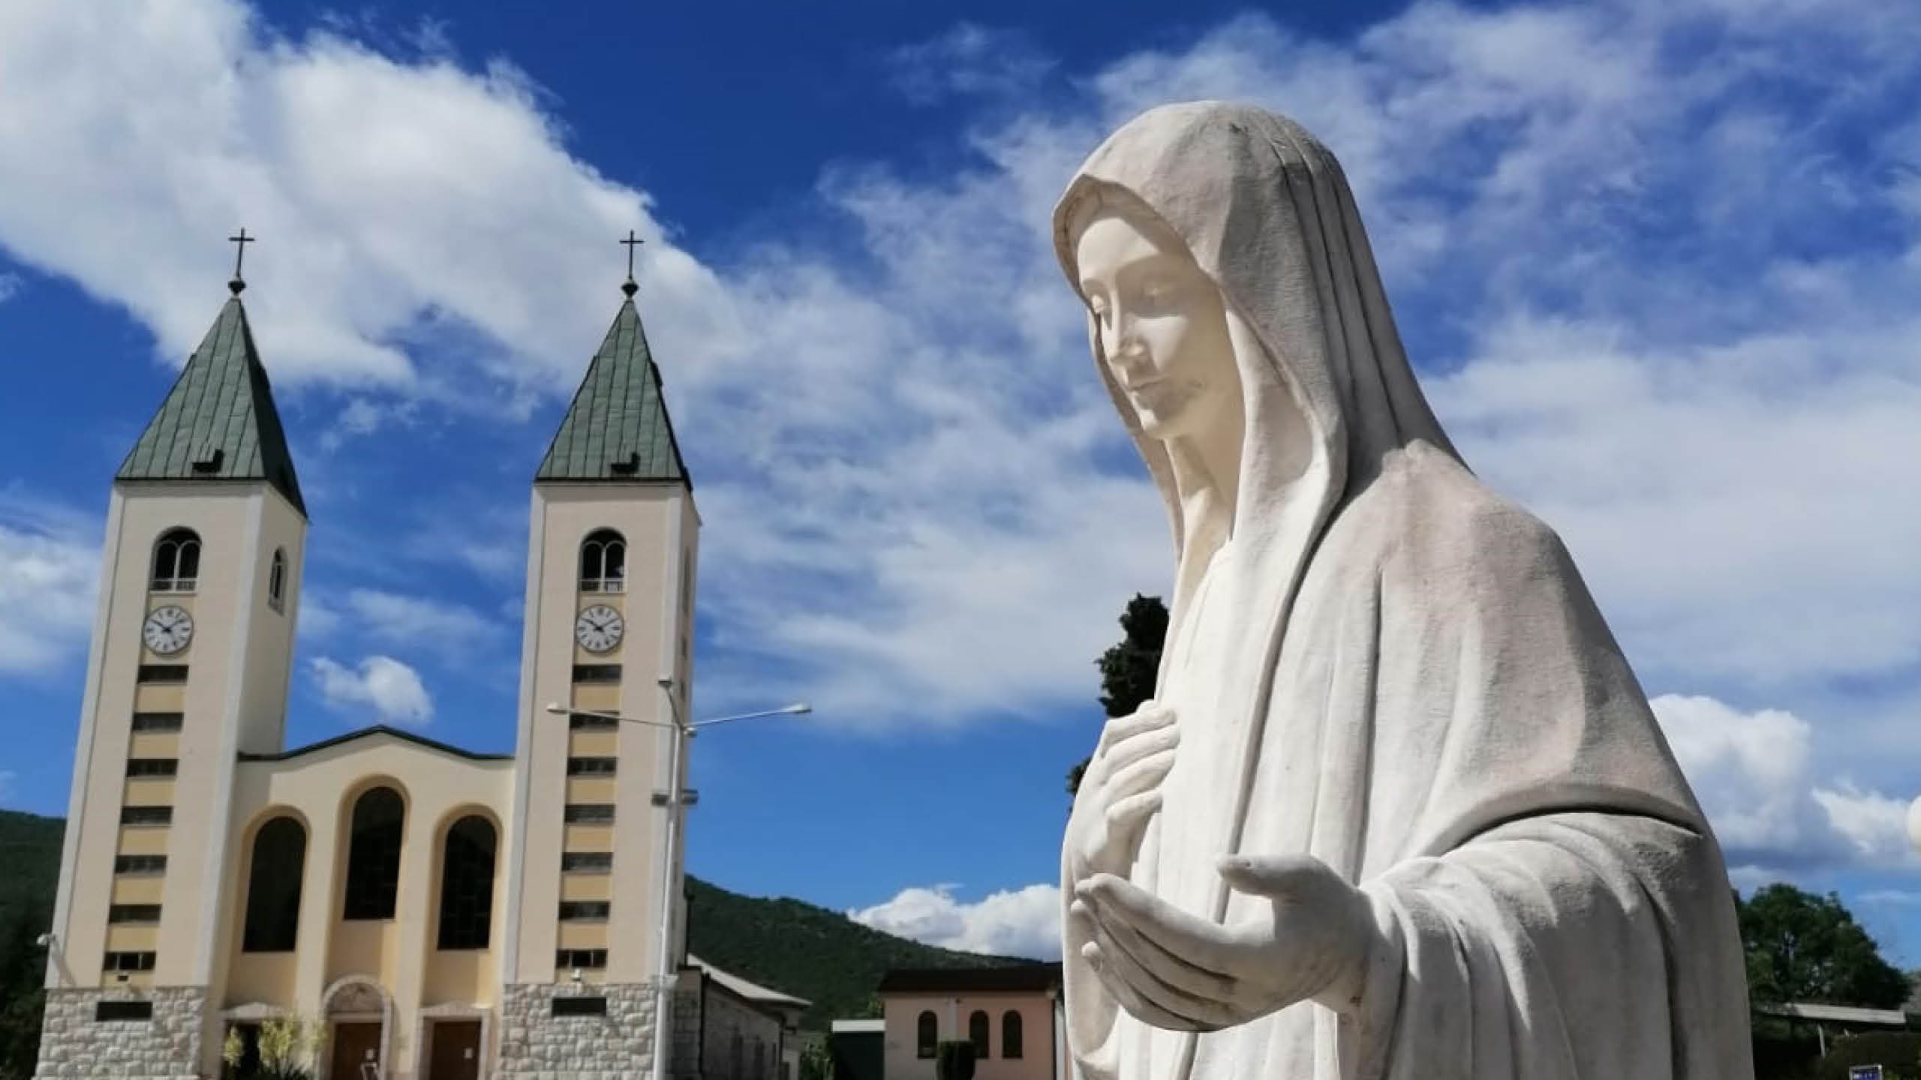

Slide 10
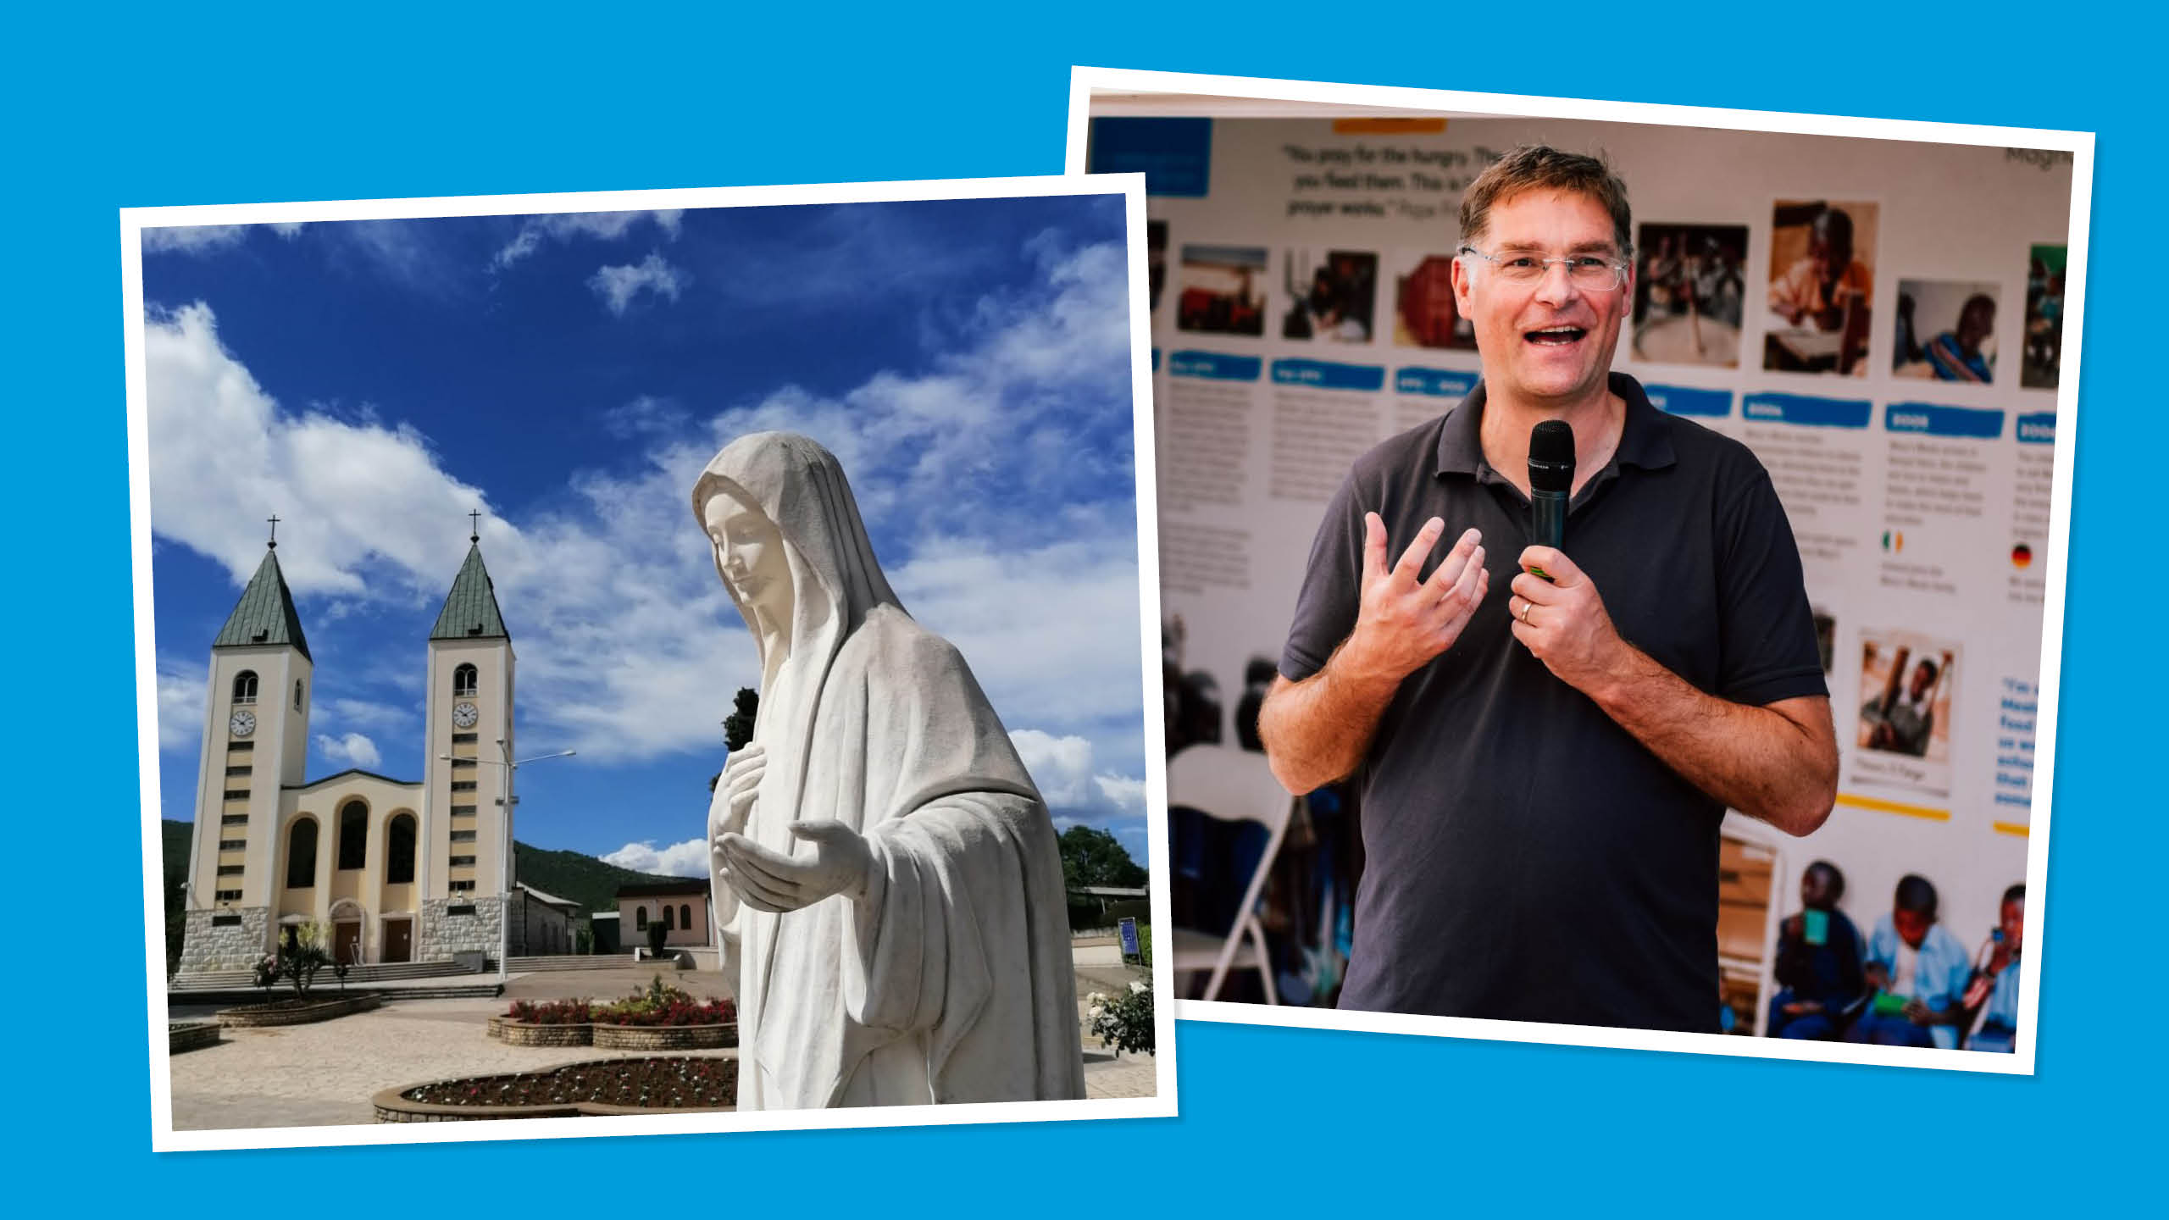

Slide 11
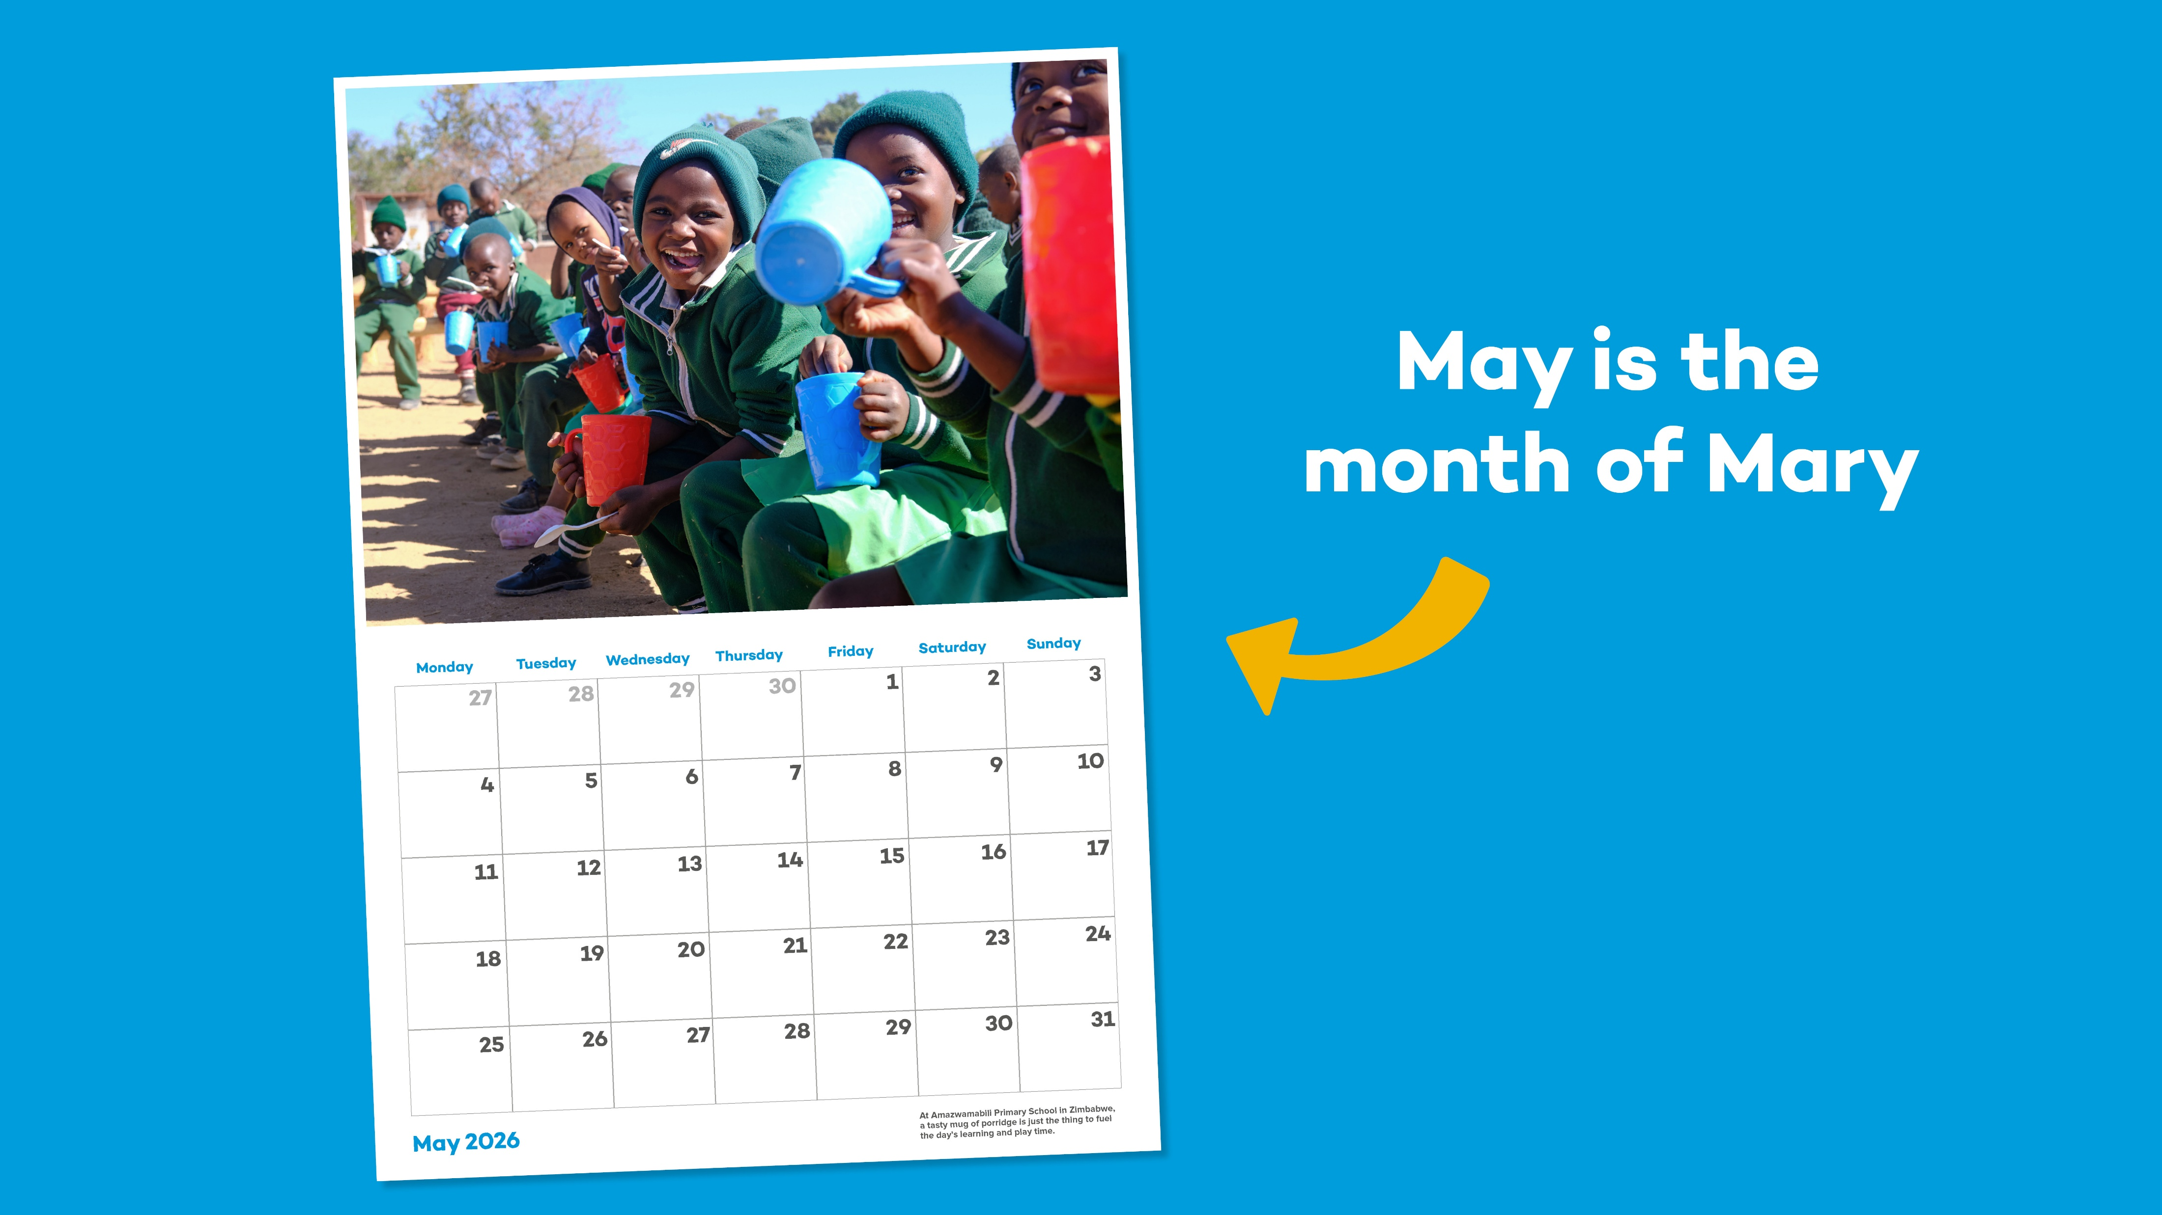

Slide 12


Slide 13
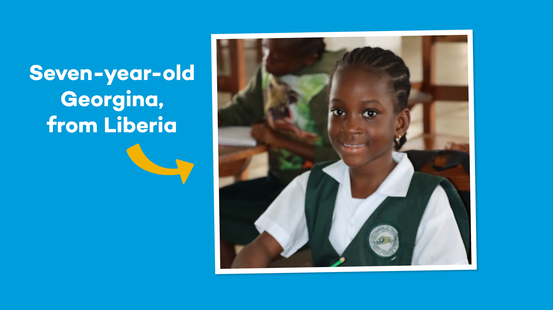

Slide 14
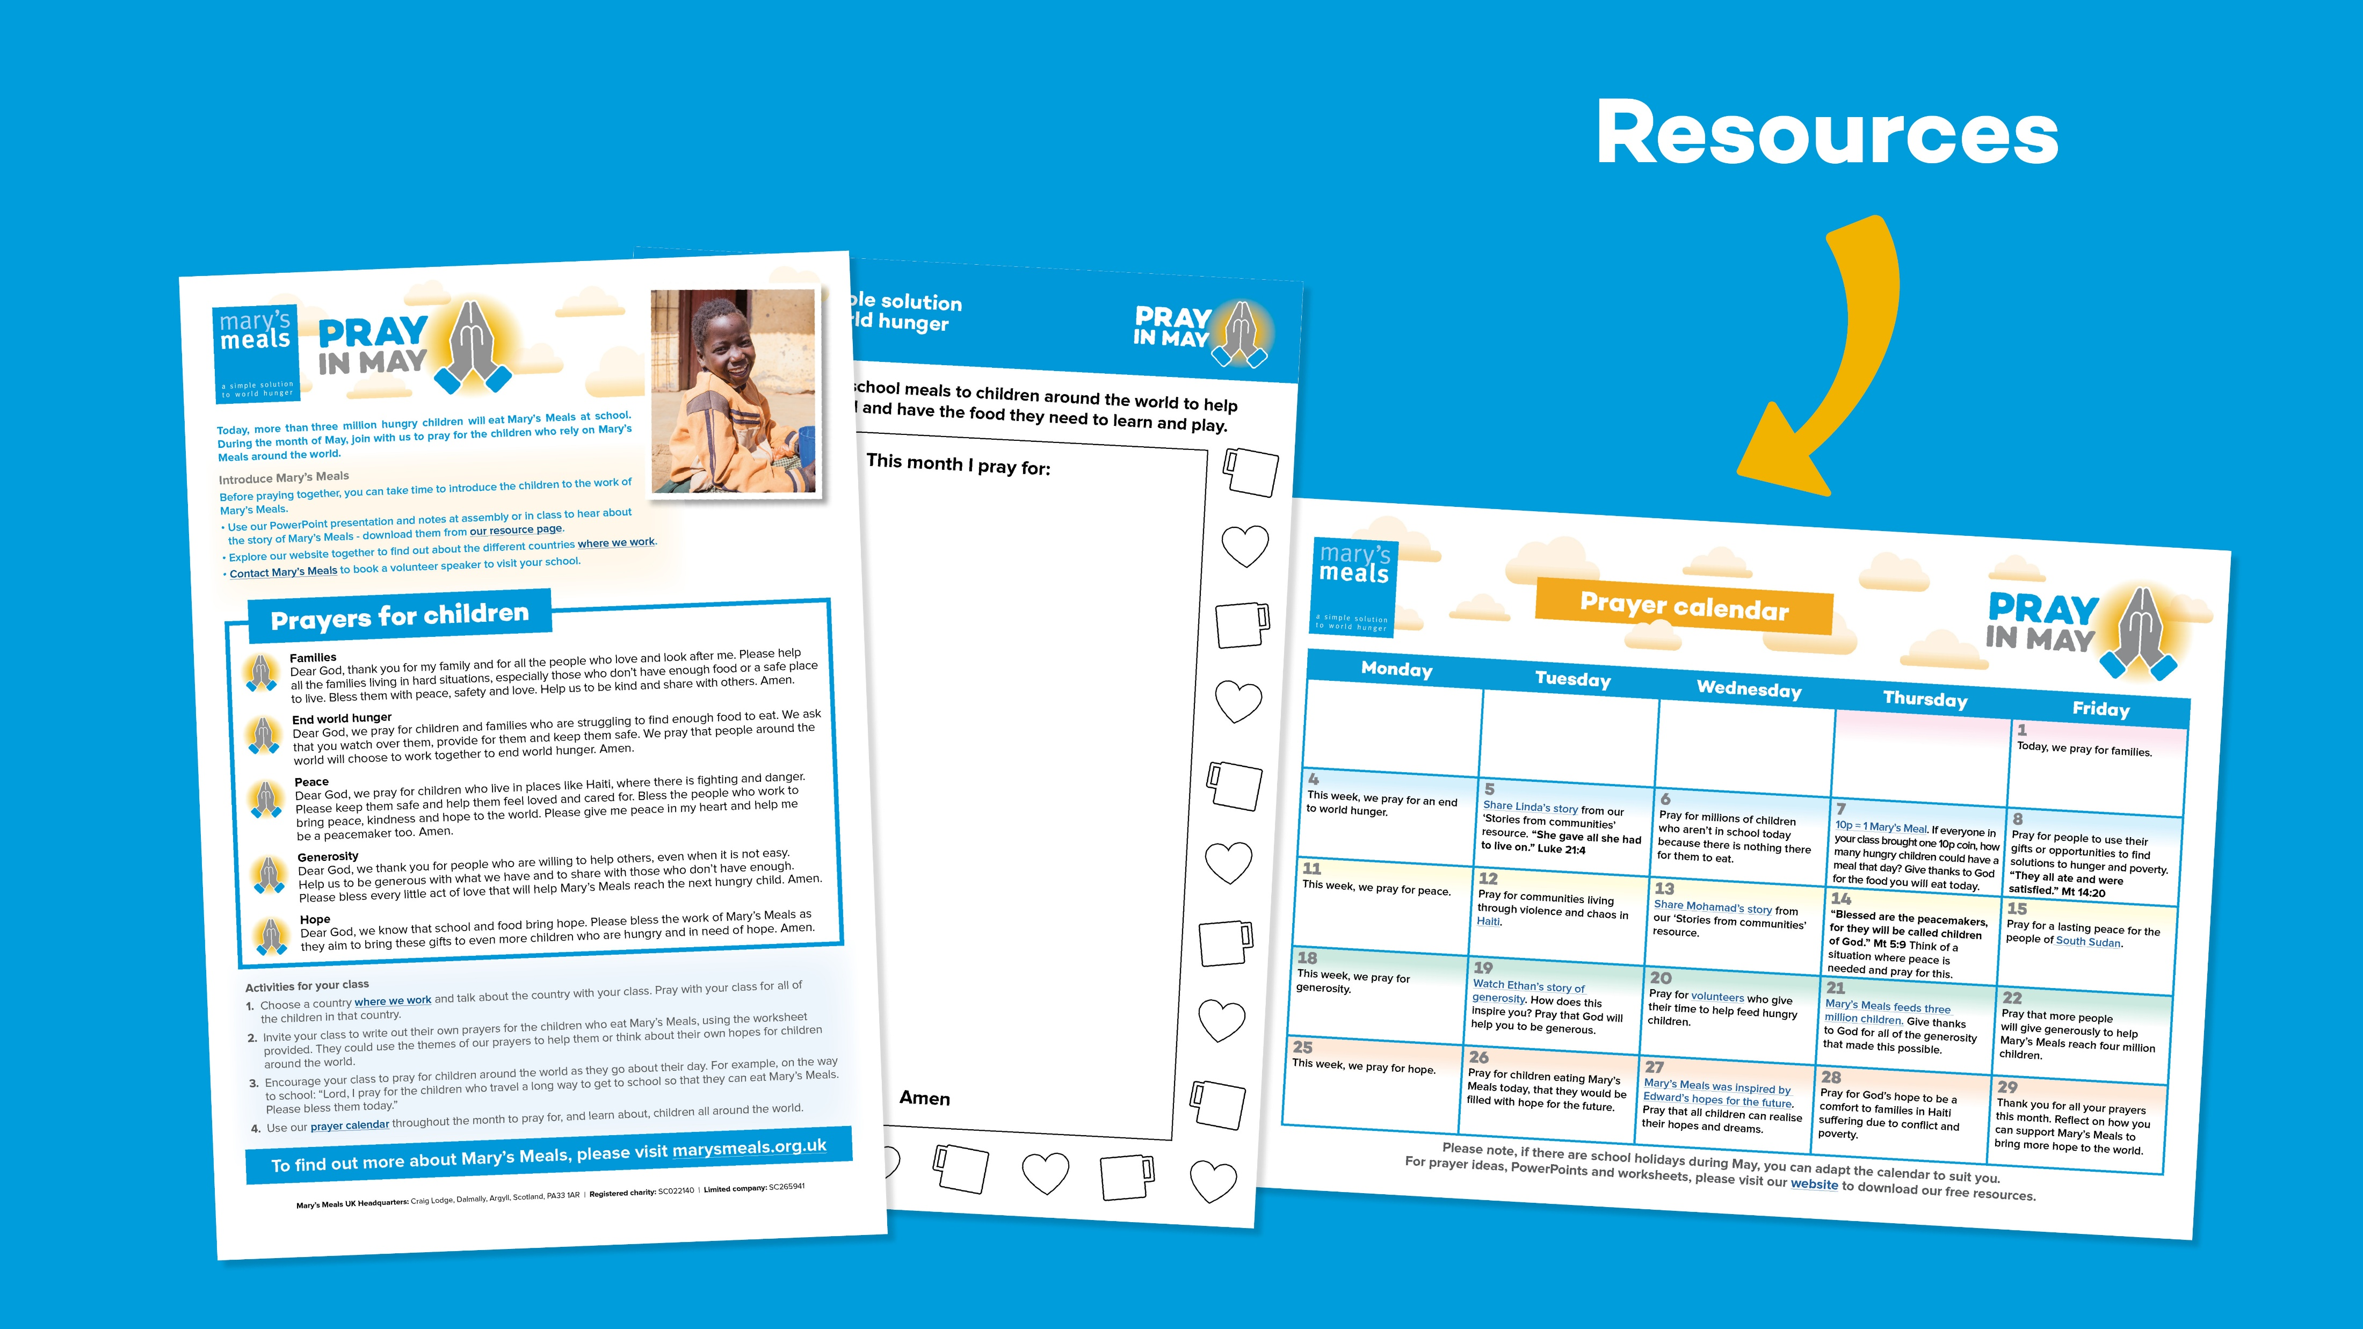

Slide 15


Slide 16
What are the different ways you can pray?

Slide 17
Let’s pray

