Slide 1


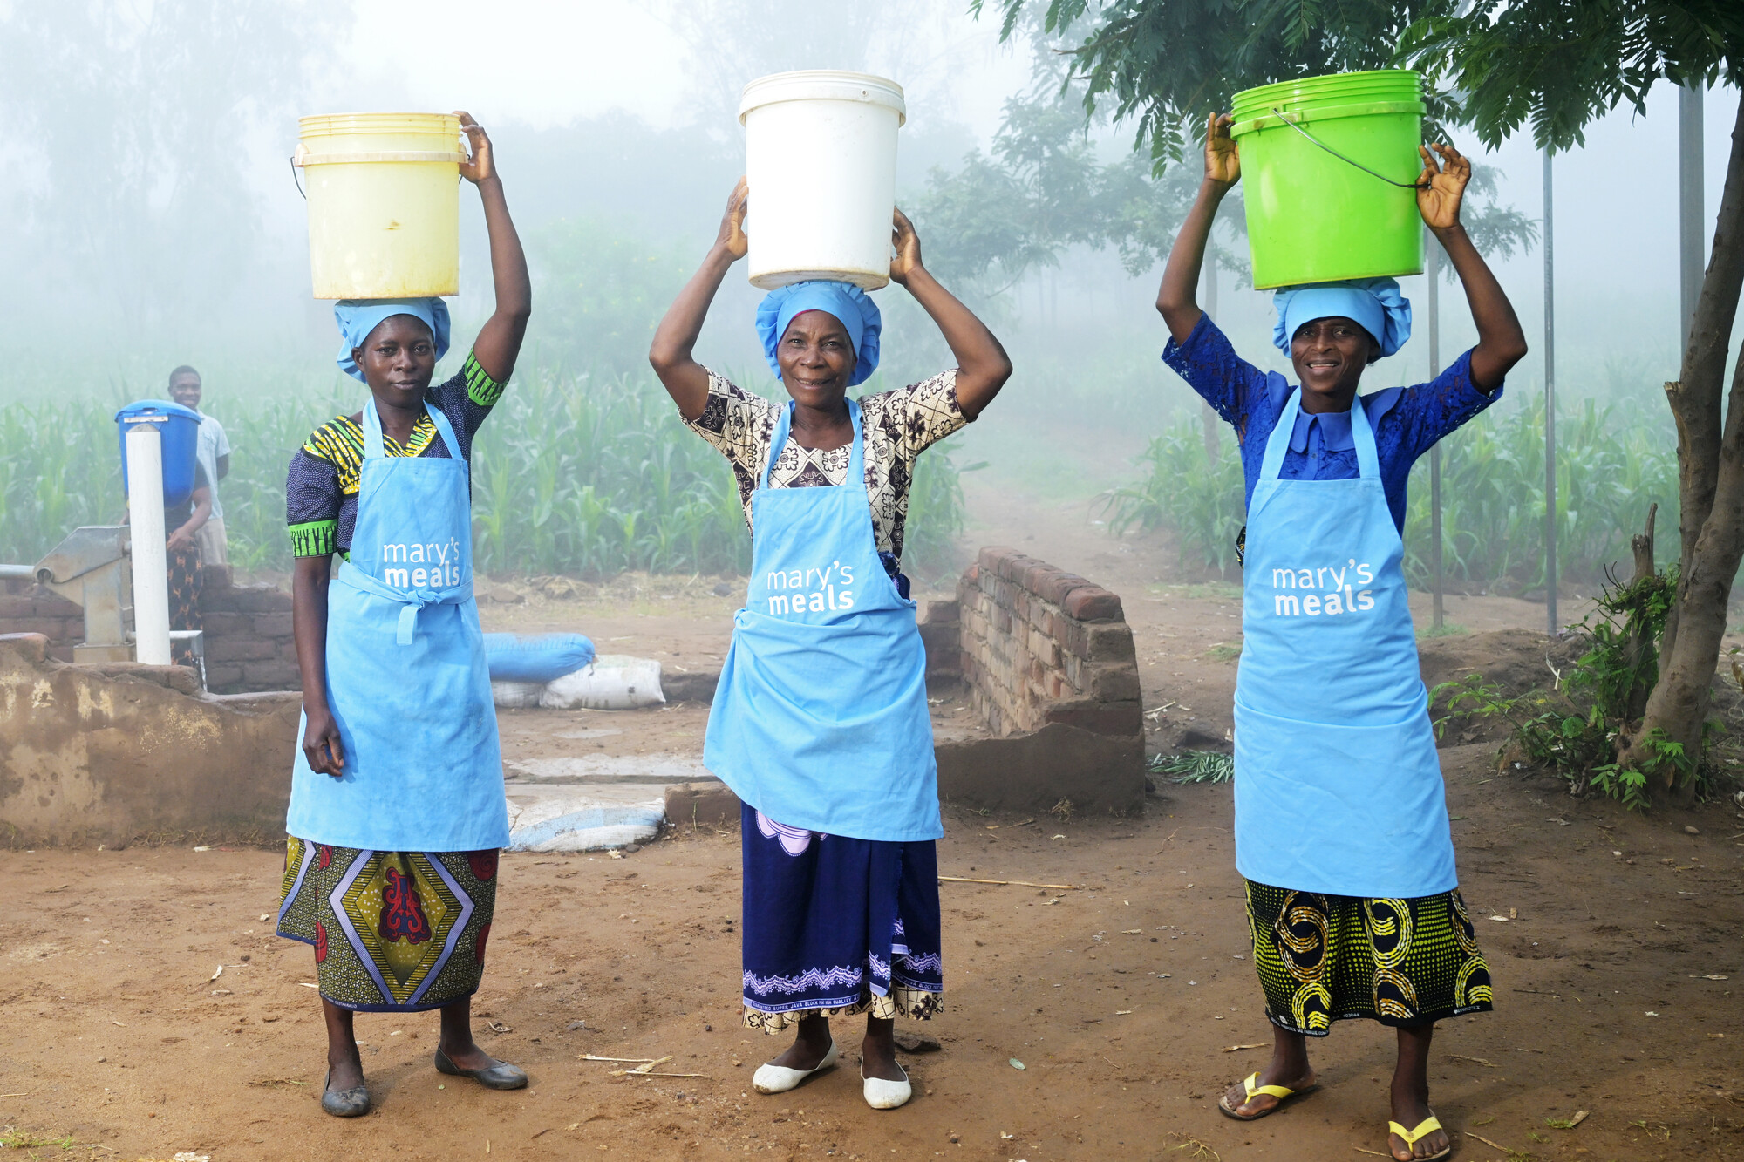
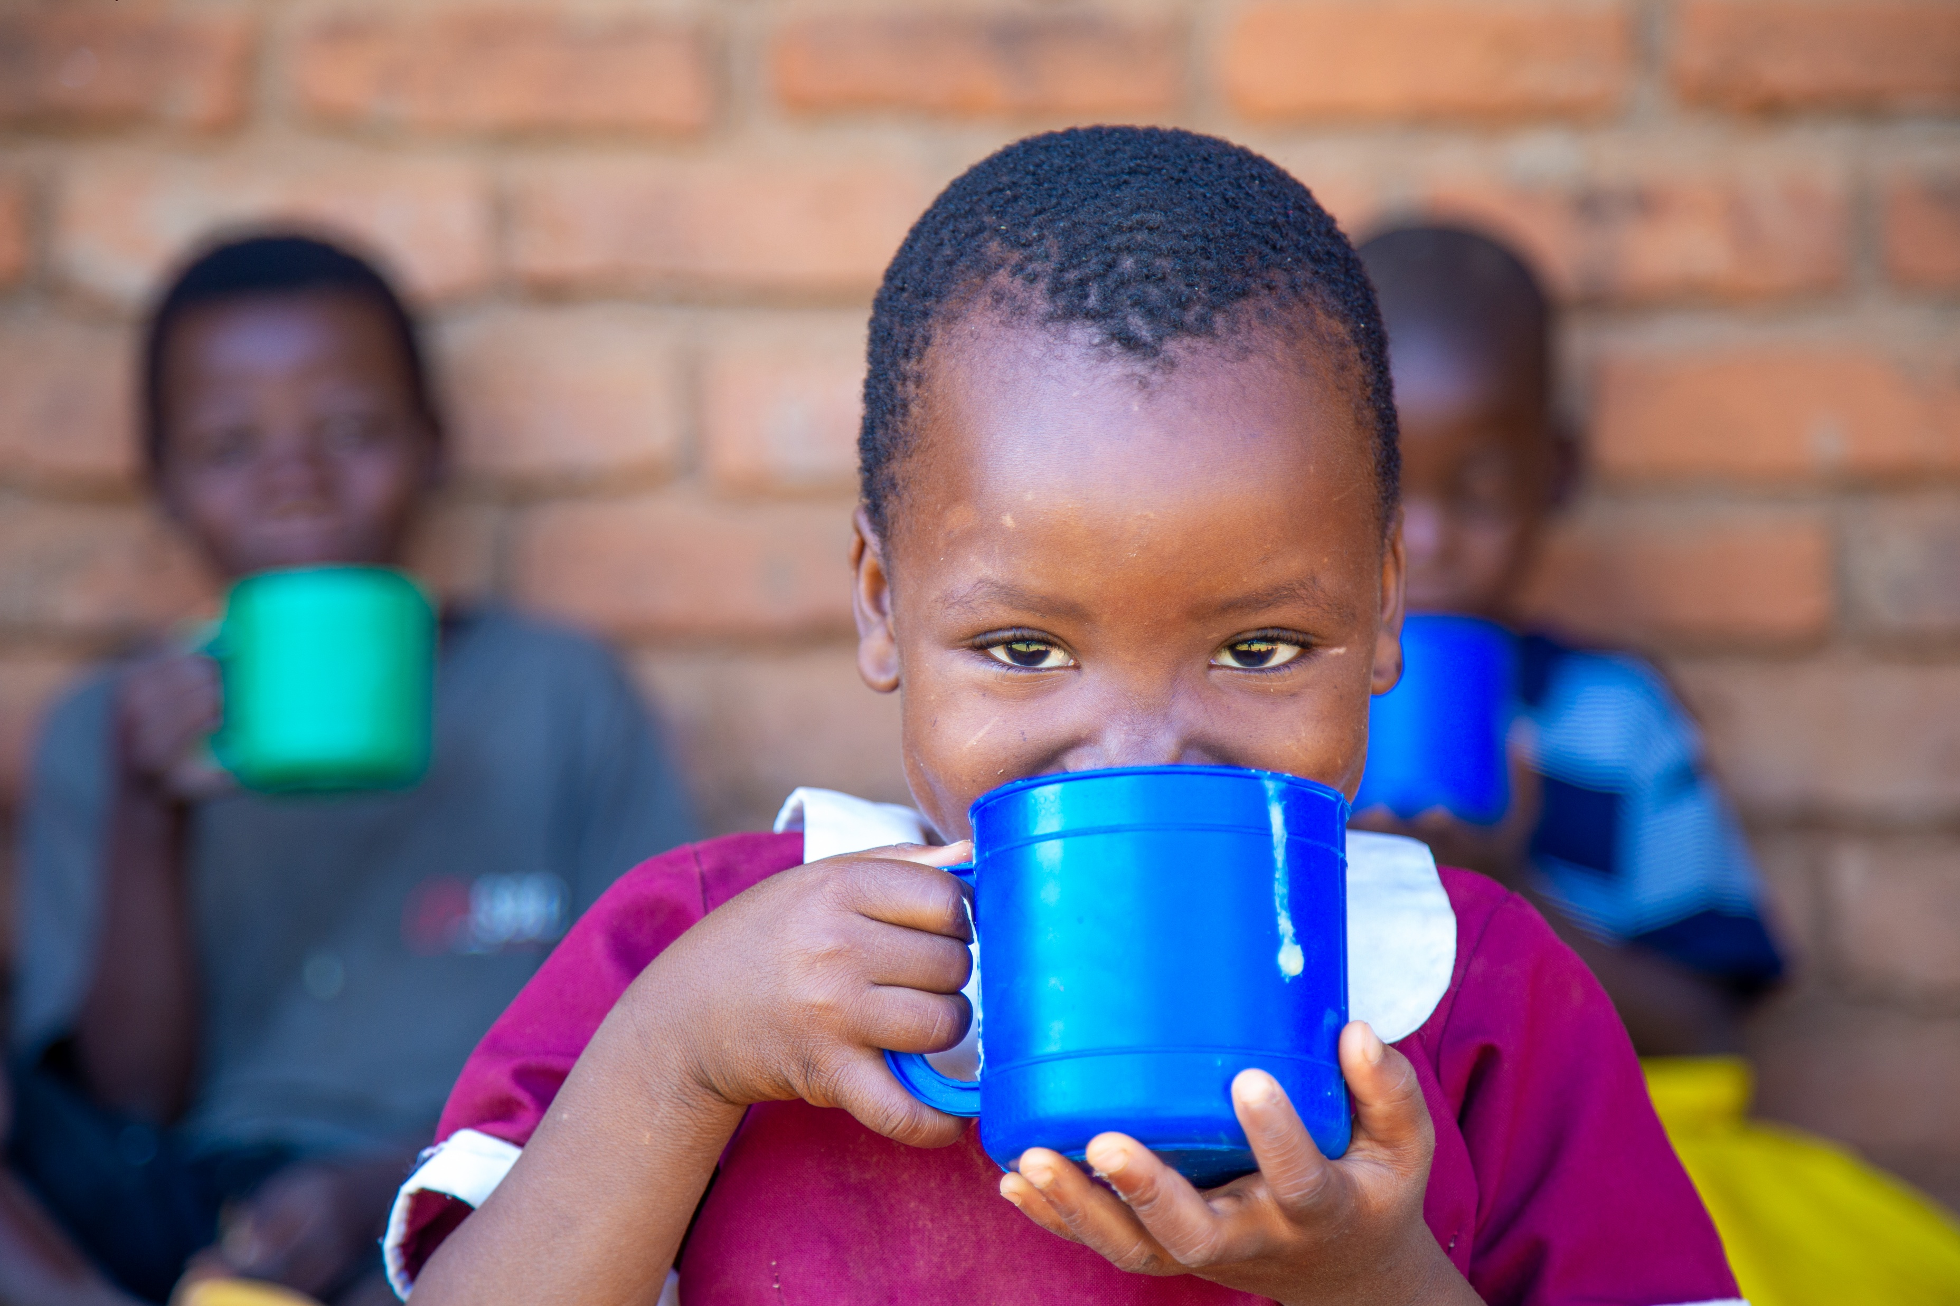
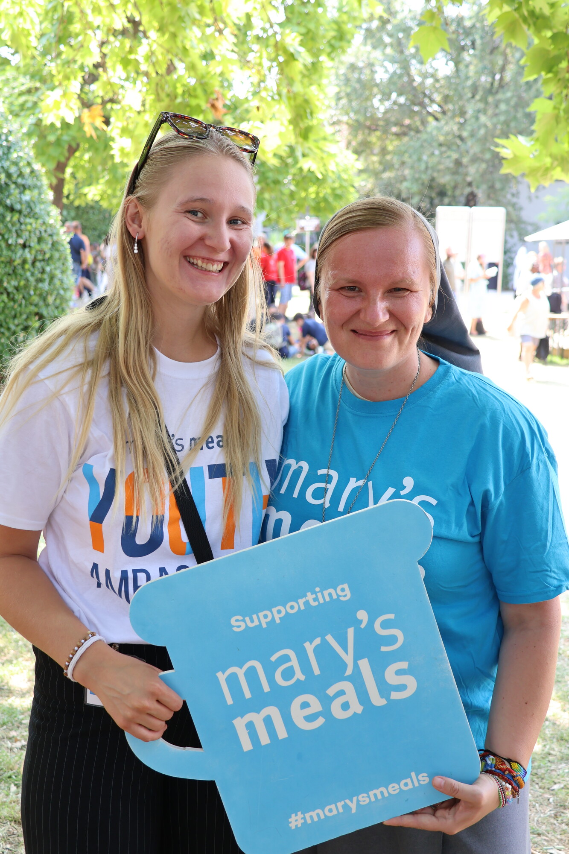
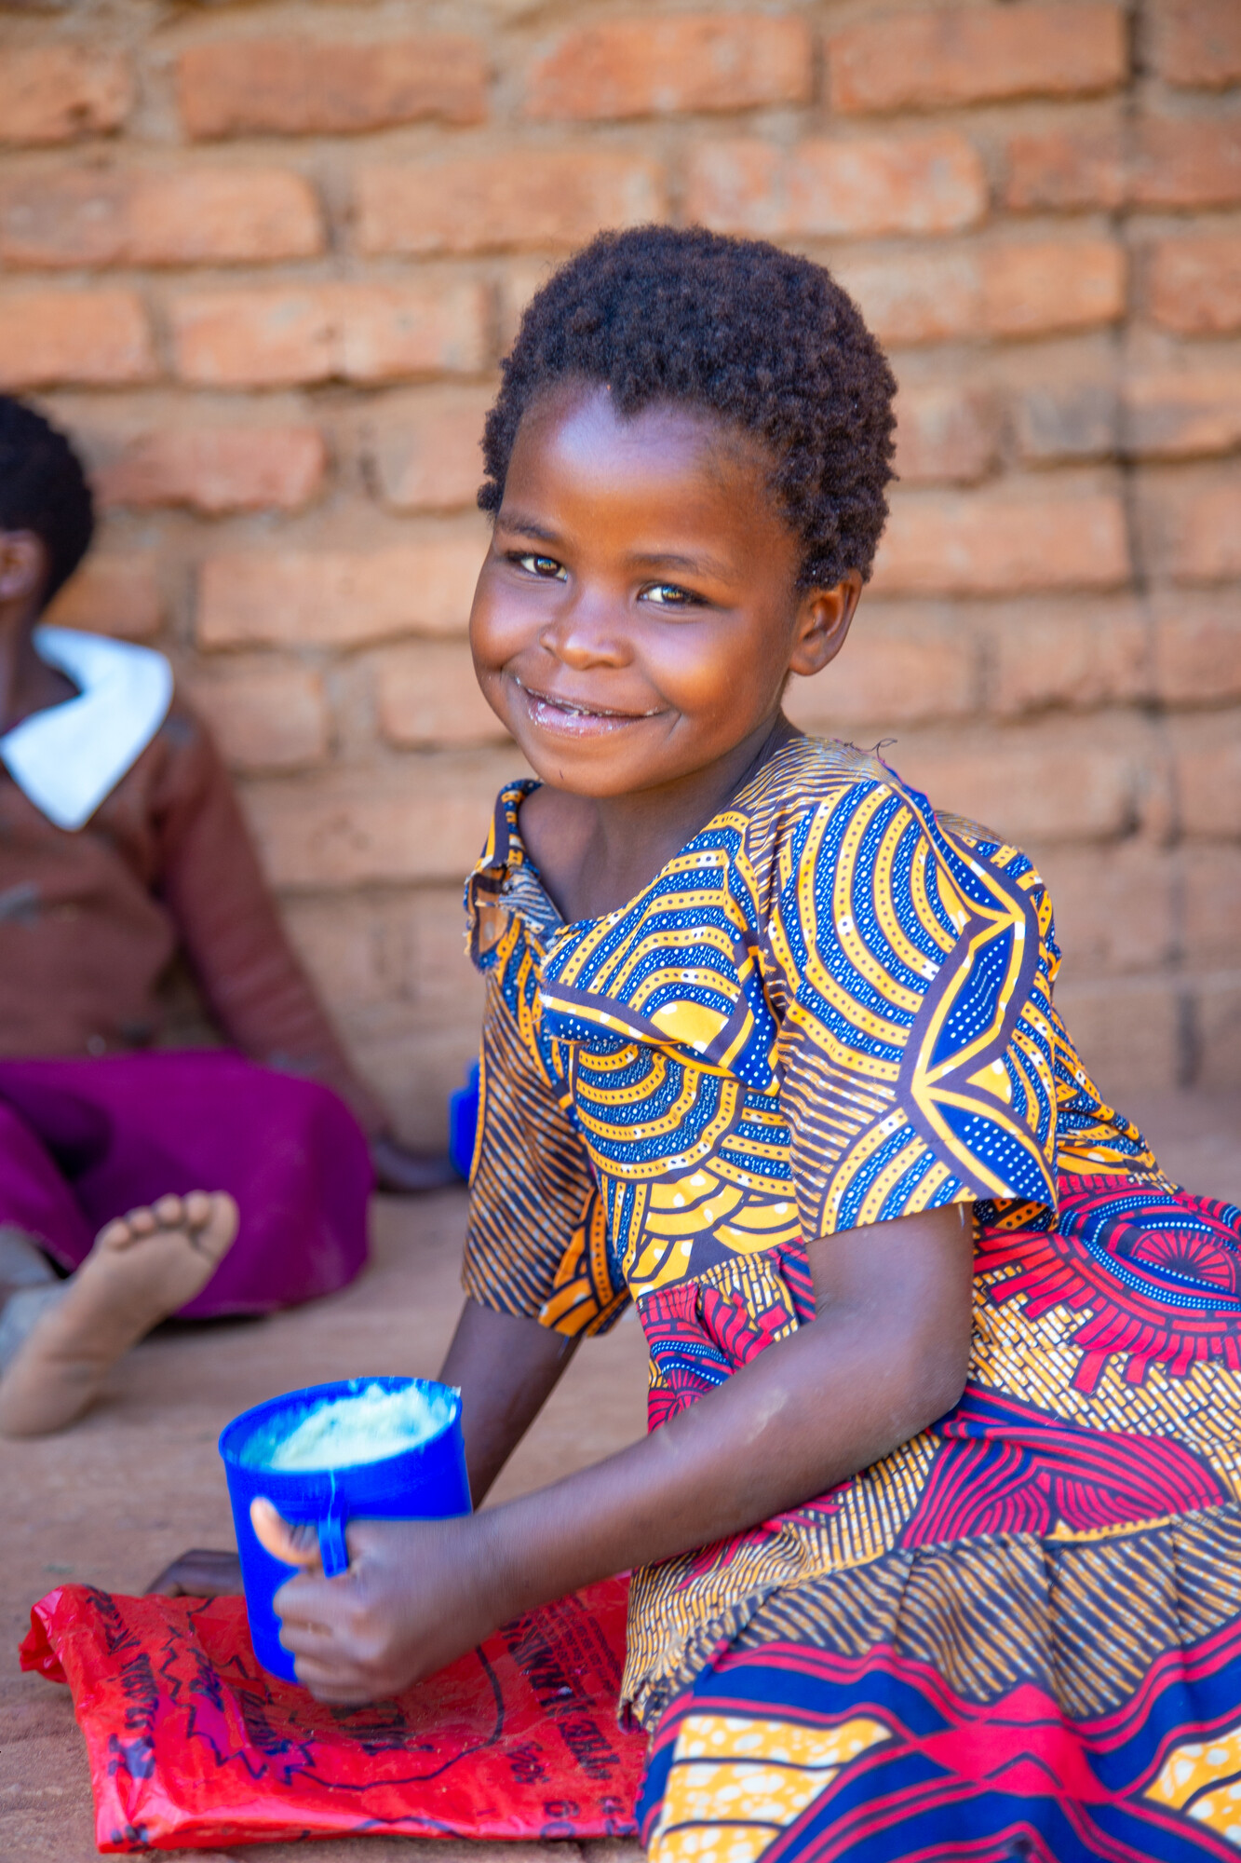

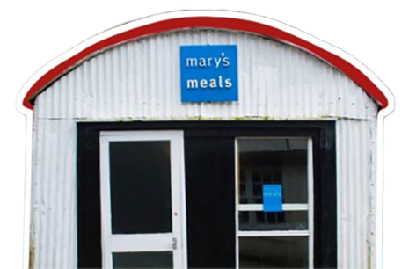
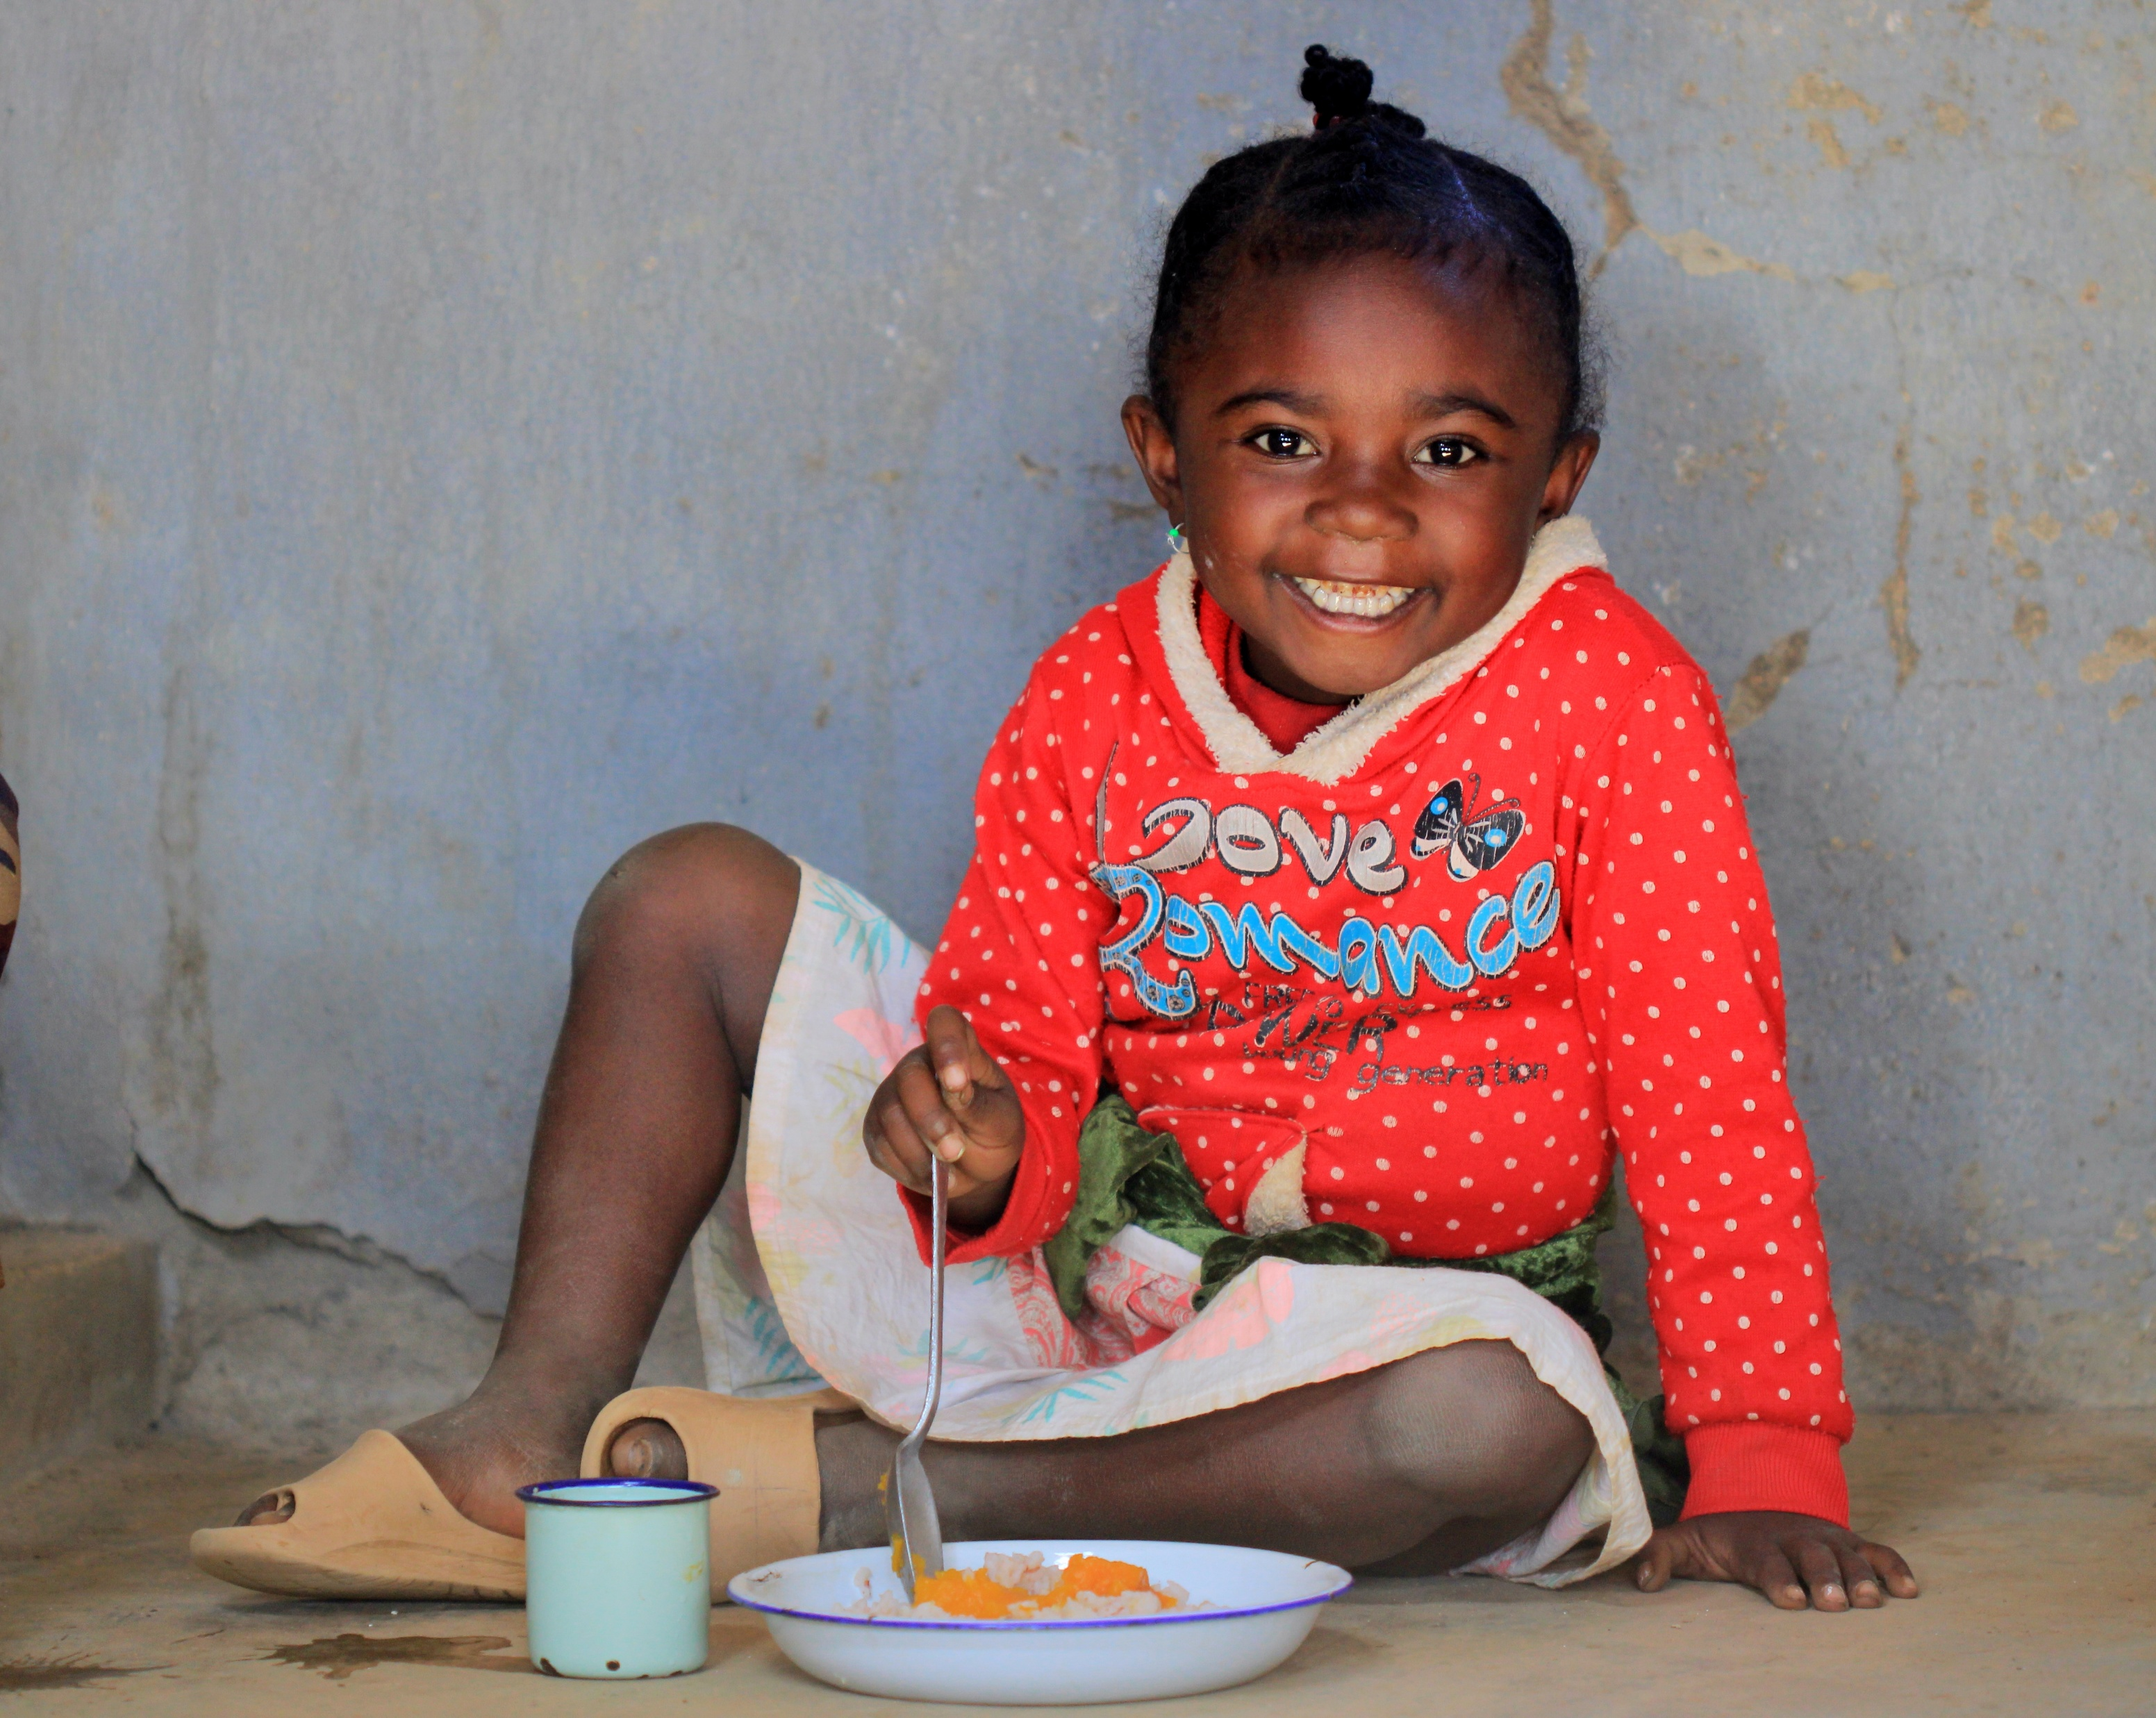
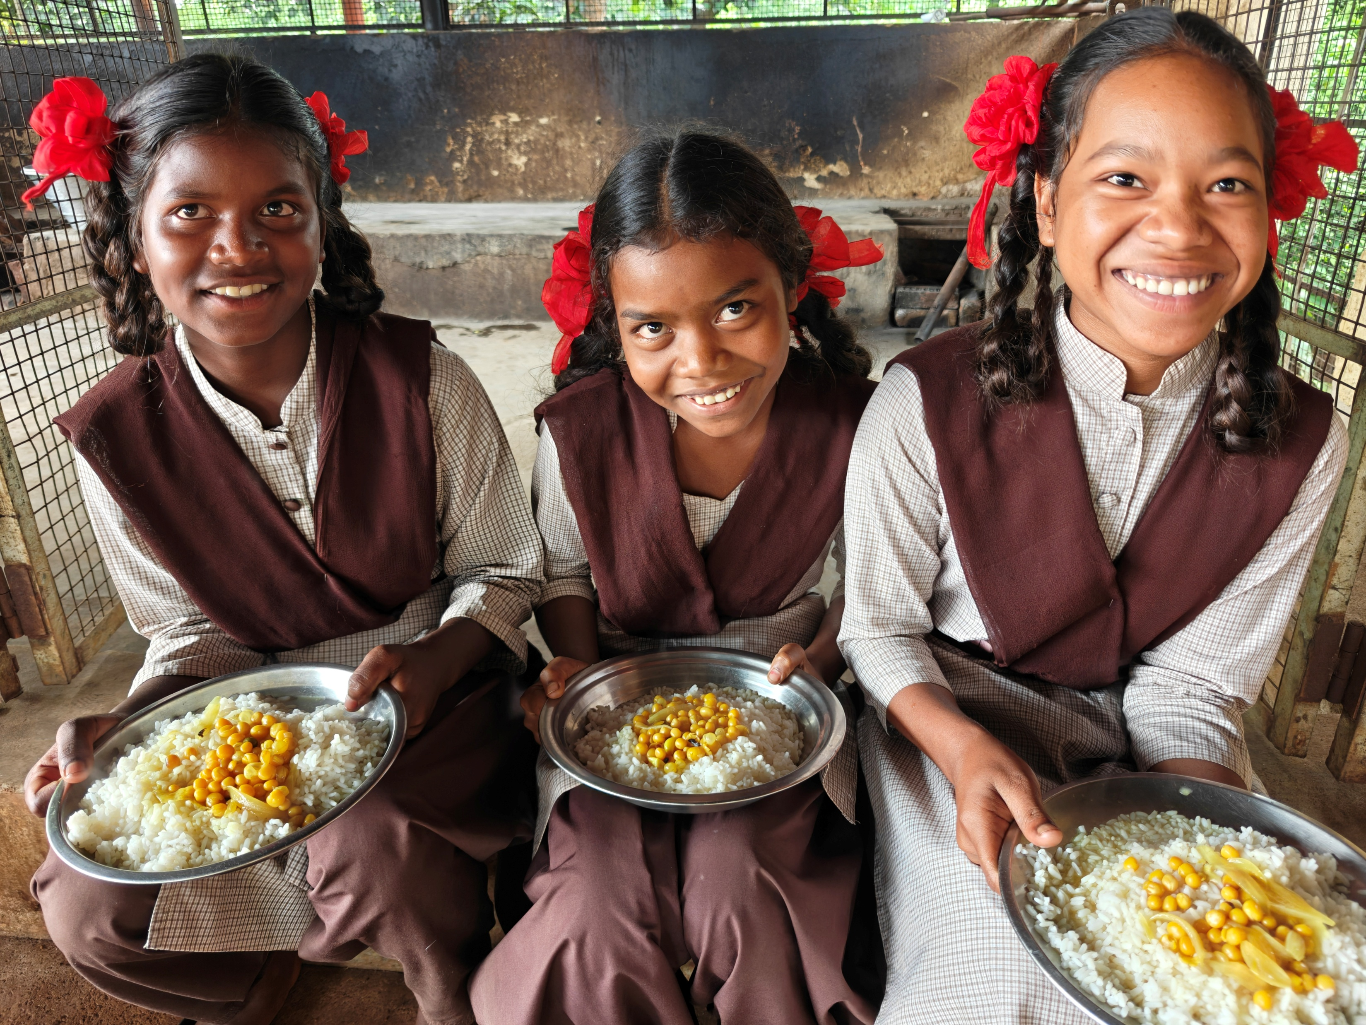
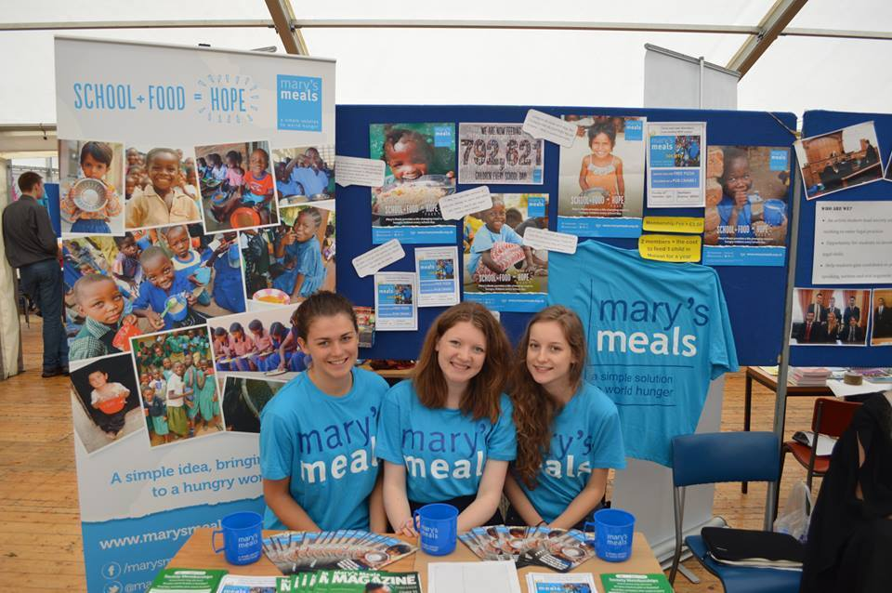
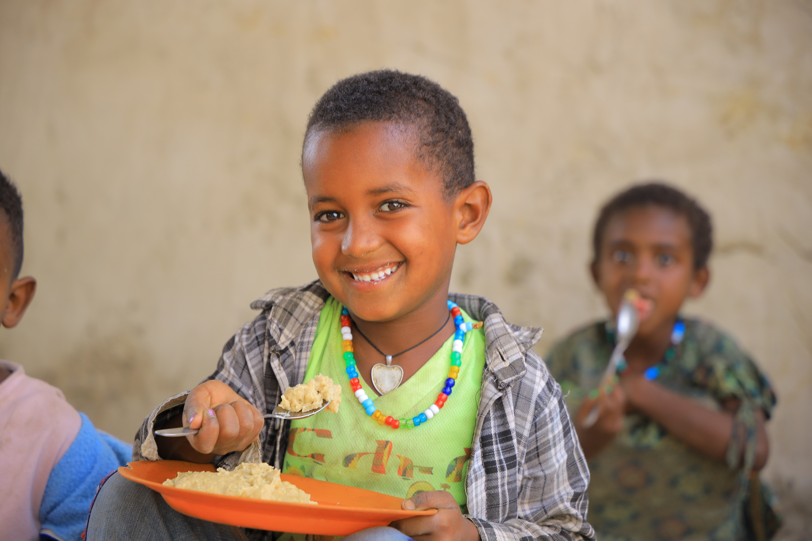
a simple solution to world hunger

Slide 2
“When Jesus looked up and saw a great crowd coming toward him, he said to Philip, ‘Where shall we buy bread for these people to eat?’ Philip answered him ‘It would take more than half a year’s wages to buy enough bread for each one to have a bite!” (John 6: 5, 7)

Slide 3
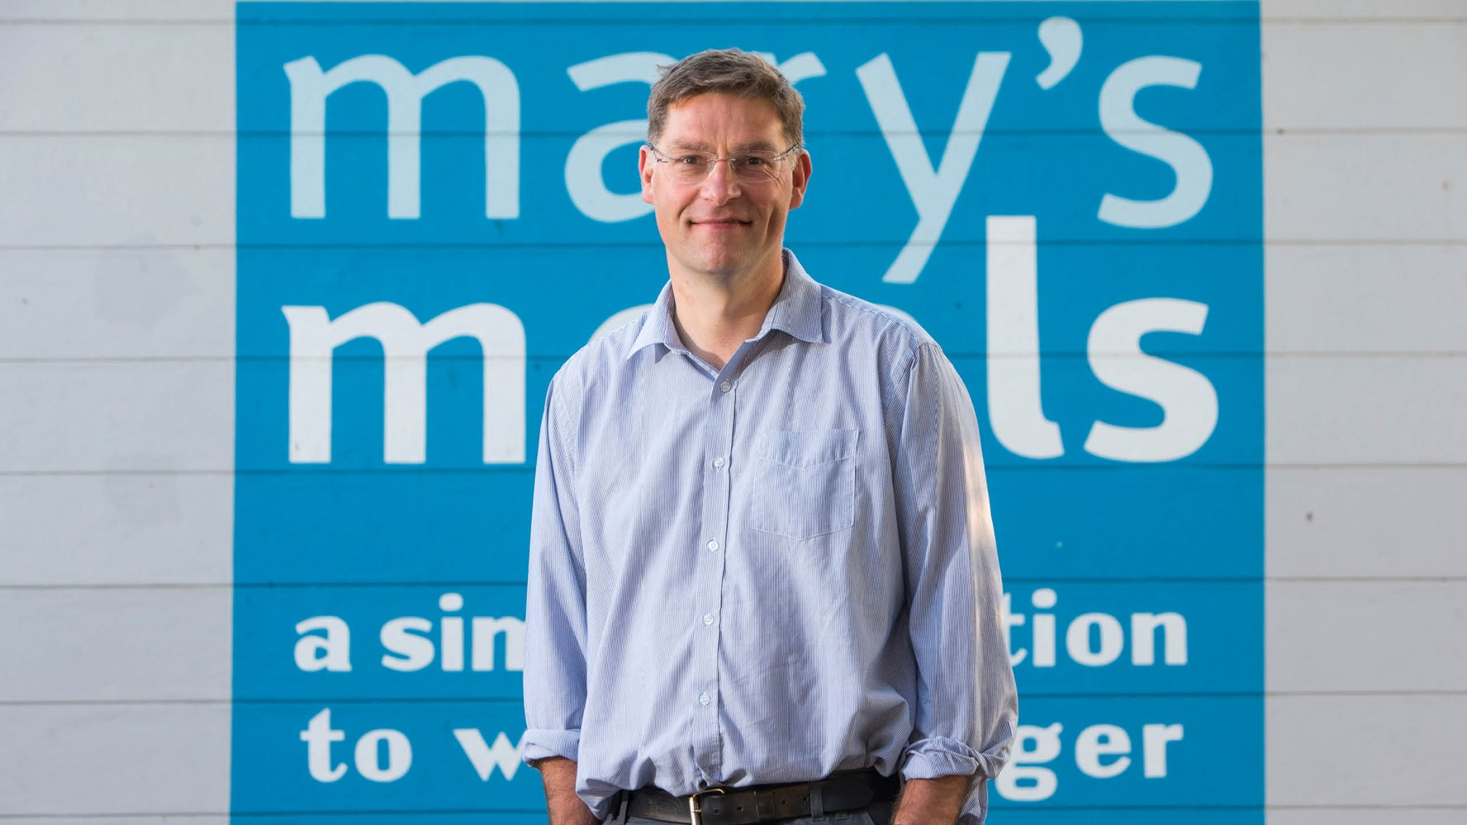

Slide 4
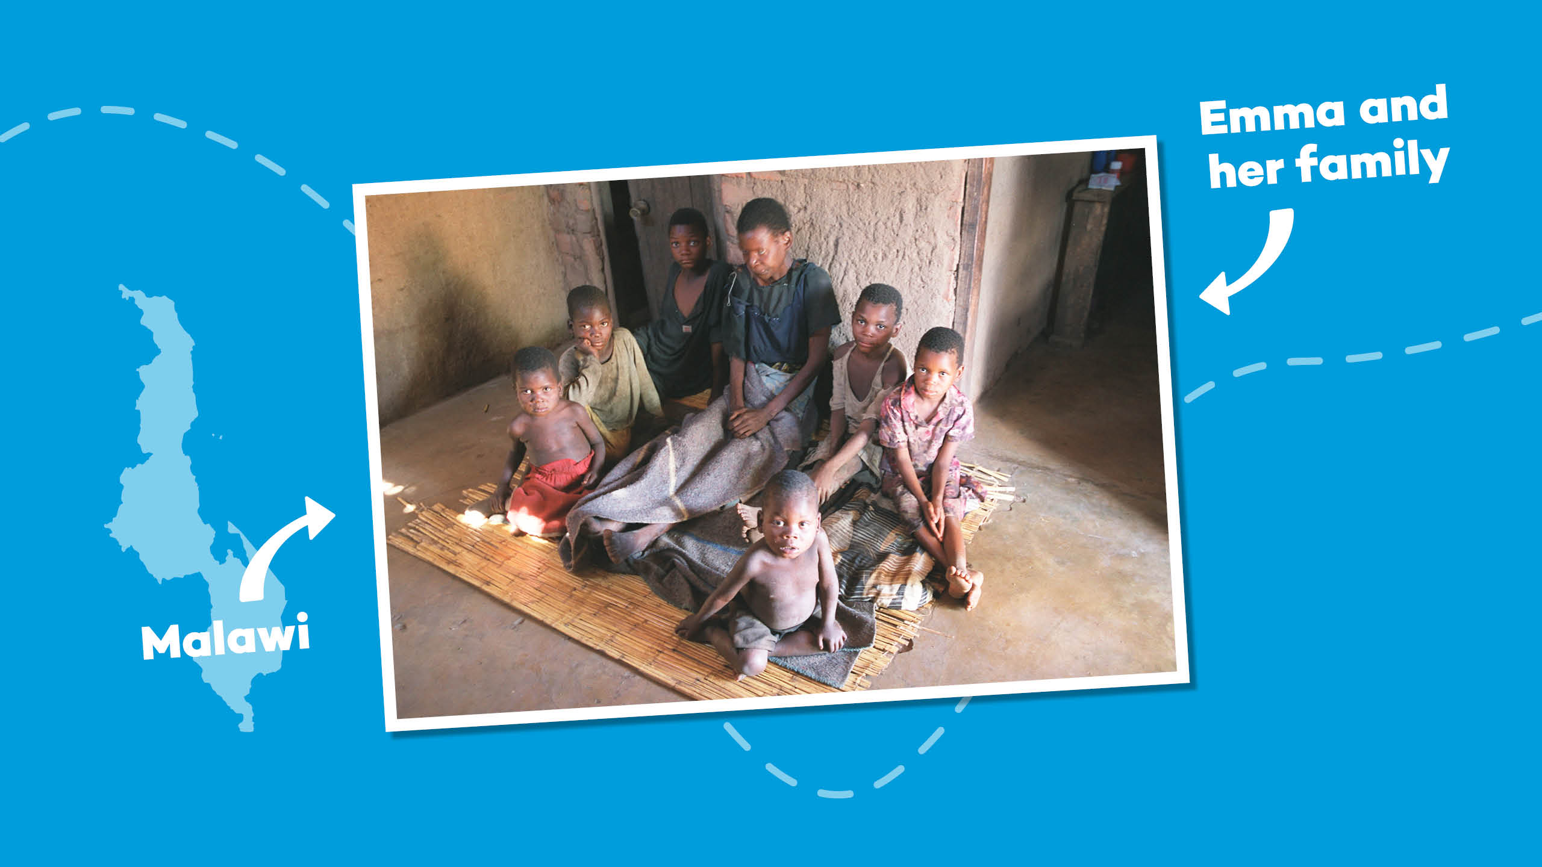

Slide 5
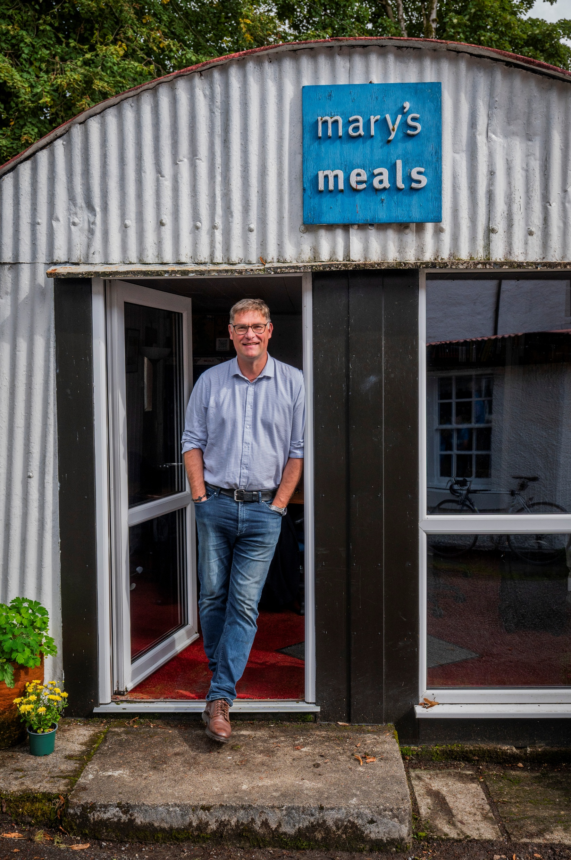
“I would like to have
enough food to eat and
I would like to go to
school one day.”
Edward, Malawi

Slide 6
Today 71 million primary school-age children are out of school around the world, and many others come to class too hungry to learn.

Slide 7
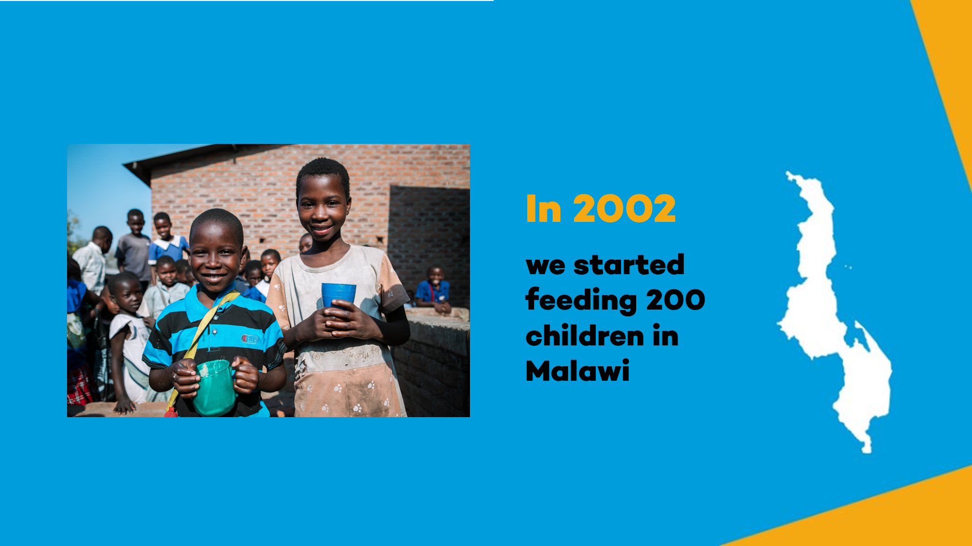
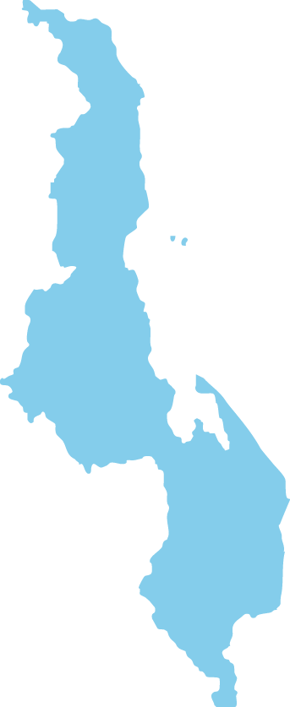

Malawi
In 2002 we started feeding 200 children in Malawi

Slide 8
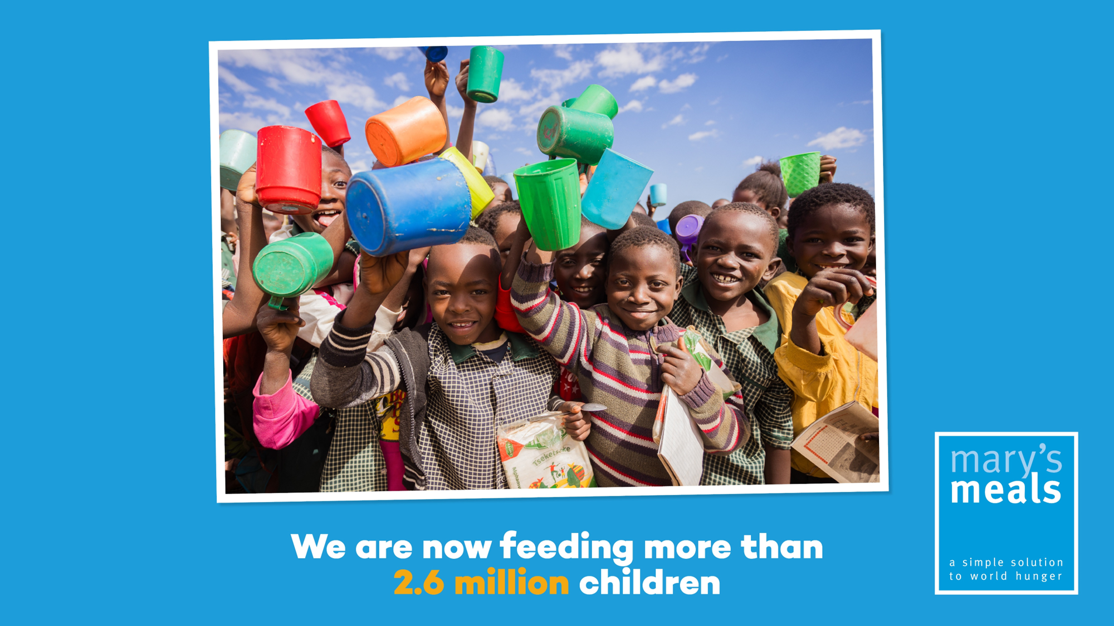

We are now feeding more than three million children every school day.

Slide 9
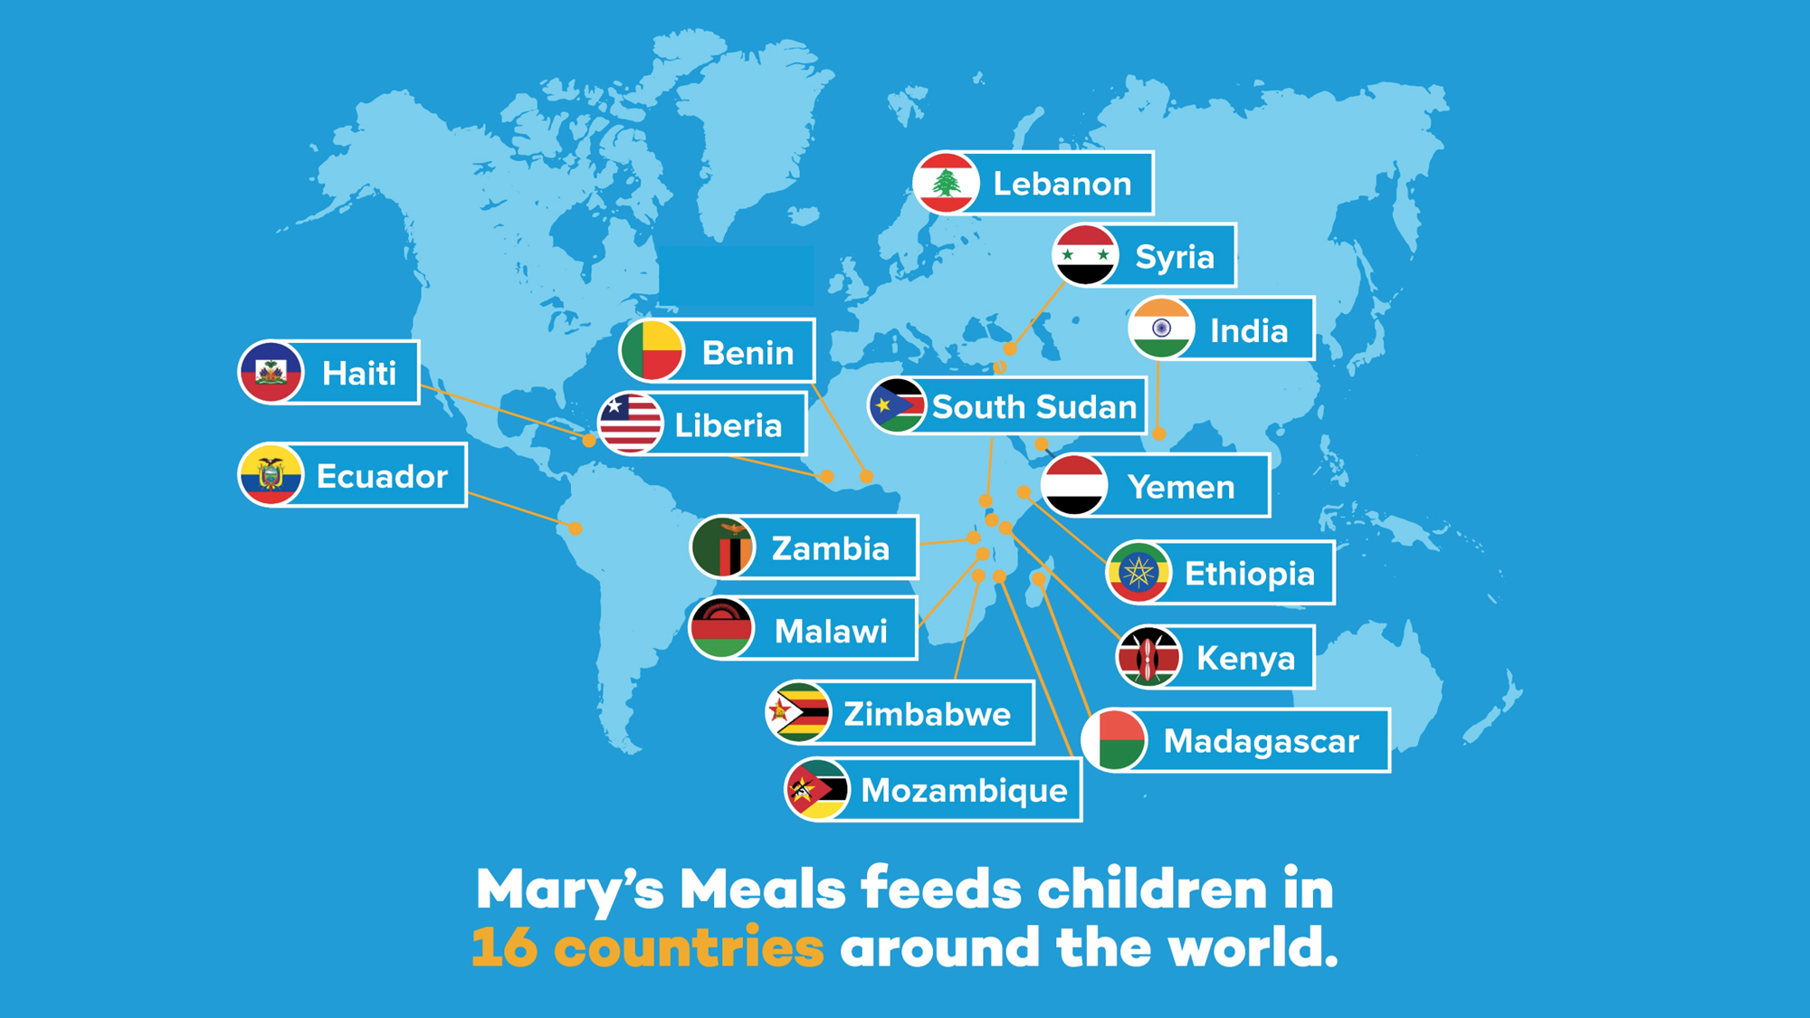
Mary’s Meals feeds children in 16 countries
around the world.

Slide 10
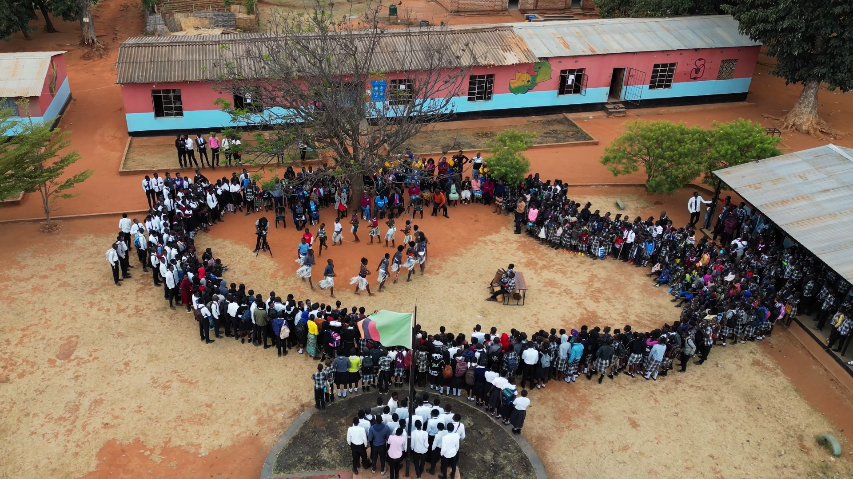
Watch the impact of Mary's Meals here!

Slide 11
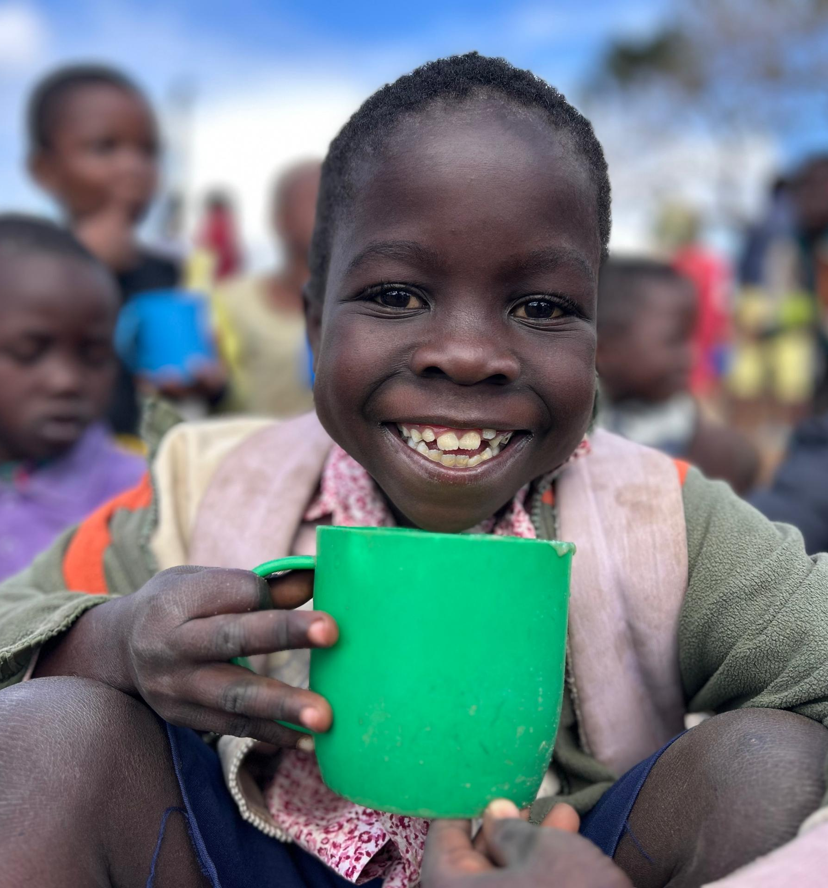
Mary’s Meals:
Reduces hunger
Improves school enrolment and attendance levels
Improves attainment
Increases community support for education
And makes children happy!

Slide 12
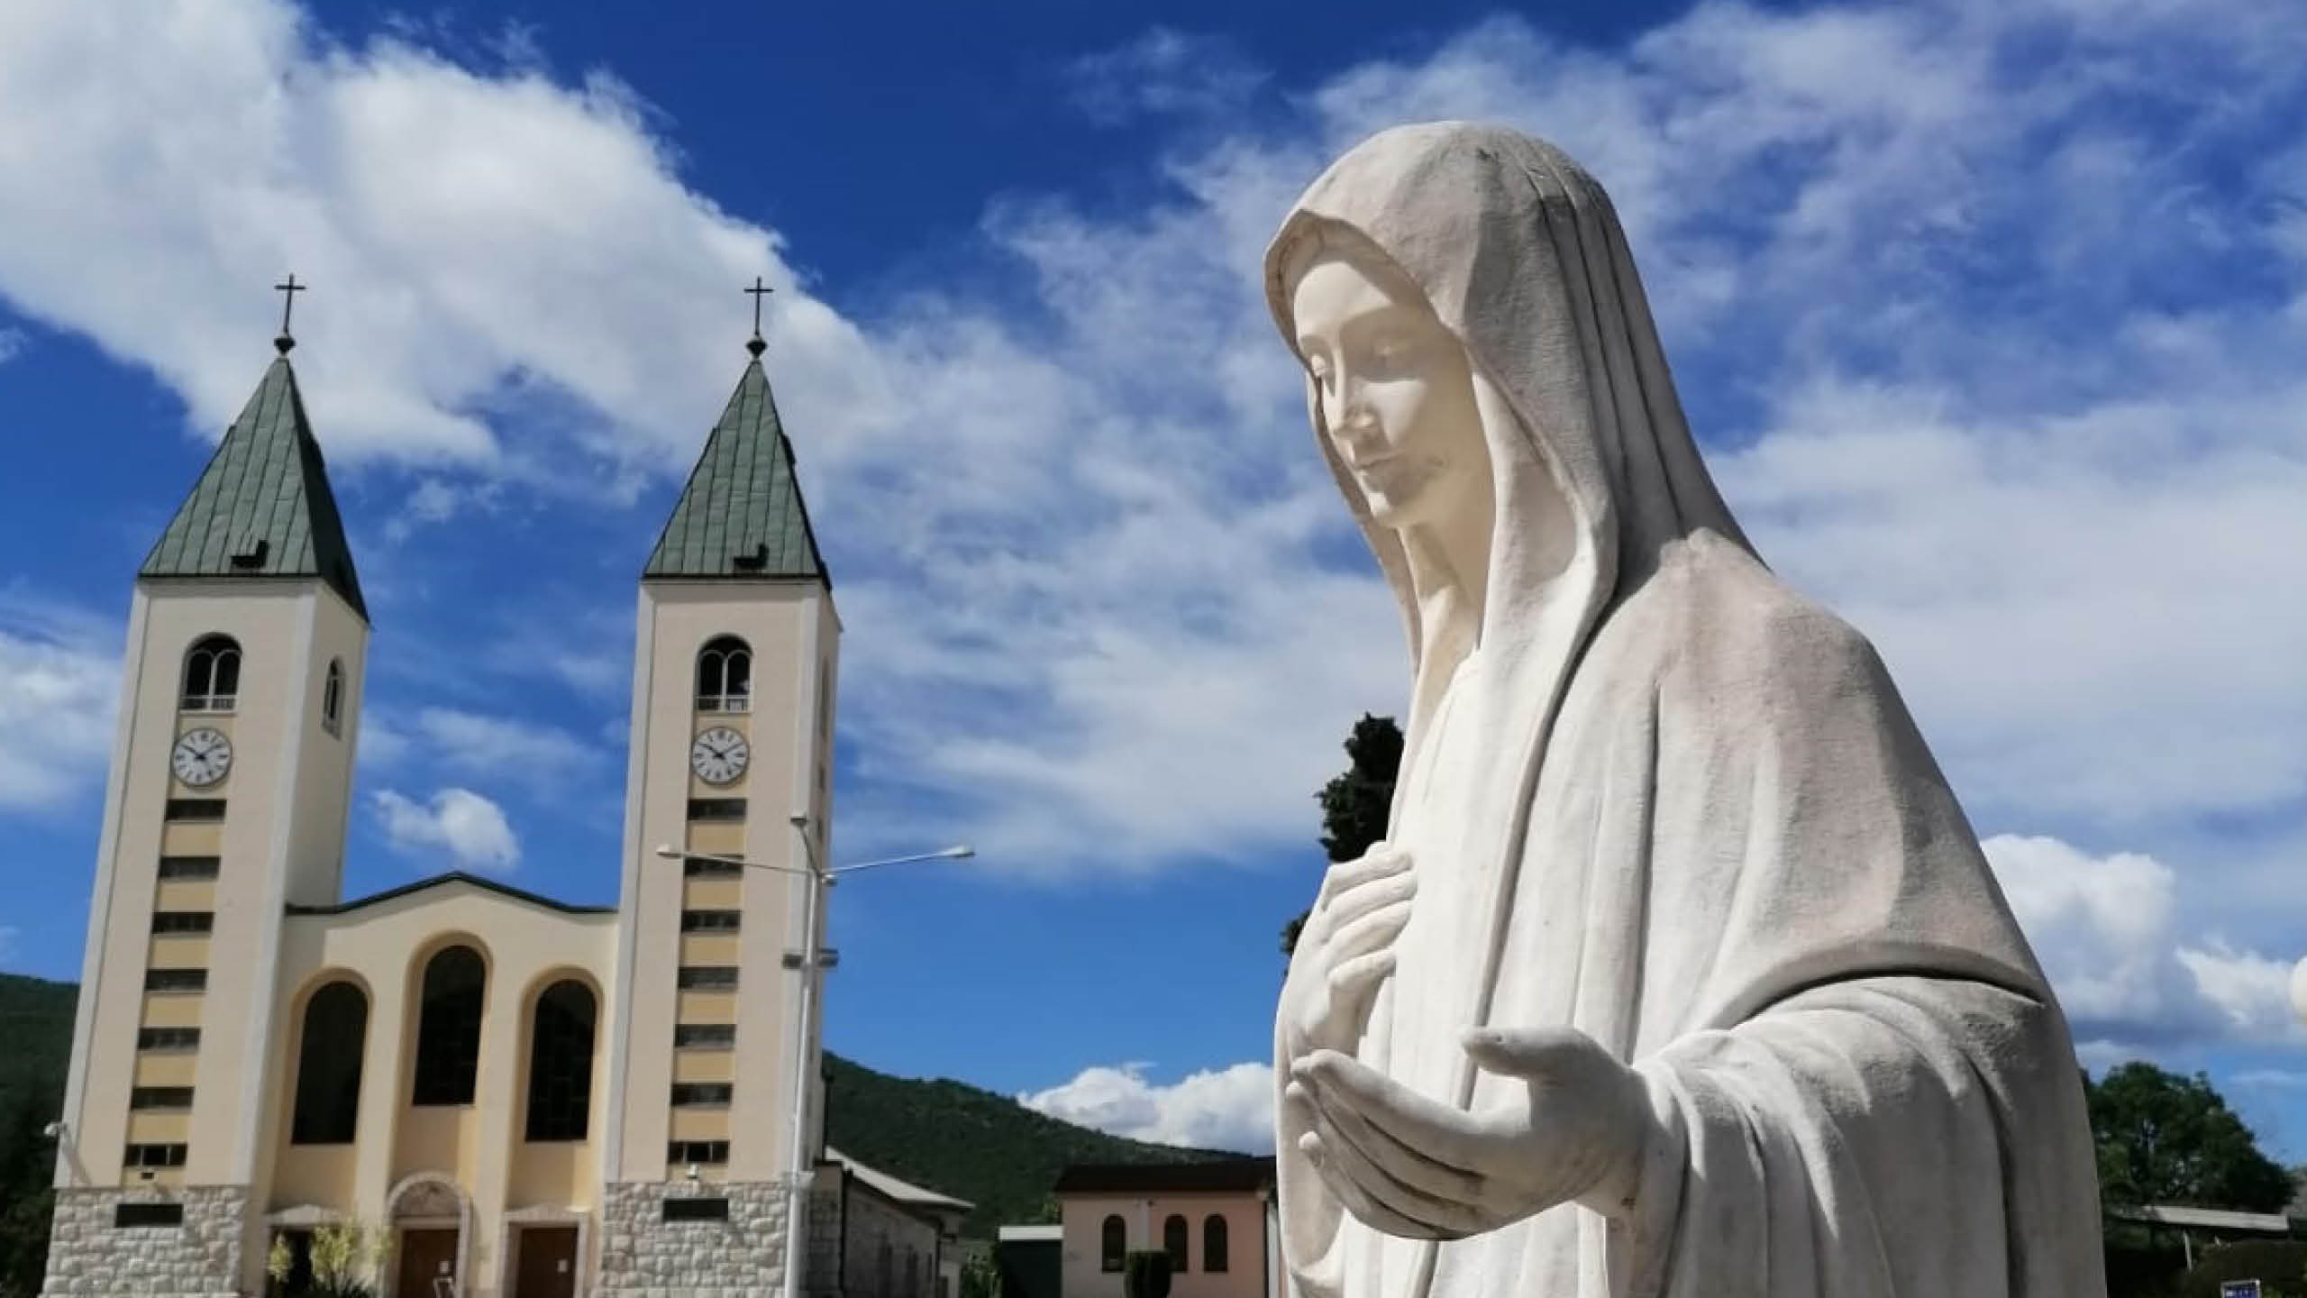

Slide 13
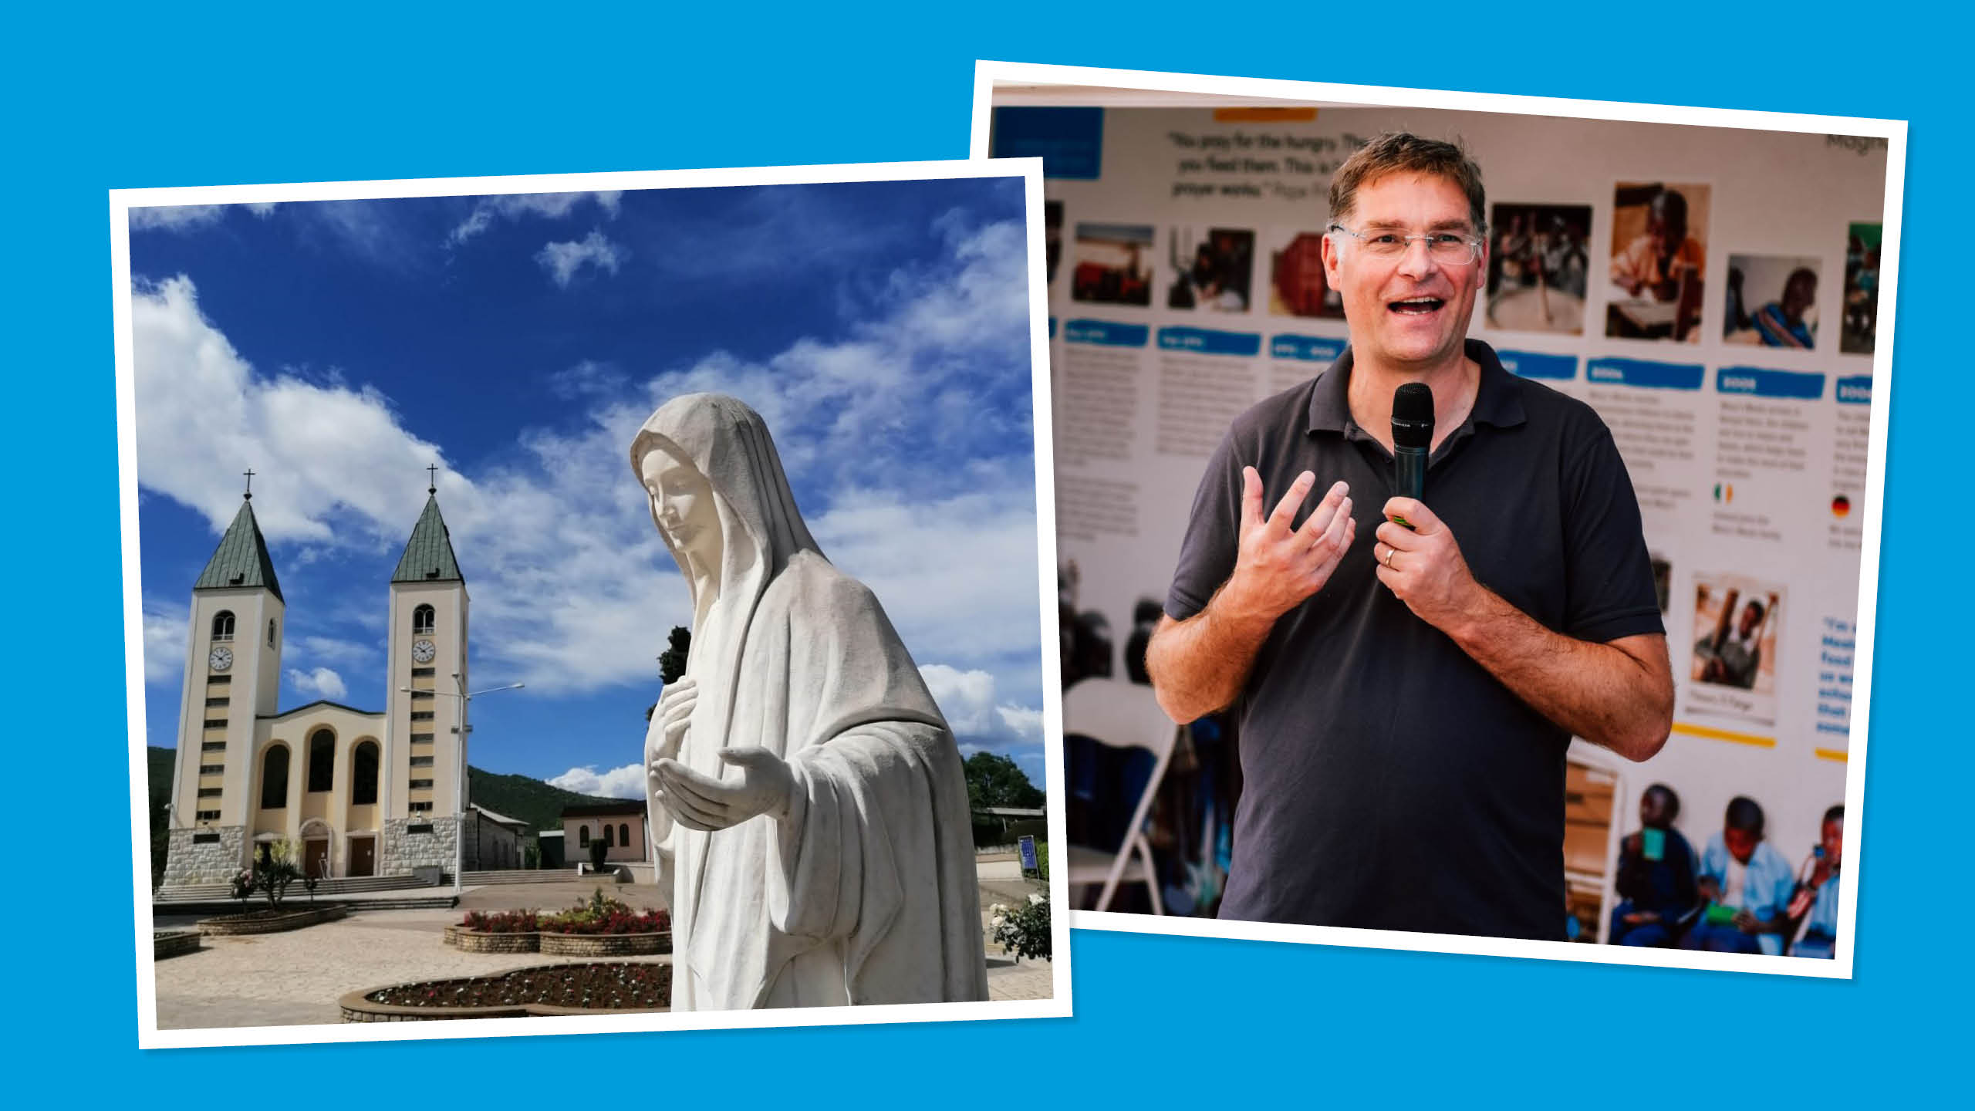

Slide 14
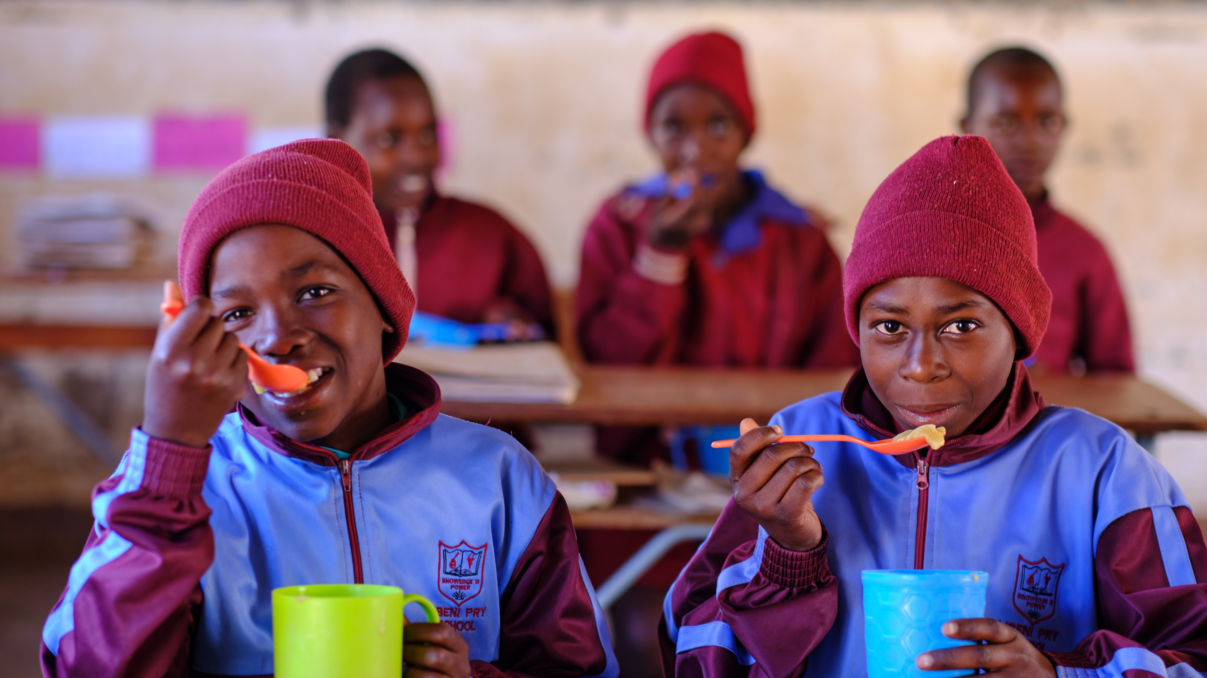

Slide 15
“When we attend to the needs of those in want, we give them what is theirs, not ours.” Catechism of the Catholic Church 2446.

Slide 16
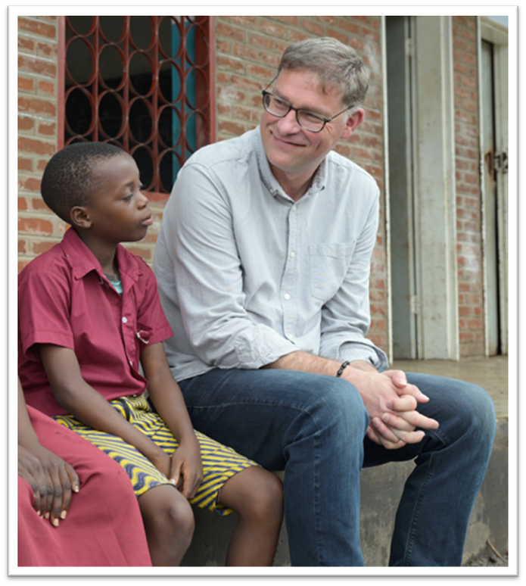
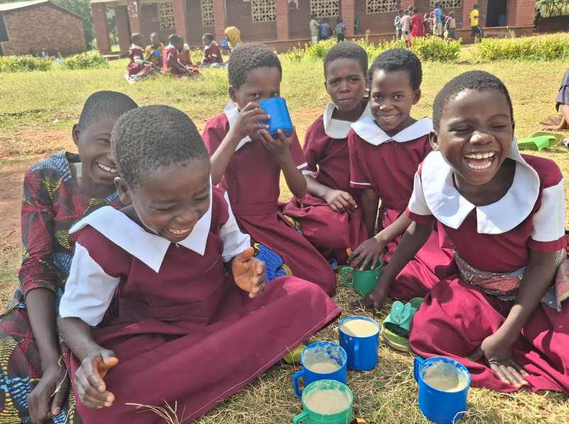
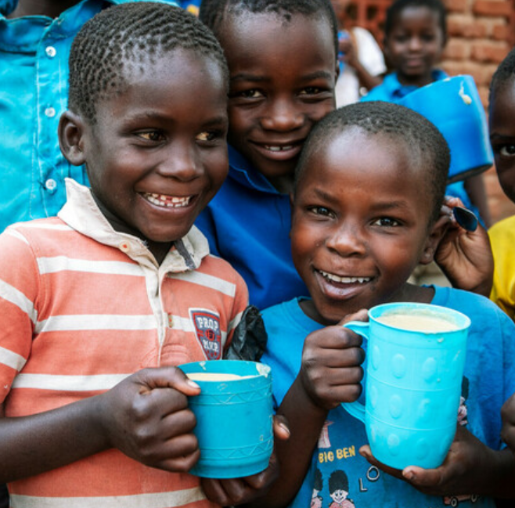
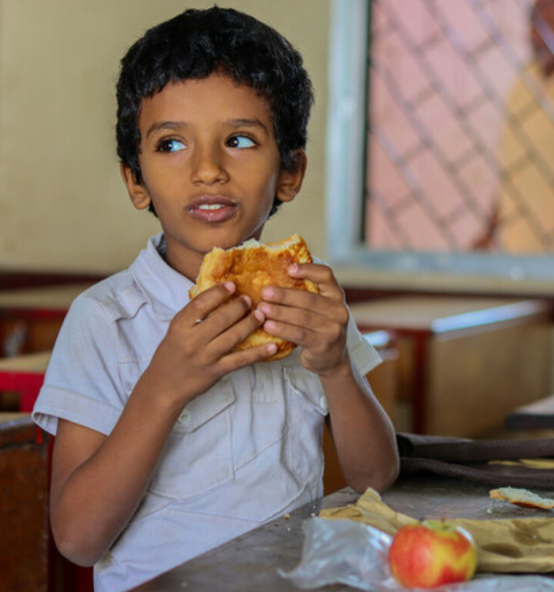

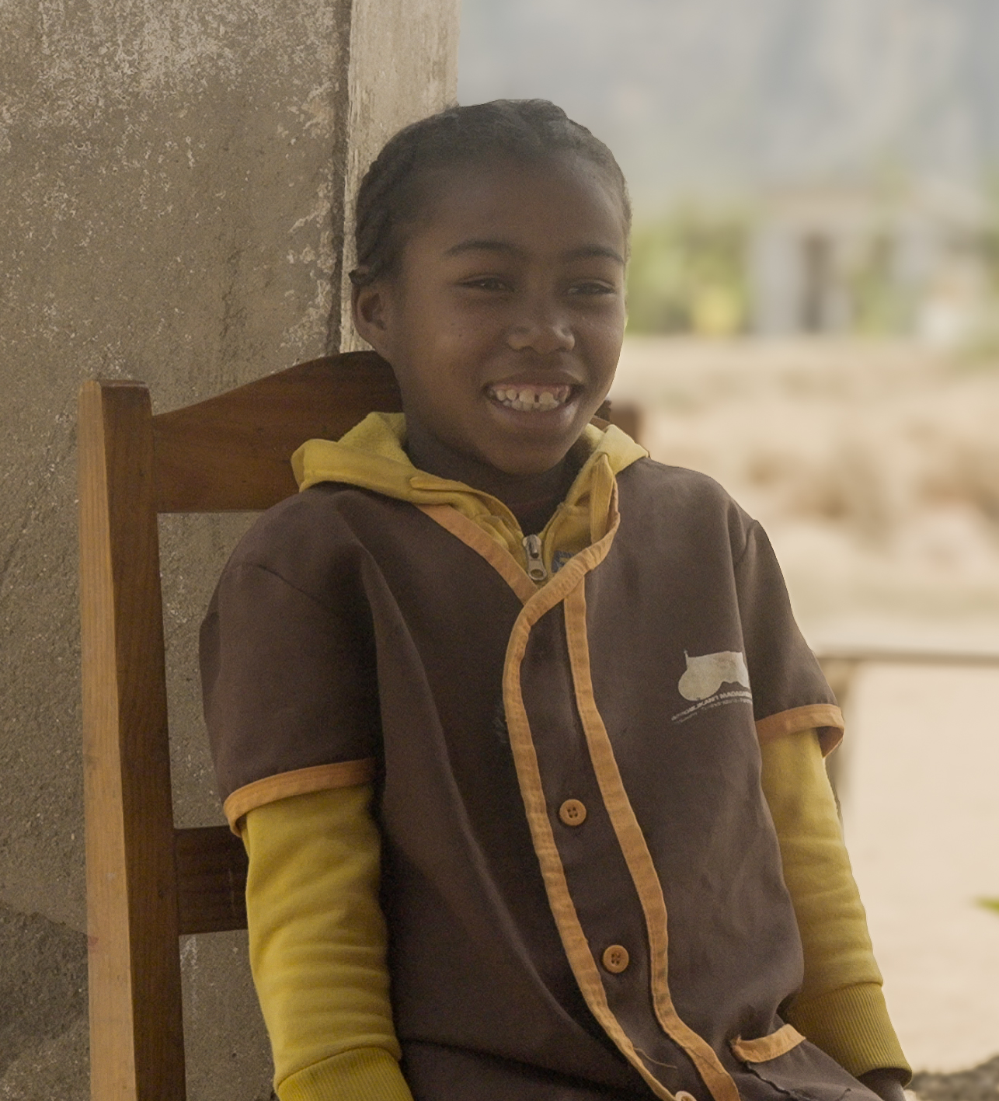
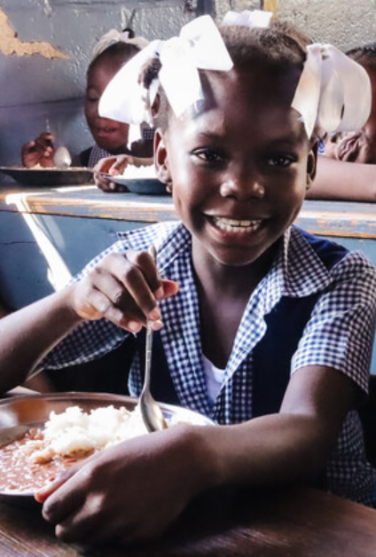
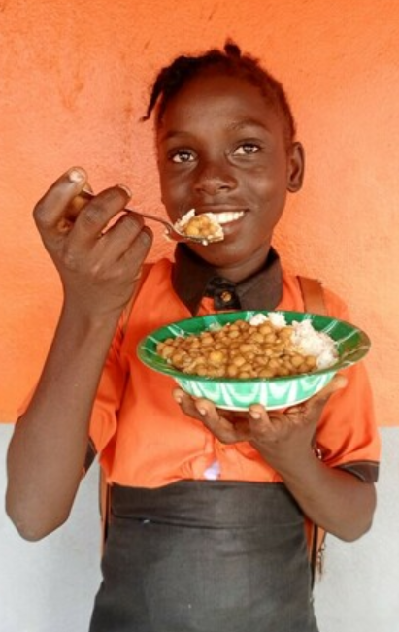
“I like to describe our work as just a series of lots and lots of little acts of love.”
Magnus MacFarlane-Barrow
Founder of Mary’s Meals

Slide 17

It costs just
£19.15
to feed a child for
a school year!

Slide 18


Slide 19
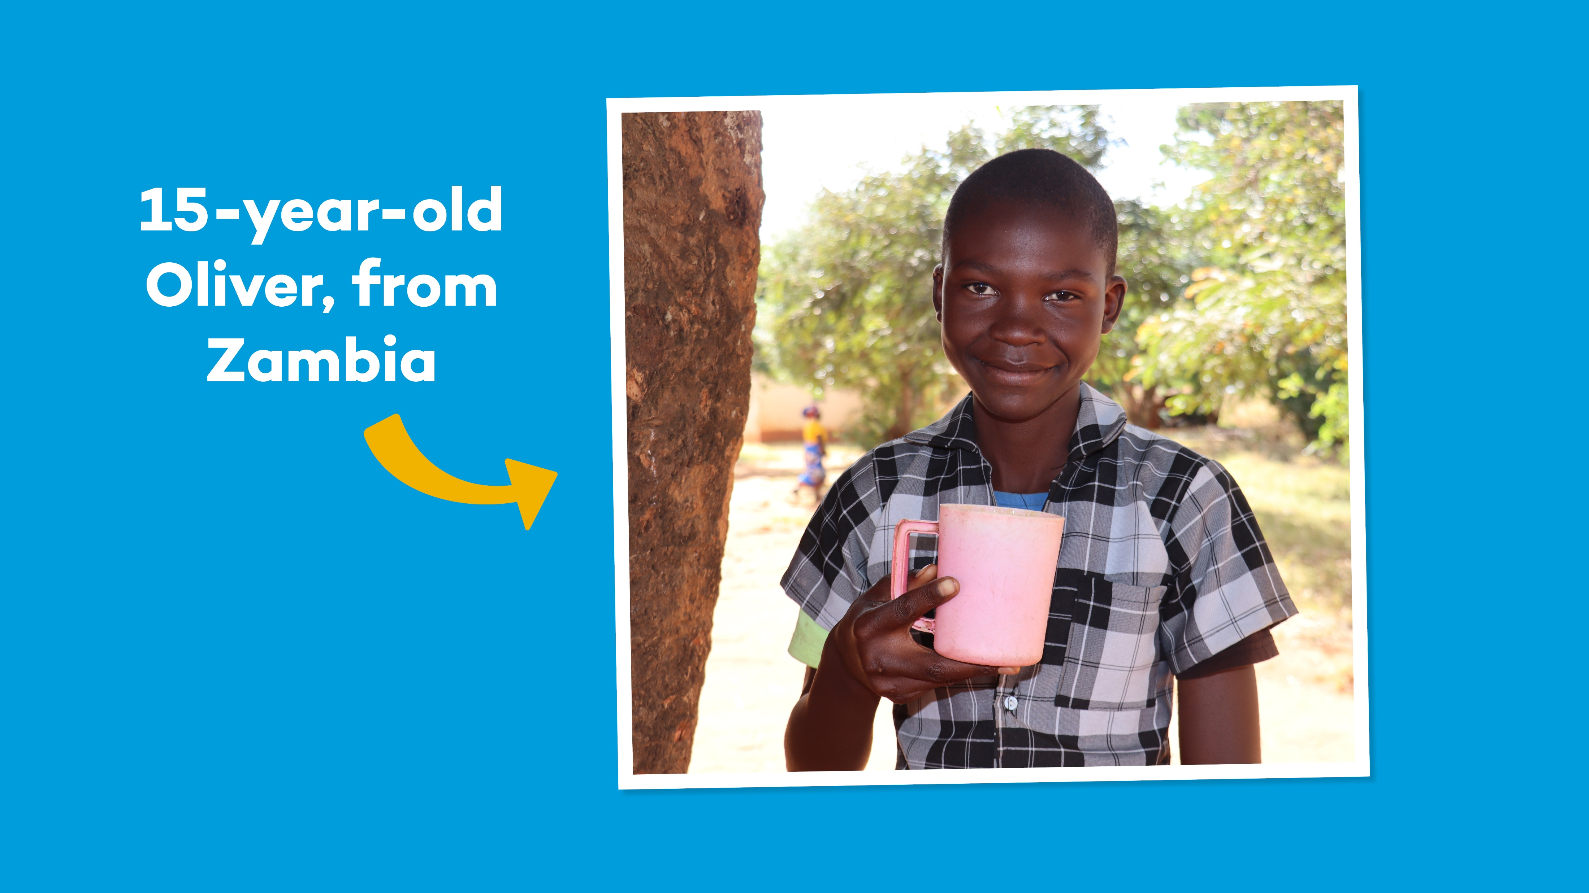

Slide 20
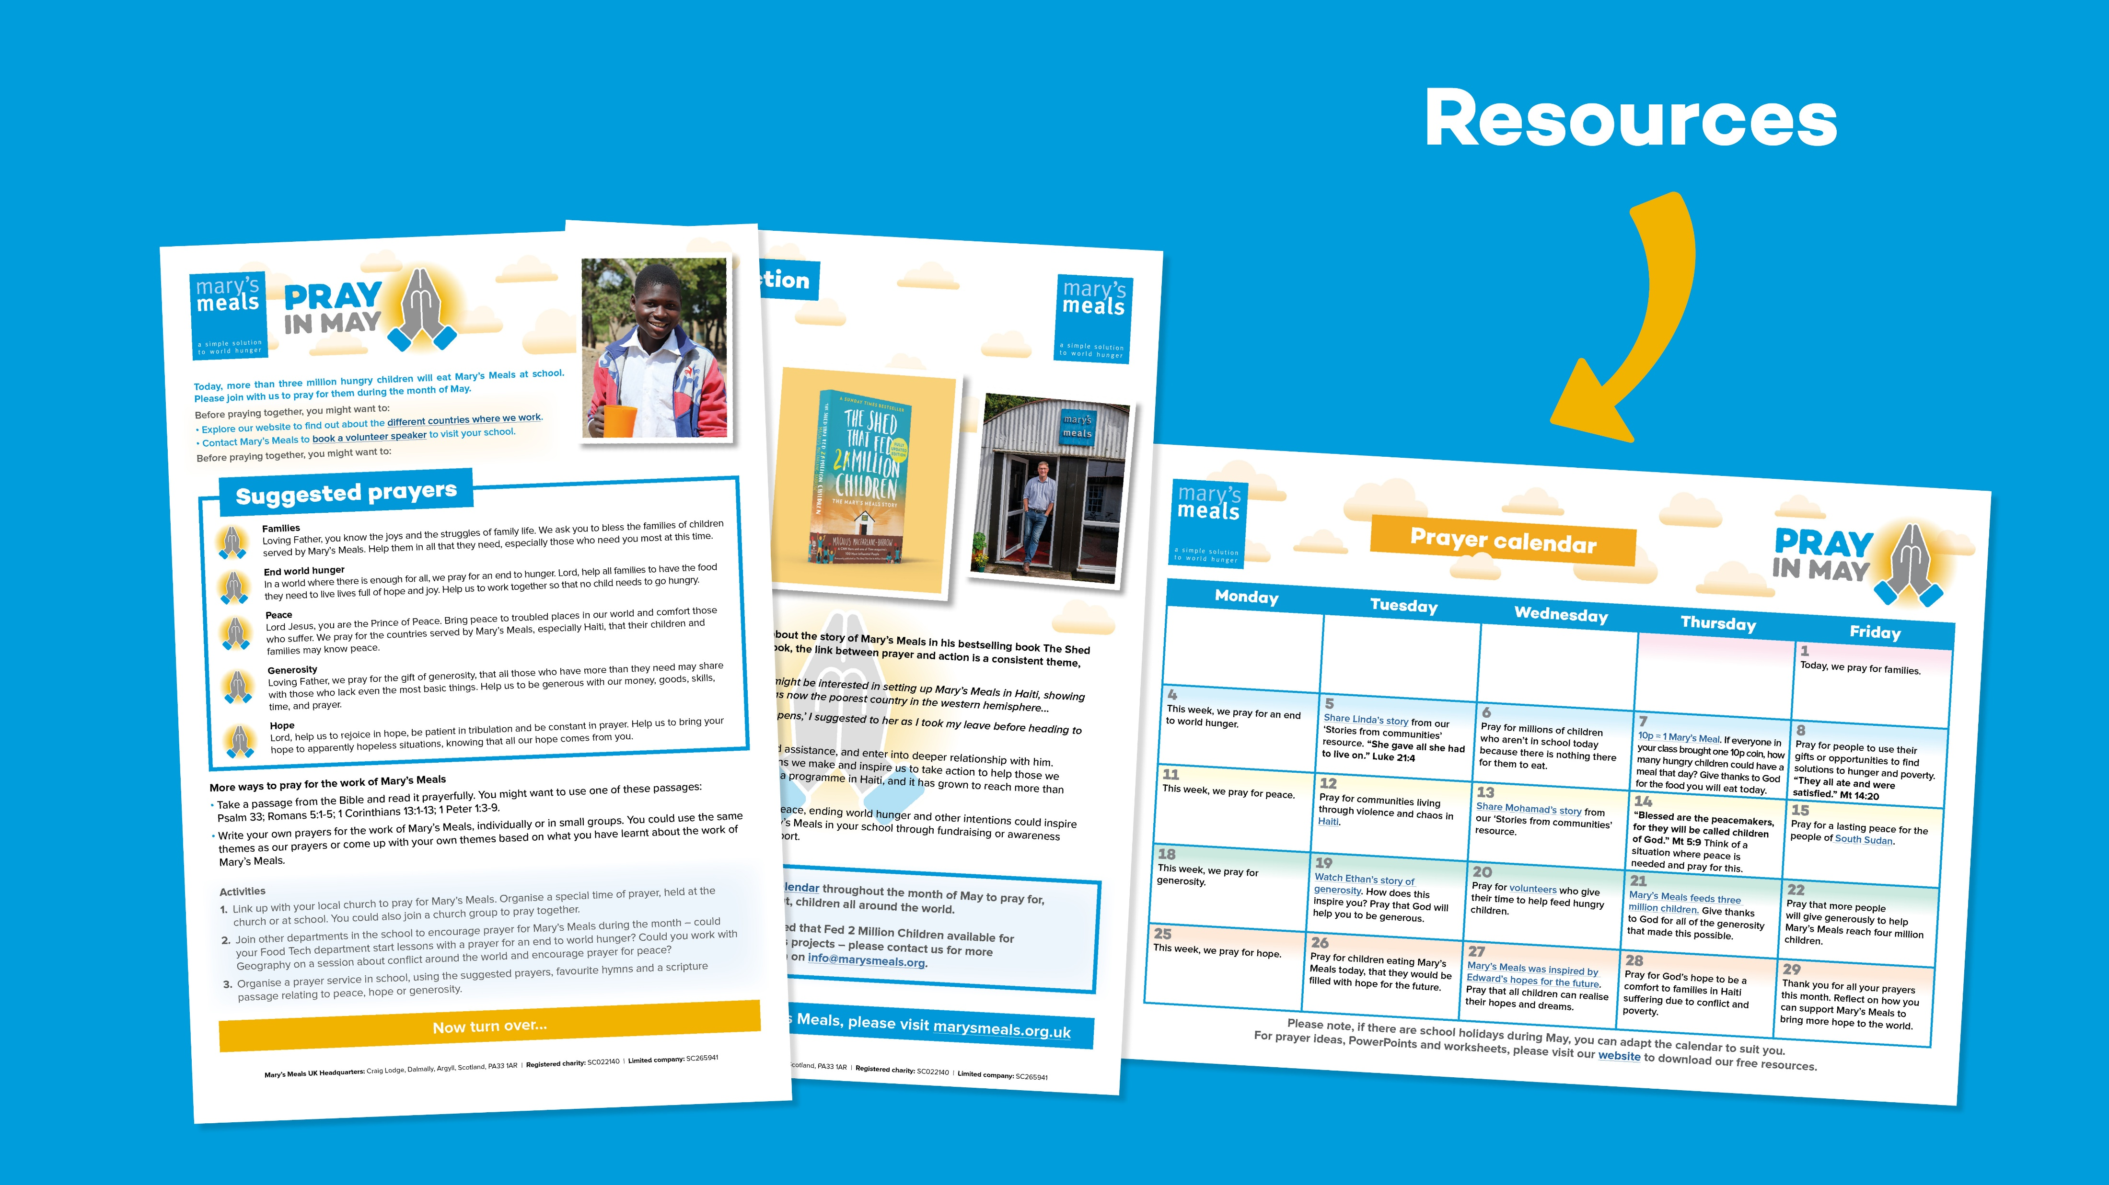

Slide 21
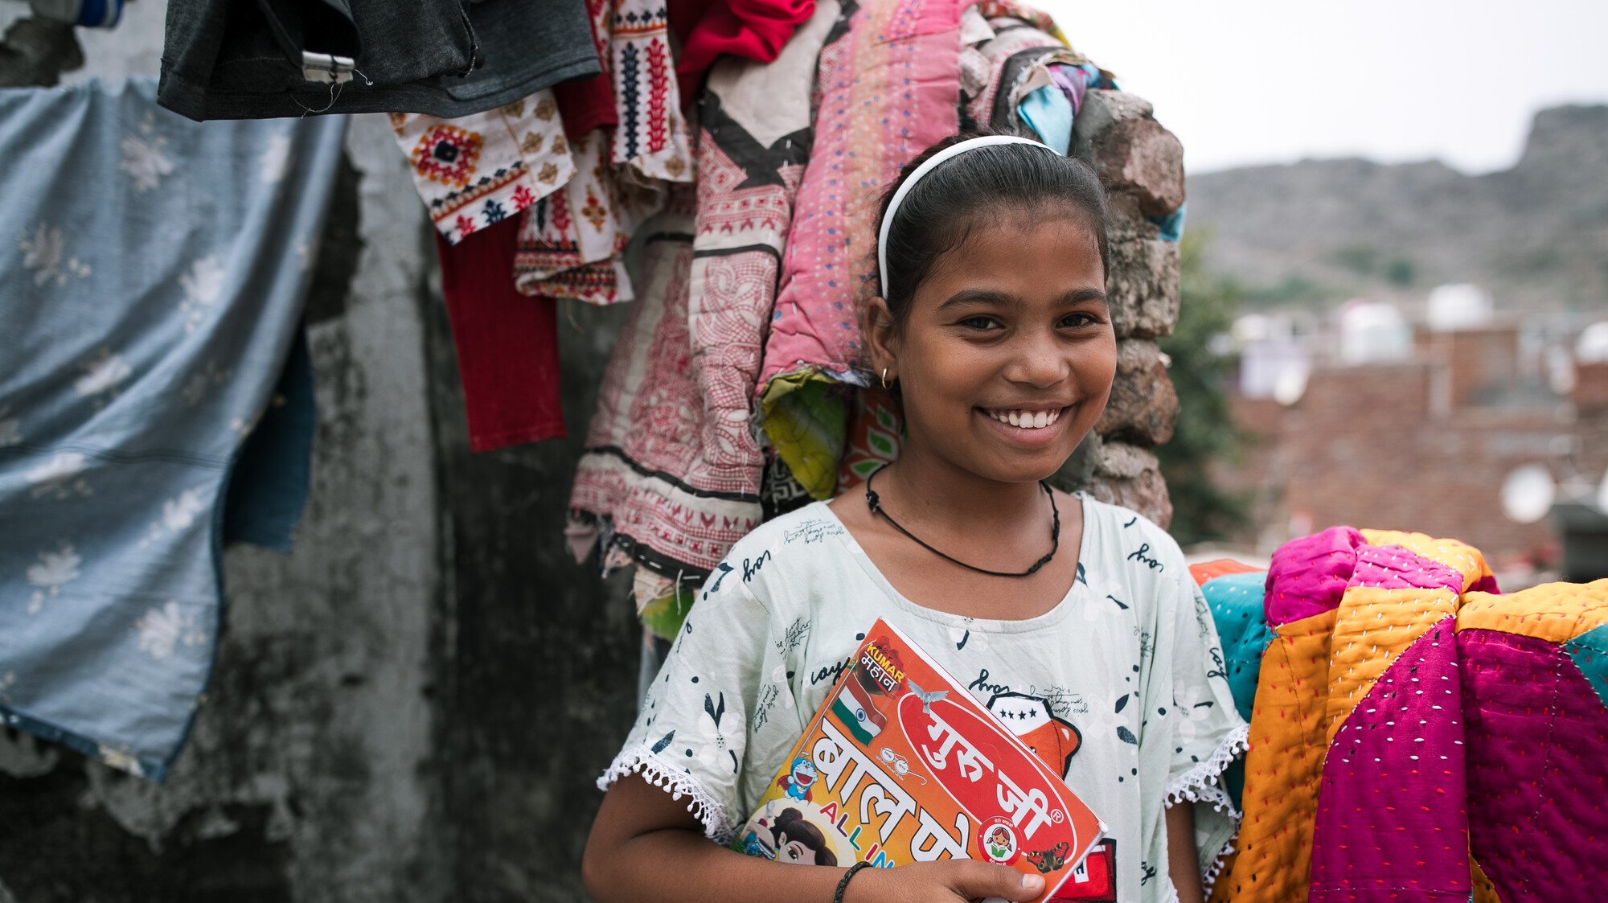

Slide 22


