Slide 1
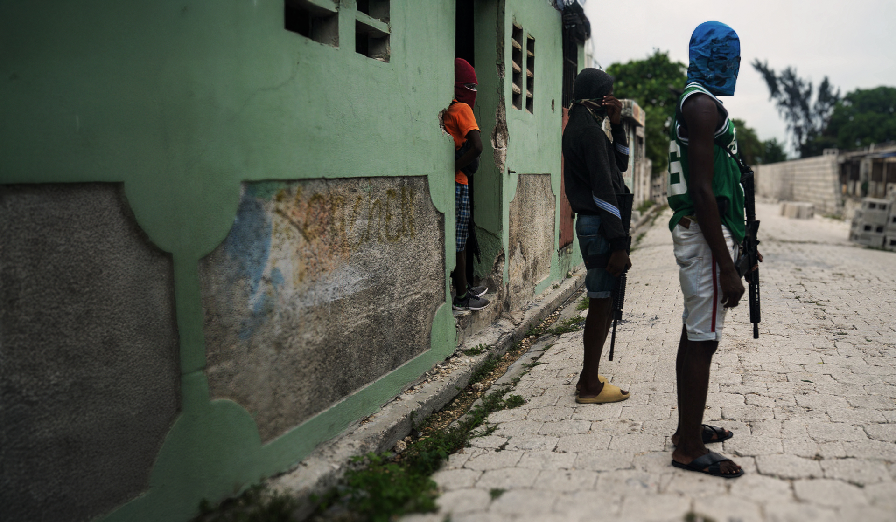


Notes:
Haiti is facing the worst hunger crisis in its history. Gang violence has reached unprecedented levels, devastating the economy and people’s lives.
More than half of the population do not have enough food, and families are in greater need than ever before.
At the heart of this crisis – and suffering the most – are Haiti’s children. With food being used to lure hungry children into armed gangs, the need for Mary’s Meals is more urgent now than ever.
Hungry and traumatised by the violence around them, our school meals are helping to keep children in Haiti in the safety and stability of the classroom where they can learn and be children again.
Together with three expert local partners, Mary's Meals is operating in one of the most challenging and risky situations we have ever faced to keep providing vital school meals for tens of thousands of children caught up in this devastating crisis.
The ongoing chaos in Haiti is also disrupting how we deliver our programme: food and fuel costs are rising, and transporting food is more challenging and costly than ever as our suppliers are forced to avoid gang-controlled highways.
We urgently need your support to keep our promise to the children we serve in Haiti and show them that there is hope beyond the violence.

Slide 2
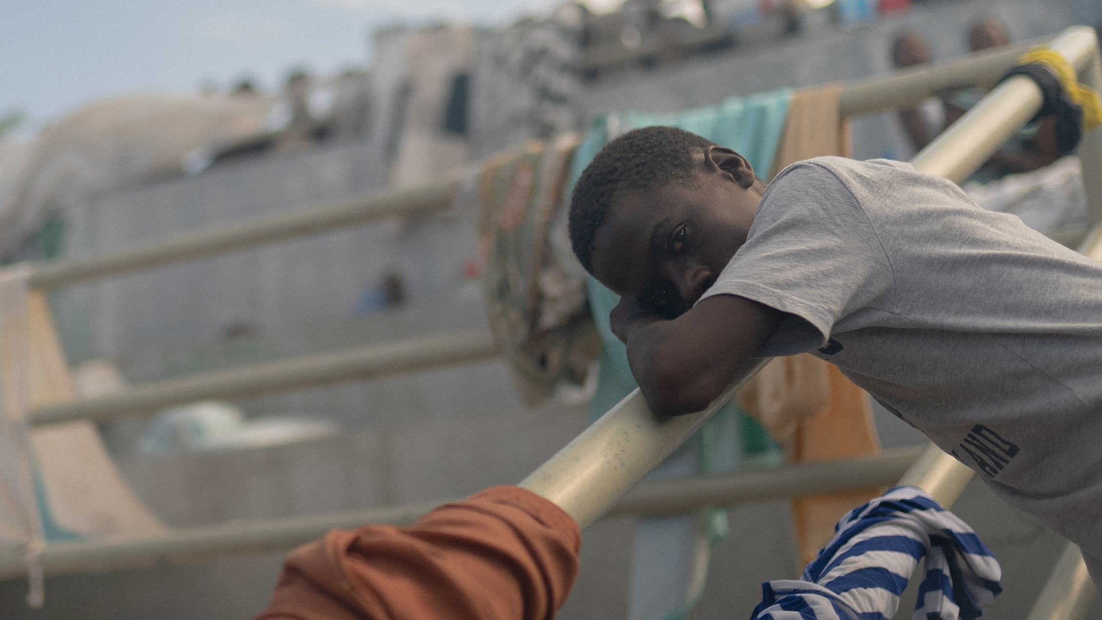

Notes:
Emmline Toussaint, from our local partner BND, is witnessing firsthand how vital our school meals are for children in Haiti.
She says there are reports of children as young as eight being recruited into gangs. Many children are forced to join the gangs while others are lured by the promise of food and money. The UN estimates that up to half of all gang members are minors and Emmline says that once a child joins a gang, their future is lost.
Emmline says: “We know that gangs are always trying to target children because they are the most vulnerable. They are the most in need of assistance.”
As the crisis deepens, Emmline believes an educated young population is important to lead Haiti to a better and brighter future. She says: “This new generation needs our support. They need Mary's Meals for them to focus on what is the most important, which is their education, and a better future for the country and for themselves.”
Mary’s Meals is providing a light in the darkness in Haiti. For children and families, our school meals are more than vital nutrition – they also offer safety, routine and hope.

Slide 3

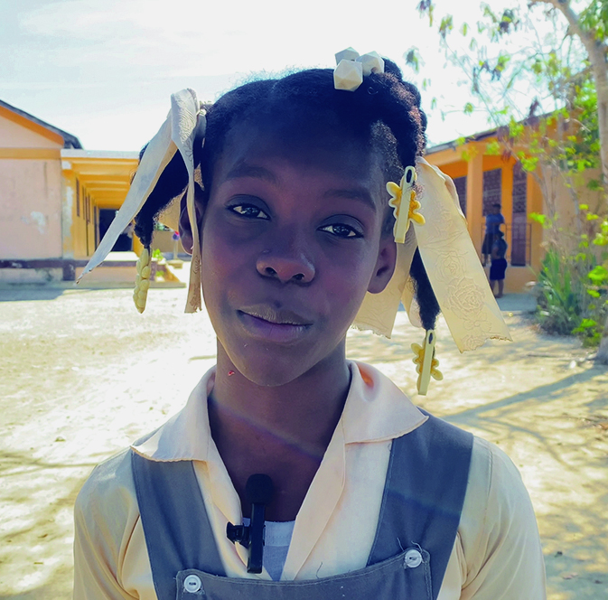
Elena, 11 years old
Notes:
11-year-old Elena has already experienced more than her share of heartbreak in her young life. Her family home, where she used to play with her sister, was burned down by gangs. Her turbulent childhood has left her with constant worry.
She told us: “My family and left [our] house because some bad people burned it down. Armed groups were shooting and we could not get enough food and water. I have a cousin who was forced to join a gang.”
It’s hard to imagine growing up amidst this chaos and fear, but Elena hasn’t given up hope. And the promise of a daily meal in school is fuelling her ambitions. She says: “It's important to continue going to school, because in the future I can be someone important in the society, like a doctor or a nurse.”
Elena’s story, while difficult to hear, shows the hope that can still be found and the light that people still strive for across Haiti.
Under normal circumstances, our programme serves more than 196,000 children in Haiti every school day – and the fact we continue to reach the vast majority of them is a testament to the resilience and determination of our partner colleagues and their belief in the power of school meals to help keep children safe.
To donate and help us keep Haiti’s children fed and safe in school, where they can learn and dream again, please visit: www.marysmeals.org.uk/campaigns/crisis-in-haiti

