Slide 1







Recruitment pack for:
Head of Supporter Experience
and Marketing
Remote working from
anywhere in the UK
Mary’s Meals UK
March 2026

Slide 2


Recruitment pack contents
Welcome from our Executive Director
Role outline and
Specification
Our vision, mission and values
About the Mary’s Meals movement
About Mary’s Meals UK
Recruitment process
information
3
5
11
13
15
17
2

Slide 3
Welcome from our Executive Director
Thank you so much for your interest in joining the Mary’s Meals family. As you consider making an application for the role of Head of Supporter Experience and Marketing with Mary’s Meals UK, I hope you find this pack helpful, encouraging, and exciting.
In joining Mary’s Meals UK, you would become part of a global movement of people who will simply not accept that any child should go hungry in this world of plenty. We are passionately driven by our simple belief that every child in the world deserves an education – and enough to eat.
From small beginnings feeding just 200 Malawian children in 2002, we are now reaching three million children across 16 programme countries (including Malawi, Liberia, Zambia, Haiti, South Sudan, and Syria) with a nutritious daily meal in school.
This meal not only meets the immediate needs of the hungry child, but it attracts children to the classroom, where they can gain an all-important education. And we firmly believe that the children who are receiving Mary’s Meals today can grow up – better nourished and better educated – to become the men and women who will lift their communities out of poverty and end their reliance on aid.​
​
The UK, where we received the first-ever donations for our work, remains the country in which Mary’s Meals raises the majority of its funds. And Mary’s Meals UK, the organisation I am privileged to lead is responsible for continuing to tell our story across Scotland, England, Northern Ireland and Wales; engaging and inspiring more and more UK volunteers and donors; and driving forward the unrelenting growth of the Mary’s Meals movement on these shores.​
3

Slide 4
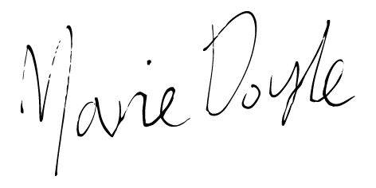
Welcome from our Executive Director
With more than 78 million children of primary school age out of school around the world, our work has never been more important.
The Head of Supporter Experience and Marketing is an exciting new role at Mary’s Meals UK, driving income and deep support for our school meals programmes through the development of warm supporter communications and excellent supporter care.
Will you play a crucial part in shaping the future of Mary’s Meals UK and, with it, the lives of so many people who both contribute to and benefit from this incredible work of love, joy, and hope?
I look forward to hearing your story.
Marie Doyle
Executive Director, Mary’s Meals UK
4

Slide 5
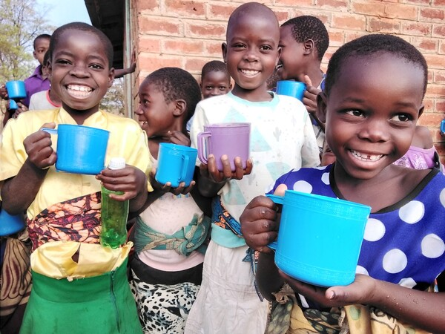
Head of Supporter Experience and Marketing
Reports to: | Director of Supporter Experience and Communications
Location: | Home working from anywhere in the UK
Salary: | c. £51,877 - £57,034 per annum FTE, plus London Weighting if applicable
Benefits: | Flexible working 34 days’ annual leave (including public holidays) Non-contributory pension with employer contributions of 8%. Volunteering and development days Enhanced maternity and paternity leave Employee Assistance programme Life Assurance Wellbeing support Cycle to Work scheme
5

Slide 6
Role Overview
Role Overview:
We’re looking for a strategic and dynamic marketing leader who is expert at inspiring support and significantly growing income through Individual Giving or Direct Marketing programmes. ​
The Head of Supporter Experience and Marketing is an exciting new role at Mary’s Meals UK, driving income and deep support for our school meals programmes through the development of warm supporter communications and excellent supporter care.​
The role will lead a newly formed team, therefore the successful candidate must have a brilliant track record of managing, inspiring and empowering teams to build a strong culture and create momentum against key objectives. You are someone who cares deeply about the people you lead and believe that how things are done is just as important as the end results.​
The core focus is to lead the creation of holistic and dynamic supporter journeys, in collaboration with Growth and Partnership and Creative Communications colleagues, that deepen the connection with our supporters, reinforces the impact of their support, and builds lifelong support.​
In the marketing space, you’ll oversee the strategic direction and impact of our email and direct mail communications, with a focus on generating income, strong ROI and engagement. ​
The Head also leads the Supporter Experience (supporter care) team who enhance supporter retention and satisfaction by ensuring supporters can easily contact Mary’s Meals, receive a warm and personal experience that aligns with the Mary’s Meals values, and process and acknowledge donations effectively.​
We’re looking for an energetic leader who thrives on working in a fast-paced environment, juggling multiple priorities while always keeping an eye out for incredible opportunities to grow supporter income and engagement. ​
Innovative, agile and entrepreneurial – you’ll ensure that growing Mary’s Meals’ mission with urgency and passion, remains central to all Supporter Experience and Marketing work, while remaining true to our values and mission.
6

Slide 7
Duties and responsibilities
Principal Duties:
Ensure that growing Mary’s Meals’ mission with urgency and passion, remains central to all Supporter Experience and Marketing work.
Drive Mary’s Meals’ Supporter Experience and Marketing strategy in the UK with a core emphasis on KPIs linked to supporter experience, income, retention and ROI.
Work side by side with the other Heads and directorate leaders to ensure an integrated and joined up approach and ensure branding, messaging and style are consistent.
Collaborate with Growth and Partnership colleagues to build dynamic data led supporter journeys tailored by donor type, channel, region, and behaviour – inspiring greater numbers of supporters to engage deeply with our mission.
Invigorate the charity’s approach to email and direct mail marketing activities leading to significant income growth and greater retention.
Embed a culture of testing and learning, to ensure excellent return on investment, and sector-leading performance in our supporter marketing.
Work alongside colleagues to develop a strong understanding of Mary’s Meals’ key audiences that enhance segmentation of supporter marketing activities.
Ensure supporters receive an excellent day-to-day experience with the charity, across all channels (including phone, post, social media and email, with consideration also to the in-person, relationship-driven activity delivered by other teams).
Ensure highly efficient income processing and administration that meet all necessary regulations.
Harness technology and data to improve relevant supporter income processes and administration across teams, with an emphasis on agility and good stewardship.
Utilise data insights (internally and externally), to identify key trends, opportunities and areas for growth.
Manage income and expenditure budgets, ensuring rigour, agile planning and accurate forecasting and excellent stewardship of funds.
Contribute to flagship fundraising and awareness raising campaigns.
Ensure all activities follow fundraising and data regulations, and marketing best practice.
Drive a culture of innovation in the team, keeping up-to-date with trends and opportunities in the sector, and identifying new ideas for Mary’s Meals that will reach more hungry children.
Direct line management of the Supporter Experience and Supporter Marketing Managers, cultivating an empowered and collaborative culture. Ensure integration and information sharing between the two functions and with the wider directorate, while ensuring Mary’s Meals’ values remain central.
Actively participate as part of the Extended Leadership Team.
7

Slide 8
Essential Qualifications, experience and skills
Essential Criteria:
Expert at building long-term, tailored supporter relationships and journeys for key donor groups, that drive measurable engagement, strong ROI and income growth.
Strong evidence of delivering innovative retention and journey campaigns across direct mail, email, organic social media and telephone.
Highly analytical and experienced in translating data insights into actionable strategies.
Expertise in audience insights data and segmentation.
Strong experience of effectively managing income and expenditure budgets.
Strategic and dynamic marketing leader with a proven track record in inspiring support and significantly growing income through Individual Giving or Direct Marketing programmes.
Proven ability to manage, inspire and empower diverse teams.
Good understanding of the charity sector, fundraising and marketing regulations and best practice
Skilled at building internal relationships, working with colleagues across multiple teams and priority areas.
A track record of delivering exciting ideas, with a passion for keeping abreast of and acting on trends and opportunities in the sector.
Passion and drive for working in a values-centred charity that deeply values every supporter while striving to reach the next hungry child.
Energetic, bold and entrepreneurial – able to exercise initiative, problem solve and influence at all levels.
Adaptable, resilient and committed to playing a key role in driving income growth.
Excellent project management skills. Ability to manage a complex workload in a fast-paced environment and juggle multiple priorities, ensuring deadlines are met.
Experience of CRM systems (i.e. Salesforce) and marketing systems (i.e. Dotdigital).
Engaging communication skills, including a strong ability to limit jargon to engage clearly with colleagues and stakeholders.
8

Slide 9
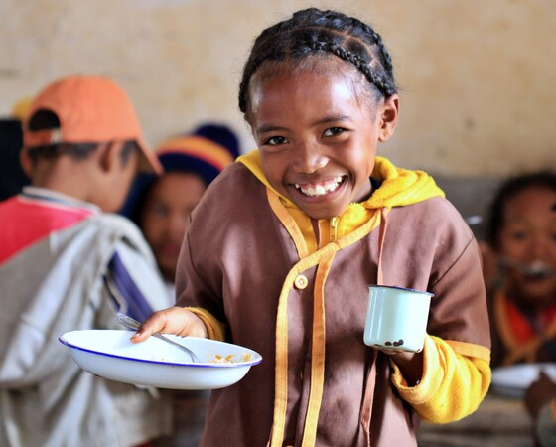
Essential Qualifications, experience and skills
Desirable criteria:
Experience of working in a remote first environment.
Understanding of other marketing disciplines such as Acquisition Marketing and PR.
Experienced at developing and implementing effective supporter care and income administration processes.
9

Slide 10
Supporter Experience and Communications directorate structure
Director of Supporter Experience and Communications
Head of Acquisition Marketing
Head of Supporter Experience and Marketing
Head of Media and Creative Comms
Acquisition Marketing Manager
Supporter Marketing Manager
Media Manager
Acquisition Marketing Officer
Digital Marketing Manager
Supporter Marketing Officer
Supporter Experience Manager
Supporter Experience Coordinator
Media Officer
Creative Communications Manager
Graphic Designer
Creative Communications Officer
Supporter Data Processing Manager (0.4)
Supporter Experience Coordinator
Supporter Data Processing Coordinator
Supporter Experience and Data Processing Officer
Supporter Experience and Data Processing Coordinator
10

Slide 11

Our vision and mission
• Our vision is that every child receives one daily meal in their place of education and that all those who have more than they need, share with those who lack even the most basic things.
• Our mission is to enable people to offer their money, goods, skills, time, or prayer, and through this involvement, provide the most effective help to those suffering the effects of extreme poverty in the world’s poorest communities.
11

Slide 12

Our values
• We have confidence in the innate goodness of people.
• We respect the dignity of every human being and family life.
• We believe in good stewardship of the resources entrusted to us.
View Mary’s Meals’ full statement of values here: Statement of Values
12

Slide 13
About the Mary’s Meals movement
Mary’s Meals is a global movement that sets up school feeding projects in some of the world’s poorest communities, where poverty and hunger prevent children from gaining an education.
Our idea is a simple one that works. We provide one daily meal in a place of learning in order to attract chronically poor children into the classroom, where they receive an education that can, in the future, be their ladder out of poverty.
The Mary’s Meals campaign was born in 2002 when Magnus MacFarlane-Barrow, from Dalmally in Argyll, visited Malawi during a famine and met a mother dying from AIDS. When Magnus asked her eldest son Edward what his dreams were in life, he replied simply: “I want to have enough food to eat and to go to school one day.”
That moment was a key part of the inspiration which led to the founding of Mary’s Meals, which began by feeding just 200 children in Malawi in 2002. Today, 20 years later, we feed three million hungry children every school day across four continents.
Where Mary’s Meals is provided, there is a rise in school enrolment, attainment and attendance. Wherever possible, Mary's Meals uses locally grown food to support the local economy and help smallholder farmers.
We work extremely hard to keep our running costs low which means that it costs just £19.15 to feed a child with Mary’s Meals for a whole school year. This is only possible because most of our work is done by an army of dedicated volunteers all over the world, who carry out lots of little acts of love on behalf of Mary’s Meals.
Having been inspired, in part, by our founder’s Catholic faith, this work is named in honour of Mary, the mother of Jesus, who brought up her own child in poverty. We consist of, respect and reach out to people of all faiths and none.
Counting on support from around the globe, Mary’s Meals has registered national affiliate organisations, which raise awareness of our work around the world. Funds raised by affiliates, including from Mary’s Meals UK, are passed to Mary’s Meals International, the organisation which co-ordinates our movement and directly manages the delivery of our school feeding programmes.
13

Slide 14
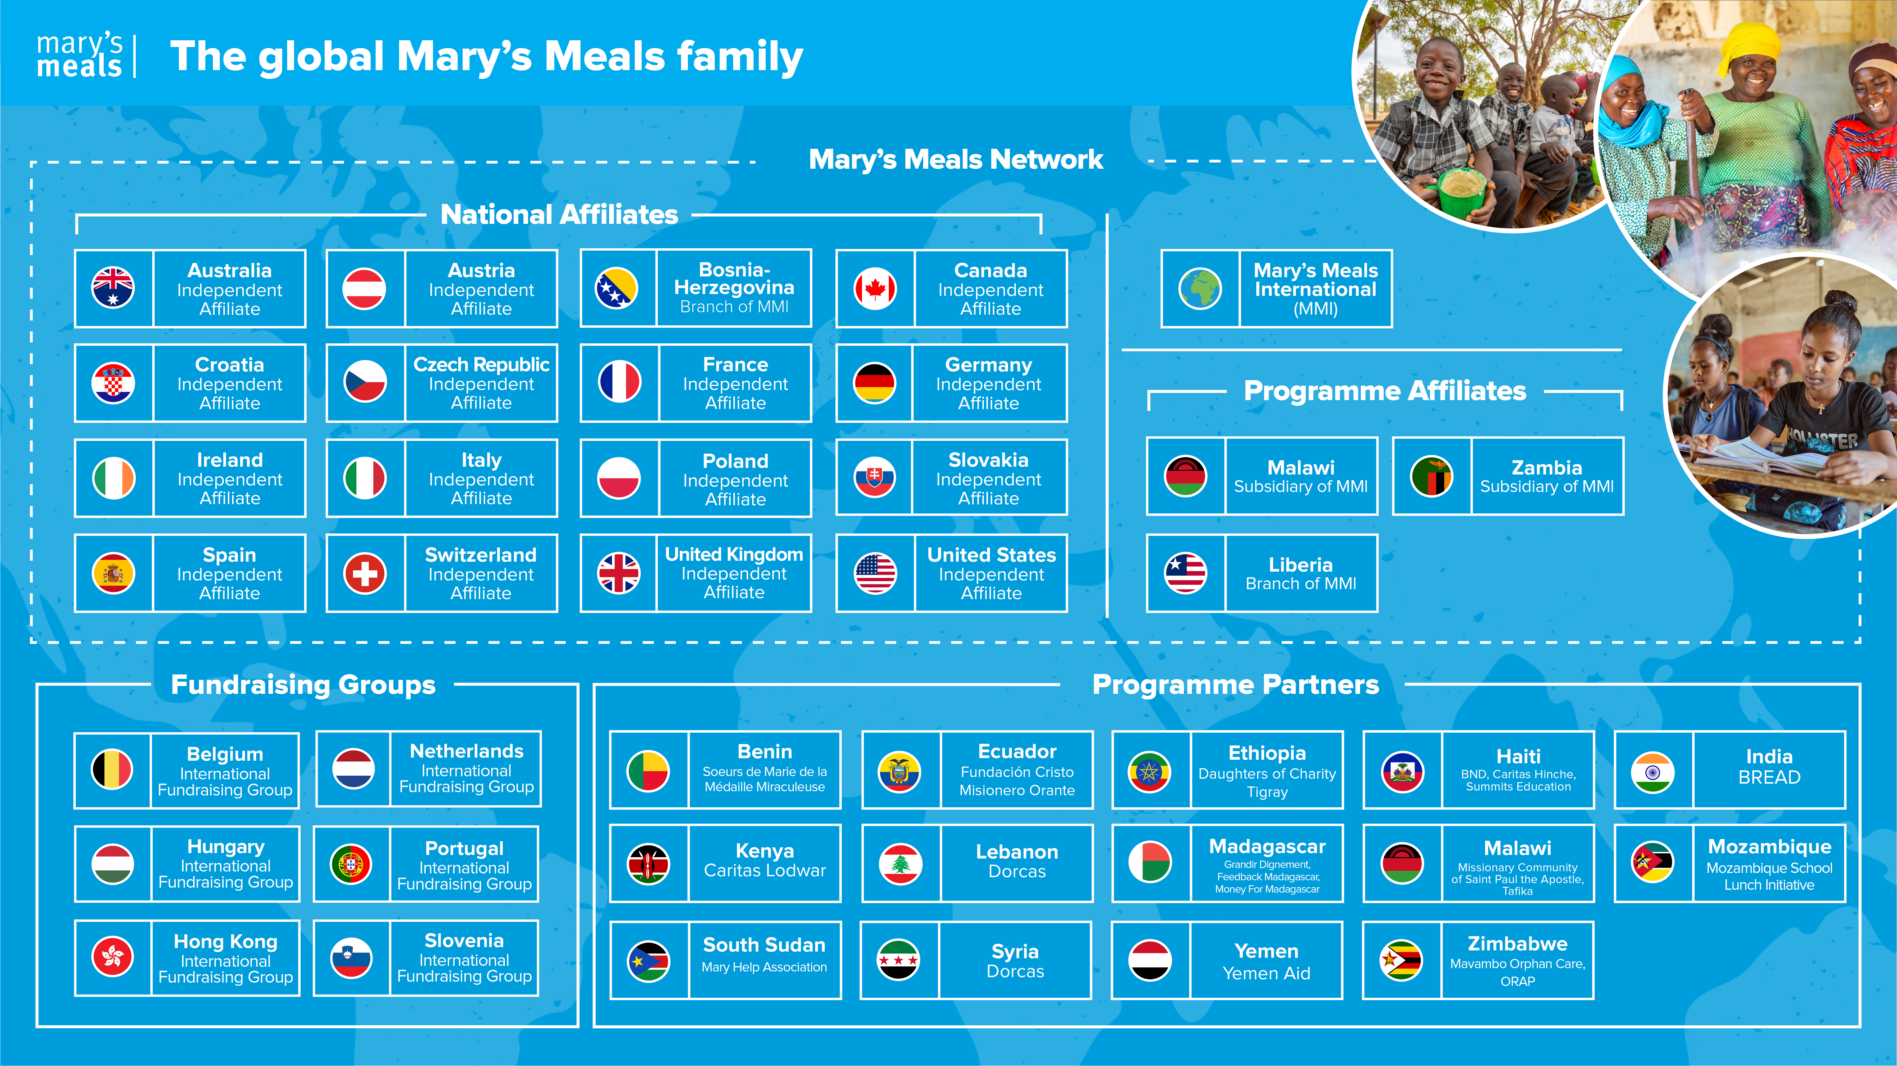
Mary’s Meals family
14

Slide 15
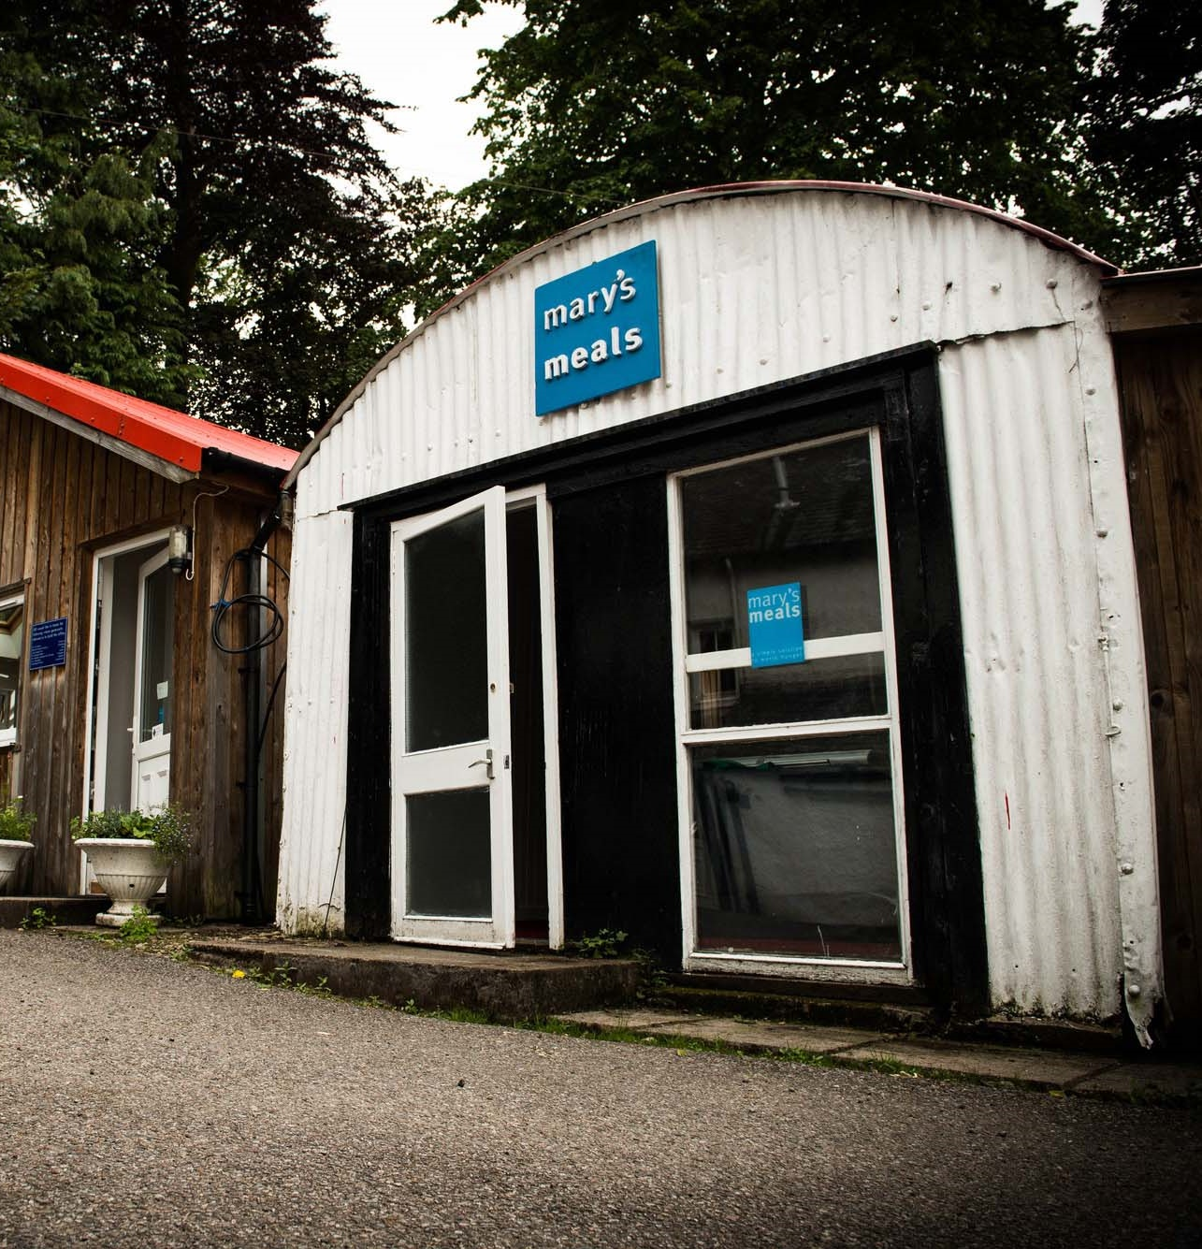
About Mary’s Meals UK
Mary’s Meals UK (or ‘MMUK’), a charity registered in Scotland, is the oldest entity in the Mary’s Meals family – the original organisation established as Scottish International Relief in the early 1990s, when our founder and global CEO, Magnus MacFarlane-Barrow, first became involved in international aid during the Bosnian Conflict.
Back then, Magnus was a simple salmon farmer who, along with his family, decided to do something to help those who were suffering because of the war.
They relied heavily on the generosity of local people in their village of Dalmally in Argyll, who relentlessly donated food, blankets and other items of aid, which were then stored in the family shed, before being driven out by Magnus to Bosnia-Herzegovina.
Though our largest office is now in Glasgow, that same shed – which continues to be filled, metaphorically at least, with the generosity of our supporters – still serves as the headquarters of Mary’s Meals UK to this day.
15

Slide 16

Mary’s Meals UK manager competencies
Managers at Mary’s Meals UK approach their role in line with our 7S competency model:
1. Self
I build and demonstrate resilience
I lead by example
I’m authentic and true to Mary’s Meals values
I develop myself and set stretching goals
2. Service
I have a vocational attitude to my work
I inspire hope in others
I build belief that even difficult challenges can be solved
I am committed to serving and enabling all who want to be part of the global movement
I work to ensure our future will be even better than our past
3. Simplicity
I communicate effectively
I follow clear decision-making criteria
I create plans that are easy to follow and contribute to organisational goals
I embrace inclusivity and diversity
I focus on delivering results
4. Stewardship
I pay attention to the things that matter most;
(a) our physical resources; (b) our people
I nurture, develop and respect our relationships with external stakeholders
I deliver on my promises
I am happy to be held accountable and to hold others to account
5. Strategy
I have a point of view about the future
I know our stakeholders and see our priorities clearly
I help others to work in ways that have the
greatest impact
I develop strategy and translate it into action
6. Strengthen
I create a positive work environment
I increase the capabilities of my team
I help people manage their careers
I find and develop next-generation talent
7. Success
I ensure my team is technically competent and developing
I build high performing teams
I ensure accountability
I am a catalyst for change
17

Slide 17
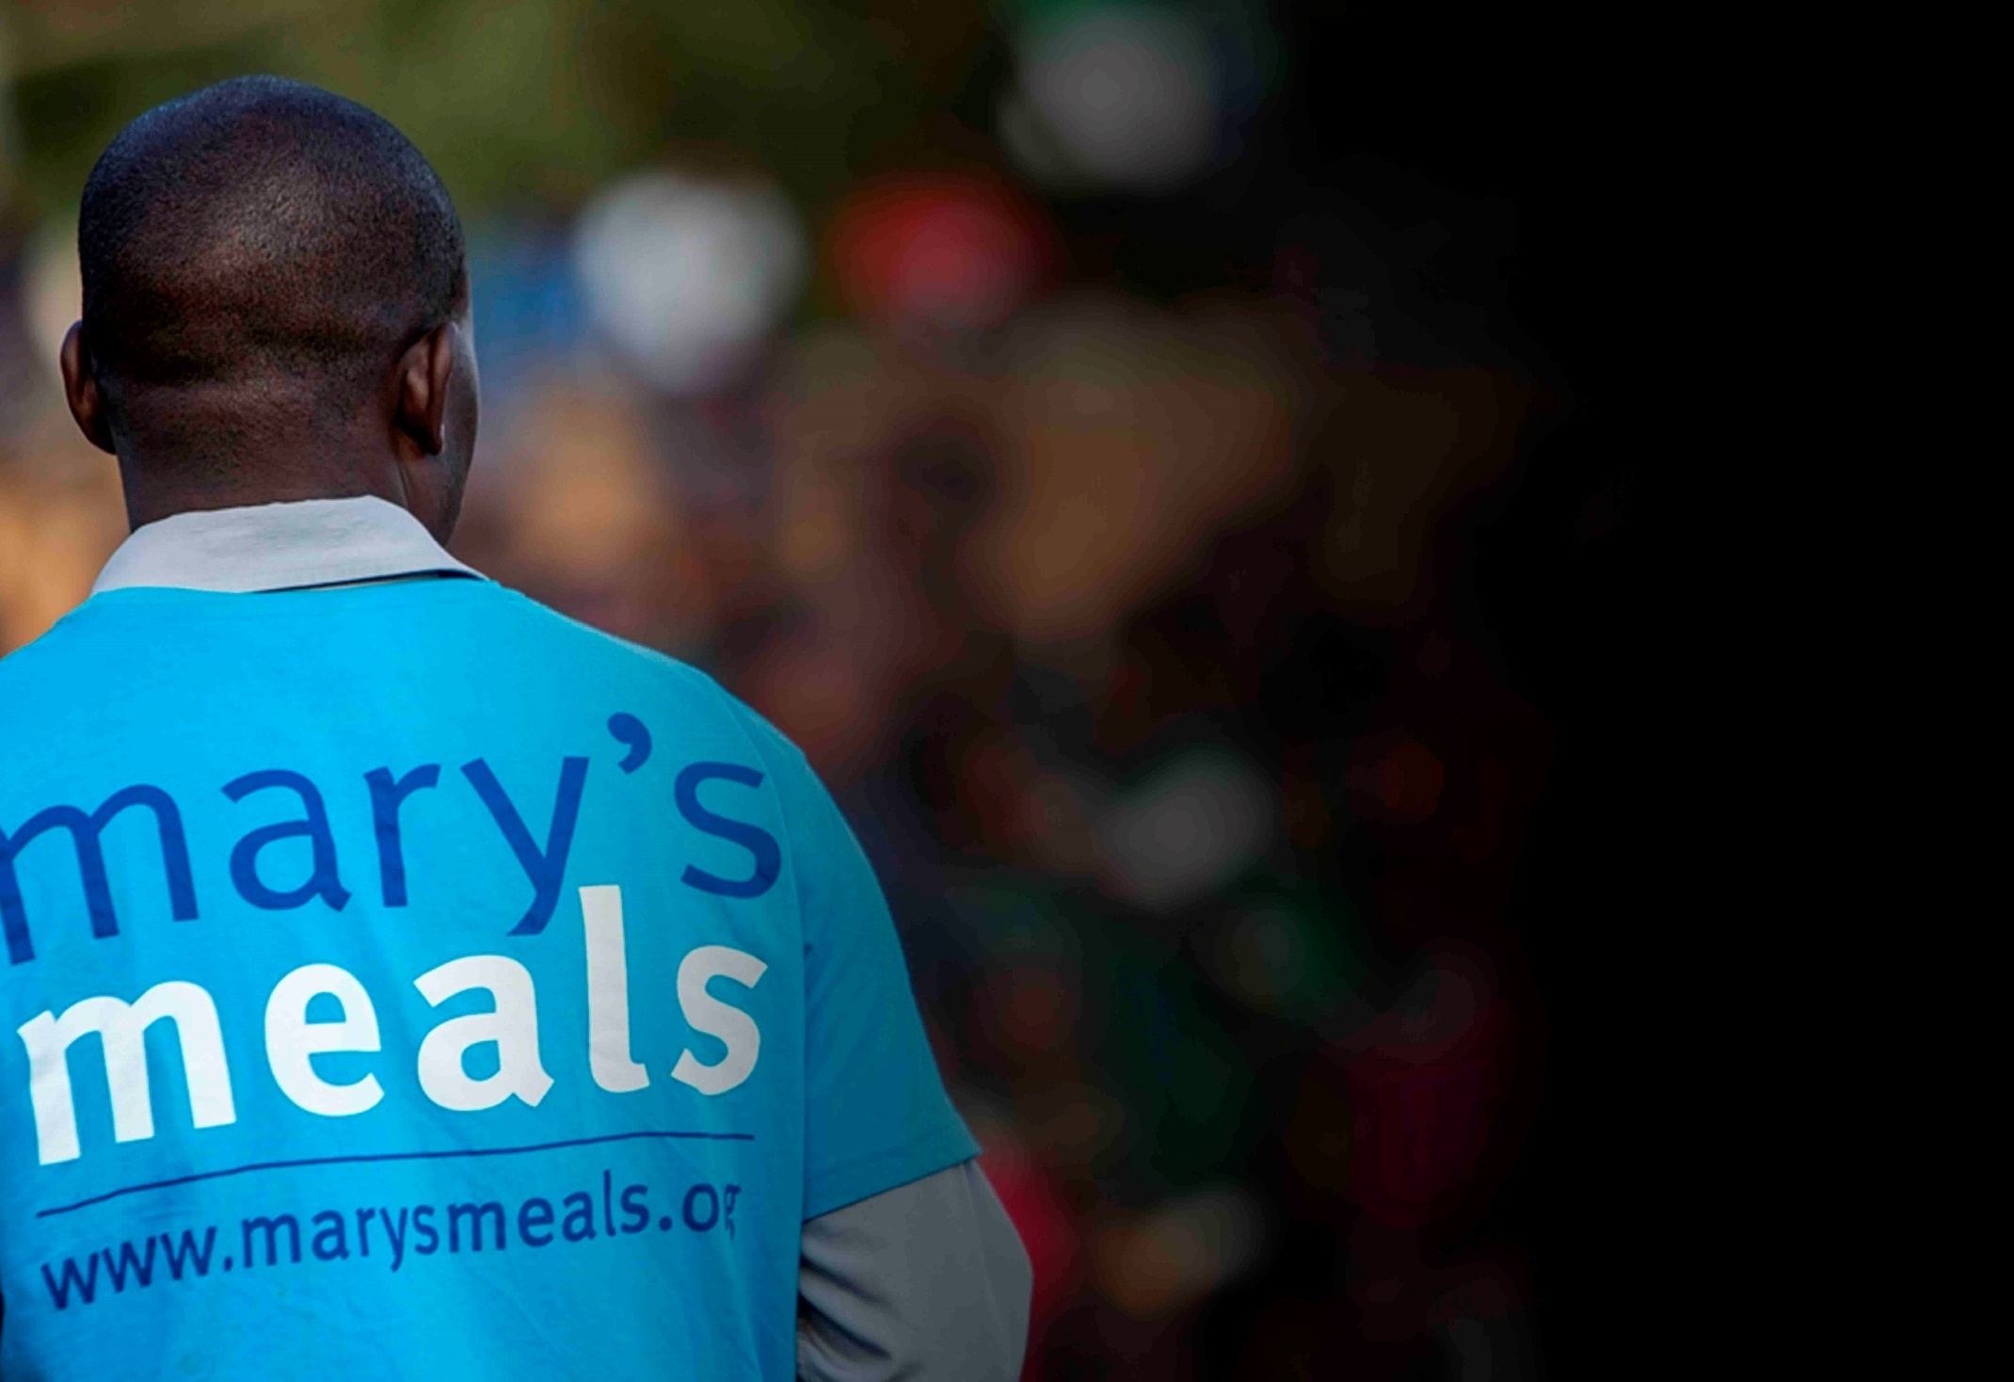
Recruitment process information
How to apply for this role
To apply for the role of Head of Supporter Experience and Marketing based at Mary’s Meals UK, please send a tailored CV and covering letter or 2–3-minute video to : Jobs@marysmeals.org
Your covering letter or video should make a compelling case for why you feel motivated to apply for this role within Mary’s Meals UK, as well as giving a concise overview of your most relevant skills and experience, and should fill no more than two pages of A4.
Applicants must hold full right to work in the UK.
We welcome applications from candidates of all different backgrounds and identities to apply. We are committed to building an inclusive and diverse charity providing a supportive place for you to do the best and most rewarding work of your career.
Recruitment timescales
Applications will close at 5pm Wednesday 18th March.
We reserve the right to close this vacancy early if we receive sufficient applications for the role. Therefore, if you are interested, please submit your application as early as possible.
Please note: If you have any special requirements or adjustments before an interview, please let us know.
16

Slide 18


Mary’s Meals UK
Charity No. SC022140
Company No. SC265941
Tel: 0141 336 7094
Dalmally office
Craig Lodge
Dalmally, Argyll
PA33 1AR
Glasgow office
Unit 10-13 Claremont Centre
39 Durham Street, Glasgow
G41 1BS
London office
13 Hippodrome Place
Notting Hill, London
W11 4SF
“Together, let’s set out on this journey; one step at a time, one meal at a time, one child at a time.”
– Magnus MacFarlane-Barrow, Mary’s Meals founder

