Slide 1


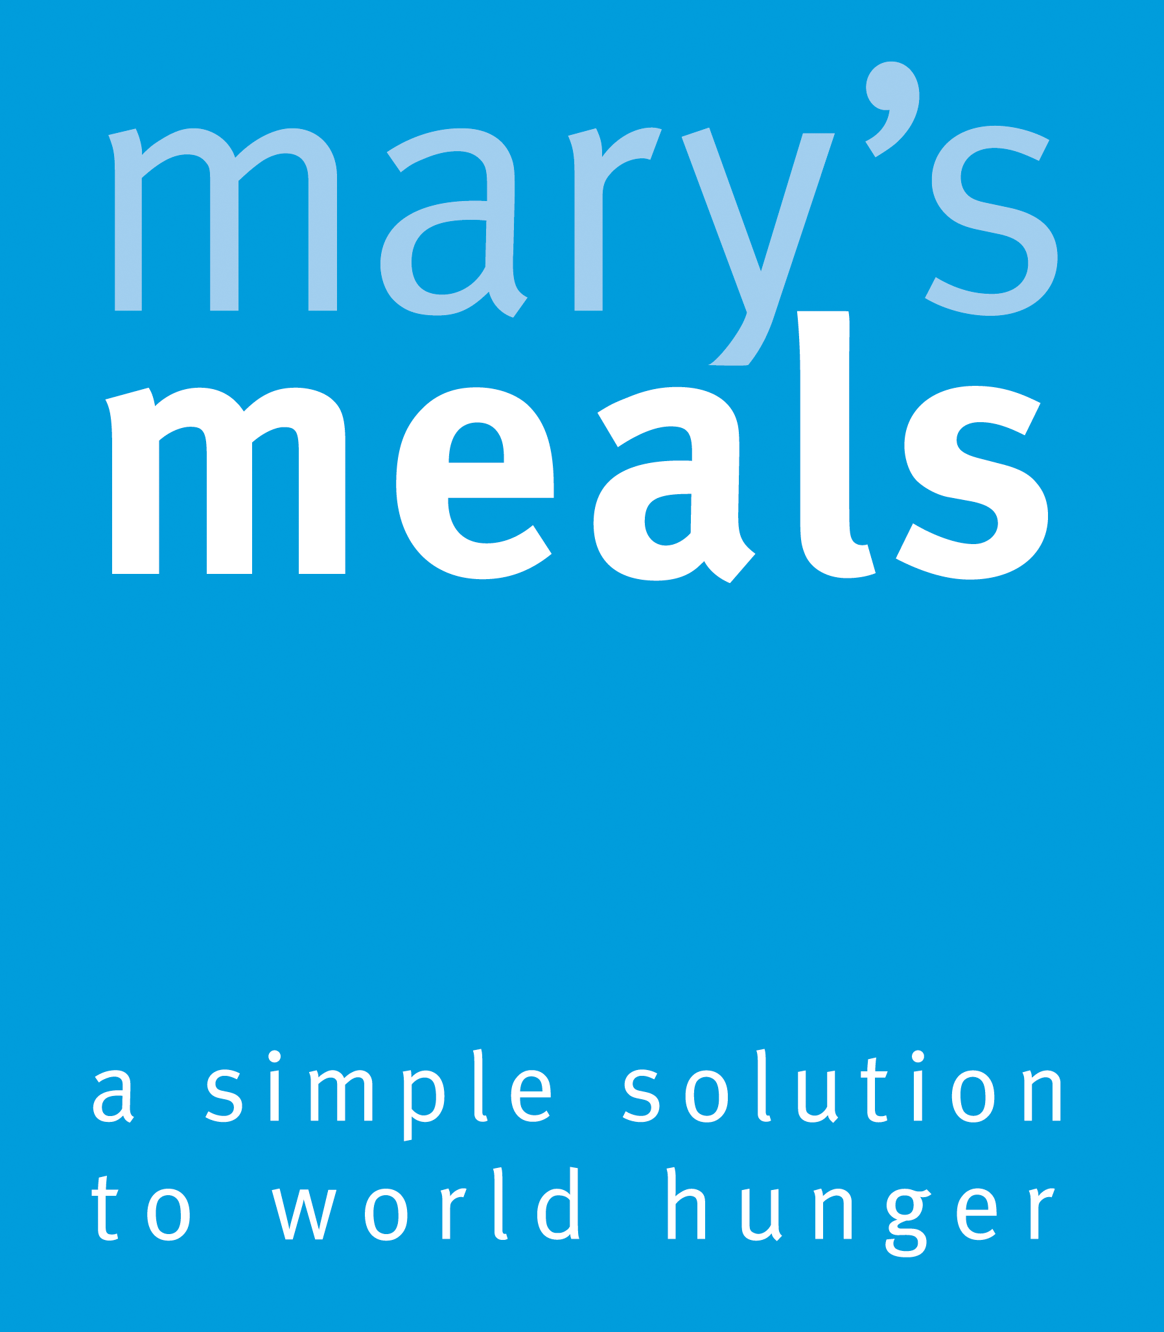




Recruitment pack for:
Legacy Officer (0.4 FTE)
Remote working from anywhere in the UK
Mary’s Meals UK
March 2026

Slide 2

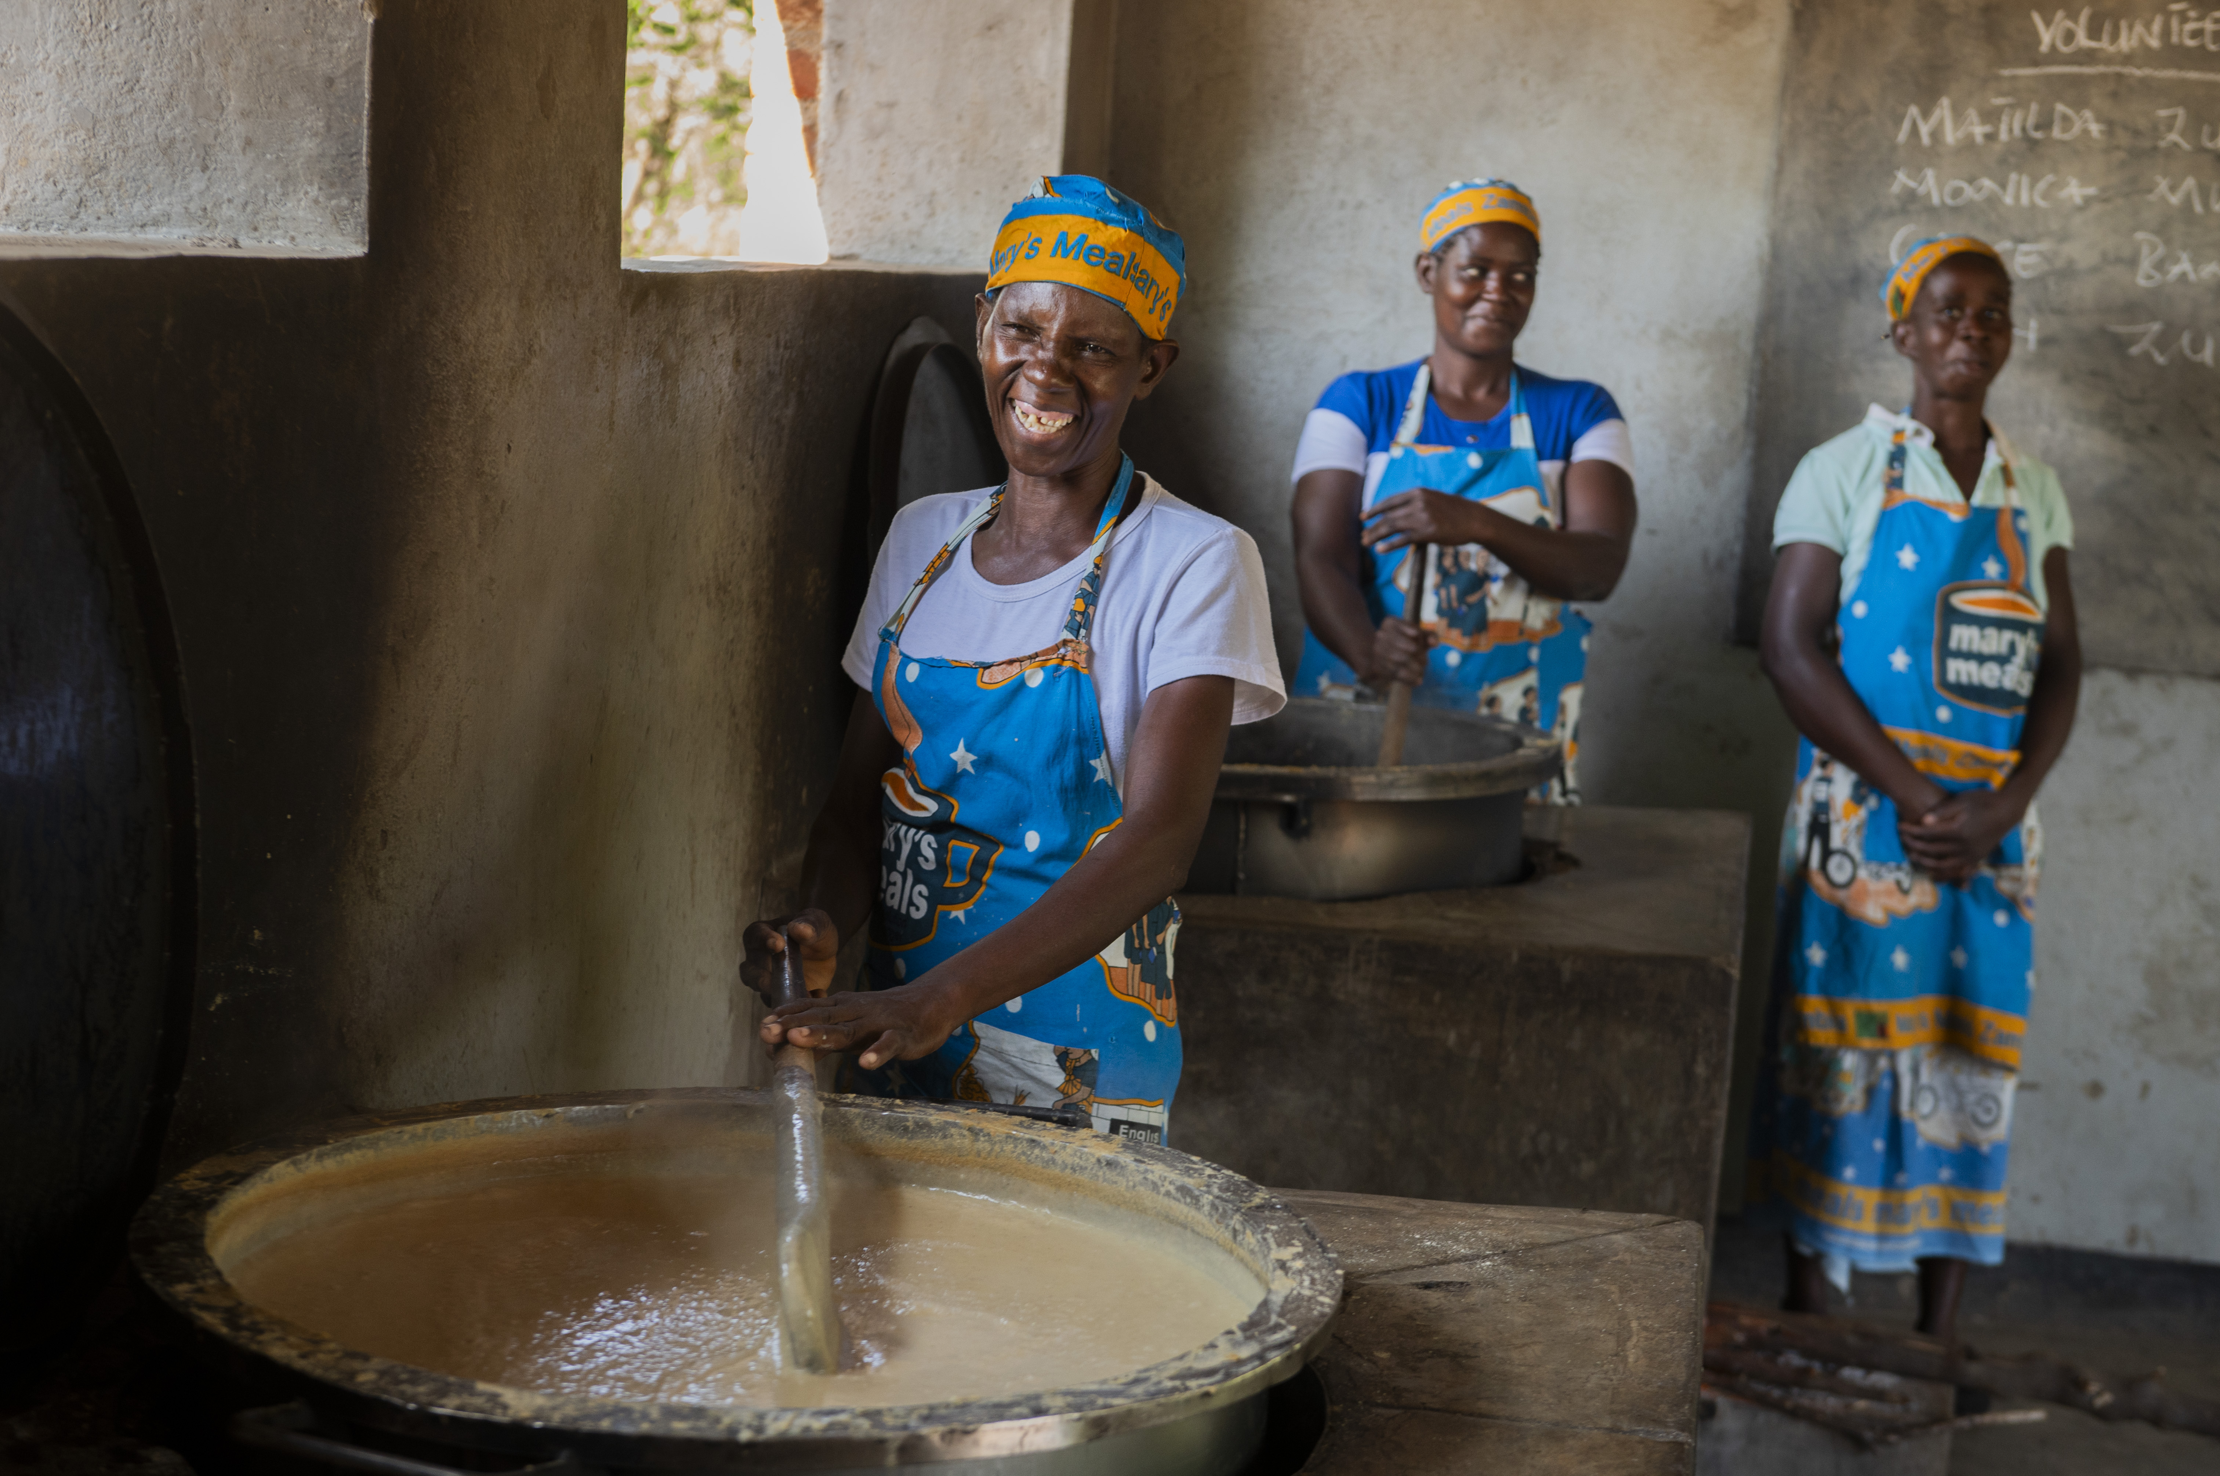
Recruitment pack contents
Welcome from our 3 Executive Director
Role outline and 5 Specification
Our vision, mission 9 and values
About the Mary’s Meals 11 movement
About Mary’s Meals UK 13
Recruitment process 15 information
2

Slide 3
Welcome from our Executive Director
Thank you so much for your interest in joining the Mary’s Meals family. As you consider making an application for the role of Legacy Officer with Mary’s Meals UK, I hope you find this pack helpful, encouraging, and exciting.
In joining Mary’s Meals UK, you would become part of a global movement of people who will simply not accept that any child should go hungry in this world of plenty. We are passionately driven by our simple belief that every child in the world deserves an education – and enough to eat.
From small beginnings feeding just 200 Malawian children in 2002, we are now reaching 3 million children across 16 programme countries (including Malawi, Liberia, Zambia, Haiti, South Sudan, and Syria) with a nutritious daily meal in school.
This meal not only meets the immediate needs of the hungry child, but it attracts children to the classroom, where they can gain an all-important education. And we firmly believe that the children who are receiving Mary’s Meals today can grow up – better nourished and better educated – to become the men and women who will lift their communities out of poverty and end their reliance on aid.​
​
The UK, where we received the first-ever donations for our work, remains the country in which Mary’s Meals raises the majority of its funds. And Mary’s Meals UK, the organisation I am privileged to lead is responsible for continuing to tell our story across Scotland, England, Northern Ireland and Wales; engaging and inspiring more and more UK volunteers and donors; and driving forward the unrelenting growth of the Mary’s Meals movement on these shores.​
3

Slide 4
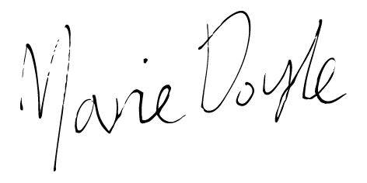
Welcome from our Executive Director
With more than 71 million children out of school around the world and a further 73 million attending school so hungry, they’re unable to concentrate and learn, our work is only just beginning.
Legacy income is an area of income growth for Mary’s Meals. The role of the legacy officer is to be responsible for the administration of the legacy income process.
Will you play a crucial part in shaping the future of Mary’s Meals UK and, with it, the lives of so many people who both contribute to and benefit from this incredible work of love, joy, and hope?
I look forward to hearing your story.
Marie Doyle Executive Director, Mary’s Meals UK
4

Slide 5

Legacy Officer
Reports to: | Finance Business Partner – Income
Location: | Home working from anywhere in the UK
Salary: | c. £30,170 - £34,926 per annum FTE, plus London weighting if applicable
Benefits: | Flexible working 34 days’ annual leave (including public holidays) Non-contributory pension with employer contributions of 8%. Volunteering and development days Enhanced maternity and paternity leave Employee Assistance programme Life Assurance Wellbeing support Cycle to Work scheme
5

Slide 6
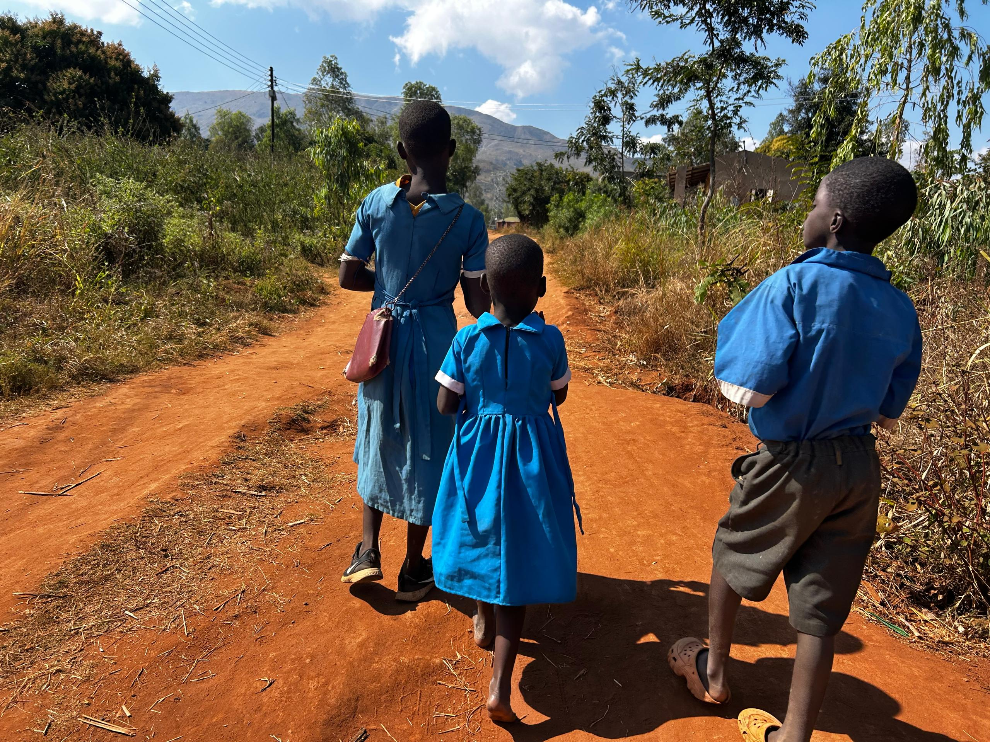
Duties and responsibilities
Duties and responsibilities:
Set up records and create case files on salesforce for all legacy bequests received from solicitors and from notifications of bequests on the Smee and Ford website.
Record the details of all legacy bequests in the case file on salesforce.
Set up a SharePoint folder for the notified legacy bequests.
Upload all legacy documentation received into the legacy case files on salesforce and into the SharePoint folder.
Respond to the solicitor or personal executor acknowledging the legacy bequest, thanking the next of kin on behalf of major giving and requesting any further documentation.
Raise tasks on the salesforce legacy case files as a reminder to follow up with the solicitor or the personal executor as to the progress of the legacy administration.
Correspond in a timely manner with solicitors and personal executors to enquire into progress of the legacy administration.
Throughout the legacy administration process update the legacy case files with notes of the correspondence with the solicitor or personal executor.
On receipt of the legacy income complete the documentation requested by the solicitor and close the legacy case file on salesforce.
Escalate any issues identified to the Finance Business Partner Income.
Review the open legacy case files with the Finance Business Partner Income and follow up on actions raised.
Highlight any improvements/enhancements to the legacy process to the Finance Business Partner Income.
6

Slide 7

Essential Qualifications, experience and skills
Essential:
ILM Certificate in Charity Legal Administration Accredited.
Experience of using and maintaining databases.
Excellent administrative and organisational skills.
Excellent communication skills.
Experience and familiarity with Microsoft Word, Excel, Outlook and PowerPoint.
Experience of organising and providing administrative assistance in an office environment.
Experience of handling a wide range of enquiries and an excellent telephone manner.
Knowledge of data protection act and responsibilities.
Clear understanding of confidentiality with written and computerised materials and processes.
Able to work independently and proactively, with the ability to consult wherever necessary.
Desirable:
Experience of using Salesforce CRM system.
7

Slide 8
Finance team structure
Director of Charity Operations
Head of Finance
Finance Business Partner - Expenditure
Finance Business Partner - Income
Senior Finance Manager
Finance Officer
Finance Officer
Legacy Officer (0.4)
8

Slide 9

Our vision and mission
• Our vision is that every child receives one daily meal in their place of education and that all those who have more than they need, share with those who lack even the most basic things.
• Our mission is to enable people to offer their money, goods, skills, time, or prayer, and through this involvement, provide the most effective help to those suffering the effects of extreme poverty in the world’s poorest communities.
9

Slide 10
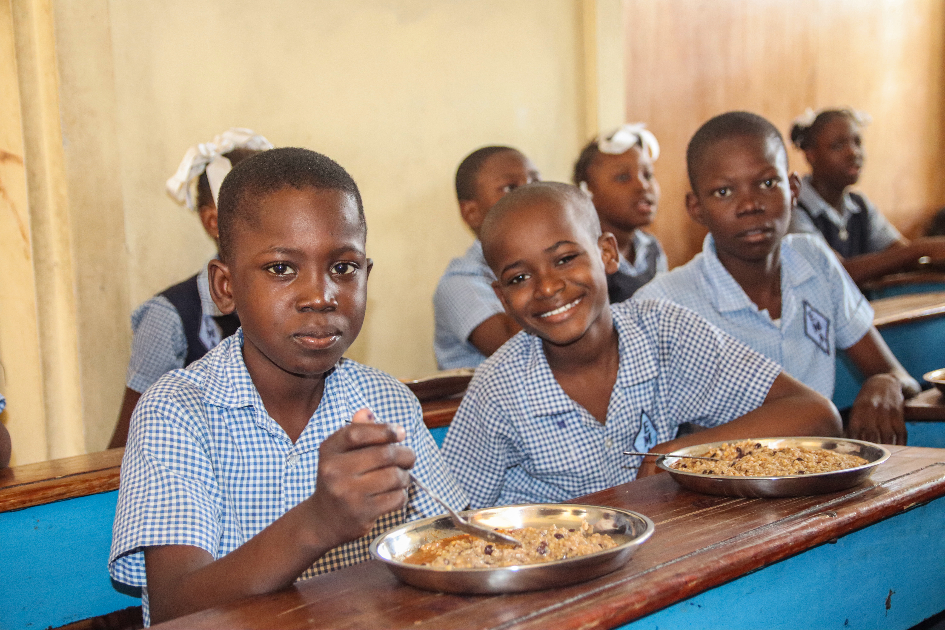
Our values
• We have confidence in the innate goodness of people.
• We respect the dignity of every human being and family life.
• We believe in good stewardship of the resources entrusted to us.
View Mary’s Meals’ full statement of values here: Statement of Values
10

Slide 11
About the Mary’s Meals movement
Mary’s Meals is a global movement that sets up school feeding projects in some of the world’s poorest communities, where poverty and hunger prevent children from gaining an education.
Our idea is a simple one that works. We provide one daily meal in a place of learning in order to attract chronically poor children into the classroom, where they receive an education that can, in the future, be their ladder out of poverty.
The Mary’s Meals campaign was born in 2002 when Magnus MacFarlane-Barrow, from Dalmally in Argyll, visited Malawi during a famine and met a mother dying from AIDS. When Magnus asked her eldest son Edward what his dreams were in life, he replied simply: “I want to have enough food to eat and to go to school one day.”
That moment was a key part of the inspiration which led to the founding of Mary’s Meals, which began by feeding just 200 children in Malawi in 2002. Today, 20 years later, we feed 3 million hungry children every school day across four continents.
Where Mary’s Meals is provided, there is a rise in school enrolment, attainment and attendance. Wherever possible, Mary's Meals uses locally grown food to support the local economy and help smallholder farmers.
We work extremely hard to keep our running costs low which means that it costs just £19.15 to feed a child with Mary’s Meals for a whole school year. This is only possible because most of our work is done by an army of dedicated volunteers all over the world, who carry out lots of little acts of love on behalf of Mary’s Meals.
Having been inspired, in part, by our founder’s Catholic faith, this work is named in honour of Mary, the mother of Jesus, who brought up her own child in poverty. We consist of, respect and reach out to people of all faiths and none.
Counting on support from around the globe, Mary’s Meals has registered national affiliate organisations, which raise awareness of our work around the world. Funds raised by affiliates, including from Mary’s Meals UK, are passed to Mary’s Meals International, the organisation which co-ordinates our movement and directly manages the delivery of our school feeding programmes.
11

Slide 12
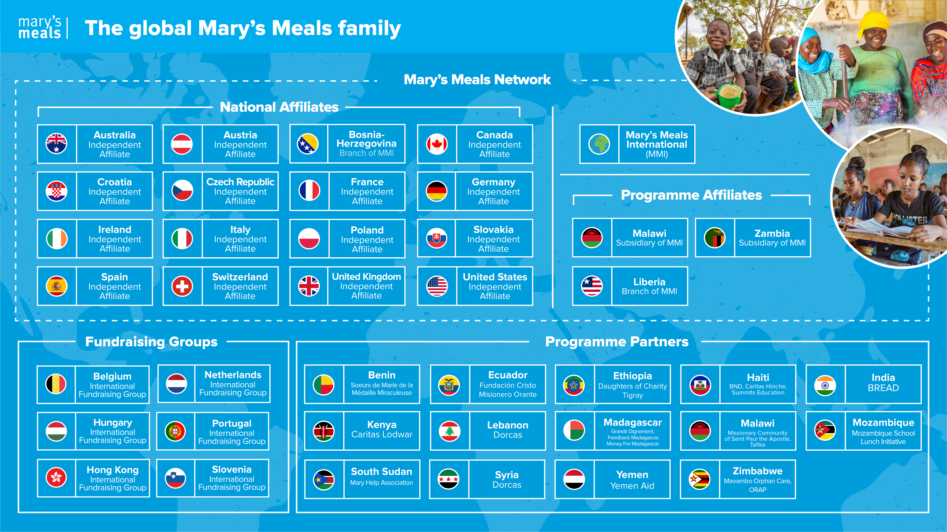
Mary’s Meals family
12

Slide 13
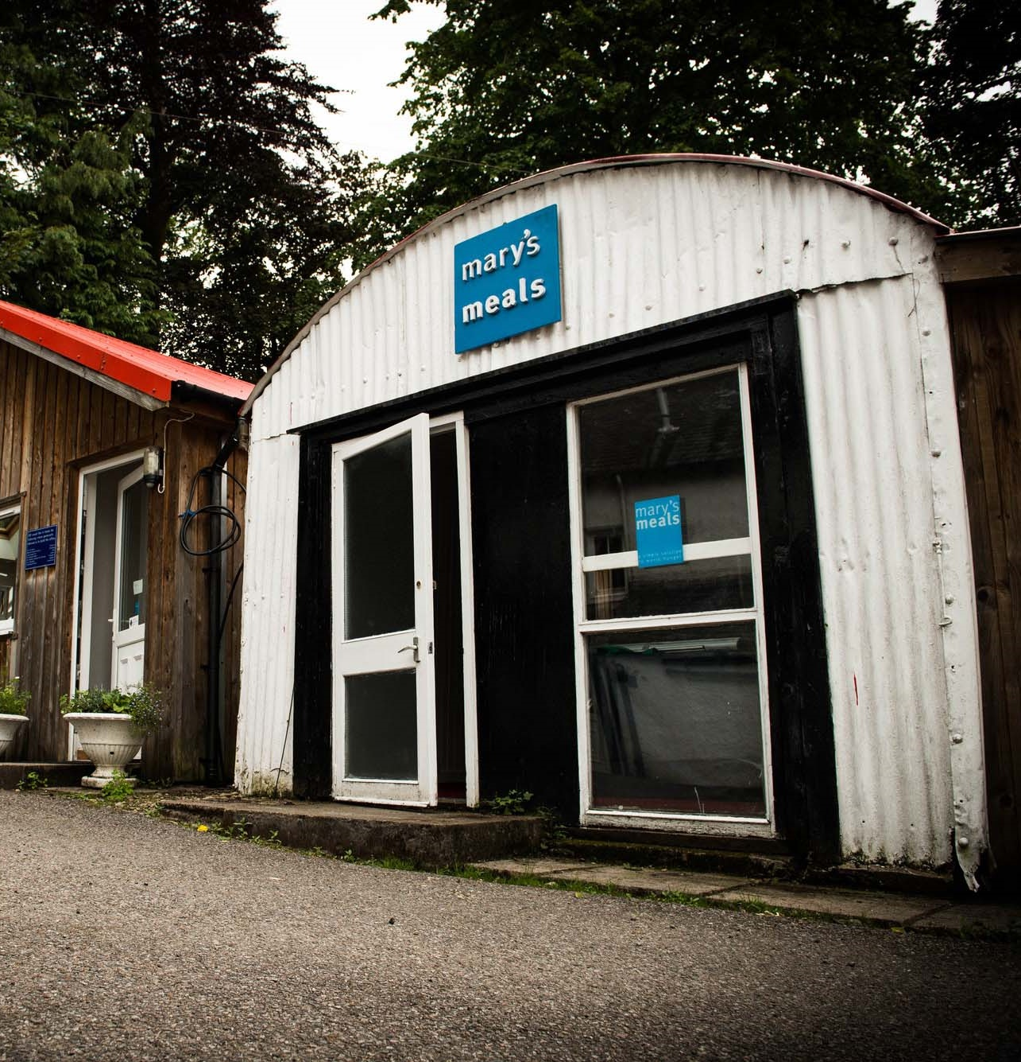
About Mary’s Meals UK
Mary’s Meals UK (or ‘MMUK’), a charity registered in Scotland, is the oldest entity in the Mary’s Meals family – the original organisation established as Scottish International Relief in the early 1990s, when our founder and global CEO, Magnus MacFarlane-Barrow, first became involved in international aid during the Bosnian Conflict.
Back then, Magnus was a simple salmon farmer who, along with his family, decided to do something to help those who were suffering because of the war.
They relied heavily on the generosity of local people in their village of Dalmally in Argyll, who relentlessly donated food, blankets and other items of aid, which were then stored in the family shed, before being driven out by Magnus to Bosnia-Herzegovina.
Though our largest office is now in Glasgow, that same shed – which continues to be filled, metaphorically at least, with the generosity of our supporters – still serves as the headquarters of Mary’s Meals UK to this day.
13

Slide 14

Mary’s Meals UK competencies
All Mary’s Meals UK employees approach their role in line with our 7S competency model:
1. Self
I build and demonstrate resilience
I lead by example
I’m authentic and true to Mary’s Meals values
I develop myself and set stretching goals
2. Service
I have a vocational attitude to my work
I inspire hope in others
I build belief that even difficult challenges can be solved
I am committed to serving and enabling all who want to be part of the global movement
I work to ensure our future will be even better than our past
3. Simplicity
I communicate effectively
I follow clear decision-making criteria
I create plans that are easy to follow and contribute to organisational goals
I embrace inclusivity and diversity
I focus on delivering results
4. Stewardship
I pay attention to the things that matter most;
(a) our physical resources; (b) our people
I nurture, develop and respect our relationships with external stakeholders
I deliver on my promises
I am happy to be held accountable and to hold others to account
5. Strategy
I have a point of view about the future
I know our stakeholders and see our priorities clearly
I help others to work in ways that have the
greatest impact
I develop strategy and translate it into action
6. Strengthen
I contribute to a positive work environment
I support those around me
7. Success
I maintain my technical competence
I contribute to the success of my team
I ensure accountability
I embrace change
14

Slide 15
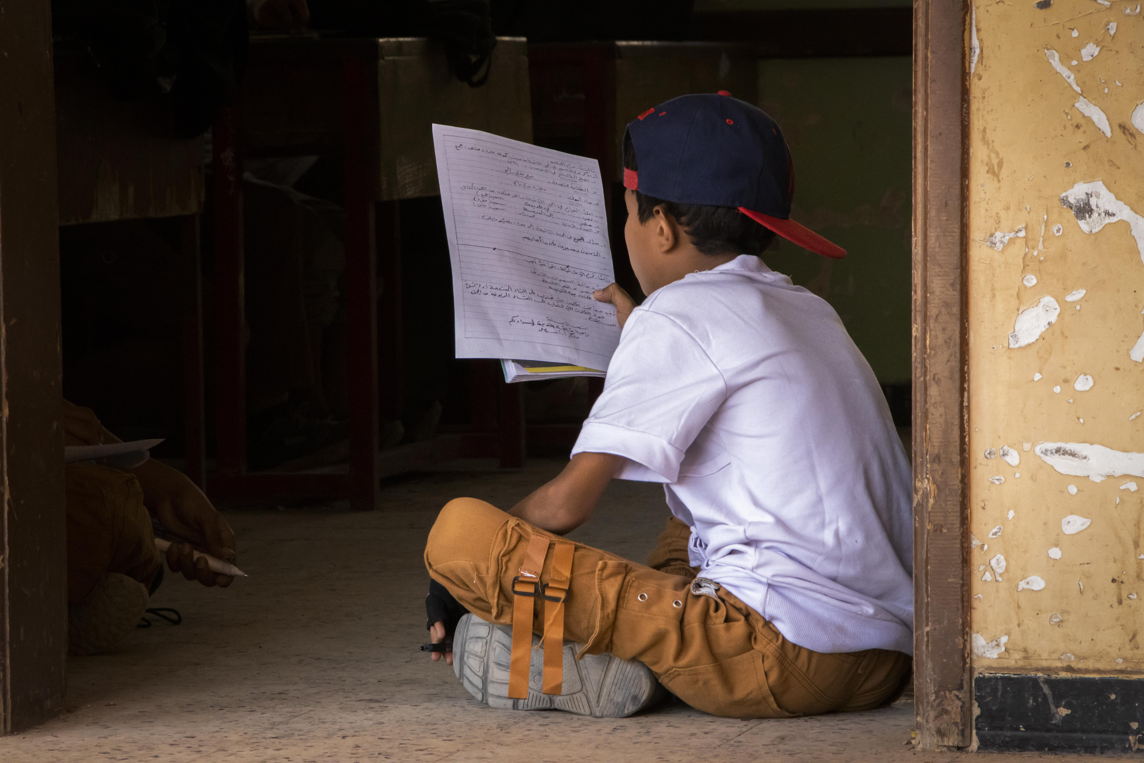
Recruitment process information
How to apply for this role
To apply for the role of Legacy Officer based at Mary’s Meals UK, please send a tailored CV and covering letter or 2–3-minute video to : Jobs@marysmeals.org
Your covering letter or video should make a compelling case for why you feel motivated to apply for this role within Mary’s Meals UK, as well as giving a concise overview of your most relevant skills and experience, and should fill no more than two pages of A4.
Applicants must hold full right to work in the UK.
We welcome applications from candidates of all different backgrounds and identities to apply. We are committed to building an inclusive and diverse charity providing a supportive place for you to do the best and most rewarding work of your career.
Recruitment timescales
Applications will be reviewed on an ongoing basis and interviews arranged accordingly.
We reserve the right to close this vacancy early if we receive sufficient applications for the role. Therefore, if you are interested, please submit your application as early as possible.
Please note: If you have any special requirements or adjustments before an interview, please let us know.
15

Slide 16


Mary’s Meals UK
Charity No. SC022140
Company No. SC265941
Tel: 0141 336 7094
Dalmally office
Craig Lodge
Dalmally, Argyll
PA33 1AR
Glasgow office
Unit 10-13 Claremont Centre
39 Durham Street, Glasgow
G41 1BS
London office
13 Hippodrome Place
Notting Hill, London
W11 4SF
“Together, let’s set out on this journey; one step at a time, one meal at a time, one child at a time.”
– Magnus MacFarlane-Barrow, Mary’s Meals founder

