Slide 1
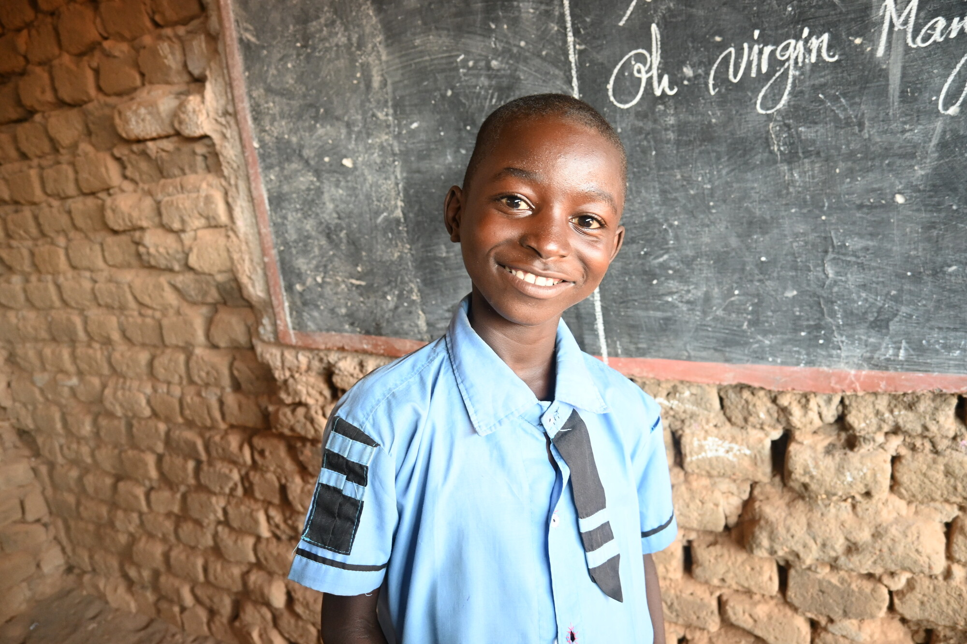
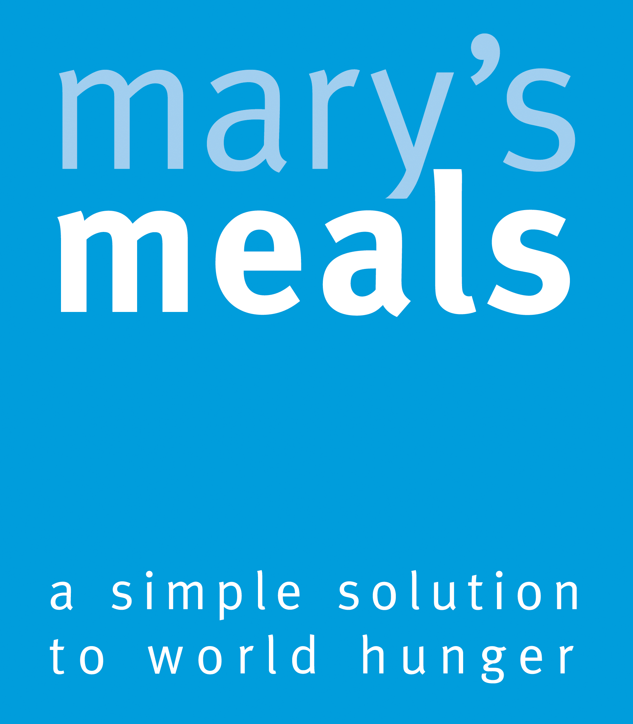





Recruitment pack for:
Digital Marketing Manager
Remote working from anywhere in the UK
Mary’s Meals UK
March 2026

Slide 2

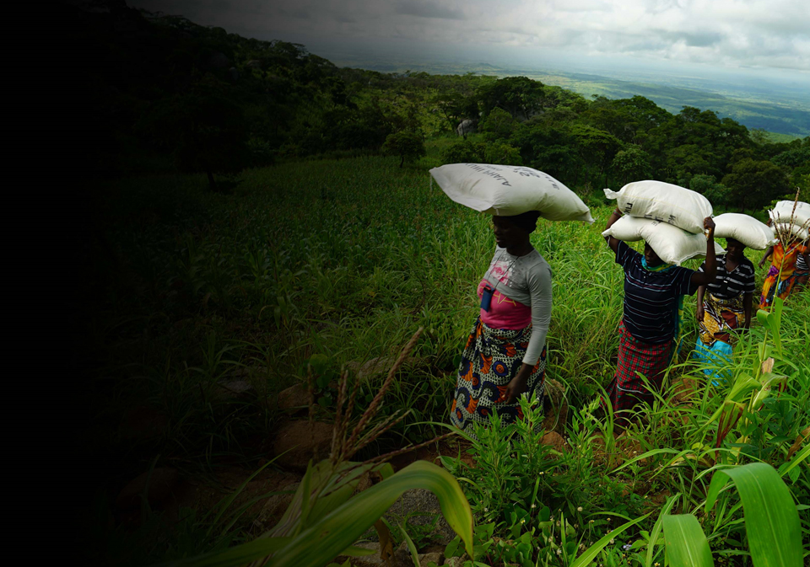
Recruitment pack contents
Welcome from our Executive Director
Role outline and Specification
Our vision, mission and values
About the Mary’s Meals movement
About Mary’s Meals UK
Recruitment process information
3
5
11
13
15
17
2

Slide 3
Welcome from our Executive Director
Thank you so much for your interest in joining the Mary’s Meals family. As you consider making an application for the role of Digital Marketing Manager with Mary’s Meals UK, I hope you find this pack helpful, encouraging, and exciting.
In joining Mary’s Meals UK, you would become part of a global movement of people who will simply not accept that any child should go hungry in this world of plenty. We are passionately driven by our simple belief that every child in the world deserves an education – and enough to eat.
From small beginnings feeding just 200 Malawian children in 2002, we are now reaching three million children across 16 programme countries (including Malawi, Liberia, Zambia, Haiti, South Sudan, and Syria) with a nutritious daily meal in school.
This meal not only meets the immediate needs of the hungry child, but it attracts children to the classroom, where they can gain an all-important education. And we firmly believe that the children who are receiving Mary’s Meals today can grow up – better nourished and better educated – to become the men and women who will lift their communities out of poverty and end their reliance on aid.​
​
The UK, where we received the first-ever donations for our work, remains the country in which Mary’s Meals raises the majority of its funds. And Mary’s Meals UK, the organisation I am privileged to lead is responsible for continuing to tell our story across Scotland, England, Northern Ireland and Wales; engaging and inspiring more and more UK volunteers and donors; and driving forward the unrelenting growth of the Mary’s Meals movement on these shores.​
3

Slide 4
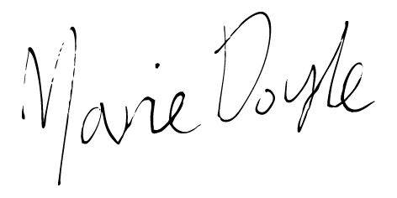
Welcome from our Executive Director
With more than 78 million children of primary school age out of school around the world, our work has never been more important.
The Digital Marketing Manager attracts new UK supporters and generates income for Mary’s Meals’ school meals programme through effective and inspiring marketing across digital channels.
Will you play a crucial part in shaping the future of Mary’s Meals UK and, with it, the lives of so many people who both contribute to and benefit from this incredible work of love, joy, and hope?
I look forward to hearing your story.
Marie Doyle Executive Director, Mary’s Meals UK
4

Slide 5
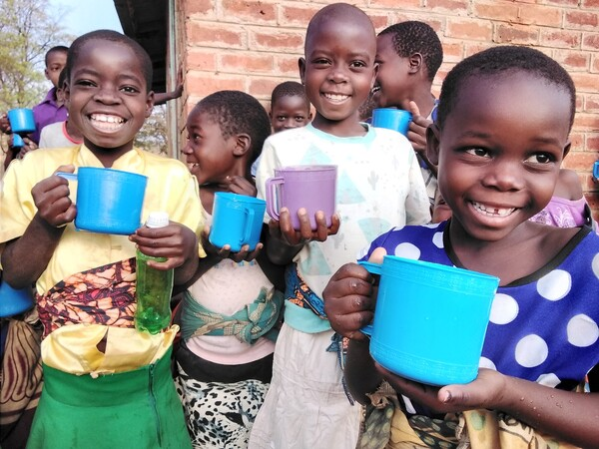
Digital Marketing Manager
Reports to: | Head of Acquisition Marketing
Location: | Home working from anywhere in the UK
Salary: | c. £36,689 - £43,061 per annum FTE, plus London Weighting if applicable
Benefits: | Flexible working 34 days’ annual leave (including public holidays) Non-contributory pension with employer contributions of 8%. Volunteering and development days Enhanced maternity and paternity leave Employee Assistance programme Life Assurance Wellbeing support Cycle to Work scheme
5

Slide 6
Role Overview
Role Overview:
The role primarily raises income (but also awareness) through performance marketing activity with a clear focus on maximising ROI and delivering supporter growth at scale. The focus is on managing digital channels including Google & Bing Paid Search and Shopping, Google Grant, Meta, Display, YouTube, SEO and identifying emerging channels. Ensuring digital marketing complements other marketing activities as part of an integrated team approach is key.
Keeping our values led approach at the central focus is essential as is harnessing technology and good fundraising practice.
The Digital Marketing Manager works side-by-side with colleagues from across the Supporter Experience and Communications directorate, ensuring a joined-up approach to all communications activities, through the integration of strong storytelling, marketing expertise and supporter engagement.
6

Slide 7
Duties and responsibilities
Principal Duties:
Ensure Mary’s Meals’ mission remains central to all Acquisition Marketing work.
Work in ways which embody the team’s culture of empowerment, innovation and collaboration ensuring that Mary’s Meals’ values remain central.
Direct line management of Officers and volunteers as required.
Manage agencies and freelancers as required.
Ensure activities follow fundraising and data regulations, and marketing best practice.
Contribute to the creation of fundraising and awareness raising campaigns that build support for our vision including being part of cross-organisation project groups.
Develop and execute a results-driven digital marketing strategy focused on income generation, conversion, and lifetime supporter value.
Maximise value from the Google Ad Grant, ensuring full utilisation within grant constraints while delivering measurable results.
Build performance-driven channel plans across Paid Search, Shopping, Meta, Display, Video, and SEO, aligned to acquisition and revenue targets.
Identify new growth channels for Mary’s Meals.
Set up, manage, and continuously optimise Paid Search and Shopping campaigns on Google Ads, Google Grant, and Bing Ads with a focus on return on ad spend (ROAS) and cost per acquisition (CPA).
Set up, manage, and continuously optimise Meta Ads with a focus on return on ad spend (ROAS) and cost per acquisition (CPA).
Deliver Display and YouTube campaigns via Google Ads, managing targeting, placements, and creative testing.
Monitor and optimise campaign structures, keyword performance, bidding strategies, and audience targeting to maximise revenue.
Lead the delivery of technical and content SEO initiatives to improve rankings and organic traffic.
Work with the Creative Communications team on agreed content and copywriting requirements for acquisition marketing activities.
Track and report on key income metrics using GA4, GTM, and UTM tagging, with a focus on ROI, revenue per click, and conversion rates.
Set and report on KPI’s such as CPA, ROAS, CTR, conversion rate, and impression share.
Analyse data to identify trends, optimise campaigns, and deliver insights to inform wider marketing activity.
Test and refine messaging, ad formats, and landing pages through A/B and multivariate testing.
Contribute to oversight and performance of organic social media channels alongside the Supporter Marketing Manager, Supporter Experience Manager and Creative Communications Manager.
Work with designers and content creators to brief, review, and optimise assets (copy, creative, landing pages).
Collaborate with the Marketing, and wider Mary’s Meals teams to ensure campaigns support broader objectives.
Champion best practices in performance marketing across the organisation.
7

Slide 8
Essential Qualifications, experience and skills
Essential Criteria:
Expert at managing Google & Bing Paid Search campaigns (Search and Shopping formats) and Meta ads that deliver income and strong ROI.
Excellent project management and organisational skills with the ability to manage multiple campaigns at once.
Strong understanding of and experience with Display and YouTube advertising on the Google Ads platform.
Strong copywriting skills for paid media and the ability to collaborate with creative and content teams.
Solid SEO knowledge including on-page optimisation, content strategy, and technical SEO basics.
Proven, hands-on expertise managing the Google Ad Grant, including understanding grant policies, maximising spend, and drive meaningful traffic and conversions.
Skilled at creating and interpreting performance reports, analysing user journeys, and making data-led decisions.
Confident managing budgets, forecasting spend and ensuring cost-effective delivery whilst optimising for revenue generation.
Evidence of building strong collaborative internal relationships with colleagues across multiple teams and priority areas.
Proficiency with Google Analytics 4 (GA4), Google Tag Manager, and implementing tracking strategies.
Experience managing and optimising for performance metrics (e.g. ROI, CTR, CPA, ROAS).
A growth mindset with a passion for continuous testing and optimisation.
Passion for working in a values-centred charity that deeply values every supporter.
Awareness of accessibility, compliance, and privacy regulations in digital marketing (e.g. GDPR).
8

Slide 9
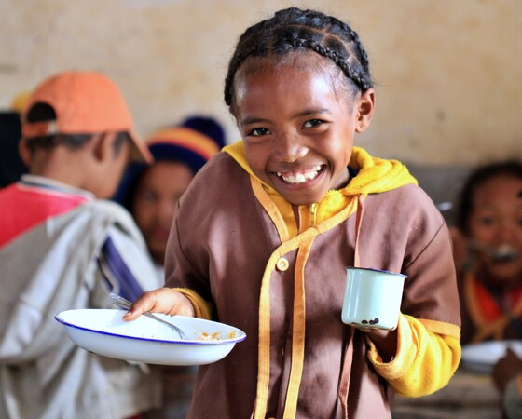
Essential Qualifications, experience and skills
Desirable criteria:
Good understanding of the charity sector, fundraising regulations and best practice.
Familiarity with CRMs (e.g. Salesforce) and email platforms for end-to-end campaign insight.
Familiarity with conversion rate optimisation (CRO) and landing page testing tools.
Understanding of other marketing disciplines such as Supporter Marketing and PR.
Understanding of supporter journeys and how acquisition activity feeds into retention.
Line management experience.
Experience working within a charity, nonprofit, or social impact organisation.
Experience using tools like Google Search Console, SEMrush, Ahrefs.
9

Slide 10
Supporter Experience and Communications directorate structure
Director of Supporter Experience and Communications
Head of Acquisition Marketing
Head of Supporter Experience and Marketing
Head of Media and Creative Comms
Acquisition Marketing Manager
Supporter Marketing Manager
Media Manager
Acquisition Marketing Officer
Digital Marketing Manager
Supporter Marketing Officer
Supporter Experience Manager
Supporter Experience Coordinator
Media Officer
Creative Communications Manager
Graphic Designer
Creative Communications Officer
Supporter Data Processing Manager (0.4)
Supporter Experience Coordinator
Supporter Data Processing Coordinator
Supporter Experience and Data Processing Officer
Supporter Experience and Data Processing Coordinator
10

Slide 11

Our vision and mission
• Our vision is that every child receives one daily meal in their place of education and that all those who have more than they need, share with those who lack even the most basic things.
• Our mission is to enable people to offer their money, goods, skills, time, or prayer, and through this involvement, provide the most effective help to those suffering the effects of extreme poverty in the world’s poorest communities.
11

Slide 12
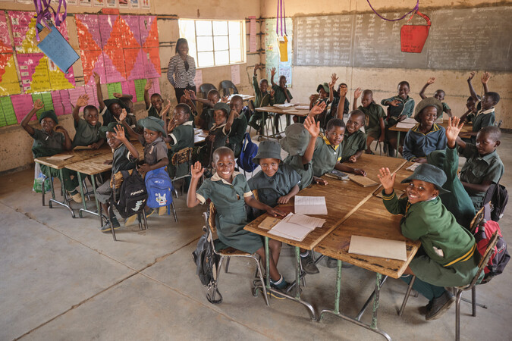
Our values
• We have confidence in the innate goodness of people.
• We respect the dignity of every human being and family life.
• We believe in good stewardship of the resources entrusted to us.
View Mary’s Meals’ full statement of values here: Statement of Values
12

Slide 13
About the Mary’s Meals movement
Mary’s Meals is a global movement that sets up school feeding projects in some of the world’s poorest communities, where poverty and hunger prevent children from gaining an education.
Our idea is a simple one that works. We provide one daily meal in a place of learning in order to attract chronically poor children into the classroom, where they receive an education that can, in the future, be their ladder out of poverty.
The Mary’s Meals campaign was born in 2002 when Magnus MacFarlane-Barrow, from Dalmally in Argyll, visited Malawi during a famine and met a mother dying from AIDS. When Magnus asked her eldest son Edward what his dreams were in life, he replied simply: “I want to have enough food to eat and to go to school one day.”
That moment was a key part of the inspiration which led to the founding of Mary’s Meals, which began by feeding just 200 children in Malawi in 2002. Today, 20 years later, we feed three million hungry children every school day across four continents.
Where Mary’s Meals is provided, there is a rise in school enrolment, attainment and attendance. Wherever possible, Mary's Meals uses locally grown food to support the local economy and help smallholder farmers.
We work extremely hard to keep our running costs low which means that it costs just £19.15 to feed a child with Mary’s Meals for a whole school year. This is only possible because most of our work is done by an army of dedicated volunteers all over the world, who carry out lots of little acts of love on behalf of Mary’s Meals.
Having been inspired, in part, by our founder’s Catholic faith, this work is named in honour of Mary, the mother of Jesus, who brought up her own child in poverty. We consist of, respect and reach out to people of all faiths and none.
Counting on support from around the globe, Mary’s Meals has registered national affiliate organisations, which raise awareness of our work around the world. Funds raised by affiliates, including from Mary’s Meals UK, are passed to Mary’s Meals International, the organisation which co-ordinates our movement and directly manages the delivery of our school feeding programmes.
13

Slide 14
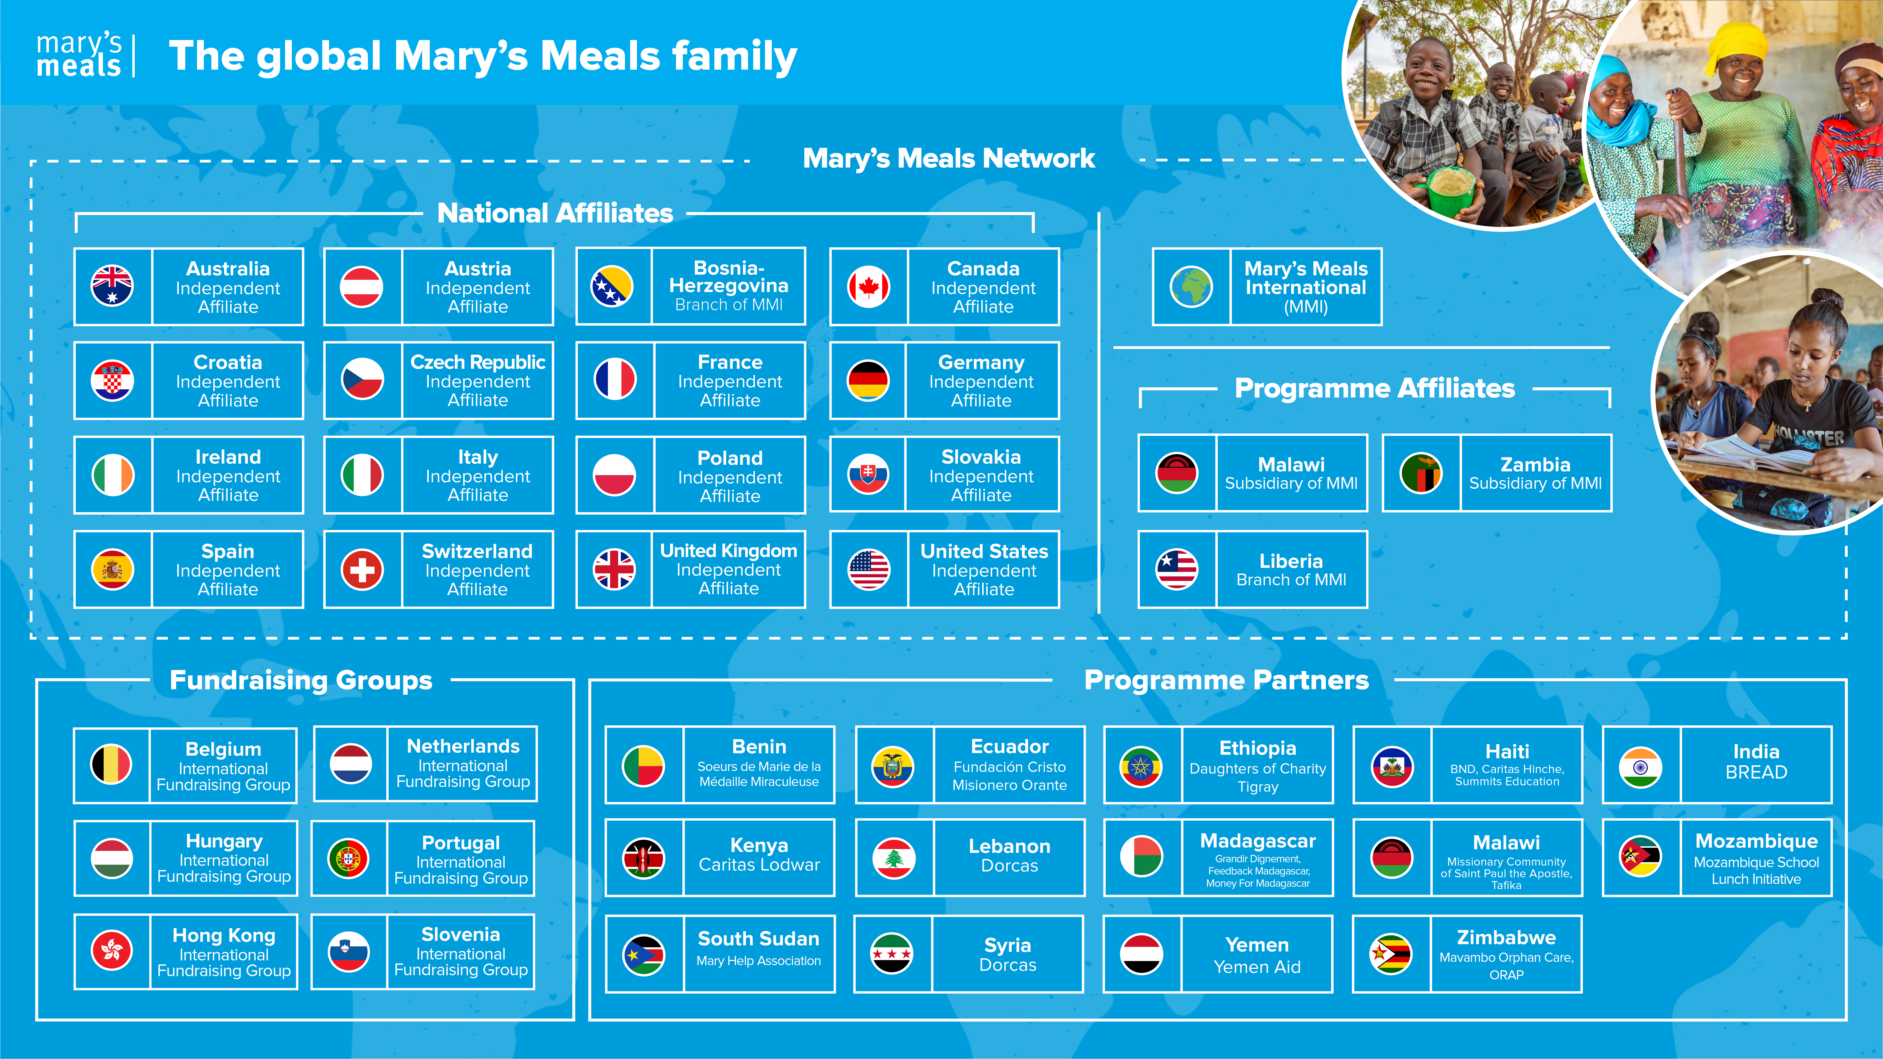
Mary’s Meals family
14

Slide 15
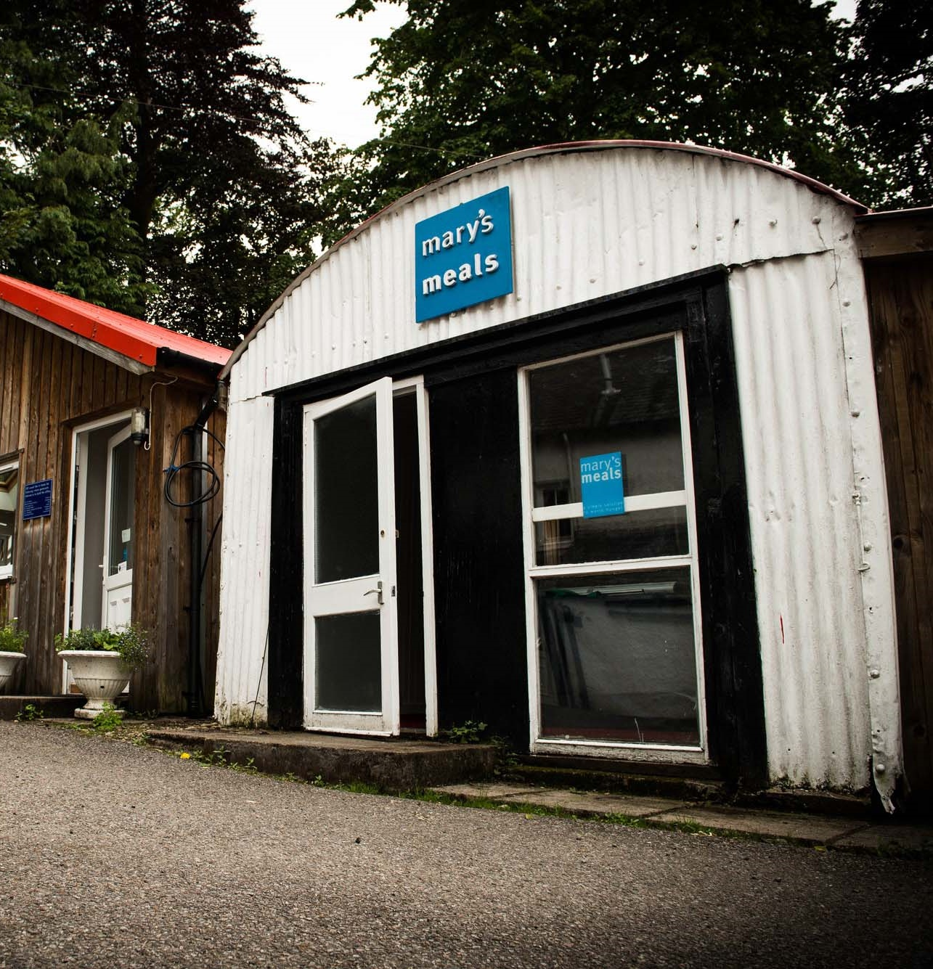
About Mary’s Meals UK
Mary’s Meals UK (or ‘MMUK’), a charity registered in Scotland, is the oldest entity in the Mary’s Meals family – the original organisation established as Scottish International Relief in the early 1990s, when our founder and global CEO, Magnus MacFarlane-Barrow, first became involved in international aid during the Bosnian Conflict.
Back then, Magnus was a simple salmon farmer who, along with his family, decided to do something to help those who were suffering because of the war.
They relied heavily on the generosity of local people in their village of Dalmally in Argyll, who relentlessly donated food, blankets and other items of aid, which were then stored in the family shed, before being driven out by Magnus to Bosnia-Herzegovina.
Though our largest office is now in Glasgow, that same shed – which continues to be filled, metaphorically at least, with the generosity of our supporters – still serves as the headquarters of Mary’s Meals UK to this day.
15

Slide 16

Mary’s Meals UK manager competencies
Managers at Mary’s Meals UK approach their role in line with our 7S competency model:
1. Self
I build and demonstrate resilience
I lead by example
I’m authentic and true to Mary’s Meals values
I develop myself and set stretching goals
2. Service
I have a vocational attitude to my work
I inspire hope in others
I build belief that even difficult challenges can be solved
I am committed to serving and enabling all who want to be part of the global movement
I work to ensure our future will be even better than our past
3. Simplicity
I communicate effectively
I follow clear decision-making criteria
I create plans that are easy to follow and contribute to organisational goals
I embrace inclusivity and diversity
I focus on delivering results
4. Stewardship
I pay attention to the things that matter most; (a) our physical resources; (b) our people
I nurture, develop and respect our relationships with external stakeholders
I deliver on my promises
I am happy to be held accountable and to hold others to account
5. Strategy
I have a point of view about the future
I know our stakeholders and see our priorities clearly
I help others to work in ways that have the greatest impact
I develop strategy and translate it into action
6. Strengthen
I create a positive work environment
I increase the capabilities of my team
I help people manage their careers
I find and develop next-generation talent
7. Success
I ensure my team is technically competent and developing
I build high performing teams
I ensure accountability
I am a catalyst for change
16

Slide 17
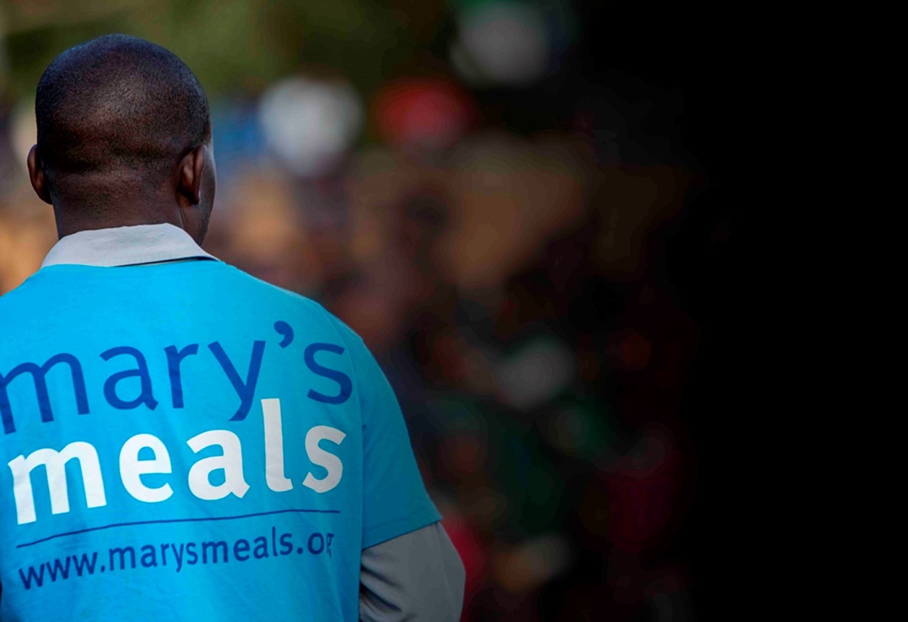
Recruitment process information
How to apply for this role
To apply for the role of Digital Marketing Manager based at Mary’s Meals UK, please send a tailored CV and covering letter or 2–3-minute video to : Jobs@marysmeals.org
Your covering letter or video should make a compelling case for why you feel motivated to apply for this role within Mary’s Meals UK, as well as giving a concise overview of your most relevant skills and experience, and should fill no more than two pages of A4.
Applicants must hold full right to work in the UK.
We welcome applications from candidates of all different backgrounds and identities to apply. We are committed to building an inclusive and diverse charity providing a supportive place for you to do the best and most rewarding work of your career.
Recruitment timescales
Applications will close at 5pm on Friday 27th March.
We reserve the right to close this vacancy early if we receive sufficient applications for the role. Therefore, if you are interested, please submit your application as early as possible.
Please note: If you have any special requirements or adjustments before an interview, please let us know.
17

Slide 18


Mary’s Meals UK
Charity No. SC022140
Company No. SC265941
Tel: 0141 336 7094
Dalmally office
Craig Lodge
Dalmally, Argyll
PA33 1AR
Glasgow office
Unit 10-13 Claremont Centre
39 Durham Street, Glasgow
G41 1BS
London office
13 Hippodrome Place
Notting Hill, London
W11 4SF
“Together, let’s set out on this journey; one step at a time, one meal at a time, one child at a time.”
– Magnus MacFarlane-Barrow, Mary’s Meals founder

