Slide 1
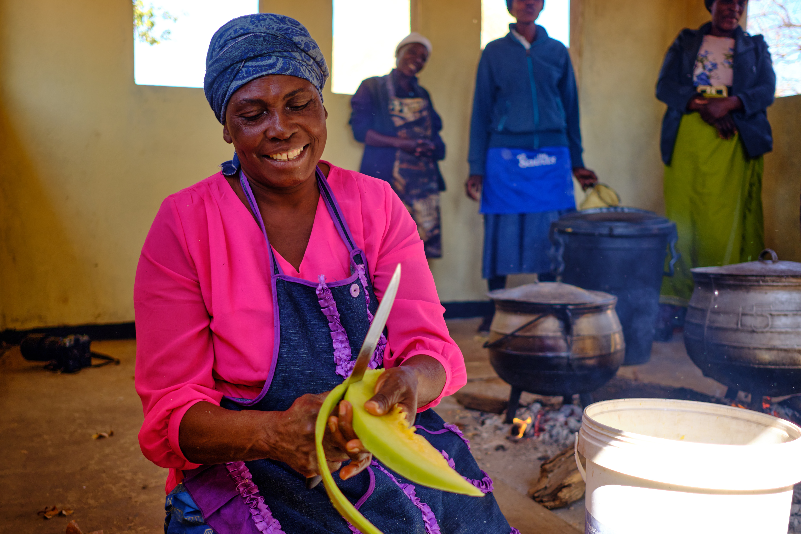






Recruitment pack for:
Head of Scotland
Remote working from anywhere in Scotland
Mary’s Meals UK
March 2026

Slide 2

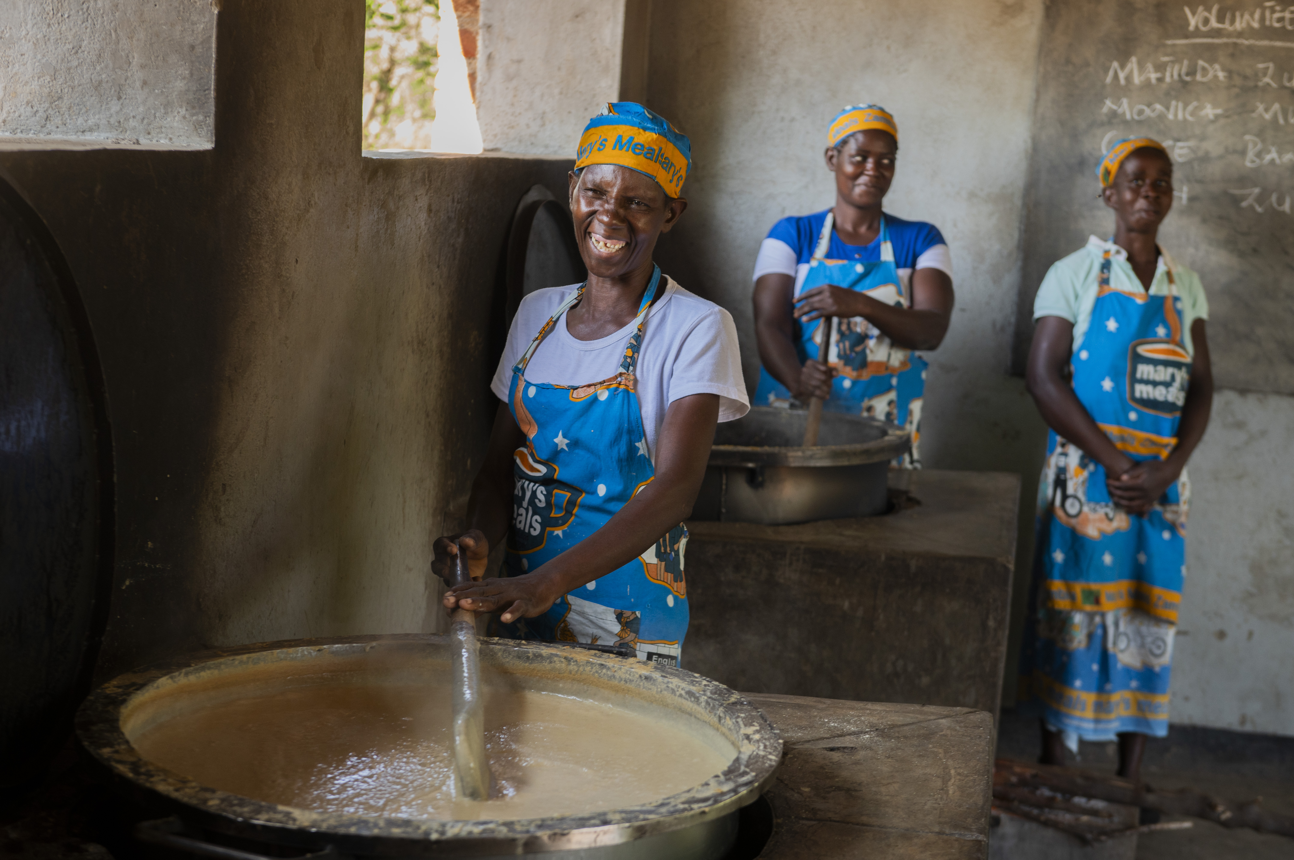
Recruitment pack contents
Welcome from our 3 Executive Director
Role outline and 5 Specification
Our vision, mission 12 and values
About the Mary’s Meals 14 movement
About Mary’s Meals UK 16
Recruitment process 18 information
2

Slide 3
Welcome from our Executive Director
Thank you so much for your interest in joining the Mary’s Meals family. As you consider making an application for the role of Head of Scotland with Mary’s Meals UK, I hope you find this pack helpful, encouraging, and exciting.
In joining Mary’s Meals UK, you would become part of a global movement of people who will simply not accept that any child should go hungry in this world of plenty. We are passionately driven by our simple belief that every child in the world deserves an education – and enough to eat.
From small beginnings feeding just 200 Malawian children in 2002, we are now reaching 3 million children across 16 programme countries (including Malawi, Liberia, Zambia, Haiti, South Sudan, and Syria) with a nutritious daily meal in school.
This meal not only meets the immediate needs of the hungry child, but it attracts children to the classroom, where they can gain an all-important education. And we firmly believe that the children who are receiving Mary’s Meals today can grow up – better nourished and better educated – to become the men and women who will lift their communities out of poverty and end their reliance on aid.​
​
The UK, where we received the first-ever donations for our work, remains the country in which Mary’s Meals raises the majority of its funds. And Mary’s Meals UK, the organisation I am privileged to lead is responsible for continuing to tell our story across Scotland, England, Northern Ireland and Wales; engaging and inspiring more and more UK volunteers and donors; and driving forward the unrelenting growth of the Mary’s Meals movement on these shores.​
3

Slide 4
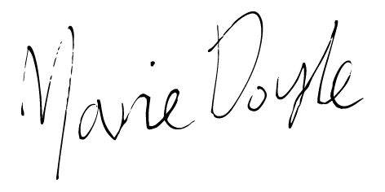
Welcome from our Executive Director
With more than 71 million children out of school around the world and a further 73 million attending school so hungry, they’re unable to concentrate and learn, our work is only just beginning.
As the Head of Scotland, you will be the senior ambassador and strategic leader for Mary’s Meals across the nation. You will guide how Mary’s Meals is seen, understood, and felt in Scotland – shaping our public profile, driving sustained income growth, and building the partnerships and grassroots energy needed to grow our movement.
Will you play a crucial part in shaping the future of Mary’s Meals UK and, with it, the lives of so many people who both contribute to and benefit from this incredible work of love, joy, and hope?
I look forward to hearing your story.
Marie Doyle Executive Director, Mary’s Meals UK
4

Slide 5
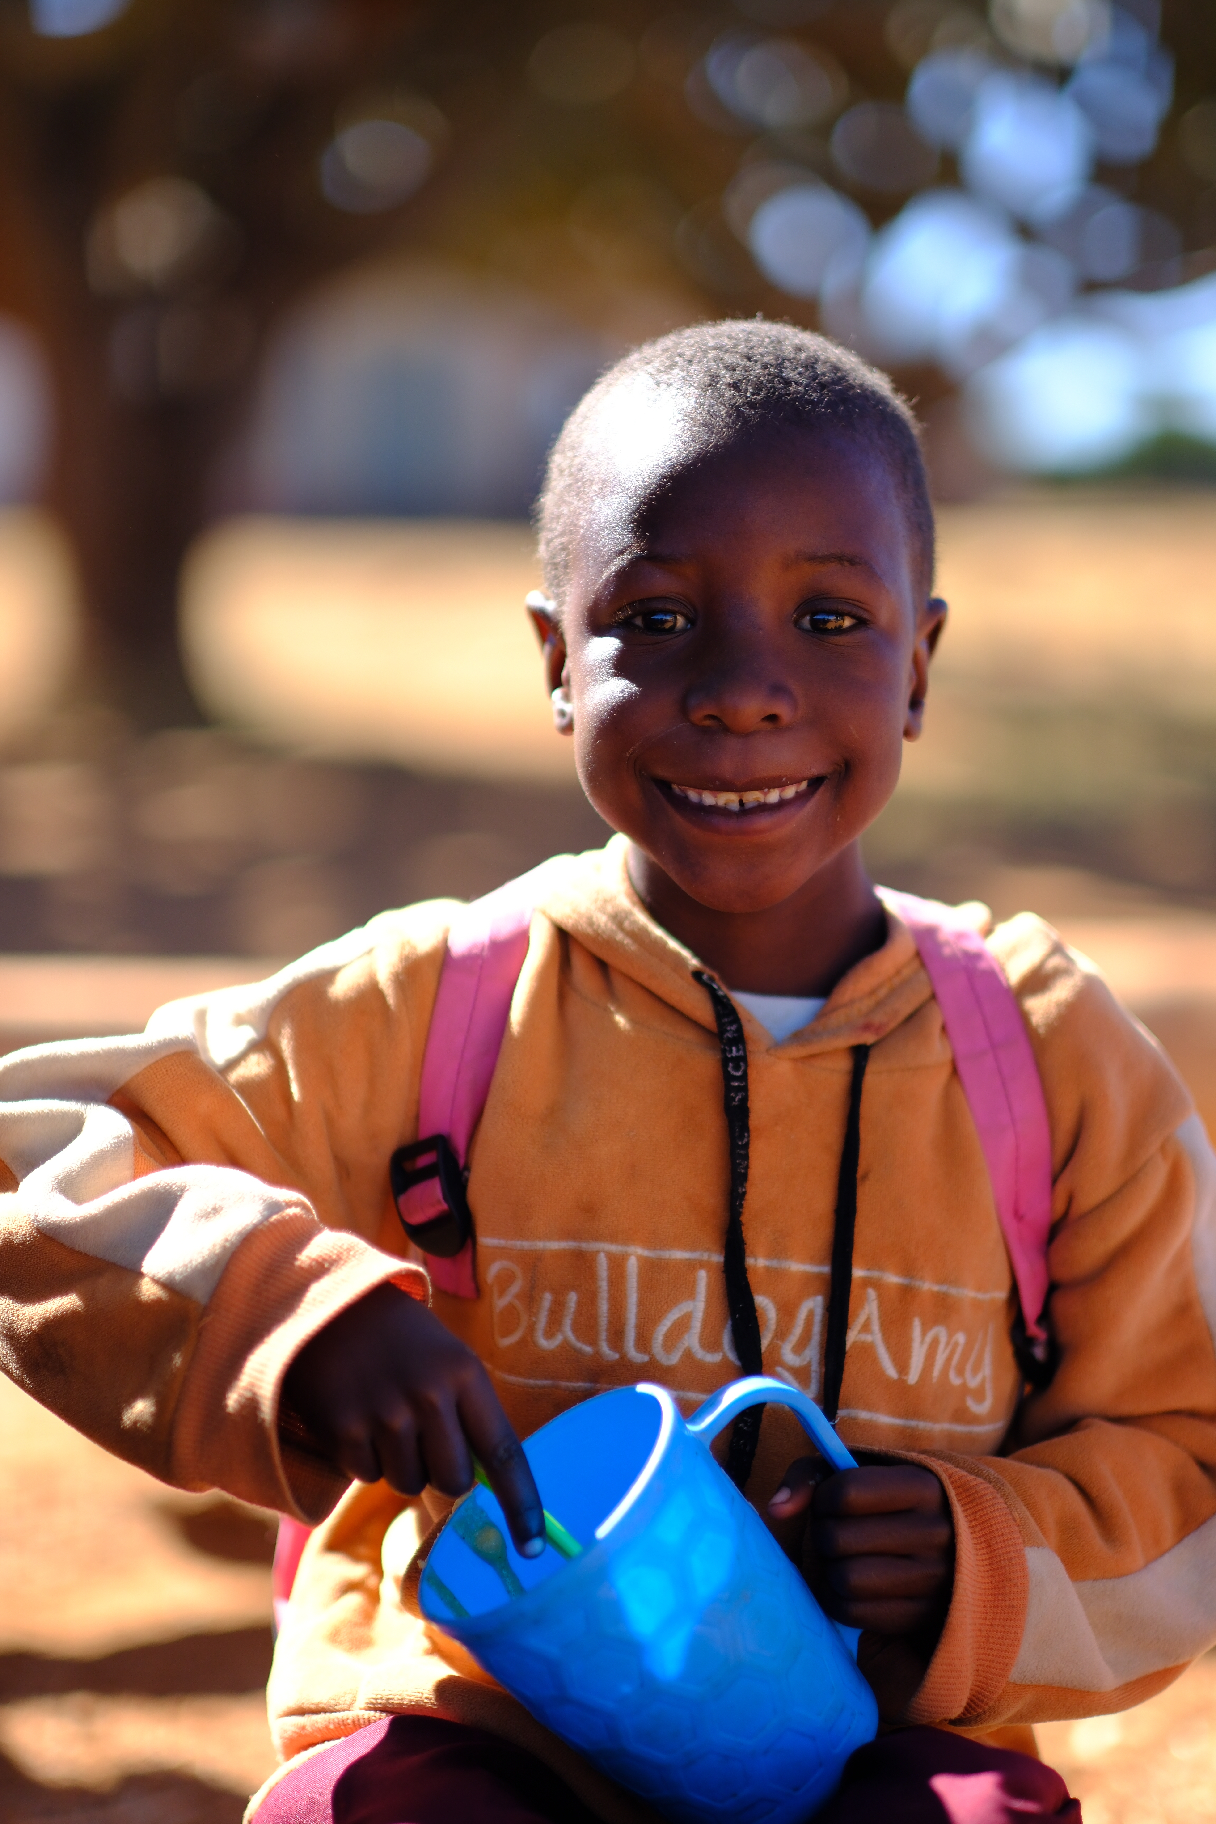
Head of Scotland
Reports to: | Director of Growth
Location: | Remote however must be based in Scotland
Salary: | c. £51,877 - £57,034 per annum
Benefits: | Flexible working 34 days’ annual leave (including public holidays) Non-contributory pension with employer contributions of 8%. Volunteering and development days Enhanced maternity and paternity leave Employee Assistance programme Life Assurance Wellbeing support Cycle to Work scheme
5

Slide 6
Scotland team structure
Vacancy
Head of Scotland
Regional Development Officer (West Scotland)
Regional Development Officer (Glasgow)
Regional Development Officer (Edinburgh & Falkirk)
Regional Development Officer (North East, Scotland 0.6)
Director of Development
6

Slide 7
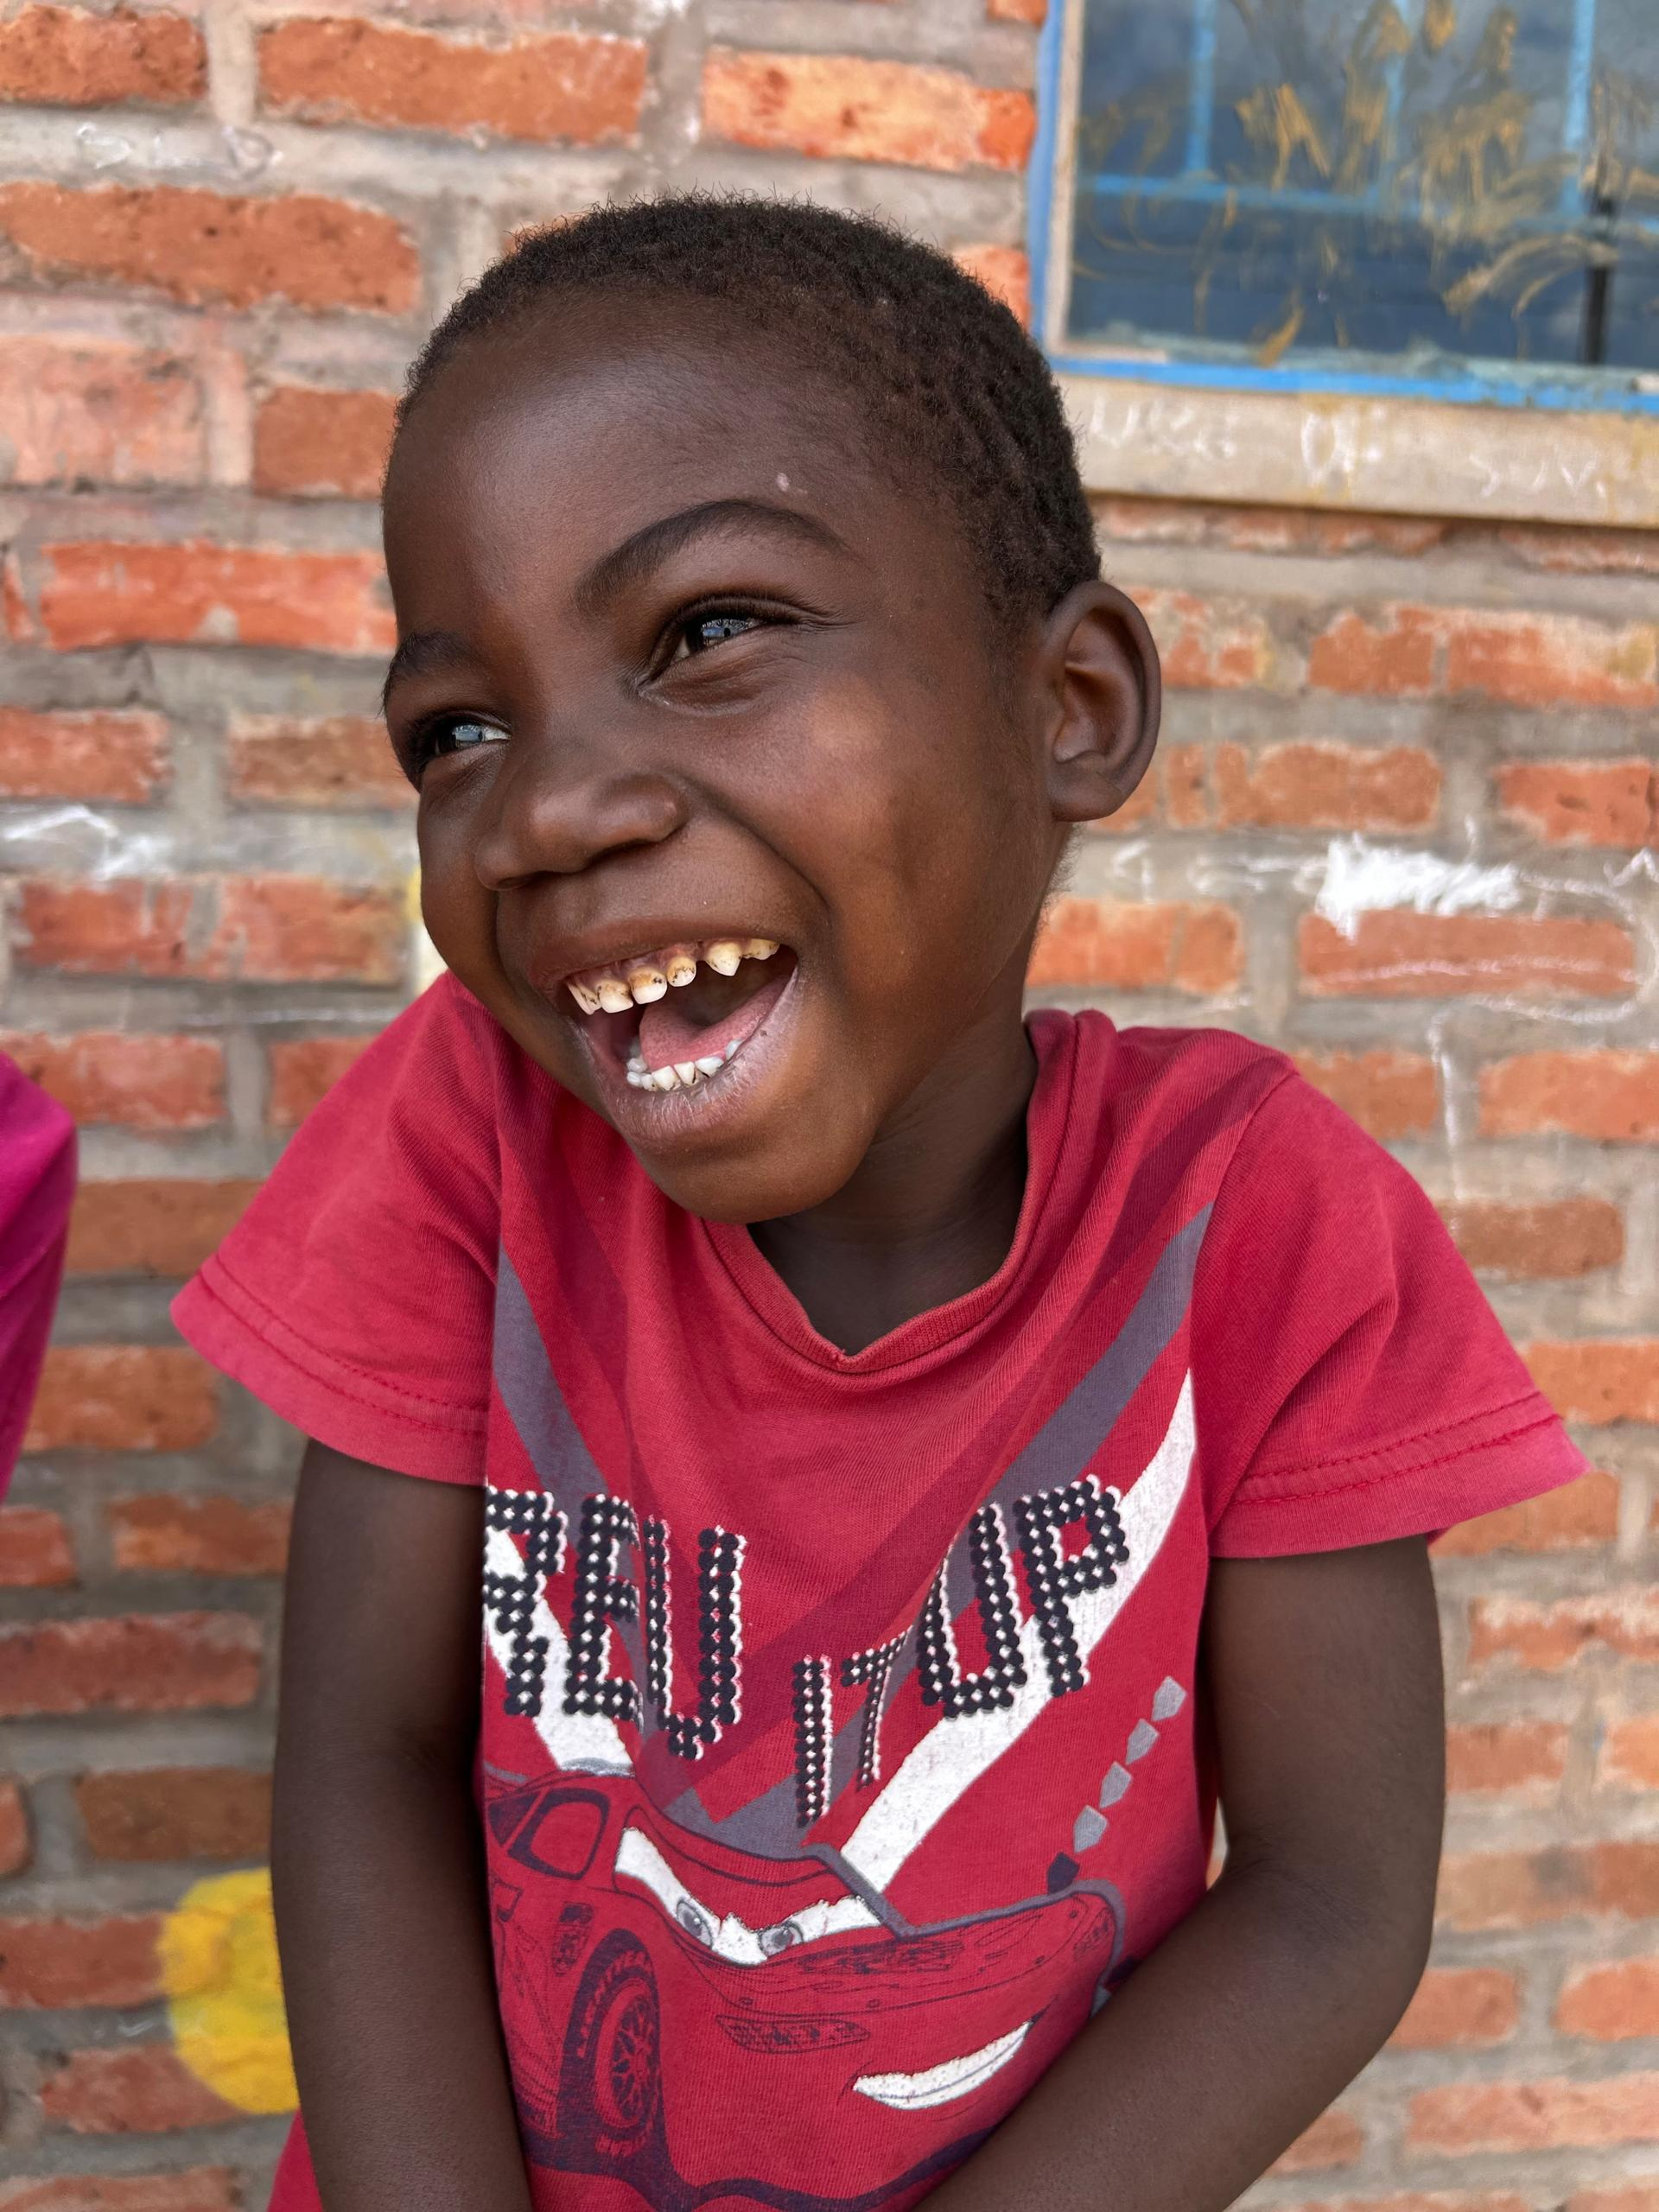
Role overview
As Head of Scotland, you will combine a deep understanding of fundraising in local communities – including the faith landscape, education system, and community networks – with strong strategic leadership. By building trusting, long‑term relationships, you will champion the charity’s vision and inspire people, churches, schools, businesses, and local partners to join us in feeding the next hungry child.
You will lead a small team, foster volunteer leadership, and collaborate with colleagues across MMUK so that national campaigns, storytelling, and supporter journeys land meaningfully within the local context.
You will be a highly visible presence across Scotland, spending considerable time externally to open doors, build alliances, and make confident, values‑led asks.
7

Slide 8
Duties and responsibilities
Leadership & Strategy
Working cross-directorate to create and deliver a fundraising growth strategy for Scotland, rooted in regional insight, cultural understanding, and community needs, and aligned with the global and national strategy.
Working with the Communications team, shape a clear and compelling narrative, respecting the nation’s strong identity, and acknowledging our brand is most recognised in Scotland.
Identify emerging opportunities across Scotland, including diocesan networks, local relationships, high-growth business sectors, and regional giving patterns, adjusting plans quickly to drive maximum impact.
Serve as the senior MMUK representative in Scotland, ensuring activity aligns with the national organisational strategy.
Act as the leading spokesperson for Mary’s Meals in Scotland, representing the charity to churches, schools, local authorities, individuals, universities, and civic or business networks.
Spend focused time externally; networking, nurturing partnerships and driving growth through representing the charity at events, meetings, faith gatherings, conferences, and civic forums.
Build alliances with leaders across churches, schools, businesses and community groups.
Confidently deliver values‑led presentations and public speaking engagements that inspire trust, generosity, and long‑term commitment.
Lead by example and work closely across the organisation to ensure that all Scottish activity is fully aligned with Supporter Experience, so that journeys, thanking and stewardship feel warm and seamless, with Communications to deliver compelling campaigns and storytelling, with Philanthropy & Partnerships to coordinate major donor and corporate engagement, and with the Volunteer Manager to strengthen volunteer mobilisation and development.
Play an active role as a member of the Extended Leadership Team (ELT), contributing to organisational strategy and direction, playing an important role in the wider leadership of the organisation.
8

Slide 9
Duties and responsibilities
Income Growth and Relationship Management
Proactively cultivate, pursue, and develop fundraising opportunities via networking and outreach with the aim of securing support for our school feeding programme.
Develop and maintain a robust national growth pipeline, ensuring proactive identification, cultivation, conversion, and stewardship of opportunities.
Collaborate closely with Philanthropy and Partnerships, co‑owning major donor and corporate pipelines with clear roles and handovers.
Make bold, relationship‑led asks, tailored to supporters’ motivations and capacity.
Ensure that all donor journeys, from first engagement to long‑term stewardship, are warm, timely, and mission‑driven.
Develop constructive relationships and effectively steward and develop potential and existing donors to build partnerships that deliver long-term and increasing levels of support.
Provide accurate and timely reports and data analysis, monitoring and evaluating activities through set key performance indicators.
Leadership and Volunteer Mobilisation
Line manage and coach a team of Regional Development Officers, enabling them to become confident, high‑performing fundraisers.
Build a culture of prioritisation, resilience, accountability, and joy, modelling the relational, values‑rooted leadership expected across Mary’s Meals.
Embed the volunteer deputy model, developing our enabler volunteers to increase capacity, reach, and community presence.
Ensure all team members use insight, data dashboards, and evaluation effectively to guide decisions and improve performance.
9

Slide 10
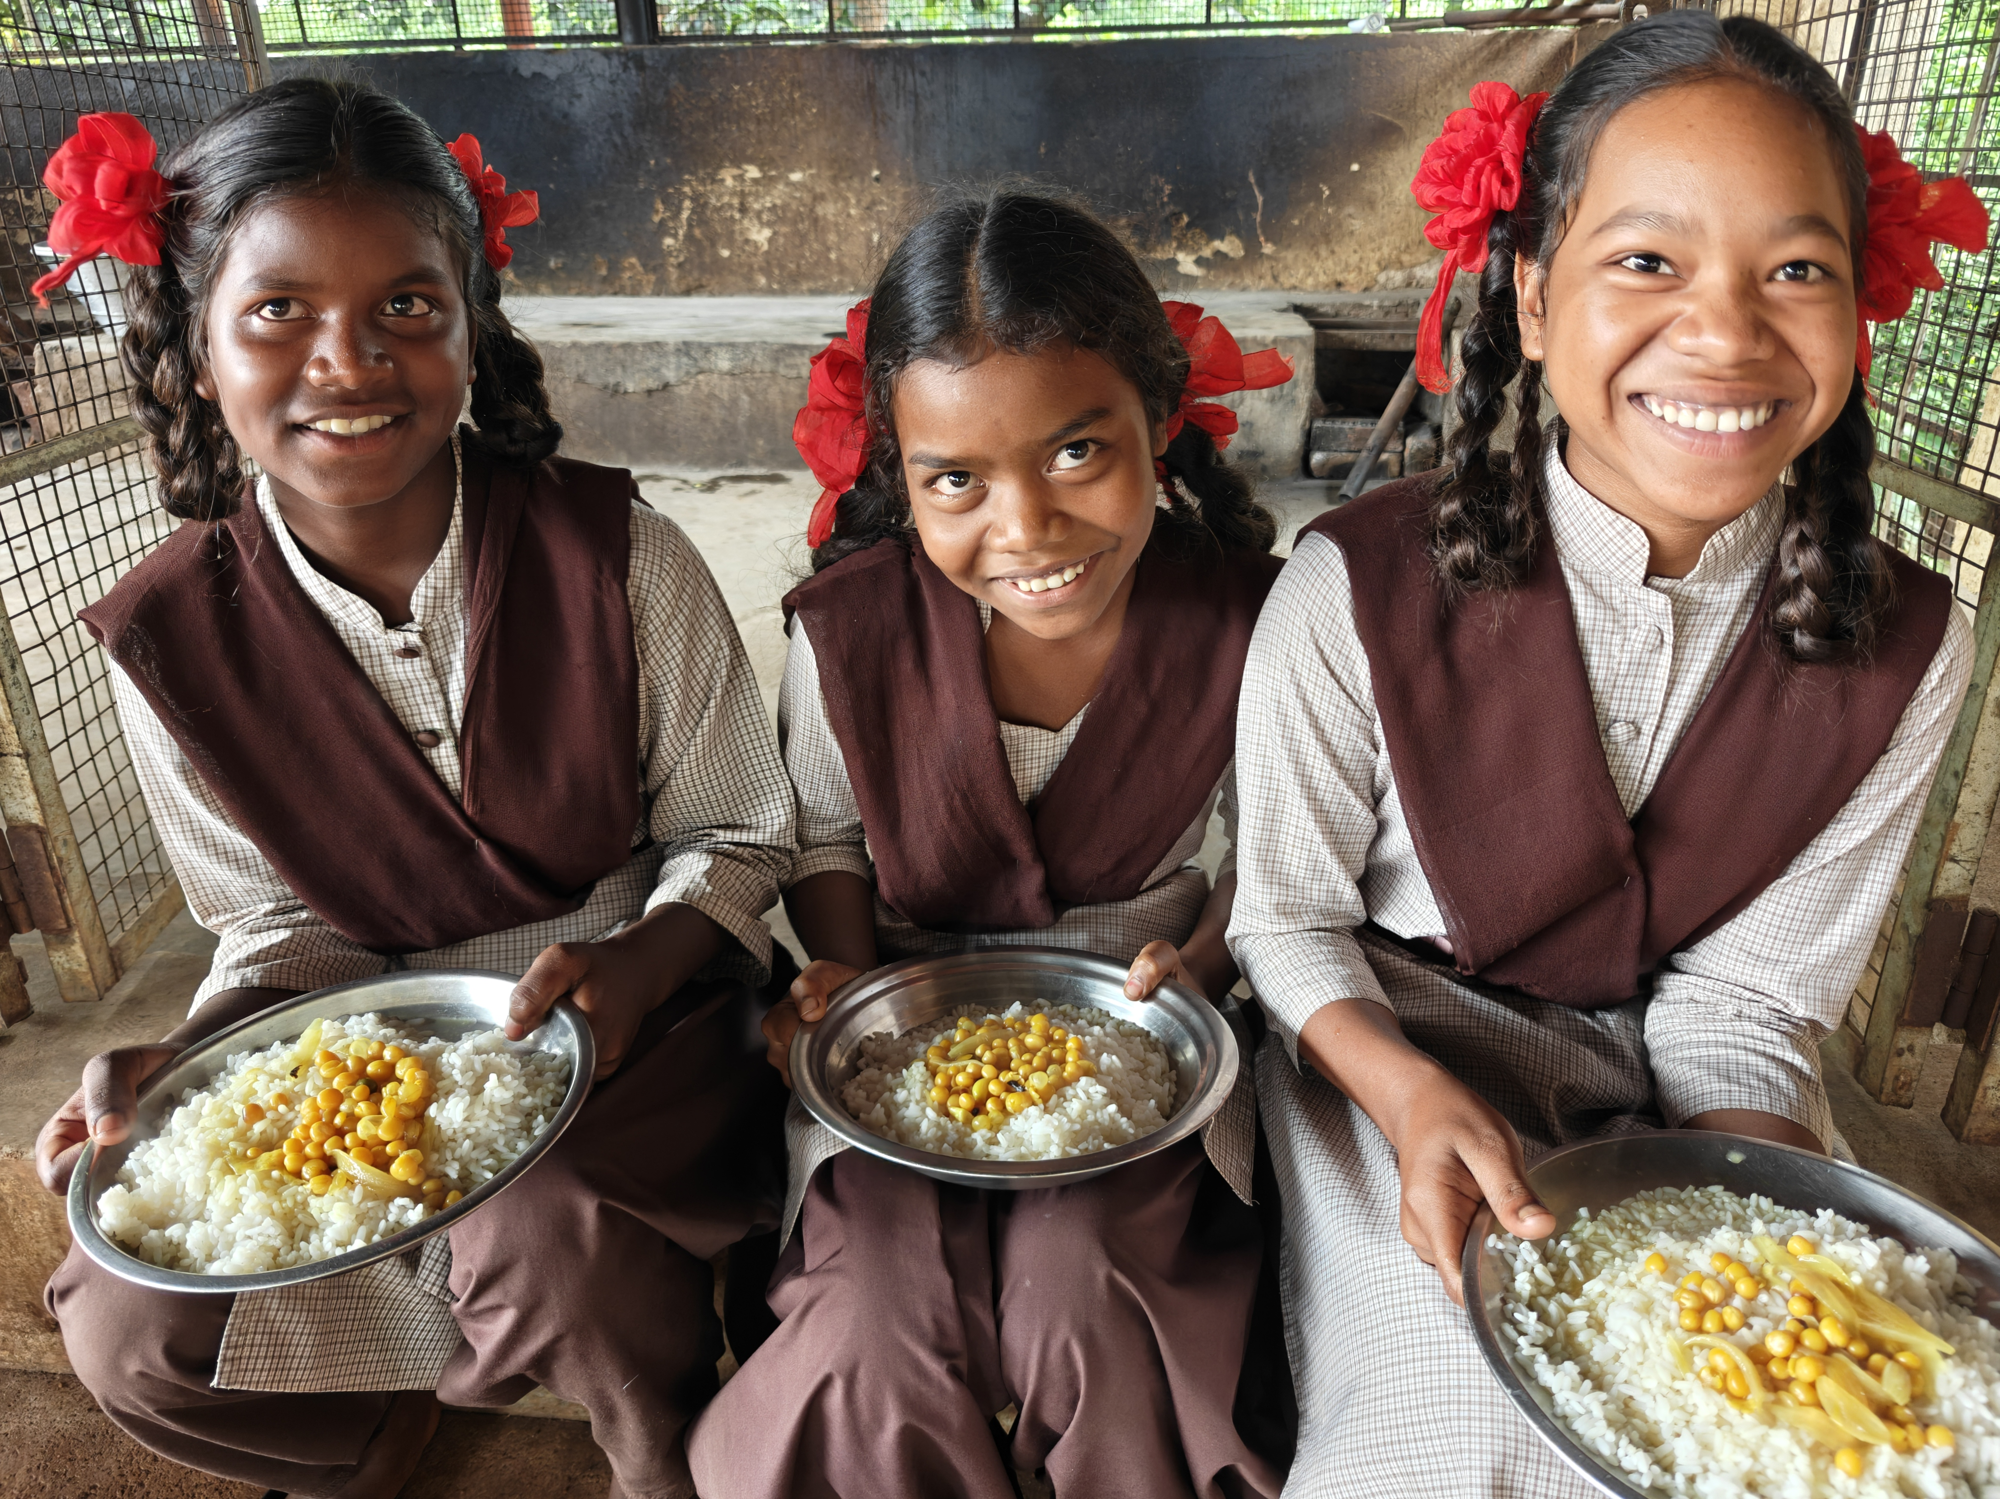
Duties and responsibilities
Media, Messaging & Storytelling
Serve as a trusted media spokesperson for press, broadcast, and faith media when required.
Work closely with the Communications team to provide compelling Scottish supporter stories, impactful moments, and local activity to showcase.
Shape national‑to‑local messaging so that campaigns resonate with Scottish audiences.
Work with your regional team and support appropriate local media coverage to raise profile and strengthen regional engagement.
Stewardship, Budget & Governance
Hold and manage the Scotland income and expenditure budget with clarity, transparency, and strong stewardship.
Support compliance with all safeguarding, representation, and brand standards across Scotland.
Model and uphold Mary’s Meals’ core values – dignity, simplicity, respect, and good stewardship.
Ensure that the Mary’s Meals approach is adopted in all activities and that there is shared understanding in the team of how to build and retain support.
Ensure all activity has the necessary checks in place to protect the name and values of Mary’s Meals, including adherence to all compliance and legislative requirements.
10

Slide 11
Essential Qualifications, experience and skills
Based in Scotland. Willing and able to be visible across the nation, with regular travel and some evening or weekend work.
Proven record of leading external-facing growth or fundraising in a region or nation, with clear income or partnership results.
Strategic planner who can translate vision into a focused regional plan for your team.
Experience in Volunteer mobilisation, including recruiting and directing volunteers to extend reach.
Experienced in creating, developing and deepening relationships with individuals and organisations.
Experience of developing first-class supporter journeys, products and propositions.
Good knowledge of the faith landscape and confidence in engaging faith leaders.
Sound knowledge of legislation, regulations and financial issues related to fundraising.
Ability to establish, develop and nurture collaborative relationships at all levels.
Proven experience acting as a visible and credible spokesperson and can confidently represent Mary’s Meals across all media channels, and in person.
Confident making values-led asks and stewarding high-value relationships, with strong public speaking and media comfort.
Strong people leader and coach, able to build a confident asking culture and raise performance across a geographically dispersed team.
Confident in engaging with a wide range of people and organisations, including faith groups, schools, community groups, businesses and more.
Deep alignment with Mary’s Meals’ values and relationship-led approach.
Driven fundraiser, capable of cultivating, identifying and developing opportunities from nothing, working proactively with an entrepreneurial approach to network building and engagement of new supporters.
Comfortable networking, acting as Mary’s Meals spokesperson.
Experience cultivating opportunities into active supporters.
Motivated to deliver the growth needed to enable us to reach more children, while working collaboratively and in keeping with values.
11

Slide 12

Our vision and mission
Our vision is that every child receives one daily meal in their place of education and that all those who have more than they need, share with those who lack even the most basic things.
Our mission is to enable people to offer their money, goods, skills, time, or prayer, and through this involvement, provide the most effective help to those suffering the effects of extreme poverty in the world’s poorest communities.
12

Slide 13
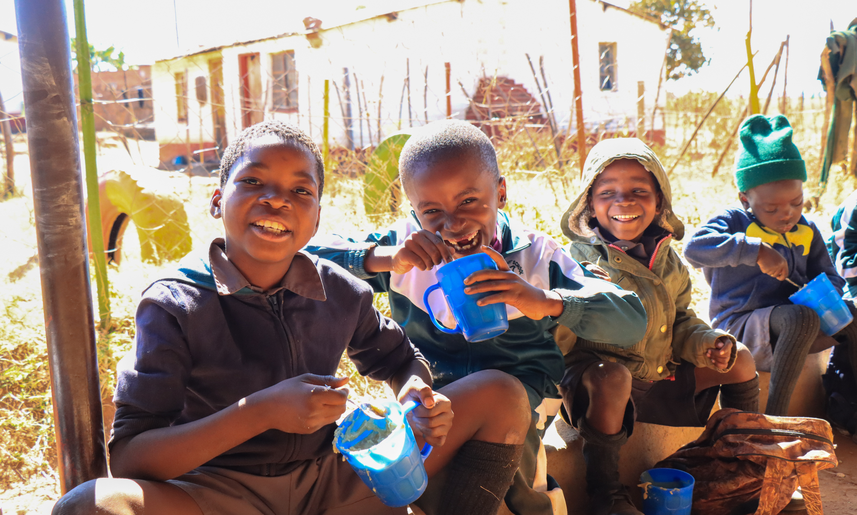
Our values
• We have confidence in the innate goodness of people.
• We respect the dignity of every human being and family life.
• We believe in good stewardship of the resources entrusted to us.
View Mary’s Meals’ full statement of values here: Statement of Values
13

Slide 14
About the Mary’s Meals movement
Mary’s Meals is a global movement that sets up school feeding projects in some of the world’s poorest communities, where poverty and hunger prevent children from gaining an education.
Our idea is a simple one that works. We provide one daily meal in a place of learning in order to attract chronically poor children into the classroom, where they receive an education that can, in the future, be their ladder out of poverty.
The Mary’s Meals campaign was born in 2002 when Magnus MacFarlane-Barrow, from Dalmally in Argyll, visited Malawi during a famine and met a mother dying from AIDS. When Magnus asked her eldest son Edward what his dreams were in life, he replied simply: “I want to have enough food to eat and to go to school one day.”
That moment was a key part of the inspiration which led to the founding of Mary’s Meals, which began by feeding just 200 children in Malawi in 2002. Today, 20 years later, we feed 3 million hungry children every school day across four continents.
Where Mary’s Meals is provided, there is a rise in school enrolment, attainment and attendance. Wherever possible, Mary's Meals uses locally grown food to support the local economy and help smallholder farmers.
We work extremely hard to keep our running costs low which means that it costs just £19.15 to feed a child with Mary’s Meals for a whole school year. This is only possible because most of our work is done by an army of dedicated volunteers all over the world, who carry out lots of little acts of love on behalf of Mary’s Meals.
Having been inspired, in part, by our founder’s Catholic faith, this work is named in honour of Mary, the mother of Jesus, who brought up her own child in poverty. We consist of, respect and reach out to people of all faiths and none.
Counting on support from around the globe, Mary’s Meals has registered national affiliate organisations, which raise awareness of our work around the world. Funds raised by affiliates, including from Mary’s Meals UK, are passed to Mary’s Meals International, the organisation which co-ordinates our movement and directly manages the delivery of our school feeding programmes.
14

Slide 15
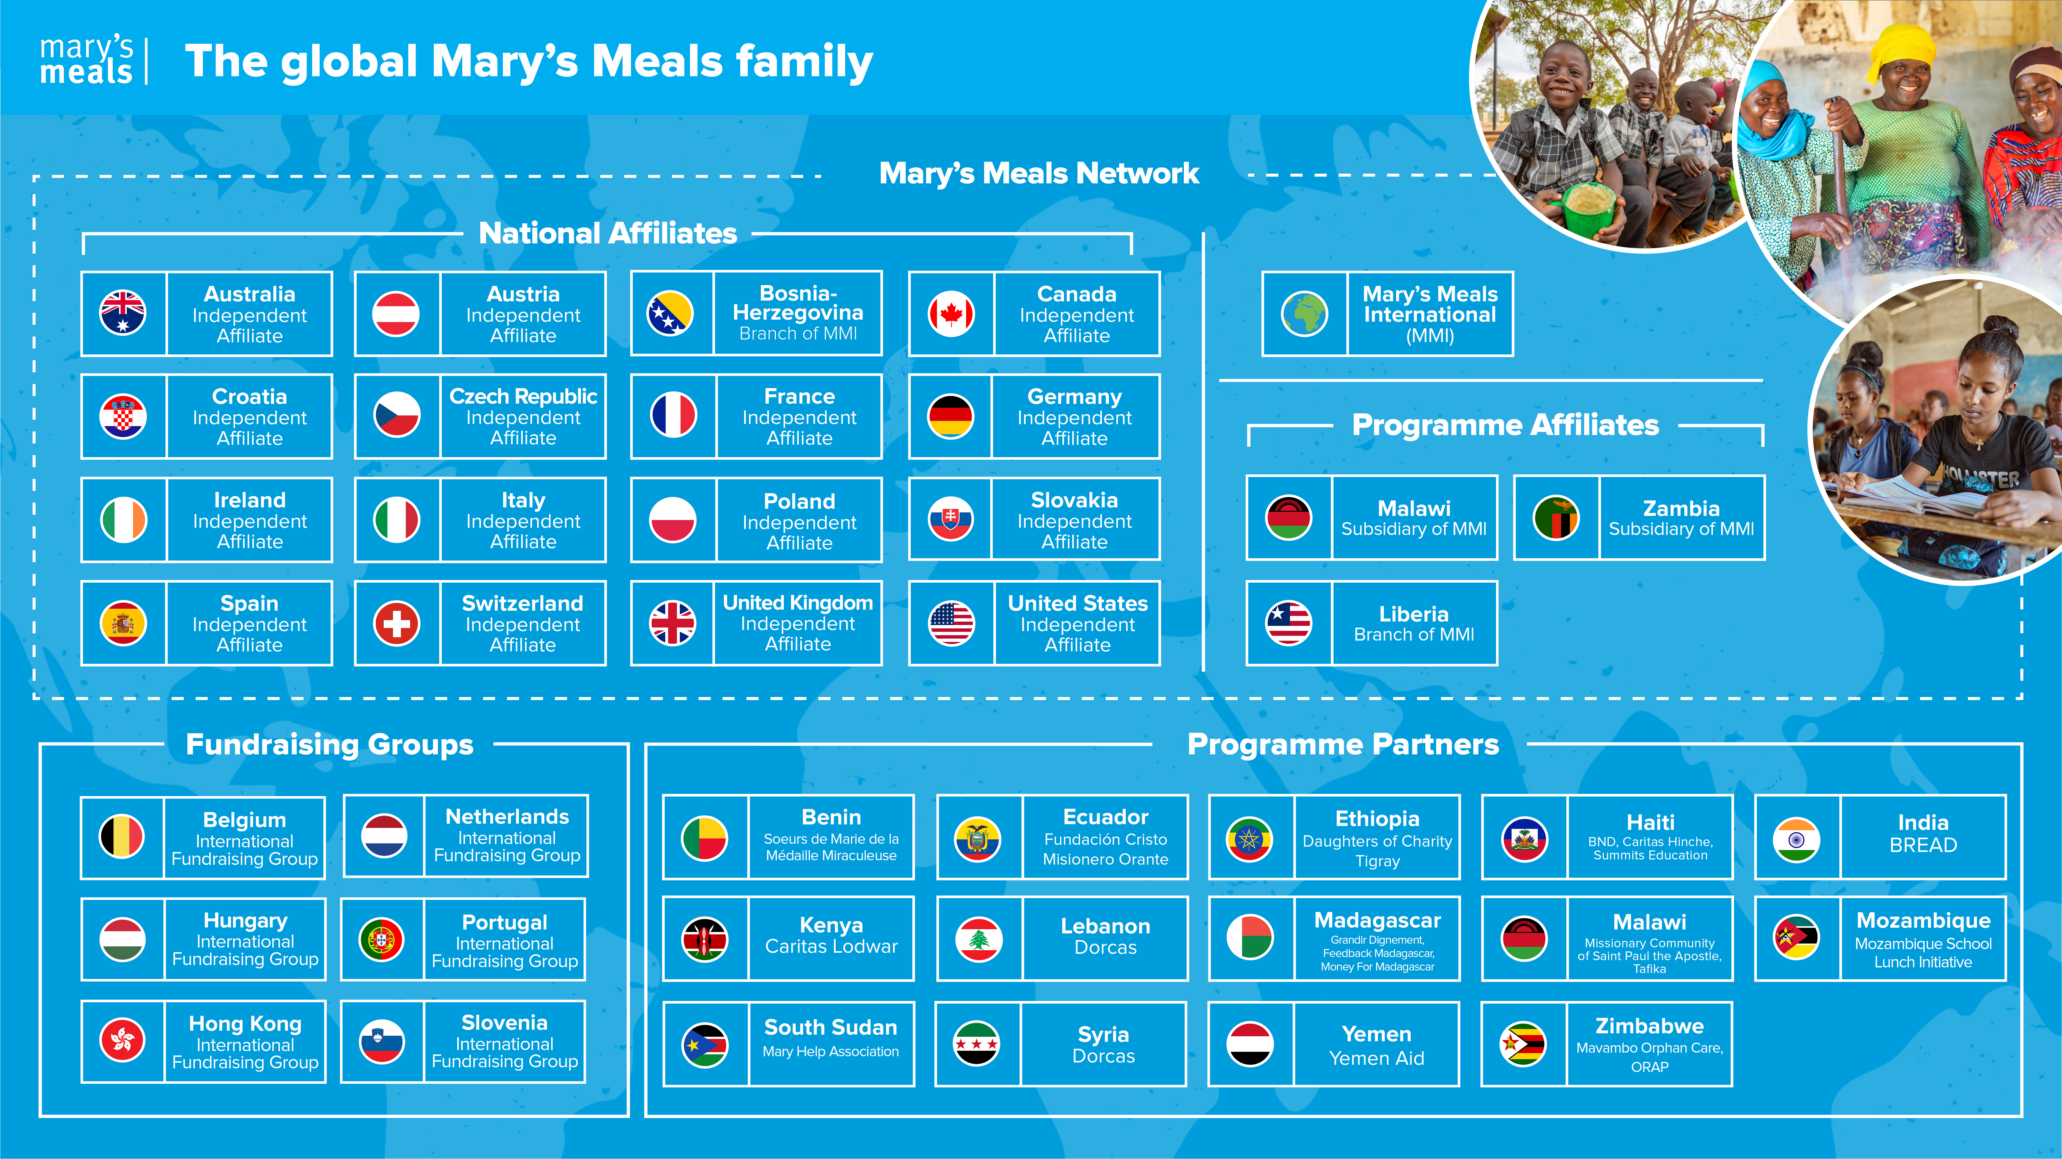
Mary’s Meals family
15

Slide 16
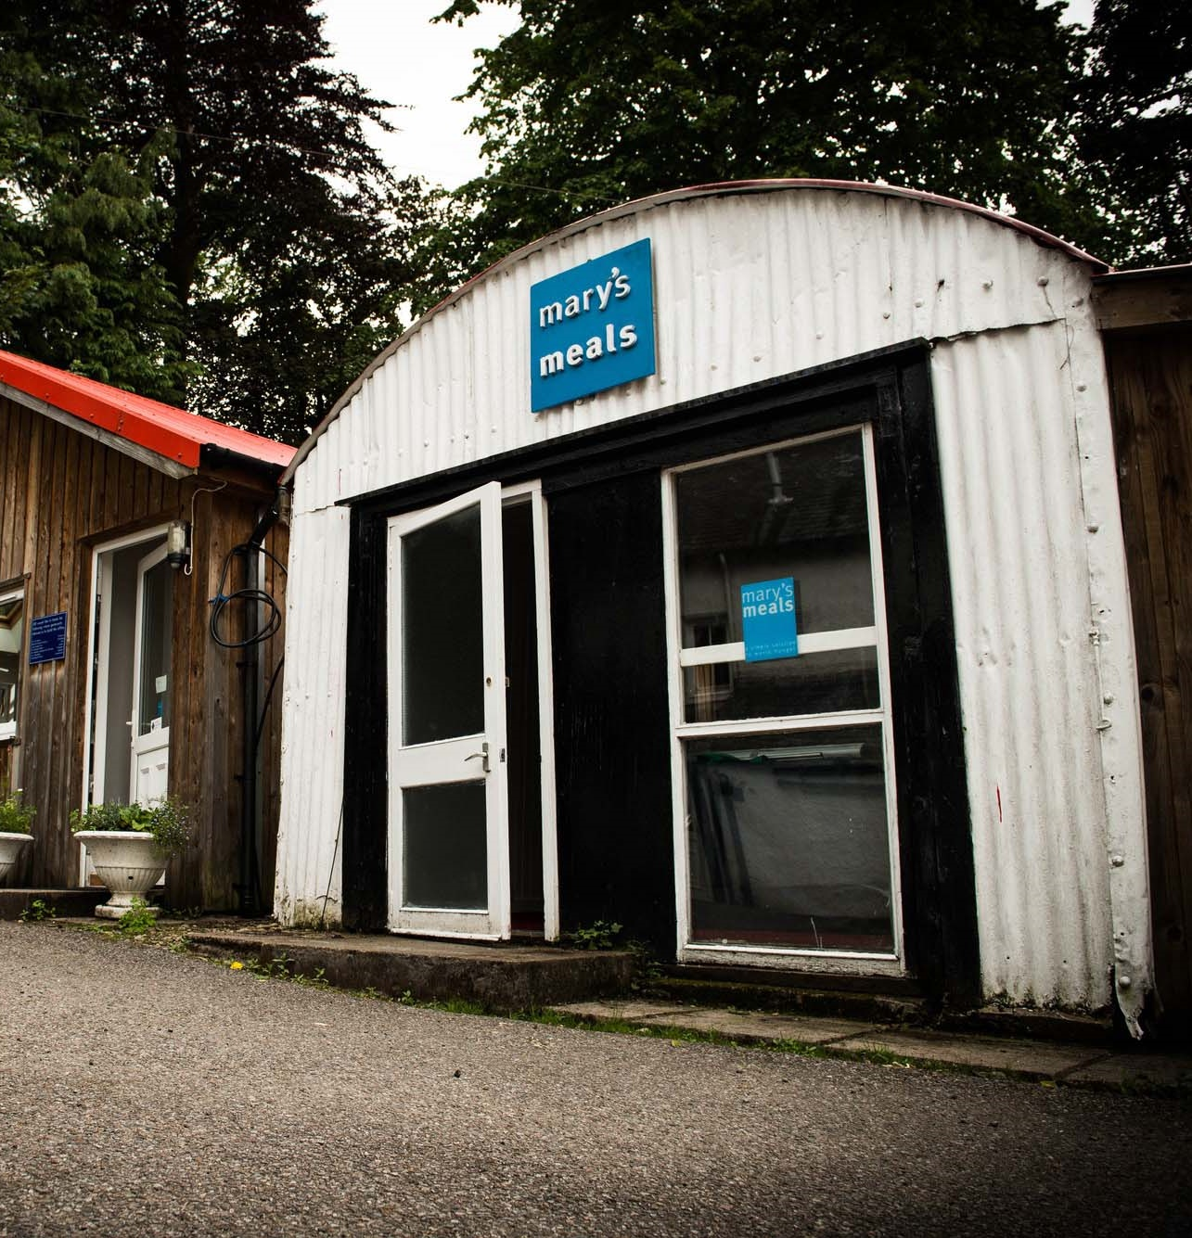
About Mary’s Meals UK
Mary’s Meals UK (or ‘MMUK’), a charity registered in Scotland, is the oldest entity in the Mary’s Meals family – the original organisation established as Scottish International Relief in the early 1990s, when our founder and global CEO, Magnus MacFarlane-Barrow, first became involved in international aid during the Bosnian Conflict.
Back then, Magnus was a simple salmon farmer who, along with his family, decided to do something to help those who were suffering because of the war.
They relied heavily on the generosity of local people in their village of Dalmally in Argyll, who relentlessly donated food, blankets and other items of aid, which were then stored in the family shed, before being driven out by Magnus to Bosnia-Herzegovina.
Though our largest office is now in Glasgow, that same shed – which continues to be filled, metaphorically at least, with the generosity of our supporters – still serves as the headquarters of Mary’s Meals UK to this day.
16

Slide 17

Mary’s Meals UK manager competencies
Managers at Mary’s Meals UK approach their role in line with our 7S competency model:
1. Self
I build and demonstrate resilience
I lead by example
I’m authentic and true to Mary’s Meals values
I develop myself and set stretching goals
2. Service
I have a vocational attitude to my work
I inspire hope in others
I build belief that even difficult challenges can be solved
I am committed to serving and enabling all who want to be part of the global movement
I work to ensure our future will be even better than our past
3. Simplicity
I communicate effectively
I follow clear decision-making criteria
I create plans that are easy to follow and contribute to organisational goals
I embrace inclusivity and diversity
I focus on delivering results
4. Stewardship
I pay attention to the things that matter most; (a) our physical resources; (b) our people
I nurture, develop and respect our relationships with external stakeholders
I deliver on my promises
I am happy to be held accountable and to hold others to account
5. Strategy
I have a point of view about the future
I know our stakeholders and see our priorities clearly
I help others to work in ways that have the greatest impact
I develop strategy and translate it into action
6. Strengthen
I create a positive work environment
I increase the capabilities of my team
I help people manage their careers
I find and develop next-generation talent
7. Success
I ensure my team is technically competent and developing
I build high performing teams
I ensure accountability
I am a catalyst for change
17

Slide 18
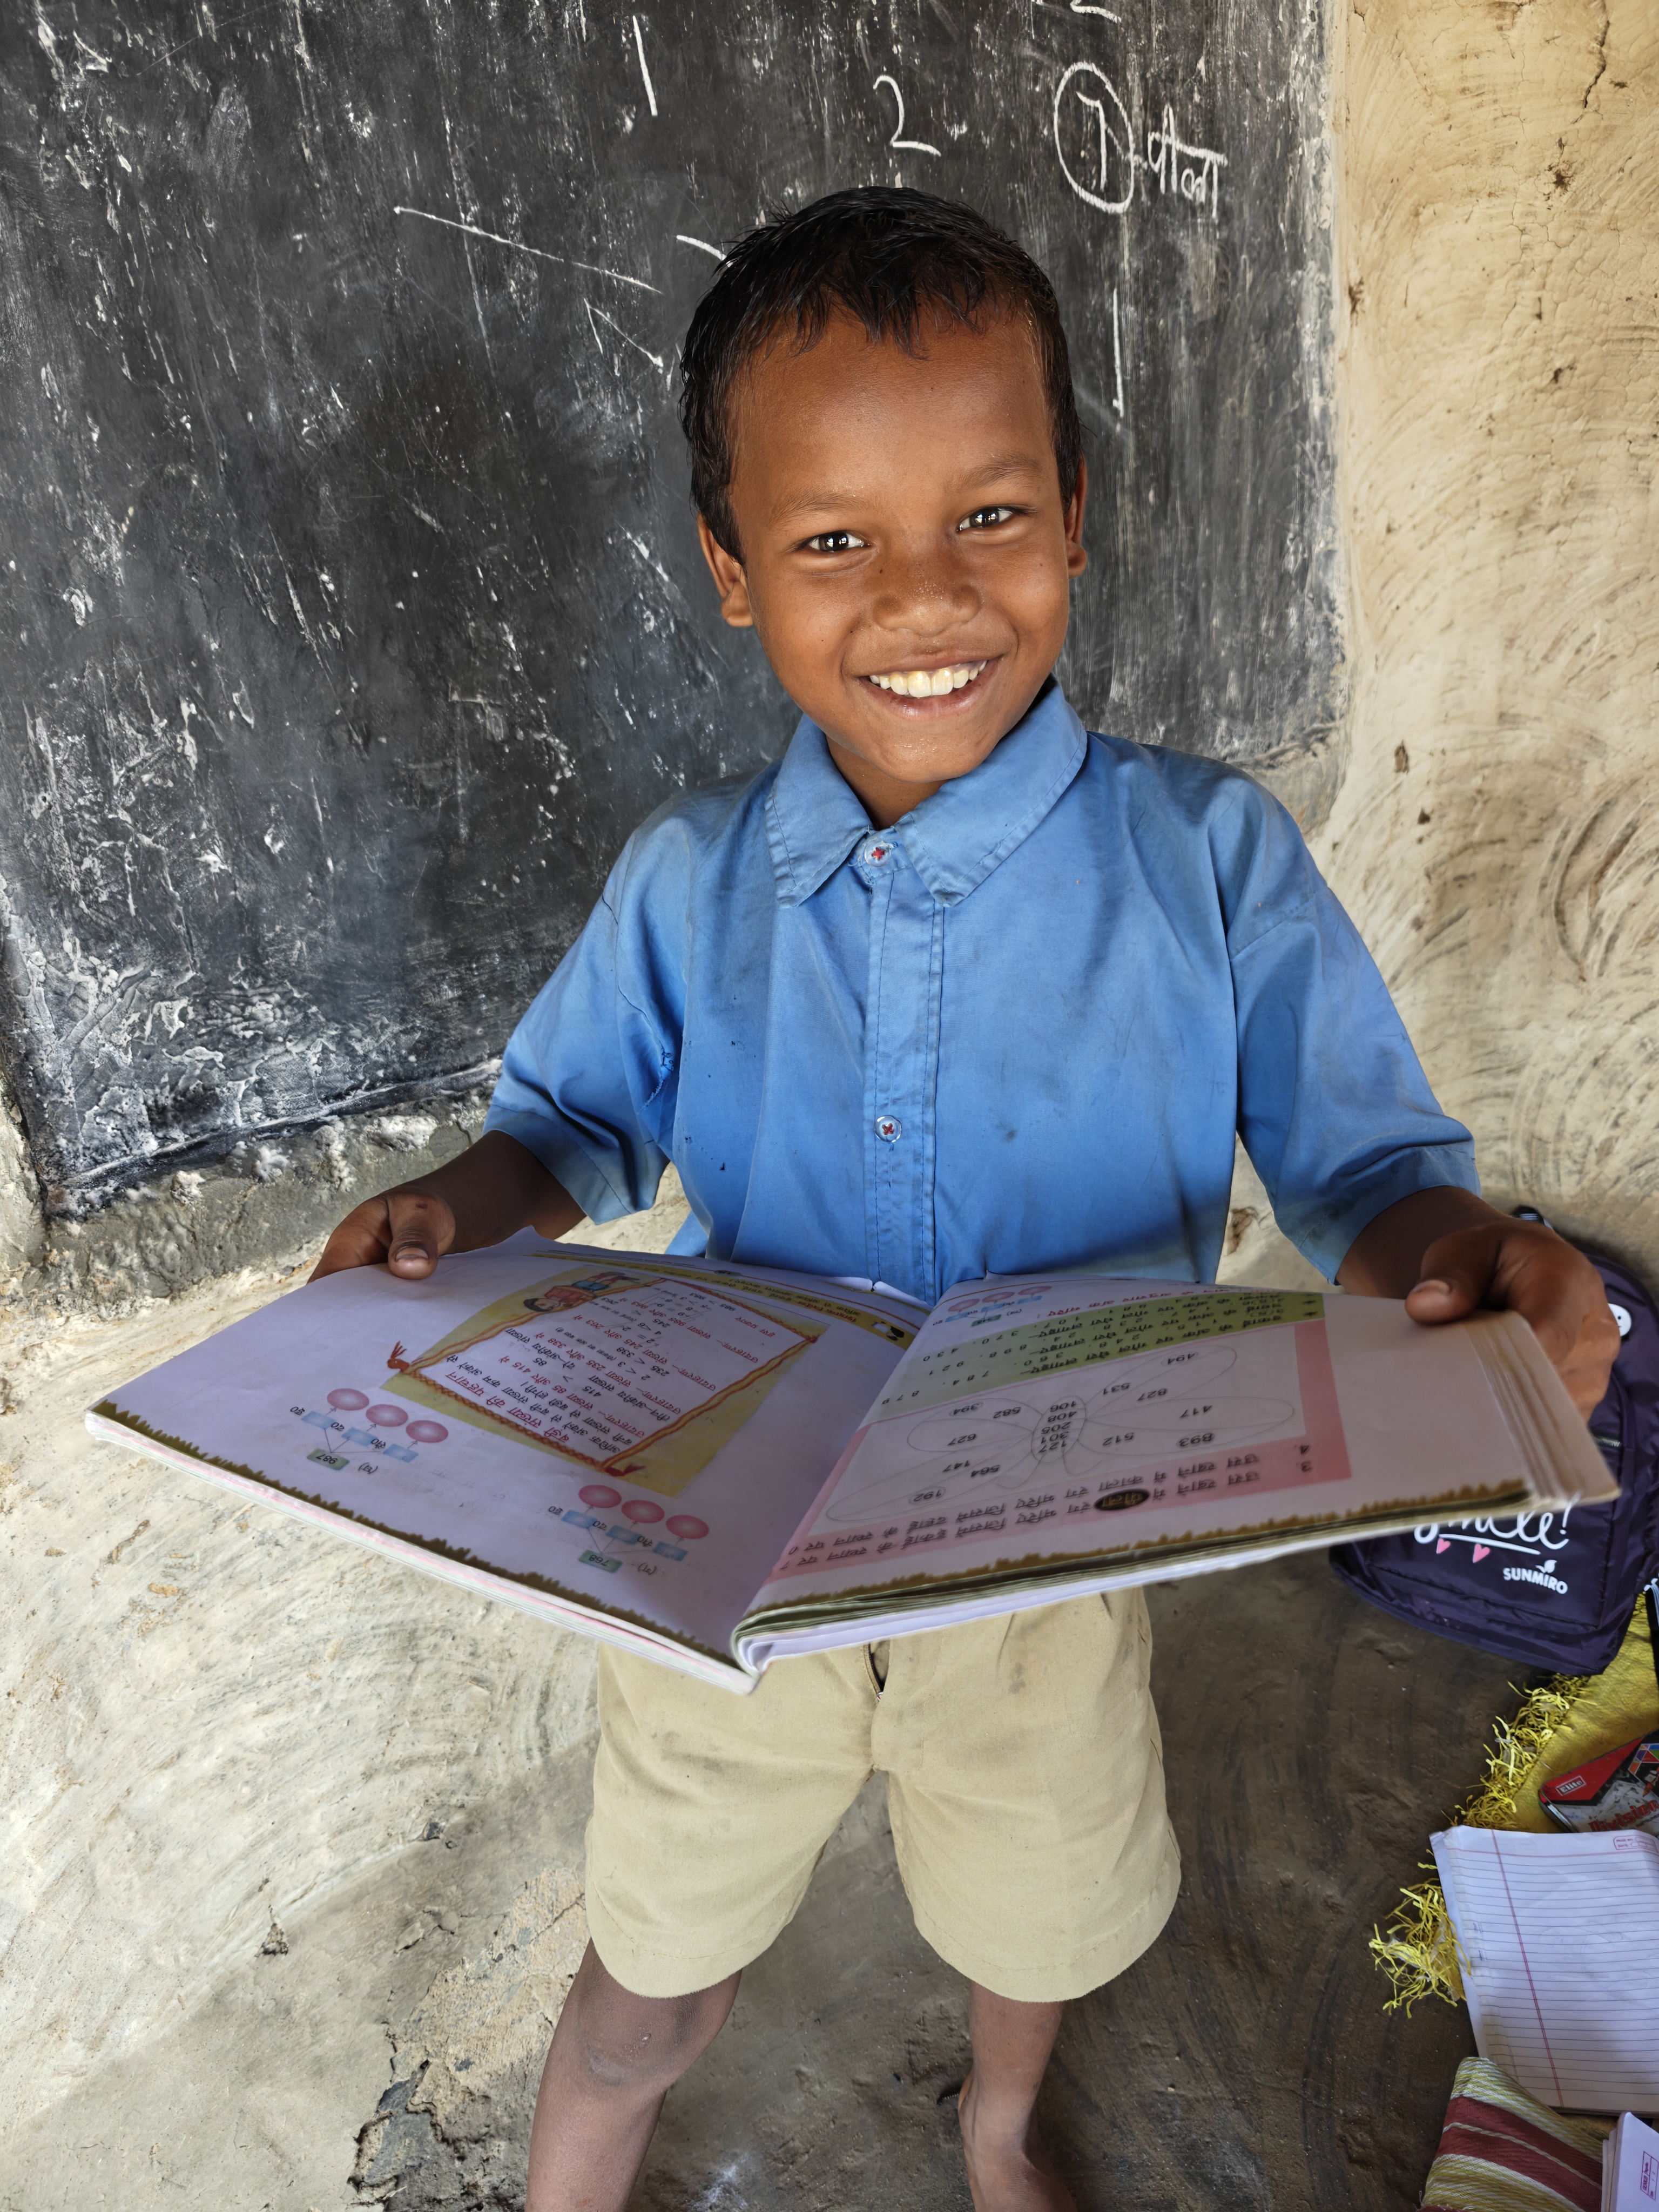
Recruitment process information
How to apply for this role
To apply for the role of Head of Scotland based at Mary’s Meals UK, please send a tailored CV and covering letter or 2–3-minute video to: Jobs@marysmeals.org
Your covering letter or video should make a compelling case for why you feel motivated to apply for this role within Mary’s Meals UK, as well as giving a concise overview of your most relevant skills and experience and should fill no more than two pages of A4.
Applicants must hold full right to work in the UK.
We welcome applications from candidates of all different backgrounds and identities to apply. We are committed to building an inclusive and diverse charity providing a supportive place for you to do the best and most rewarding work of your career.
Recruitment timescales
Closing date for applications is Friday 3rd April at 5pm
Applications will be reviewed on an ongoing basis and interviews arranged accordingly.
We reserve the right to close this vacancy early if we receive sufficient applications for the role. Therefore, if you are interested, please submit your application as early as possible.
Please note: If you have any special requirements or adjustments before an interview, please let us know.
18

Slide 19


Mary’s Meals UK
Charity No. SC022140
Company No. SC265941
Tel: 0141 336 7094
Dalmally office
Craig Lodge
Dalmally, Argyll
PA33 1AR
Glasgow office
Unit 10-13 Claremont Centre
39 Durham Street, Glasgow
G41 1BS
London office
13 Hippodrome Place
Notting Hill, London
W11 4SF
“Together, let’s set out on this journey; one step at a time, one meal at a time, one child at a time.”
– Magnus MacFarlane-Barrow, Mary’s Meals founder

