Slide 1
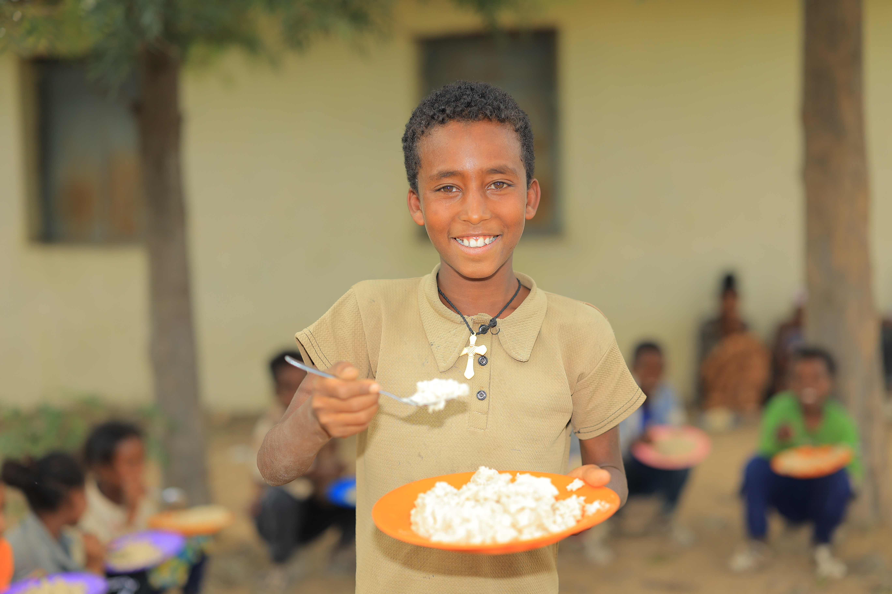






Recruitment pack for:
Regional Development Officer
Glasgow
Remote working however
must be based region
Mary’s Meals UK
March 2026

Slide 2

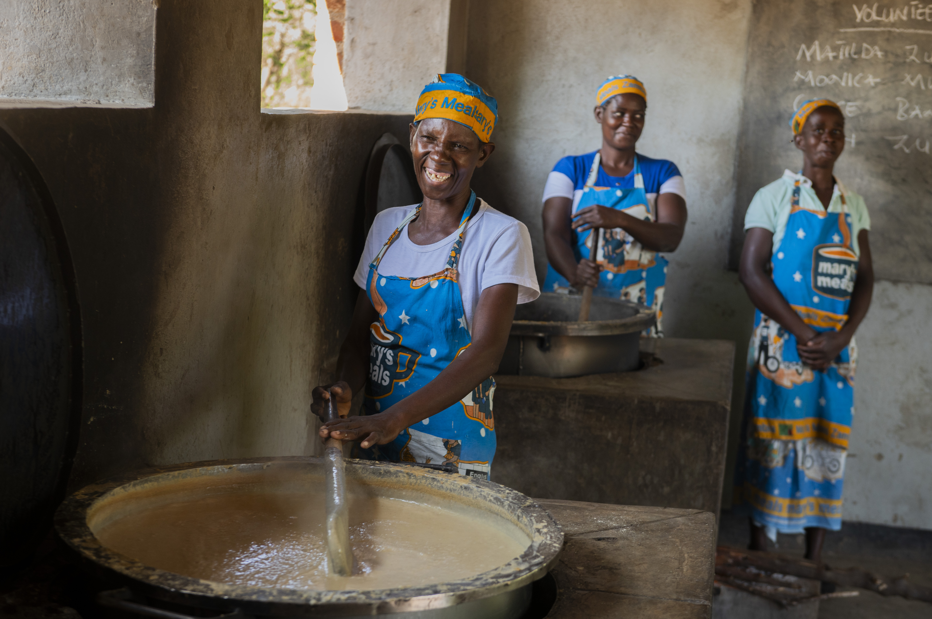
Recruitment pack contents
Welcome from our 3
Executive Director
Role outline and 5
Specification
Our vision, mission 11
and values
About the Mary’s Meals 13
movement
About Mary’s Meals UK 15
Recruitment process 17
information
2

Slide 3
Welcome from our Executive Director
Thank you so much for your interest in joining the Mary’s Meals family. As you consider applying for the Regional Development Officer (RDO) role with Mary’s Meals UK, I hope you find this pack helpful, encouraging, and exciting.
In joining Mary’s Meals UK, you would become part of a global movement of people who will simply not accept that any child should go hungry in this world of plenty. We are passionately driven by our simple belief that every child in the world deserves an education – and enough to eat.
From small beginnings feeding just 200 Malawian children in 2002, we are now reaching 3 million children across 16 programme countries (including Malawi, Liberia, Zambia, Haiti, South Sudan, and Syria) with a nutritious daily meal in school.
This meal not only meets the immediate needs of the hungry child, but it attracts children to the classroom, where they can gain an all-important education. And we firmly believe that the children who are receiving Mary’s Meals today can grow up – better nourished and better educated – to become the men and women who will lift their communities out of poverty and end their reliance on aid.​
​
The UK, where we received the first-ever donations for our work, remains the country in which Mary’s Meals raises the majority of its funds. And Mary’s Meals UK, the organisation I am privileged to lead is responsible for continuing to tell our story across Scotland, England, Northern Ireland and Wales; engaging and inspiring more and more UK volunteers and donors; and driving forward the unrelenting growth of the Mary’s Meals movement on these shores.​
3

Slide 4
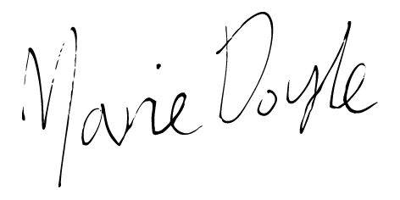
Welcome from our Executive Director
With more than 71 million children out of school around the world and a further 73 million attending school so hungry, they’re unable to concentrate and learn, our work is only just beginning.
As the Regional Development Officer for Glasgow, you will be a warm, visible ambassador for Mary’s Meals – igniting enthusiasm, inspiring action, and helping people across your region join our mission and help feed more children. By building genuine, values‑driven relationships and using insight to guide your priorities, you’ll nurture local networks, identify high‑potential opportunities, and confidently grow income, participation, and supporter engagement. Through strategic, outward‑facing work, you’ll turn first conversations into committed, long‑term support that strengthens our movement and fuels our mission.
Will you play a crucial part in shaping the future of Mary’s Meals UK and, with it, the lives of so many people who both contribute to and benefit from this incredible work of love, joy, and hope?
I look forward to hearing your story.
Marie Doyle
Executive Director, Mary’s Meals UK
4

Slide 5
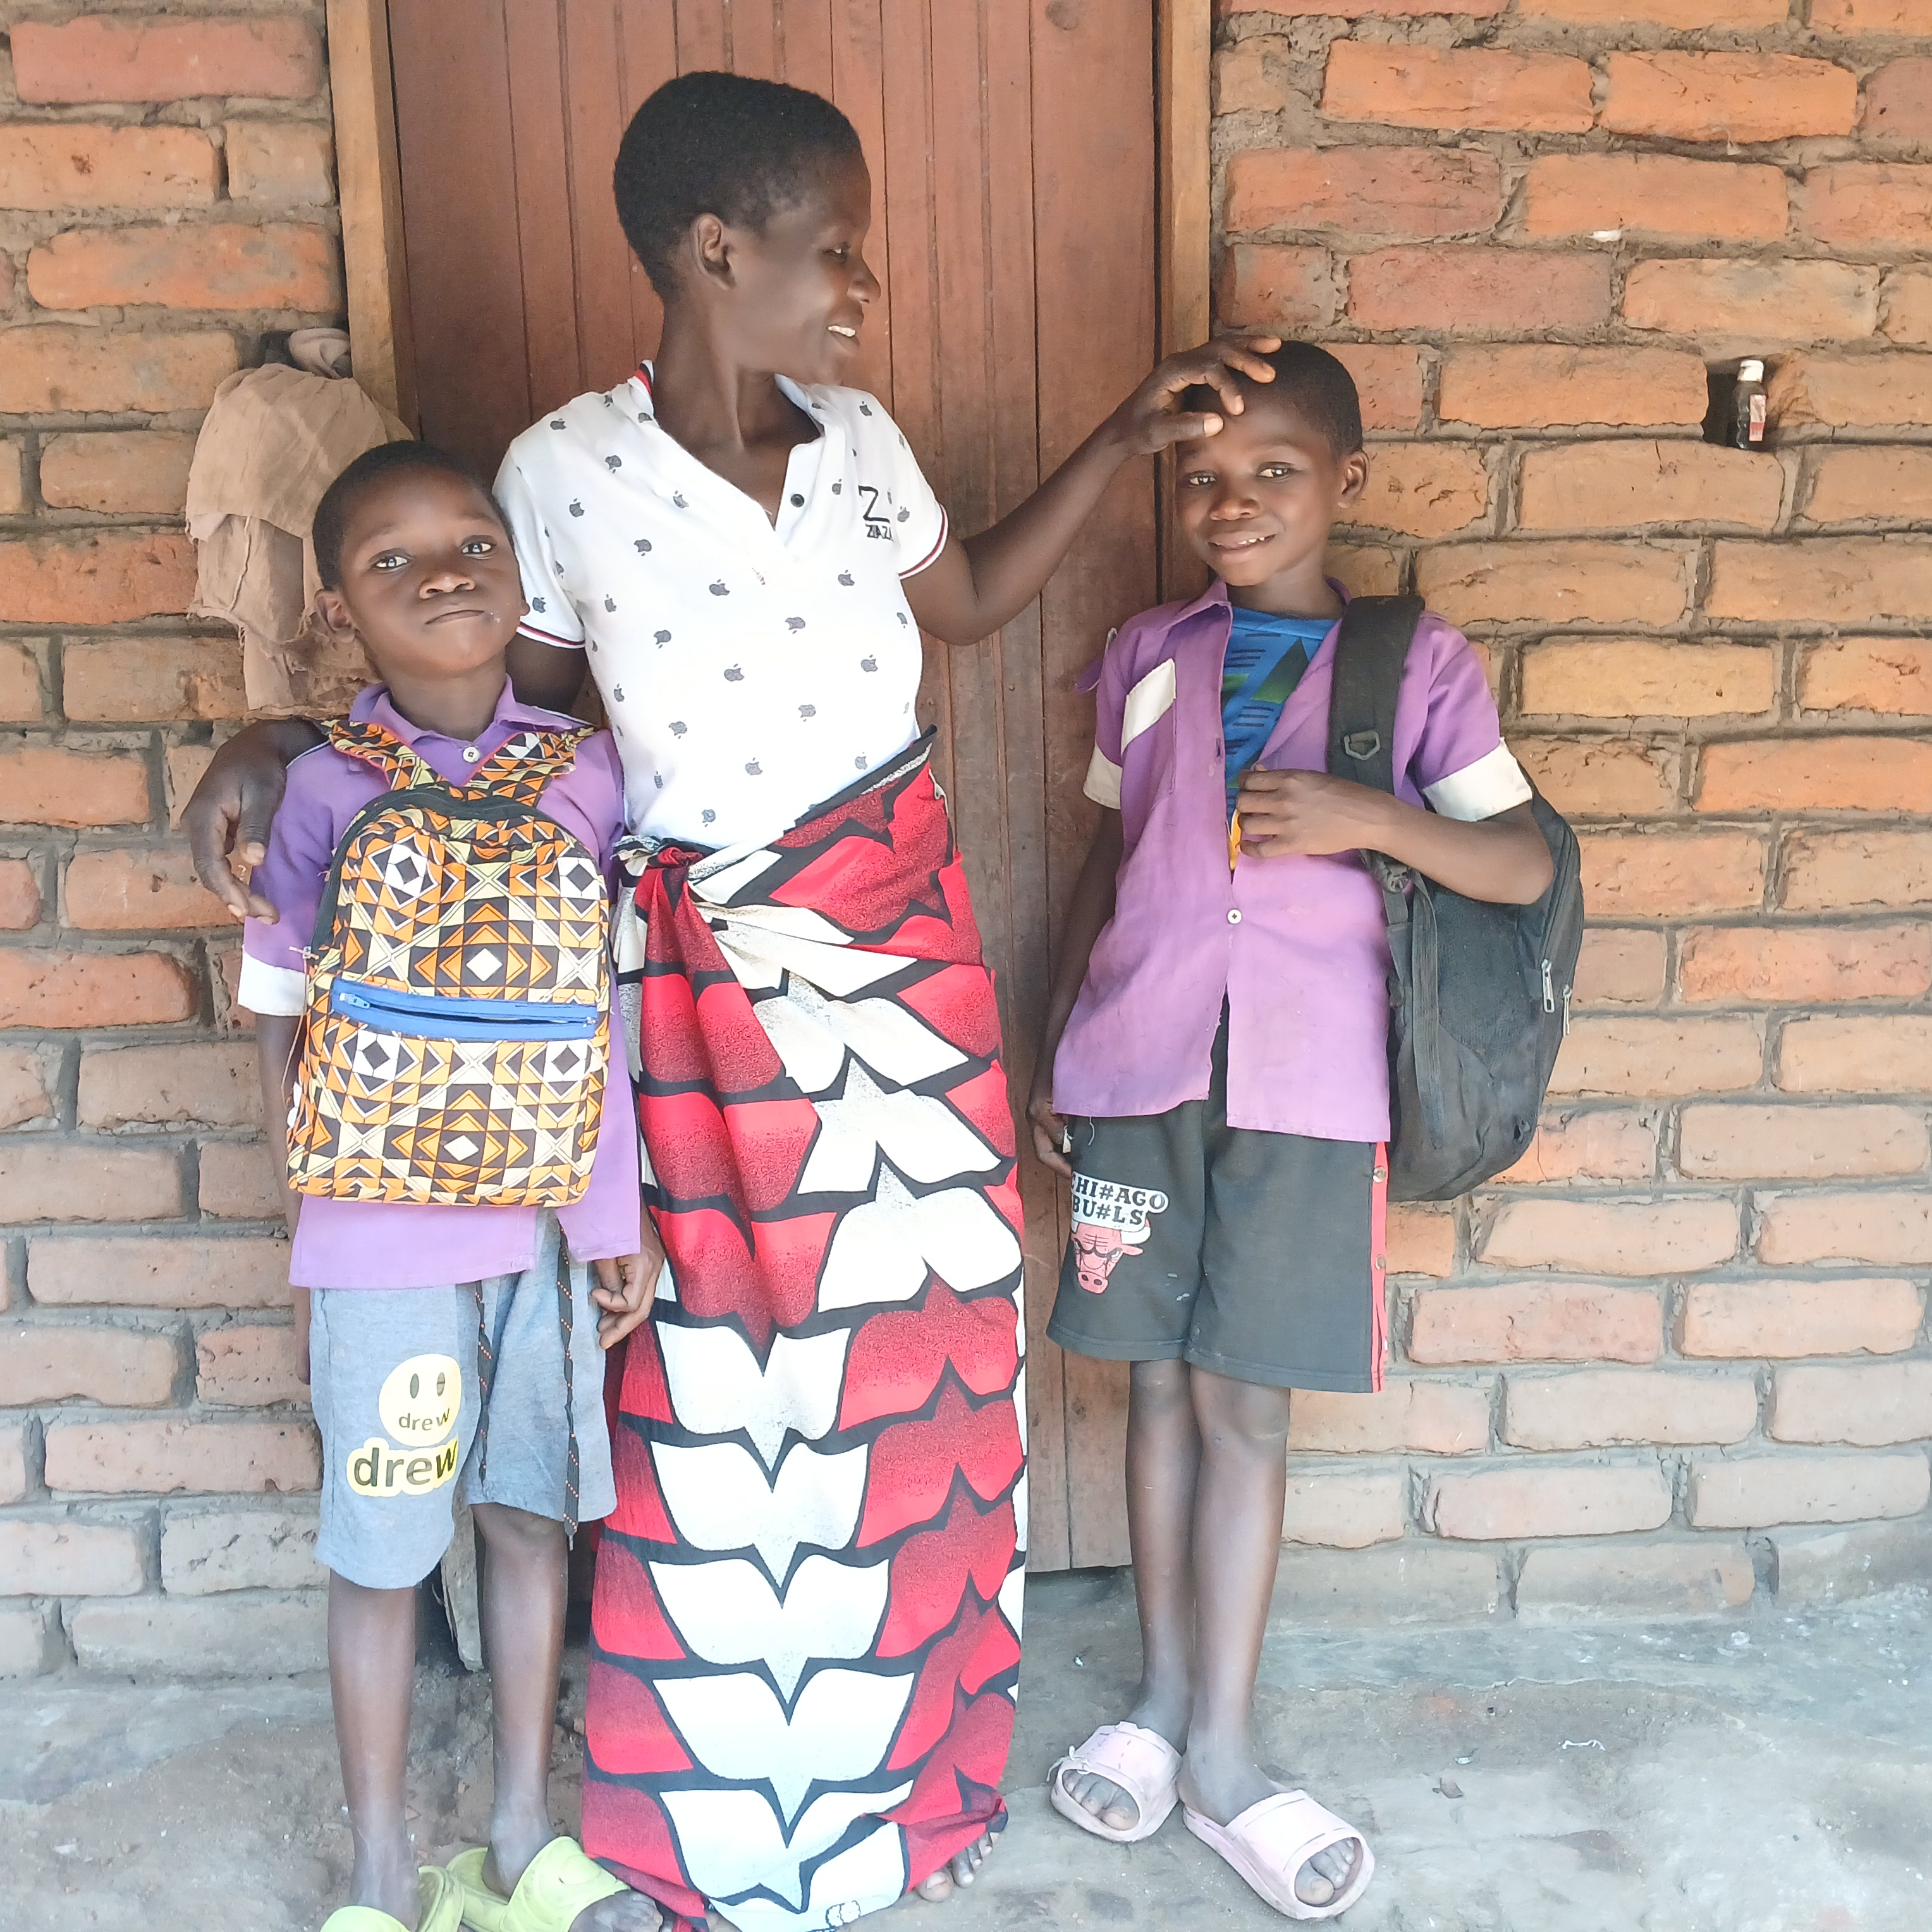
Regional Development Officer
Reports to: | Head of Scotland
Location: | Remote working however must be based in the region, Glasgow
Salary: | c. £30,170 - £34,926 per annum
Benefits: | Flexible working 34 days’ annual leave (including public holidays) Non-contributory pension with employer contributions of 8%. Volunteering and development days Enhanced maternity and paternity leave Employee Assistance programme Life Assurance Wellbeing support Cycle to Work scheme
5

Slide 6
Glasgow Regional team structure
Director of Development
Head of Scotland
Regional Development Officer
(Edinburgh and Falkirk)
Regional Development Officer
(West Scotland)
Regional Development Officer
(North East, Scotland
0.6 FTE)
Regional Development Officer
(Glasgow)
6

Slide 7
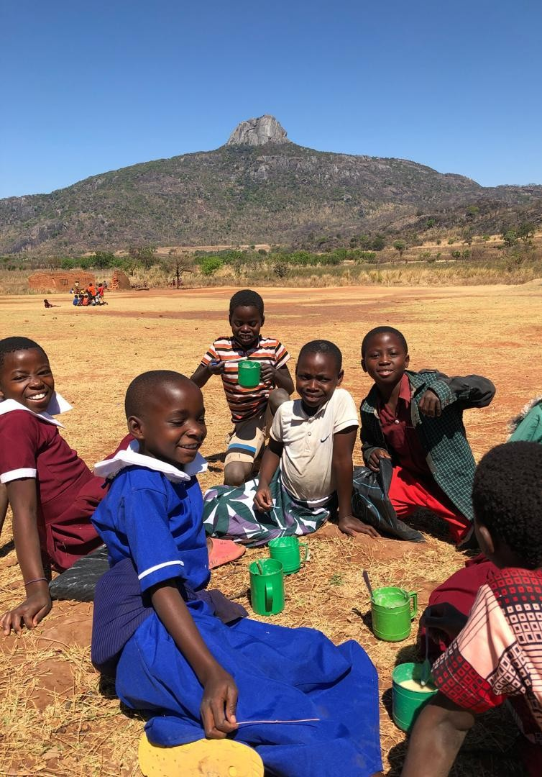
Role overview
A recent reshaping of our Regional teams means this role will sit under our newly created Head of Scotland and be part of an exciting new chapter in Mary's Meals UK's UK fundraising vision.
Working closely with the Head of Scotland you will co-create and deliver a tailored local growth plan that reflects your region's communities and opportunities. You will represent Mary’s Meals across schools, churches, corporates and community partners and play a pivotal role in activating supporters, mobilising volunteers, and sharing compelling local stories.
Operating with high autonomy, you will use insights and data to focus on high potential and growth areas, and collaborate closely with our Philanthropy & Partnerships, Supporter Experience and Communications teams to deliver seamless supporter journeys and strong storytelling. Everything you do will reflect Mary’s Meals’ warmth and dignity, helping us reach more children through relationship-led growth.
7

Slide 8
Duties and responsibilities
Local Strategy & Regional Growth
Work with the Head of Scotland to design and deliver a clear, insight‑driven local growth plan with defined priorities, income drivers, volunteer mobilisation efforts, and visibility activities.
Use data, local insight, and regional understanding to focus your time where growth potential is strongest.
Balance relationship‑building with a proactive, opportunity-led approach, identifying new supporters, networks, and partnerships and developing them from prospective supporters into committed donors.
Volunteer Mobilisation & Support
To create the conditions for a volunteer Deputy and a motivated volunteer network to confidently lead talks, events, introductions and other activities that broaden our reach
Empower volunteers through clear delegation, coaching, and recognition, ensuring they feel confident and aligned with Mary’s Meals’ mission and values.
Inspire and back volunteers to own the mission. Spot people with energy and networks, invite their ideas, give light-touch support and tools, and celebrate their impact so they bring others into our movement.
Relationship Building
Represent Mary’s Meals throughout your region with confidence and authenticity, engaging schools, parishes, community groups, businesses, and local networks.
Deliver talks, small events, parish visits, school assemblies, partner meetings, local networking engagements, and other targeted activities that grow income, participation, and visibility.
Make confident, values-led asks that move supporters from interest to action across giving, volunteering, and awareness raising.
Actively network across your region to identify new prospects, initiate first meetings, and follow up quickly and purposefully.
Collaborate closely with the Philanthropy & Partnerships team on key opportunities and ensuring the donor is at the heart of each stewardship decision.
Build a diverse pipeline of leads, opportunities, and partnerships reflective of your regions communities and faith landscape.
8

Slide 9
Duties and responsibilities
Cross Organisational Collaboration
Work closely across the organisation to ensure your regional activity feels seamless and aligned, collaborating with Supporter Experience so that journeys, thanking and stewardship feel warm and timely; with Creative Communications to deliver compelling local storytelling; with Philanthropy & Partnerships to coordinate opportunities for major donors and corporates; and with the Volunteer Manager to strengthen mobilisation and development across your region.
Local Storytelling, Messaging & Visibility
Proactively translate and tailor national messages and campaigns for regional audiences using templates, supporter stories, and local successes.
Spot and share regional stories, images, results, and moments of advocacy to enhance national storytelling.
Strengthen local visibility by cultivating community connectors and being confident in supporting and delivering appropriate local media engagement in coordination with Comms colleagues.
Data, Insight & Reporting
Maintain rigorous CRM discipline, logging meaningful interactions, asks, outcomes, and next steps in Salesforce.
Use insight and analysis to refine activities, track ROI, and adapt your plan based on what delivers the strongest return.
Manage a modest local budget and report learning, opportunities, and insight to the Head of Scotland.
Stewardship, Values & Compliance
Ensure all interactions reflect Mary’s Meals’ warmth, dignity, and relationship-led approach.
Ensure Mary’s Meals’ values are reflected in your conduct, decision-making and engagement with others.
Champion safe, compliant practice across fundraising, safeguarding, and data handling.
Contribute to the wider Development directorate by sharing results, insights and good practice with colleagues to improve the overall regional model.
Model and uphold Mary’s Meals’ core values – dignity, simplicity, respect, and good stewardship.
Ensure that the Mary’s Meals approach is adopted in all activities and that there is shared understanding in the team of how to build and retain support.
9

Slide 10
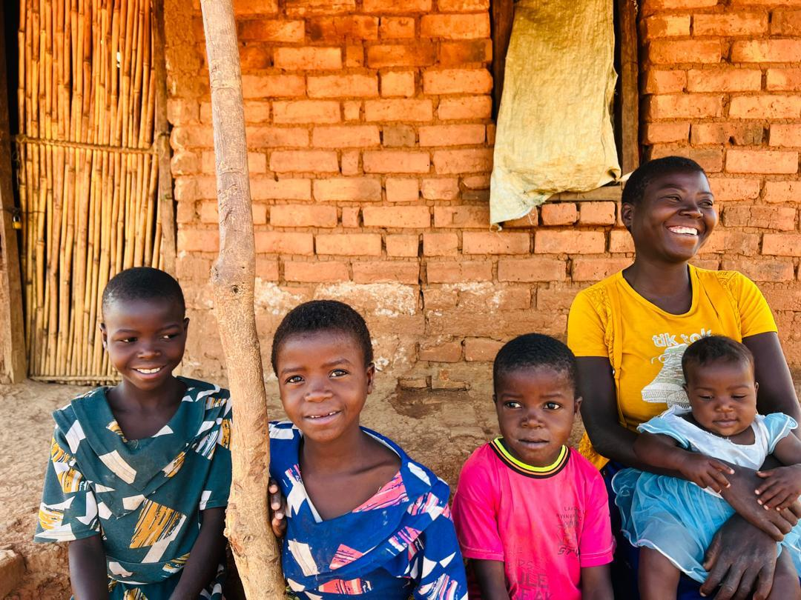
Essential Qualifications, experience and skills
Based in or short commutable distance to cover region, using local knowledge to provide a consistent, active presence in the region.
Fundraising qualification or relevant experience.
Confident in engaging with a wide range of people and organisations, including faith groups, schools, community groups, businesses and more.
Confident in making asks – converting interest into giving, participation and volunteering.
Confident and experienced in developing and deepening empowering relationships with volunteers.
Inspiring and engaging relationship builder with strong interpersonal and networking skills and the ability to deliver growth.
Capable of tailoring key messages to different audiences, and comfortable in speaking in many different settings, from schools and churches to conference halls and boardrooms.
Entrepreneurial self-starter: plans and prioritises independently, focuses on high-return opportunities.
Ability to think creatively and capable of generating new ideas, opportunities and resources.
Confident self-starter able to work independently with excellent judgement.
Possess advanced communication skills, both written and oral.
Excellent organisational, prioritisation and time management skills.
Deep alignment with Mary’s Meals’ values and relationship-led approach.
Good IT skills and administrative skills. Previous experience of using a database.
10

Slide 11

Our vision and mission
• Our vision is that every child receives one daily meal in their place of education and that all those who have more than they need, share with those who lack even the most basic things.
• Our mission is to enable people to offer their money, goods, skills, time, or prayer, and through this involvement, provide the most effective help to those suffering the effects of extreme poverty in the world’s poorest communities.
11

Slide 12
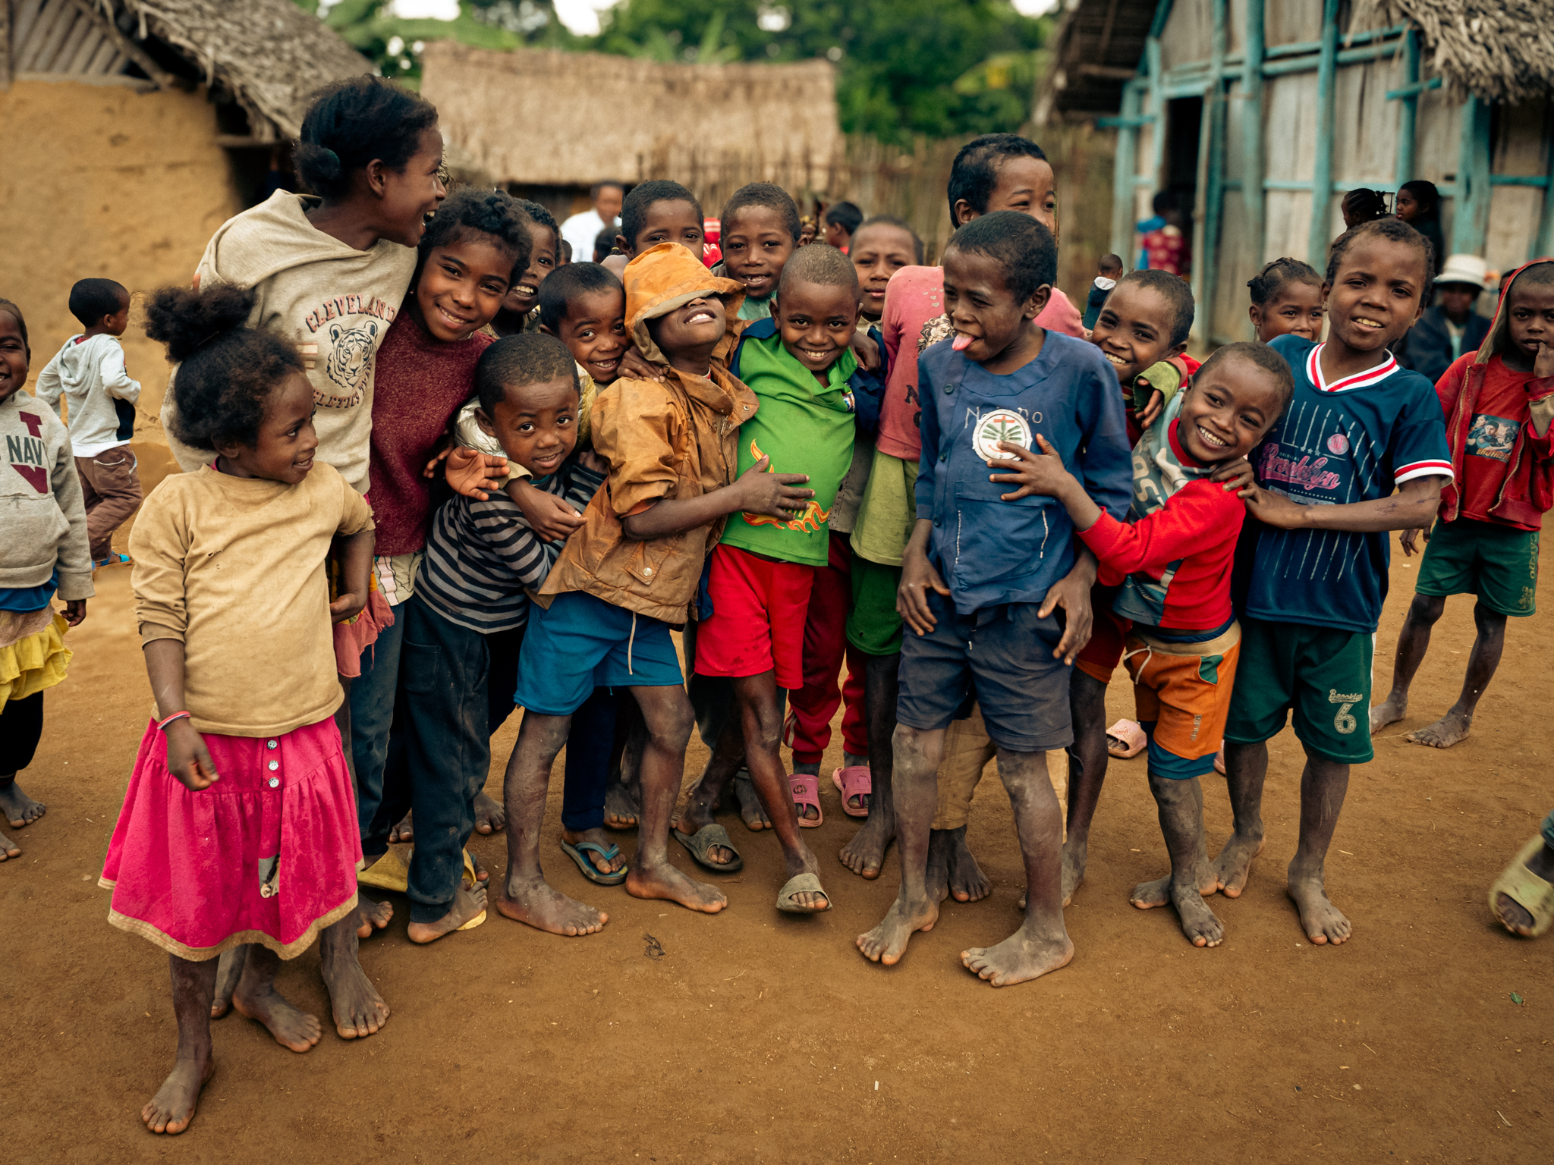
Our values
• We have confidence in the innate goodness of people.
• We respect the dignity of every human being and family life.
• We believe in good stewardship of the resources entrusted to us.
View Mary’s Meals’ full statement of values here: Statement of Values
12

Slide 13
About the Mary’s Meals movement
Mary’s Meals is a global movement that sets up school feeding projects in some of the world’s poorest communities, where poverty and hunger prevent children from gaining an education.
Our idea is a simple one that works. We provide one daily meal in a place of learning in order to attract chronically poor children into the classroom, where they receive an education that can, in the future, be their ladder out of poverty.
The Mary’s Meals campaign was born in 2002 when Magnus MacFarlane-Barrow, from Dalmally in Argyll, visited Malawi during a famine and met a mother dying from AIDS. When Magnus asked her eldest son Edward what his dreams were in life, he replied simply: “I want to have enough food to eat and to go to school one day.”
That moment was a key part of the inspiration which led to the founding of Mary’s Meals, which began by feeding just 200 children in Malawi in 2002. Today, 20 years later, we feed 3 million hungry children every school day across four continents.
Where Mary’s Meals is provided, there is a rise in school enrolment, attainment and attendance. Wherever possible, Mary's Meals uses locally grown food to support the local economy and help smallholder farmers.
We work extremely hard to keep our running costs low which means that it costs just £19.15 to feed a child with Mary’s Meals for a whole school year. This is only possible because most of our work is done by an army of dedicated volunteers all over the world, who carry out lots of little acts of love on behalf of Mary’s Meals.
Having been inspired, in part, by our founder’s Catholic faith, this work is named in honour of Mary, the mother of Jesus, who brought up her own child in poverty. We consist of, respect and reach out to people of all faiths and none.
Counting on support from around the globe, Mary’s Meals has registered national affiliate organisations, which raise awareness of our work around the world. Funds raised by affiliates, including from Mary’s Meals UK, are passed to Mary’s Meals International, the organisation which co-ordinates our movement and directly manages the delivery of our school feeding programmes.
13

Slide 14
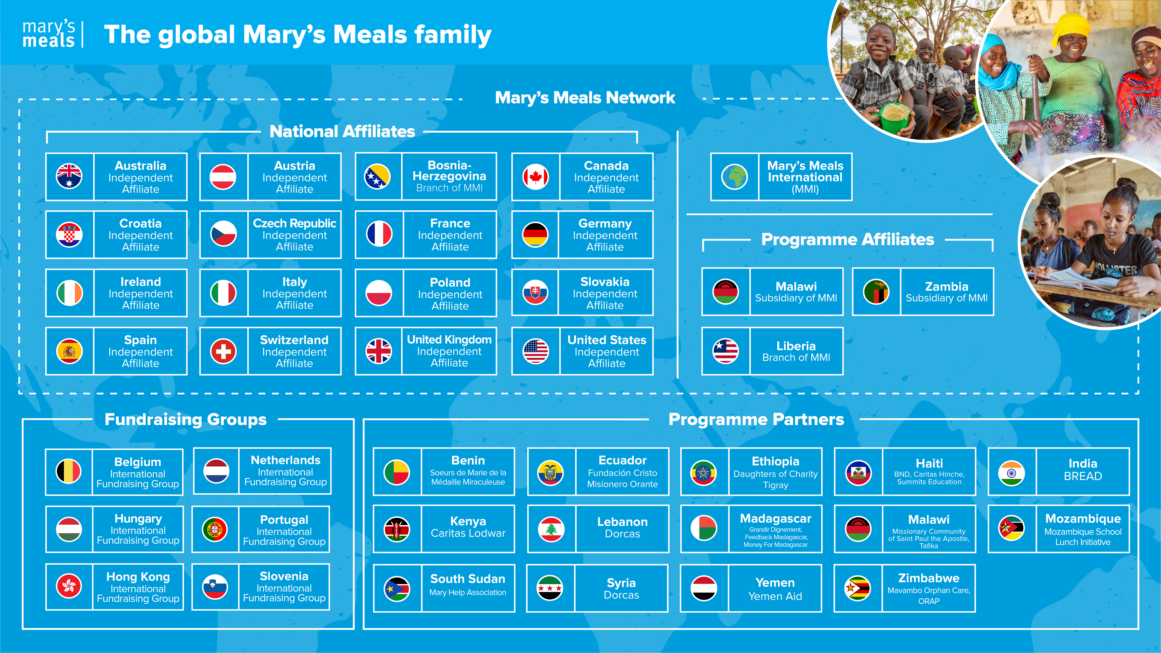
Mary’s Meals family
14

Slide 15
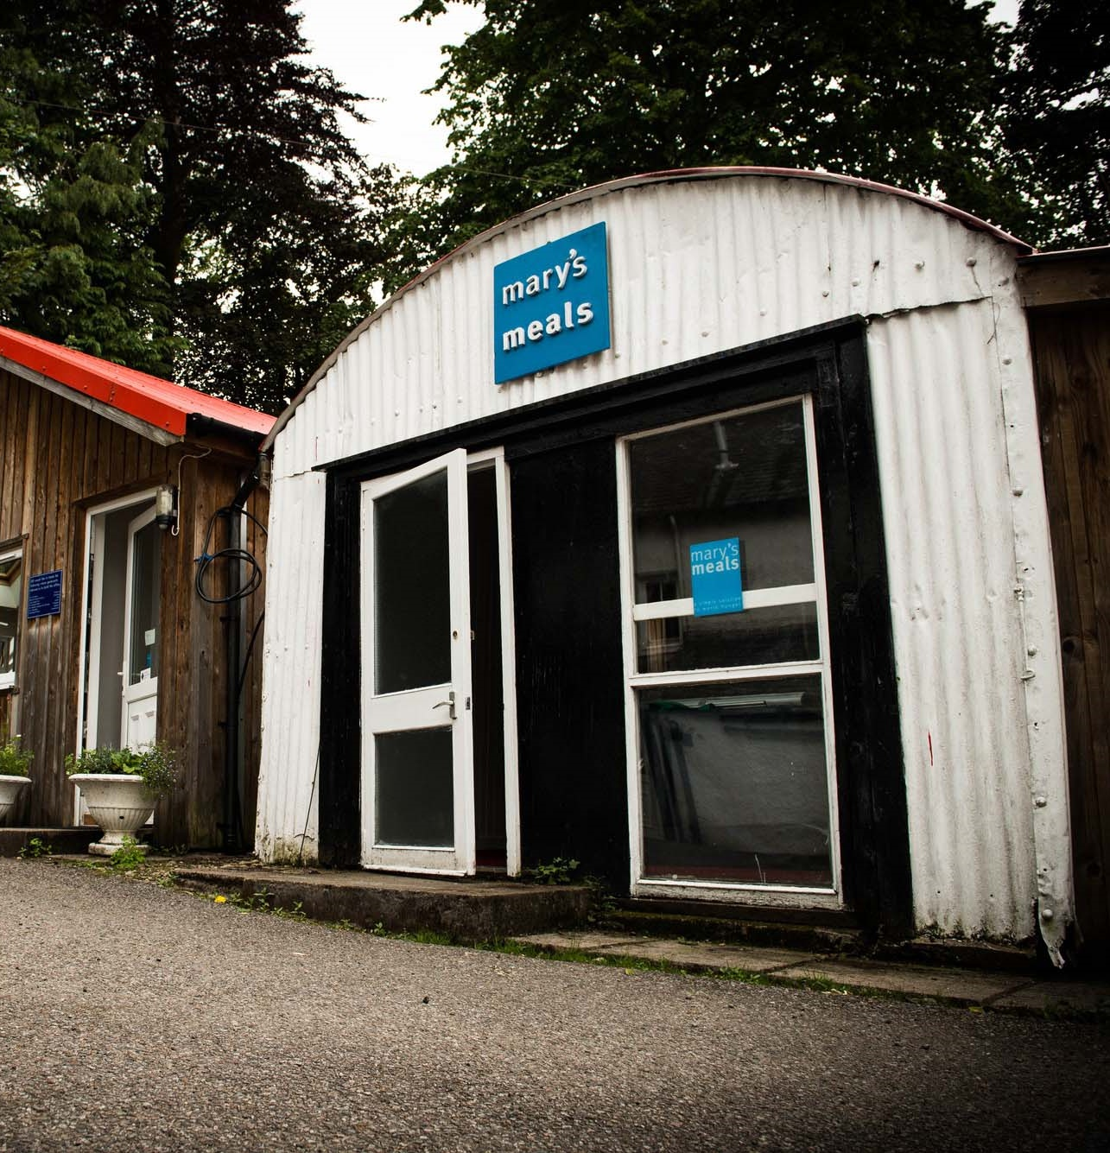
About Mary’s Meals UK
Mary’s Meals UK (or ‘MMUK’), a charity registered in Scotland, is the oldest entity in the Mary’s Meals family – the original organisation established as Scottish International Relief in the early 1990s, when our founder and global CEO, Magnus MacFarlane-Barrow, first became involved in international aid during the Bosnian Conflict.
Back then, Magnus was a simple salmon farmer who, along with his family, decided to do something to help those who were suffering because of the war.
They relied heavily on the generosity of local people in their village of Dalmally in Argyll, who relentlessly donated food, blankets and other items of aid, which were then stored in the family shed, before being driven out by Magnus to Bosnia-Herzegovina.
Though our largest office is now in Glasgow, that same shed – which continues to be filled, metaphorically at least, with the generosity of our supporters – still serves as the headquarters of Mary’s Meals UK to this day.
15

Slide 16

Mary’s Meals UK competencies
All Mary’s Meals UK employees approach their role in line with our 7S competency model:
1. Self
I build and demonstrate resilience
I lead by example
I’m authentic and true to Mary’s Meals values
I develop myself and set stretching goals
2. Service
I have a vocational attitude to my work
I inspire hope in others
I build belief that even difficult challenges can be solved
I am committed to serving and enabling all who want to be part of the global movement
I work to ensure our future will be even better than our past
3. Simplicity
I communicate effectively
I follow clear decision-making criteria
I create plans that are easy to follow and contribute to organisational goals
I embrace inclusivity and diversity
I focus on delivering results
4. Stewardship
I pay attention to the things that matter most;
(a) our physical resources; (b) our people
I nurture, develop and respect our relationships with external stakeholders
I deliver on my promises
I am happy to be held accountable and to hold others to account
5. Strategy
I have a point of view about the future
I know our stakeholders and see our priorities clearly
I help others to work in ways that have the
greatest impact
I develop strategy and translate it into action
6. Strengthen
I contribute to a positive work environment
I support those around me
7. Success
I maintain my technical competence
I contribute to the success of my team
I ensure accountability
I embrace change
16

Slide 17
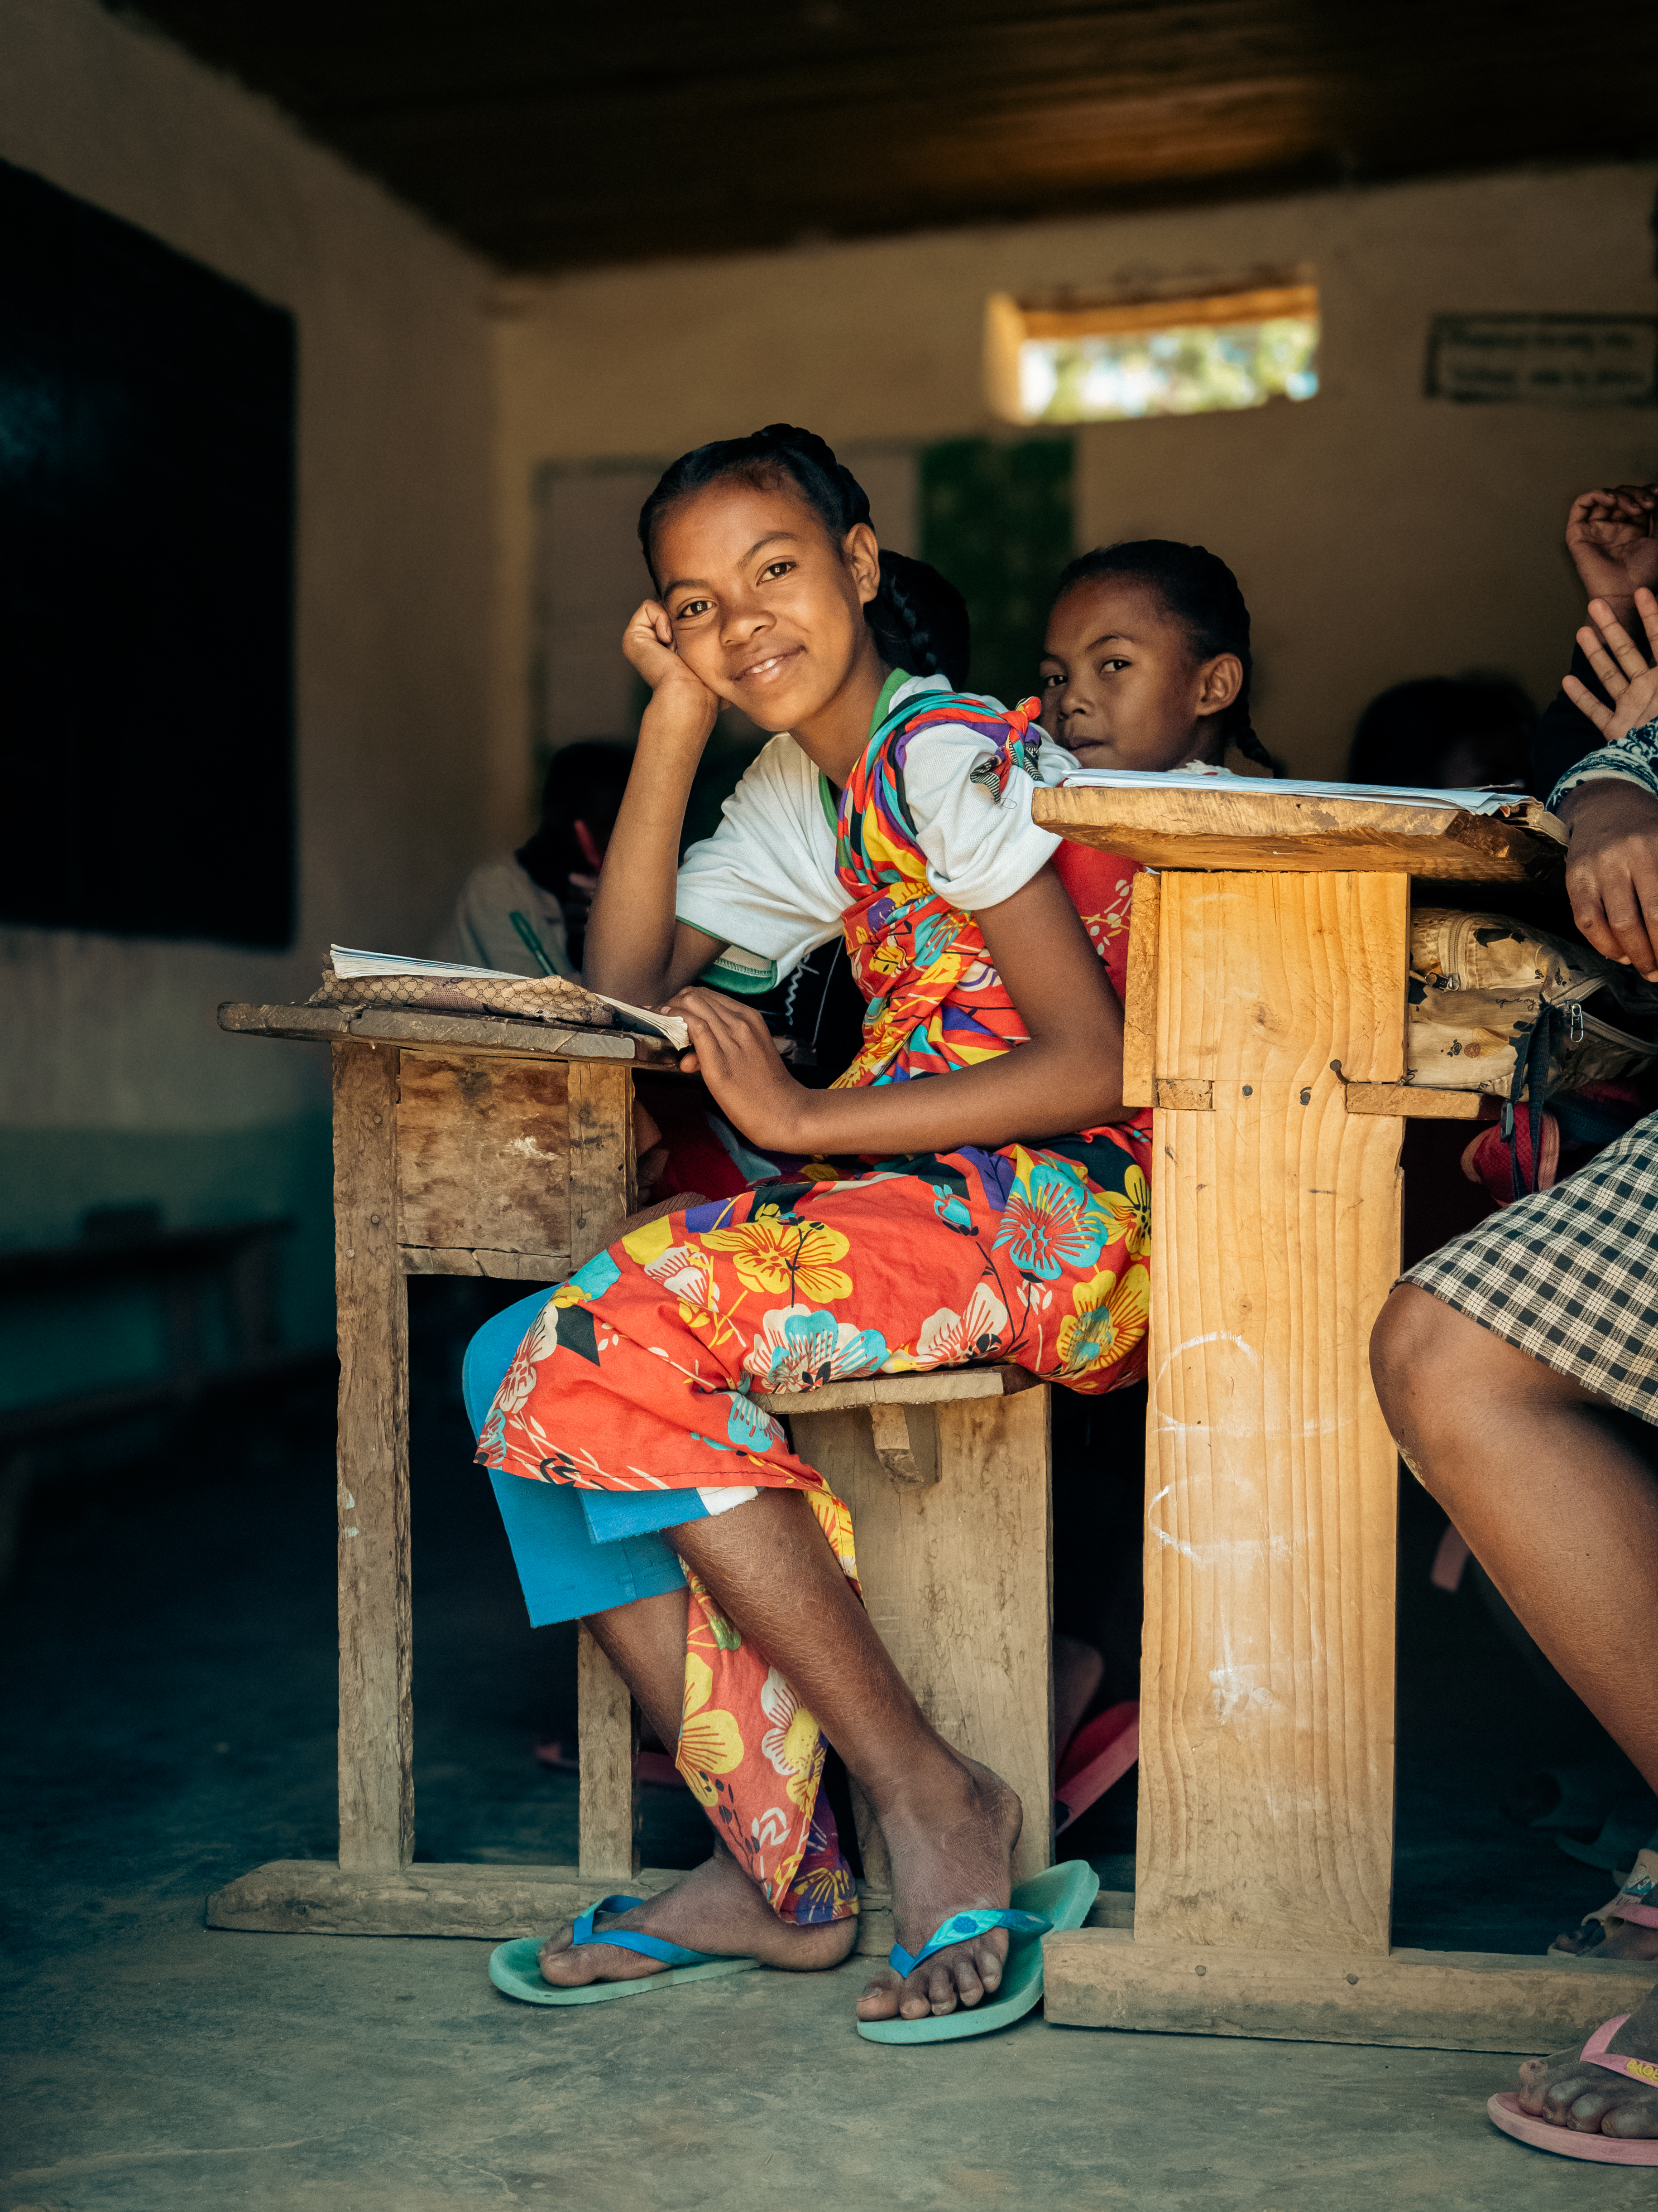
Recruitment process information
How to apply for this role:
To apply for the role of Regional Development Officer based at Mary’s Meals UK, please send a tailored CV and covering letter or 2–3-minute video to: Jobs@marysmeals.org
Your covering letter or video should make a compelling case for why you feel motivated to apply for this role within Mary’s Meals UK, as well as giving a concise overview of your most relevant skills and experience, and should fill no more than two pages of A4.
Applicants must hold full right to work in the UK.
We welcome applications from candidates of all different backgrounds and identities to apply. We are committed to building an inclusive and diverse charity providing a supportive place for you to do the best and most rewarding work of your career.
Recruitment timescales:
Closing date for applications is Thursday 26th March at 5pm.
Interviews will commence week commencing 30th March.
We reserve the right to close this vacancy early if we receive sufficient applications for the role. Therefore, if you are interested, please submit your application as early as possible.
Please note: If you have any special requirements or adjustments before an interview, please let us know.
17

Slide 18

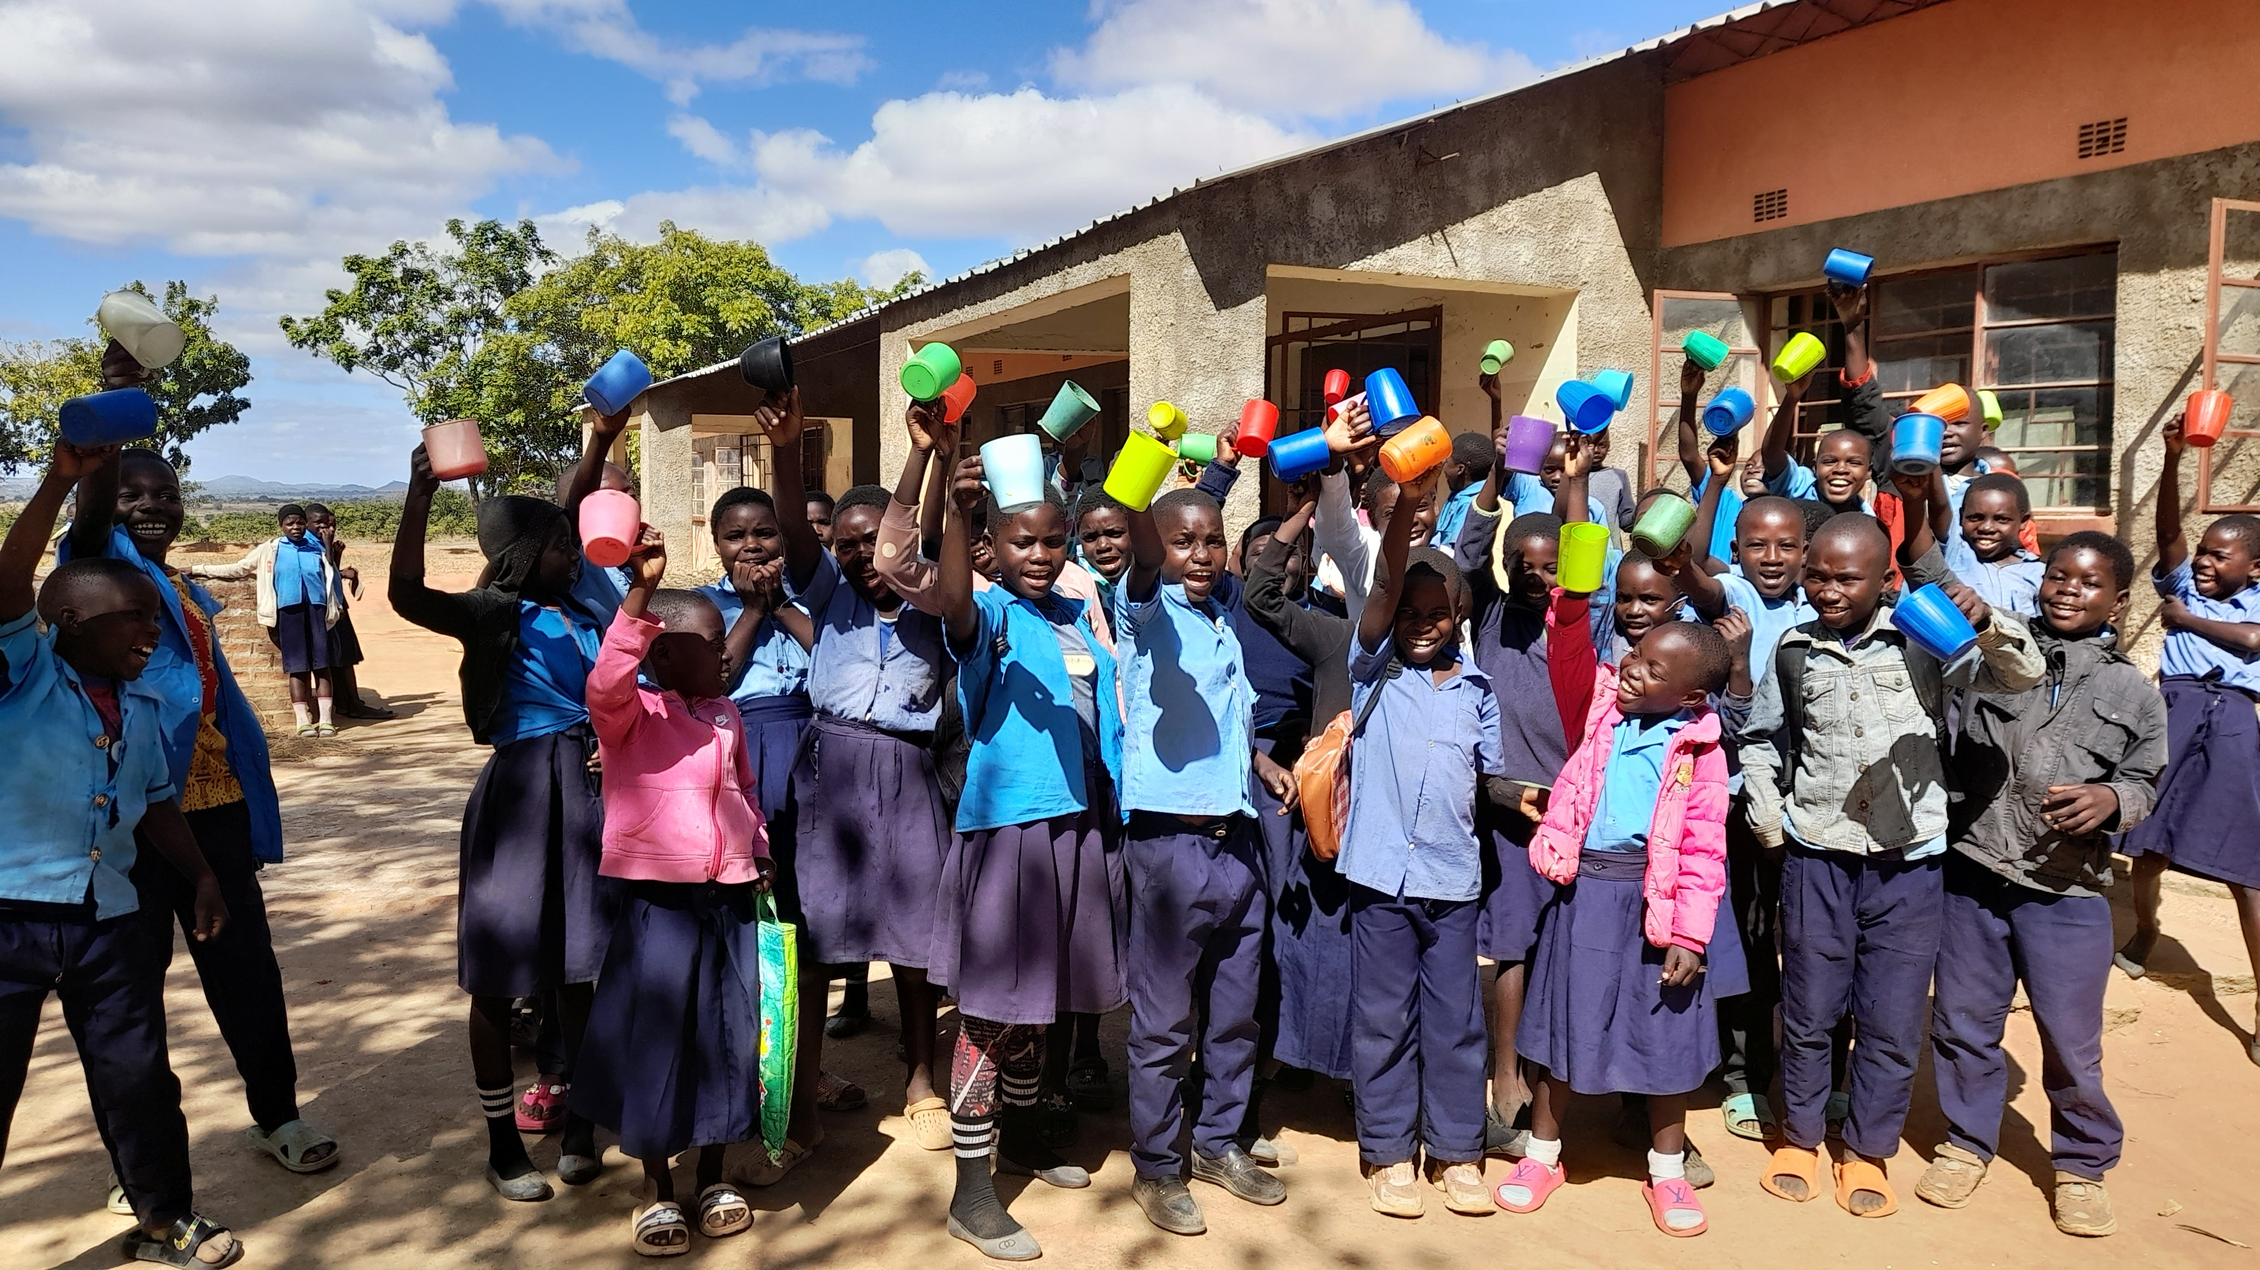
Mary’s Meals UK
Charity No. SC022140
Company No. SC265941
Tel: 0141 336 7094
Dalmally office
Craig Lodge
Dalmally, Argyll
PA33 1AR
Glasgow office
Unit 10-13 Claremont Centre
39 Durham Street, Glasgow
G41 1BS
London office
13 Hippodrome Place
Notting Hill, London
W11 4SF
“Together, let’s set out on this journey; one step at a time, one meal at a time, one child at a time.”
– Magnus MacFarlane-Barrow, Mary’s Meals founder

