Slide 1
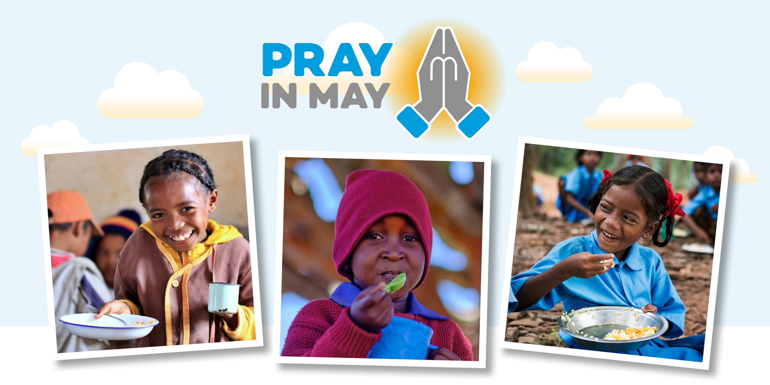
Notes:
Throughout the month of May, we ask churches and people of faith to pray with us to bless Mary’s Meals, as we recognise the special place of prayer in our work. ​
Since our humble beginnings, Mary’s Meals – named after Mary, the mother of Jesus – has been built on a foundation of prayer and the many little acts of love from those who support us.
We invite individuals, churches, schools and faith groups to pray with us that our work continues to flourish and grow, and that more children throughout the world will see their lives transformed by a daily meal in a place of education. ​
We have created a variety of resources to guide you in prayer during May, including prayer guides, prayer calendars, and more, which you can download at marysmeals.org.uk/prayinmay​.
During the month of May, you can also support Mary’s Meals by:
Holding a time of prayer and reflection.
Encouraging children and your local schools to pray for our mission.
Joining our global family to pray for Mary’s Meals. Our online Rosary is a regular opportunity to join with others from around the world in a time of prayer, regardless of faith, tradition and beliefs. More information about the prayer events can be found at: www.marysmealsmedjugorje.org/events/marys-meals-monthly-prayer
While we recognise the important place of prayer in our work, Mary’s Meals consists of, respects and reaches out to people of all faiths and none.

