Slide 1
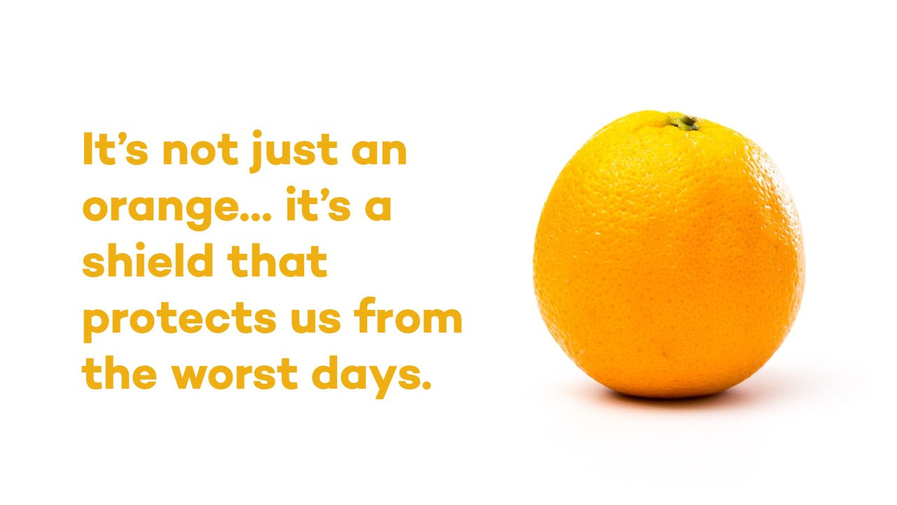
Notes:
Mary’s Meals operates extensively in areas of conflict and crisis, delivering school meals in some of the world’s most dangerous and challenging locations. We serve some of the world’s most vulnerable children, those hardest to reach who might otherwise be forgotten.
· The promise of a nutritious meal helps to bring children living in fragile and crisis-affected areas into the safety of the classroom, providing them with a sanctuary from the chaos around them where they can learn, play and simply be children.
· For children affected by conflict, regular and nourishing school meals are not just beneficial. They are vital for helping children to stay healthy, supporting them to stay in school and helping them to build resilience in the face of ongoing hardship.
· Mary’s Meals helps bring children and communities together in times of crisis. In the classroom, hunger and exhaustion give way to laughter and joy as daily school meals fuel learning and play. And parents, teachers and community volunteers work side by side with a shared purpose to support the schools that provide food and stability for their children.
· Mary’s Meals provides a vital safety net for families enduring hardship caused by conflict and economic crisis. The promise of a daily school meal reassures parents that their children will eat today and frees up any income or food they might have at home to stretch a little further and meet other urgent needs.
· In places torn apart by conflict, school meals are a lifeline that lasts. As conflict subsides, the Mary’s Meals school feeding programme provides a foundation for recovery – supporting education, strengthening communities, and providing a sustainable solution to hunger in the long term.
· In areas of high insecurity and instability – from war in Yemen and Lebanon, to conflict in Ethiopia and South Sudan and gang violence in Haiti – we work closely with our expert local partners to adapt our school feeding programme and pivot when necessary, so that we can keep providing children in crisis with food, stability and a reason to attend school.
· We don’t shy away from working in some of the world’s most dangerous and challenging locations – we are always striving to reach the next child who needs us
most. This year alone, we have expanded our programmes in Haiti and South Sudan to reach more than 14,000 additional children with our school meals.

Slide 2
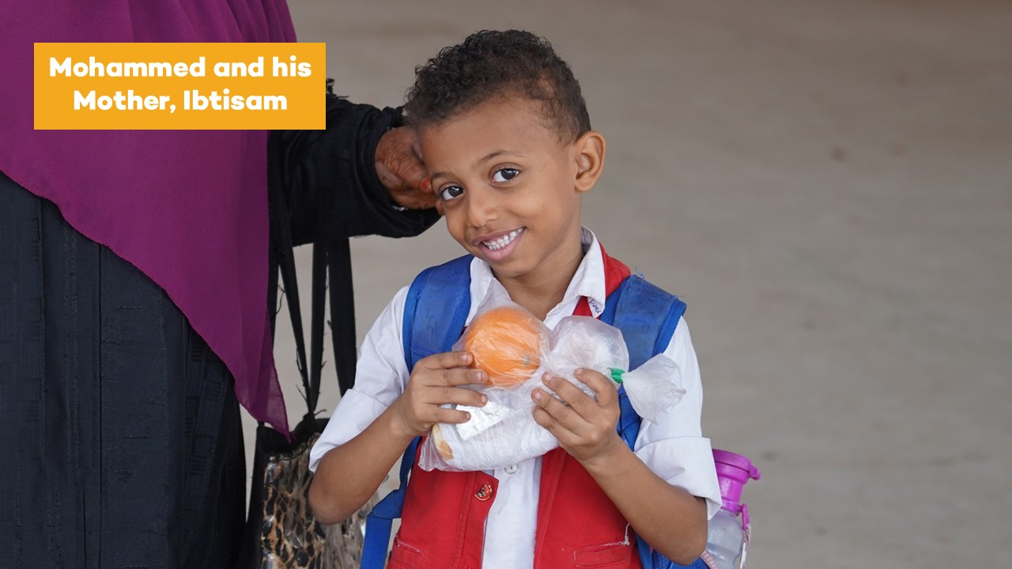
Notes:
Ibtisam is raising Mohammed alone in the Al-Mansoura district of Aden, Yemen, navigating Yemen’s severe economic crisis with very little to fall back on.
Before Mary’s Meals started at Mohammed’s school, Ibtisam would worry about whether there was enough money for food that day. The rising cost of basic groceries meant that providing a proper meal for Mohammed was never guaranteed.
Ibtisam says: “We live in a very difficult economic situation. The prices of basic food have gone up so much in Aden. I used to wake up with a heavy chest, constantly doing the maths in my head, wondering how I would afford to feed him that day. We have very little financial cushioning if things get worse.
“Because Mary’s Meals provides a fresh sandwich and fruit for him every school day, I know he will not starve. It is a shield that protects us from the worst days – it protects his health and protects my sanity as a mother. A hungry child cannot learn, and a worried mother cannot sleep.”
Thanks to your support, children like Mohammed can learn, eat and play like a child should, easing their parents’ concerns.

Slide 3
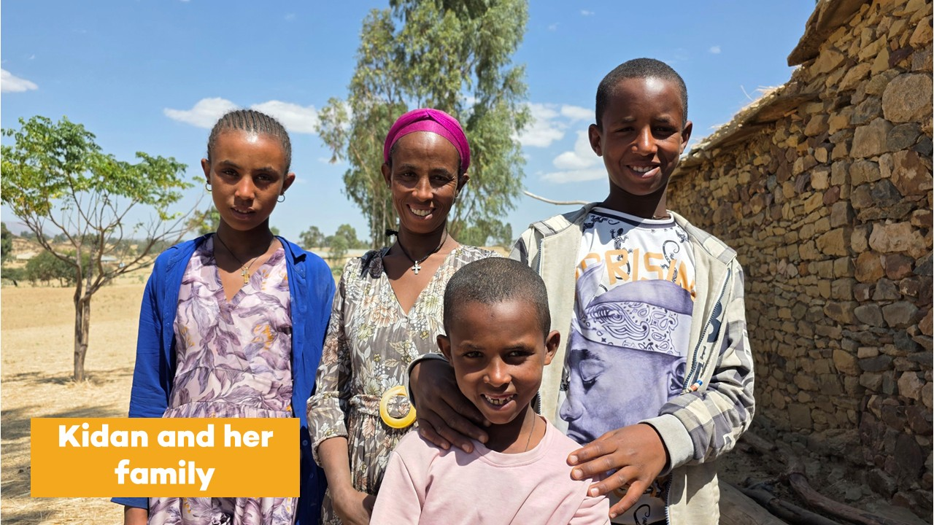
Notes:
In Tigray, Ethiopia, the scars of war are not only visible on the region’s rugged landscapes, but also on its survivors. Kidan, a mother of three children, was widowed during the conflict that broke out in 2020, which also meant the family lost their main provider.
Since her husband’s death, Kidan has faced an uphill battle. Without a home of her own, she and her children live with her mother-in-law, trying to rebuild their lives while overcoming the physical and psychological burden of poverty and hunger.
“After my husband died, I struggled to provide for my children. We had days when there was no food at home,” she says. “For a mother like me, the situation was desperate. We were forced to send my older daughter to work or sell items just to get money for food. But our economic situation remains fragile and the struggle is constant.”
Kidan’s three children attend the local primary school where they receive a reliable daily meal every school day. This reduces the financial pressure on Kidan and allows her meagre earnings to stretch that little bit further.
“By guaranteeing a meal every day for [my children], the programme protects me from the fear of rising grain prices and the uncertainty of my modest income,” she says. “I can now save what would have been their breakfast and serve it for lunch or dinner."
Kidan’s story is a testament to how school feeding acts as a safety net for vulnerable families, allowing a single mother to rebuild her livelihood while helping to ensure her children are healthy, happy, and educated.
As conflict and crisis continue to disrupt children’s lives around the world, your donation will make the difference between a child struggling in the most devastating of circumstances and a child experiencing a sense of stability and normality through school meals. Just £19.15 will provide a child with food, stability, and hope for a whole school year.
For more info, you can visit marysmeals.org.uk

Slide 4
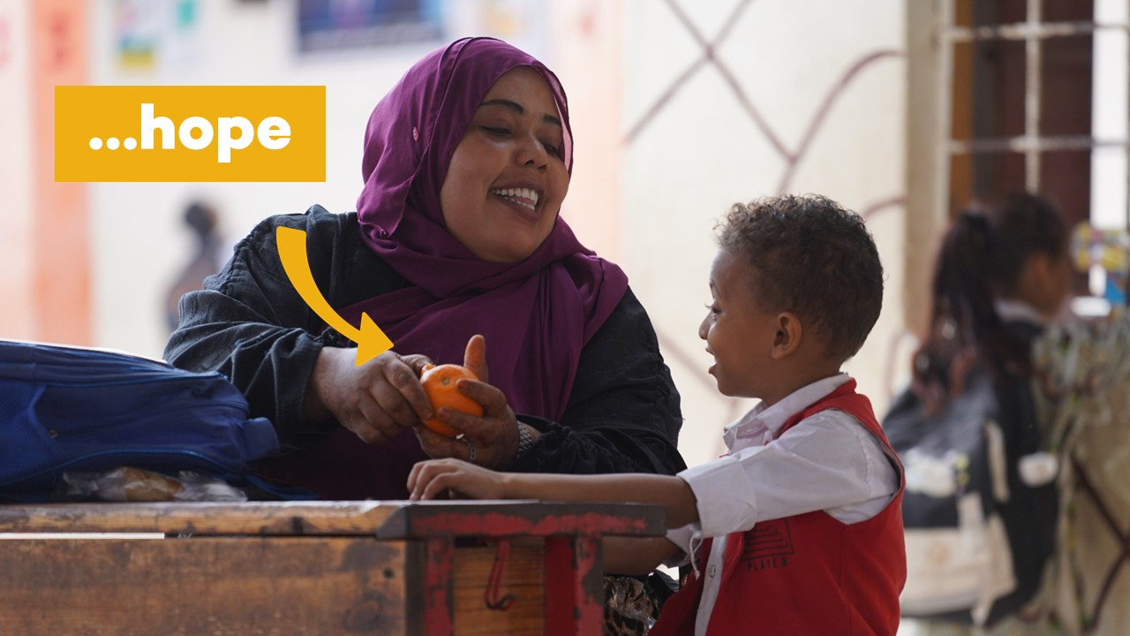

Slide 5


